Slide 1


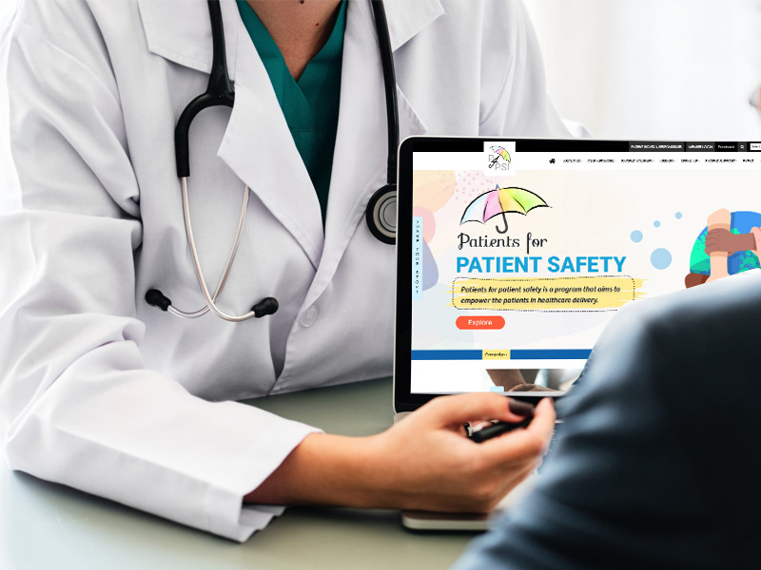
Avoiding Harm - Your Role
My Health, My Responsibility
Patients for Patient Safety Foundation

Slide 2
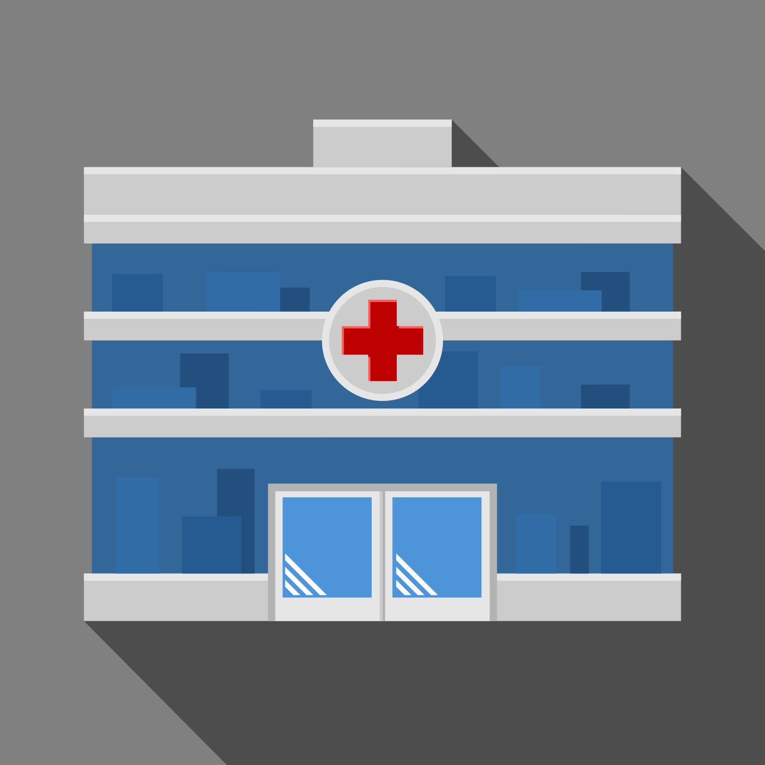
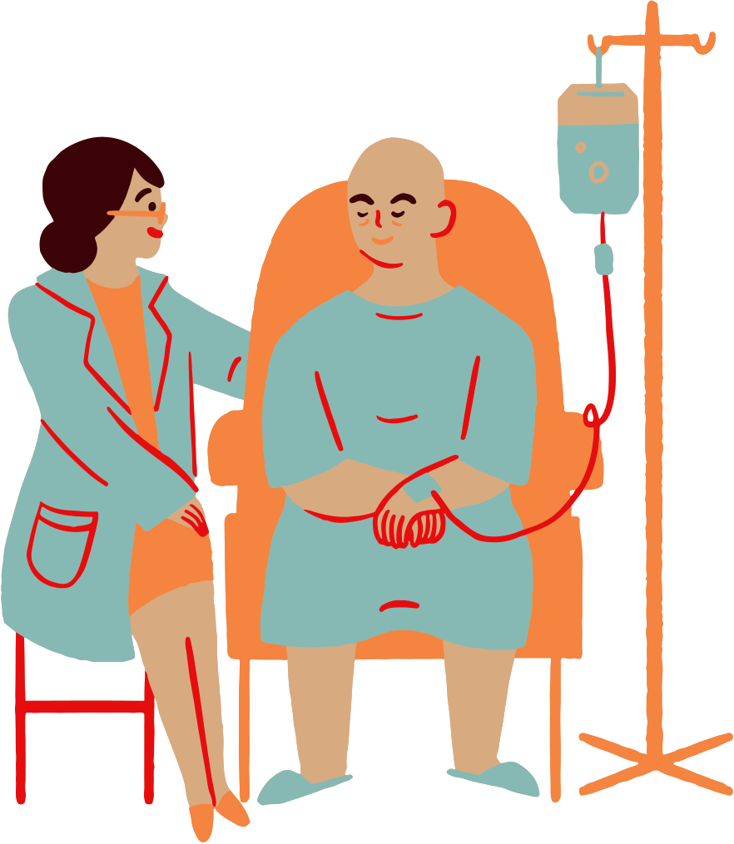
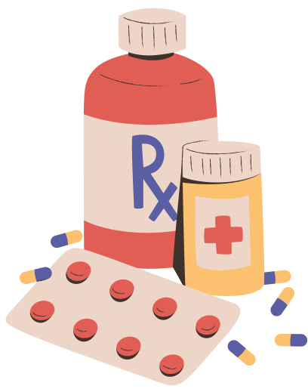
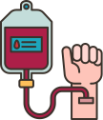

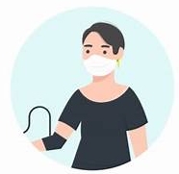
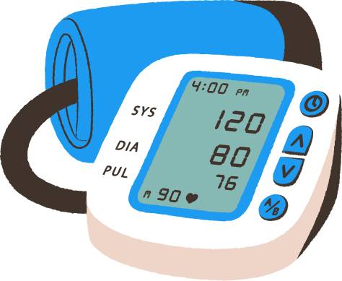
Medical Harm Happens - in spite of best efforts
1 in 10 patients* suffer harm during hospitalization
4 out of 10 OPD patients* are harmed due to missed/incorrect diagnosis, medication and prescriptions errors
Medication Errors* constitute 50% of avoidable harm
Unsafe Transfusion/ Injections lead to infections
Unsafe Surgical Practices* cause
complications in 25% of patients
Patient Harm is also caused due to ignorance of patients and lack of active involvement in their treatment
Miscalibrated Medical Devices lead to medical errors
Up to 50% of this avoidable harm can be prevented
* Source:WHO
My Health, My Responsibility

Slide 3
Where and How Does Medical Harm Happen
Individual : Patient : Caregiver
At Hospital
At Home
Errors/Misses by HCP
Omissions by Patients
By Patient & Caregivers
Medications Errors
Wrong Diagnosis
Surgical Mistakes
Infections
Communication Errors
Ignore Symptoms
Late Presentation
Incomplete Info
Not being alert
Not asking right questions
Lack of awareness
Lack of preparedness
Not following prescriptions
Self treatment
Missing clinical signs
Aware Patients/Caregivers can help Prevent Medical Harm
My Health, My Responsibility

Slide 4
Harm happens at different stages
Are my symptoms serious enough?
Why do I need a
follow-up visit?
Surgery vs tests, should I take a Second Opinion?
Are preventive health checkups really helpful?
How should I prepare for my Doctor’s visit?
Shall I discontinue Medicines?
Tracking Symptoms
Treatment Options
Post Care Importance
Better Diagnosis
Medication Management
Preventive
Choices
Delayed diagnosis
Recurrence
Unsatisfactory Treatment Outcomes
Incomplete information
Incomplete Treatment
Severe illness
Ignorance, ‘Doctor is God’ syndrome and lack of involvement by patients can lead to errors

Slide 5
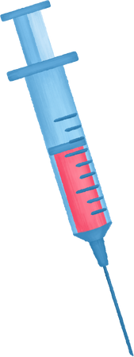
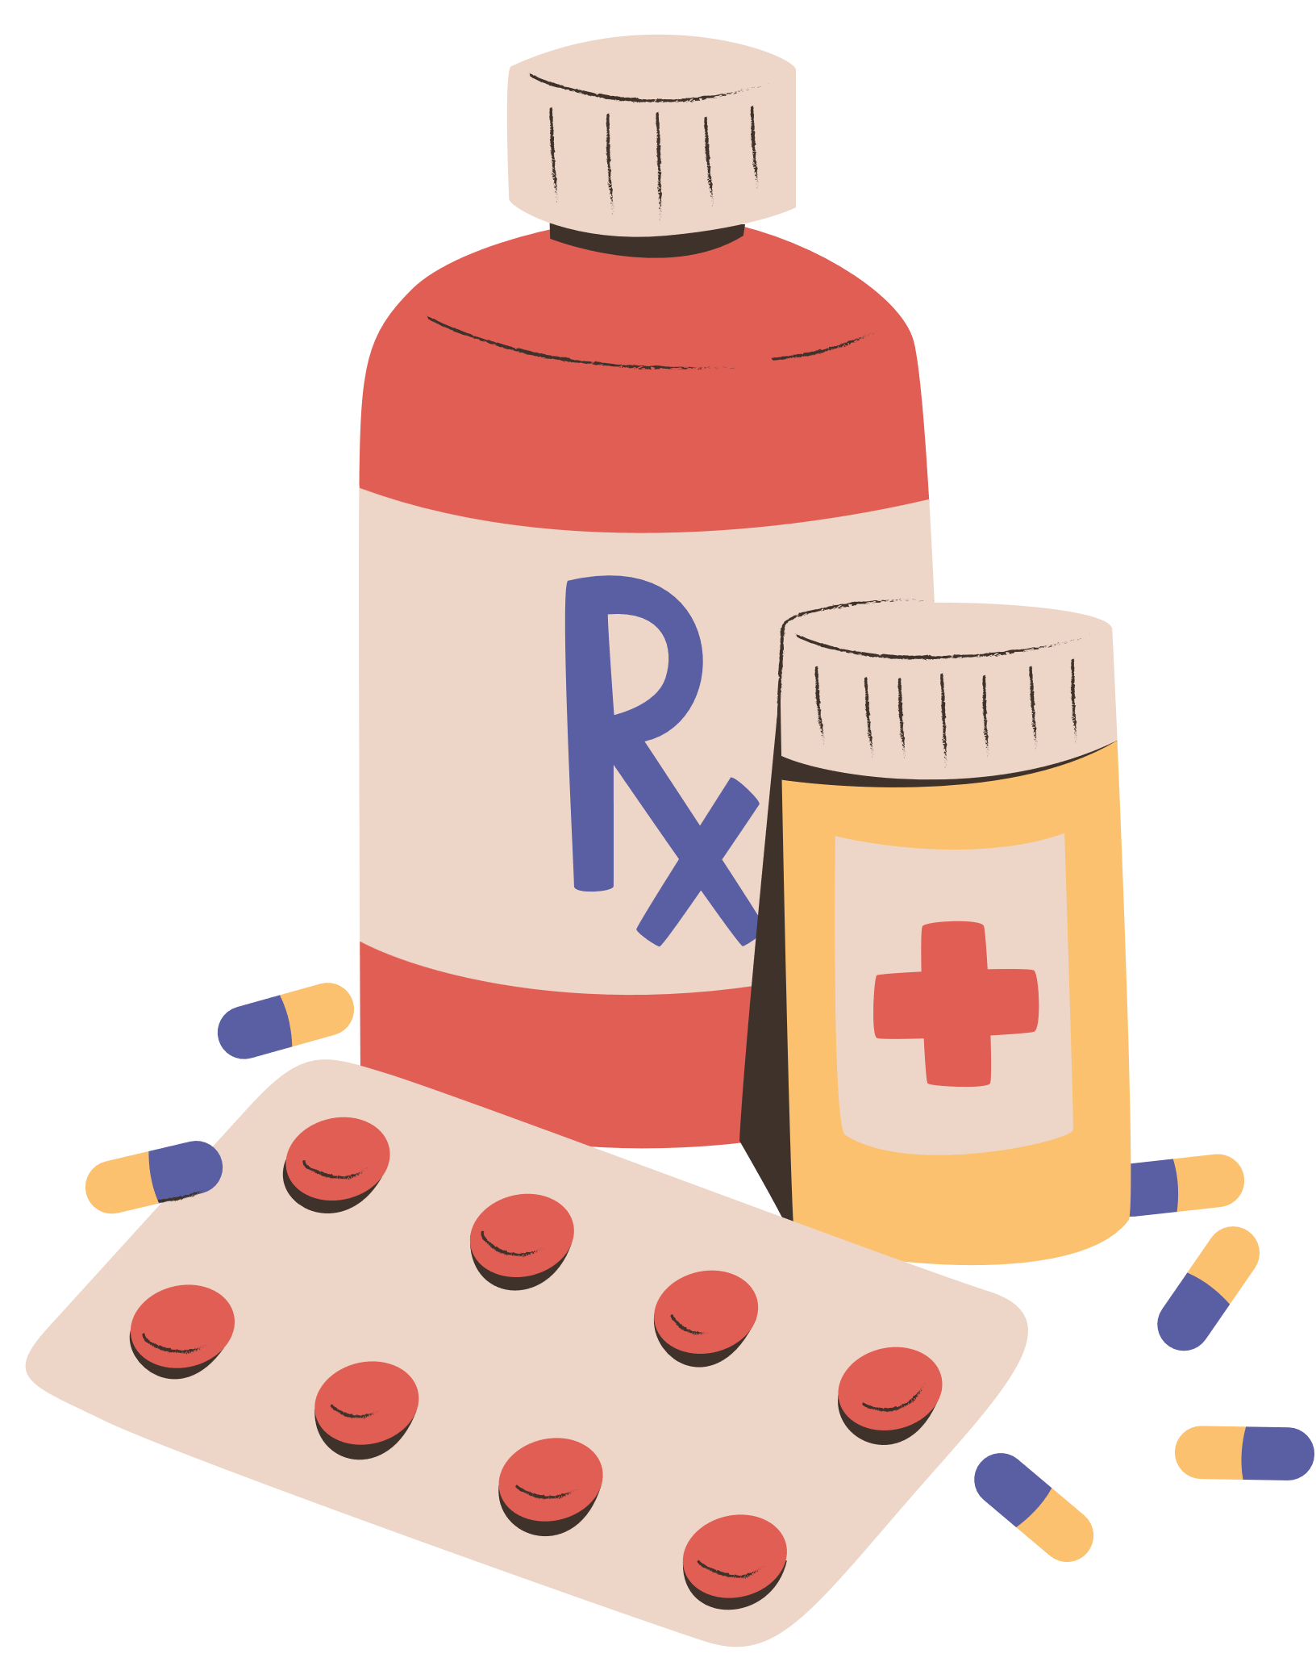

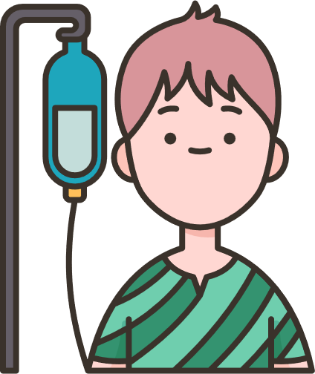


We help by engaging Patients & Caregivers
Know Risk & Causes of Medical harm & Guidelines to help prevent
Understand their Rights and Responsibilities
Guidance on the Role that Patients can play
Provide alerts, tips, and advice for a Safe Patient Journey
Knowledge of healthy lifestyle choices
My Health, My Responsibility

Slide 6
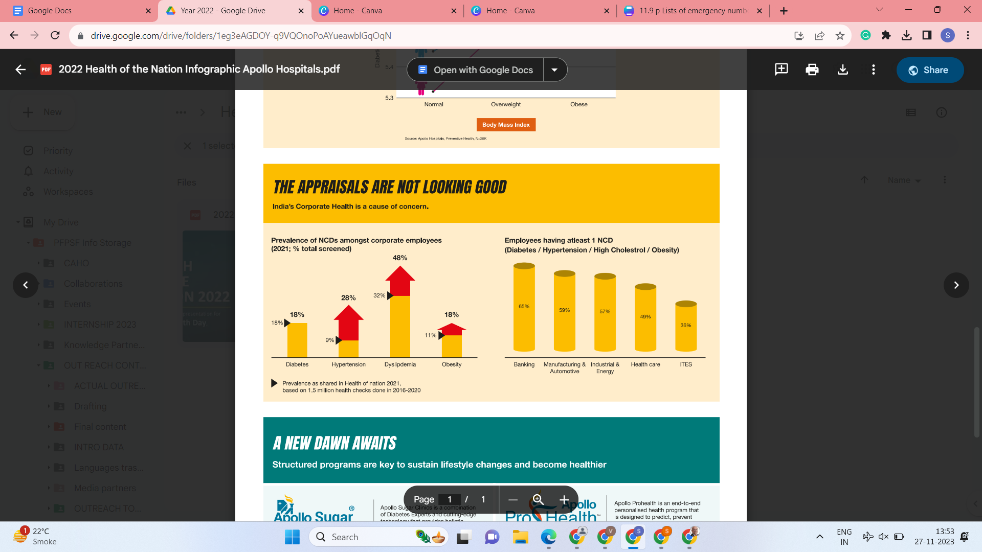
Corporate Health - A Source of Concern
Higher prevalence of NCDs among employees
Onset at an Early age is mostly ignored
Younger age bracket
My Health, My Responsibility

Slide 7
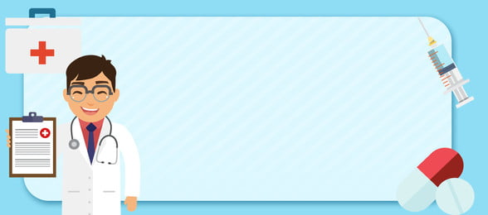
Some Examples on Preventing Harm
My Health, My Responsibility

Slide 8
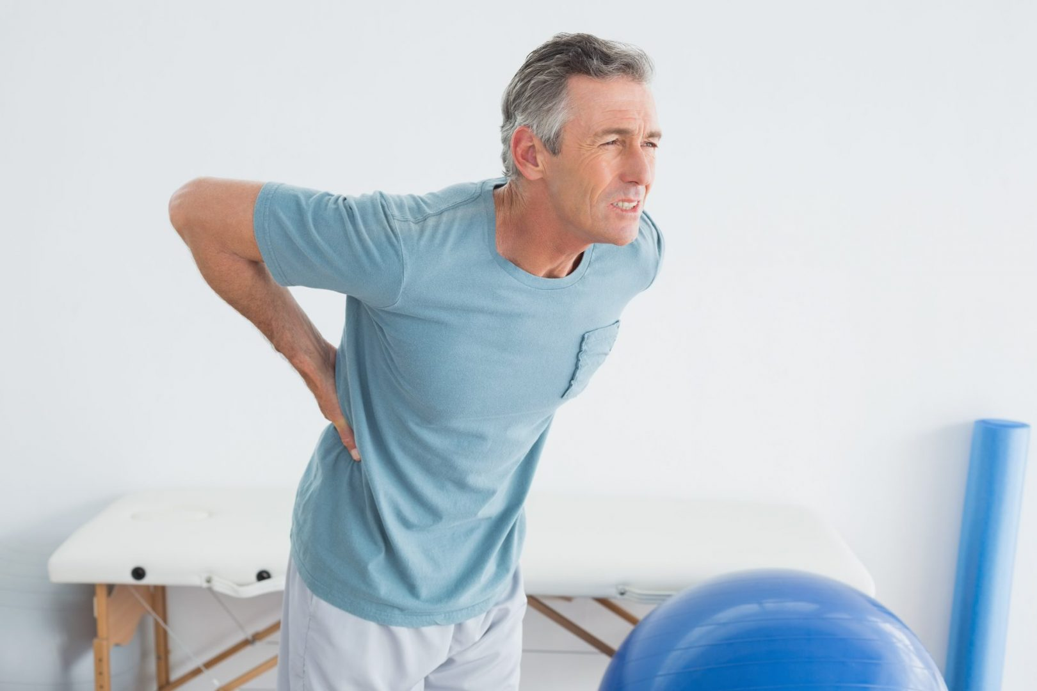
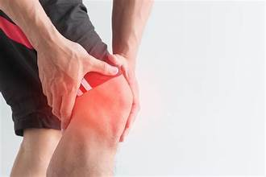
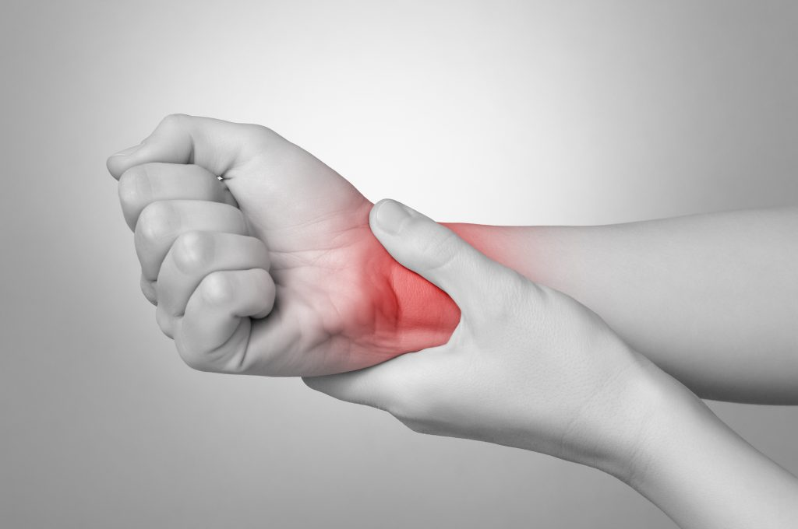
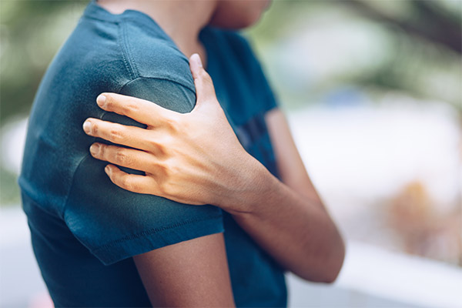
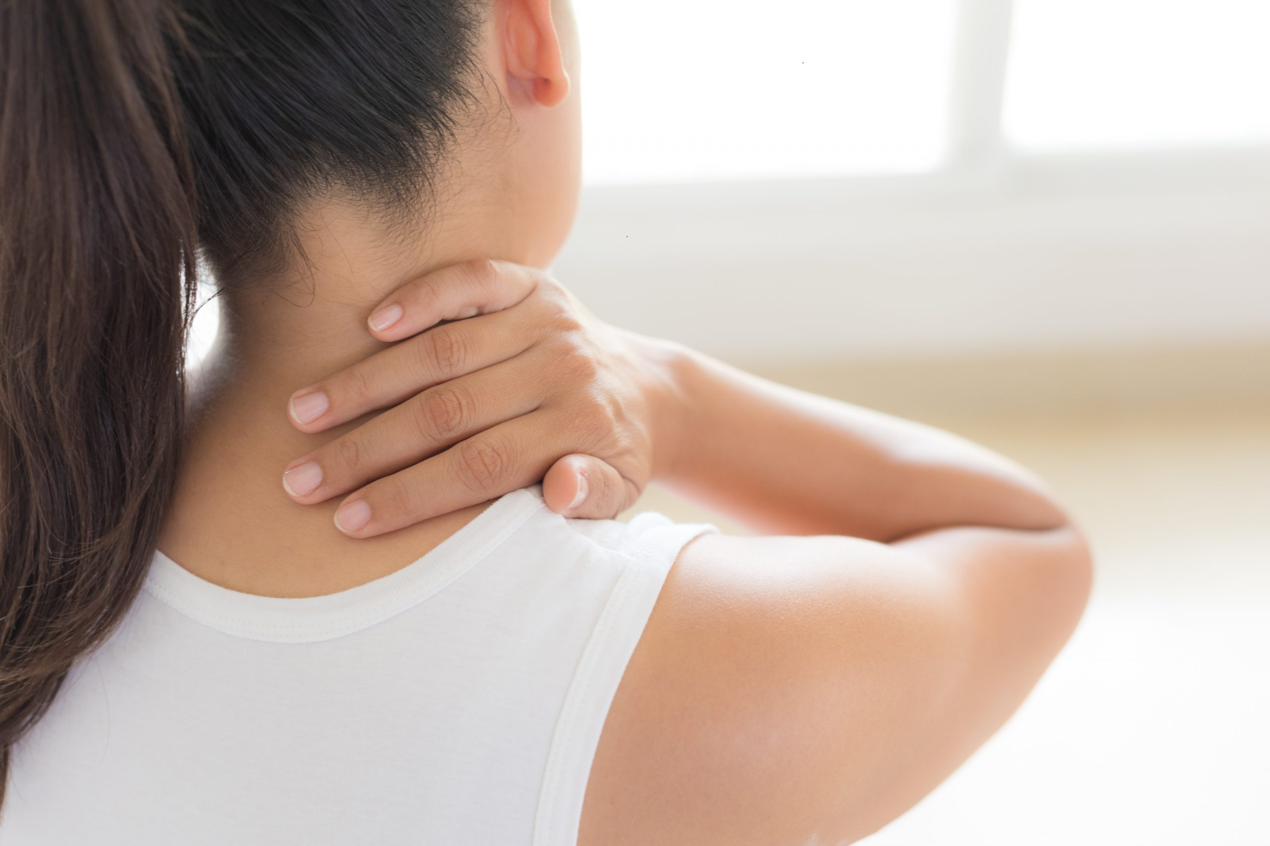
Are you experiencing any of these?
Source:www
My Health, My Responsibility

Slide 9
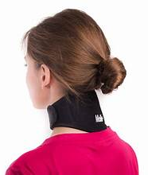
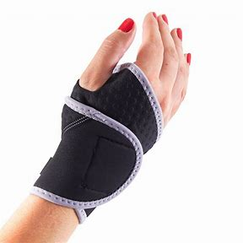
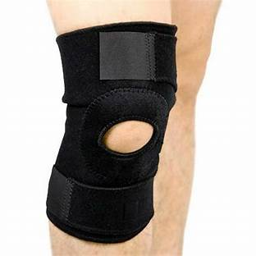
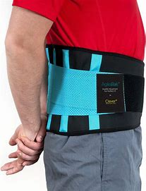
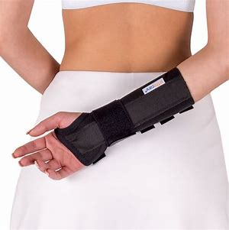
Or have worn any of these at some point in your lives?
Then it’s time for a reality check!
Source:www
My Health, My Responsibility

Slide 10
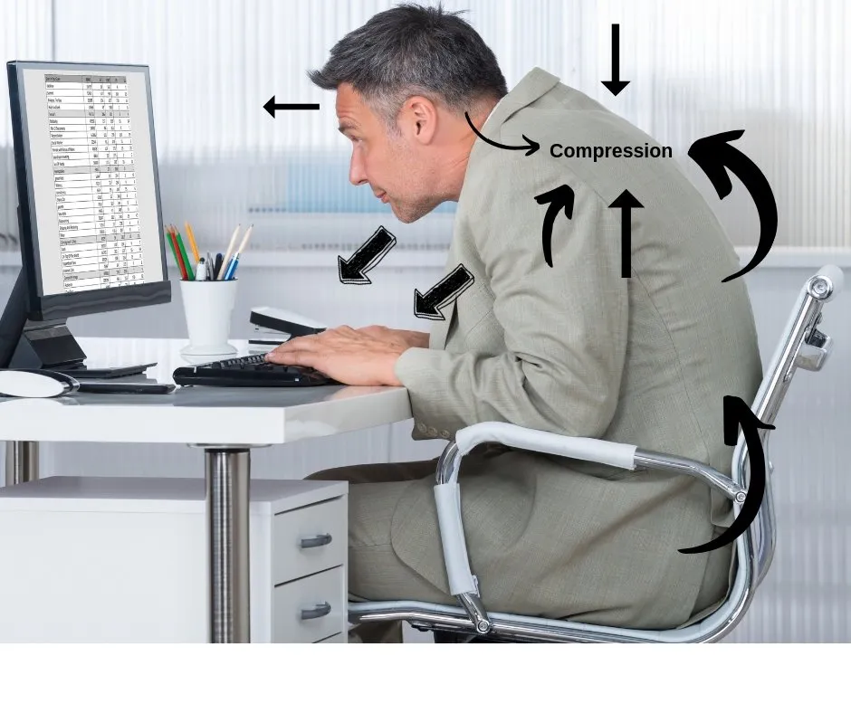
Is this how you are at Work/WFH?
Source:www
My Health, My Responsibility

Slide 11
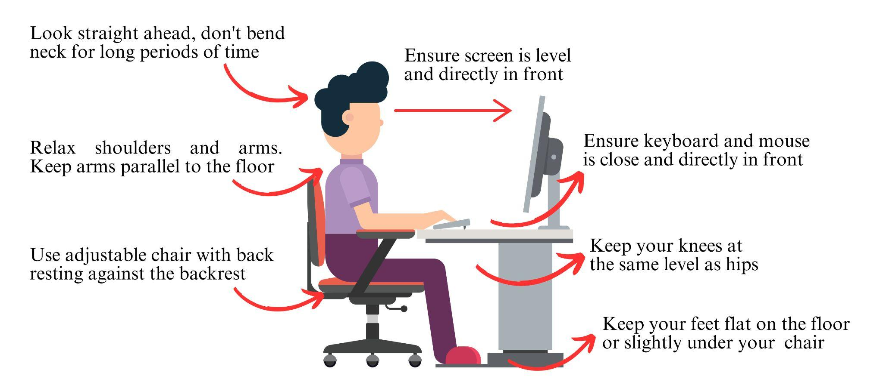
Your Posture Can Help Avoid Pain
My Health, My Responsibility

Slide 12
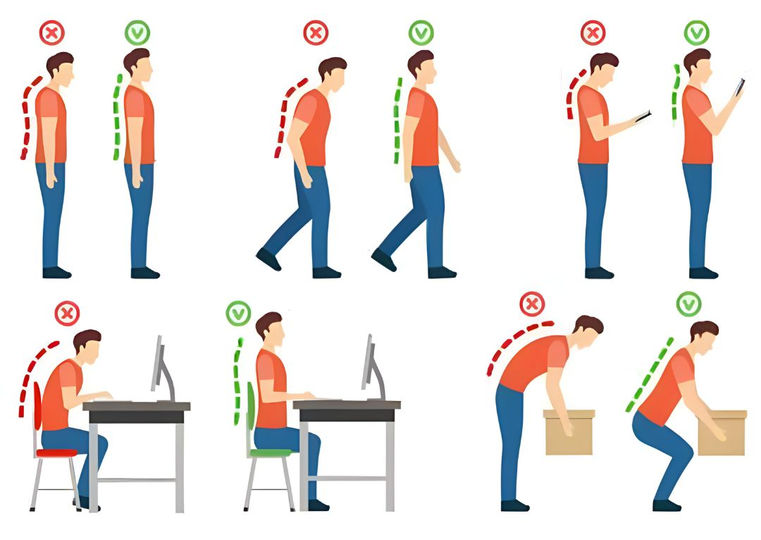
Be Mindful of Your Posture
My Health, My Responsibility

Slide 13
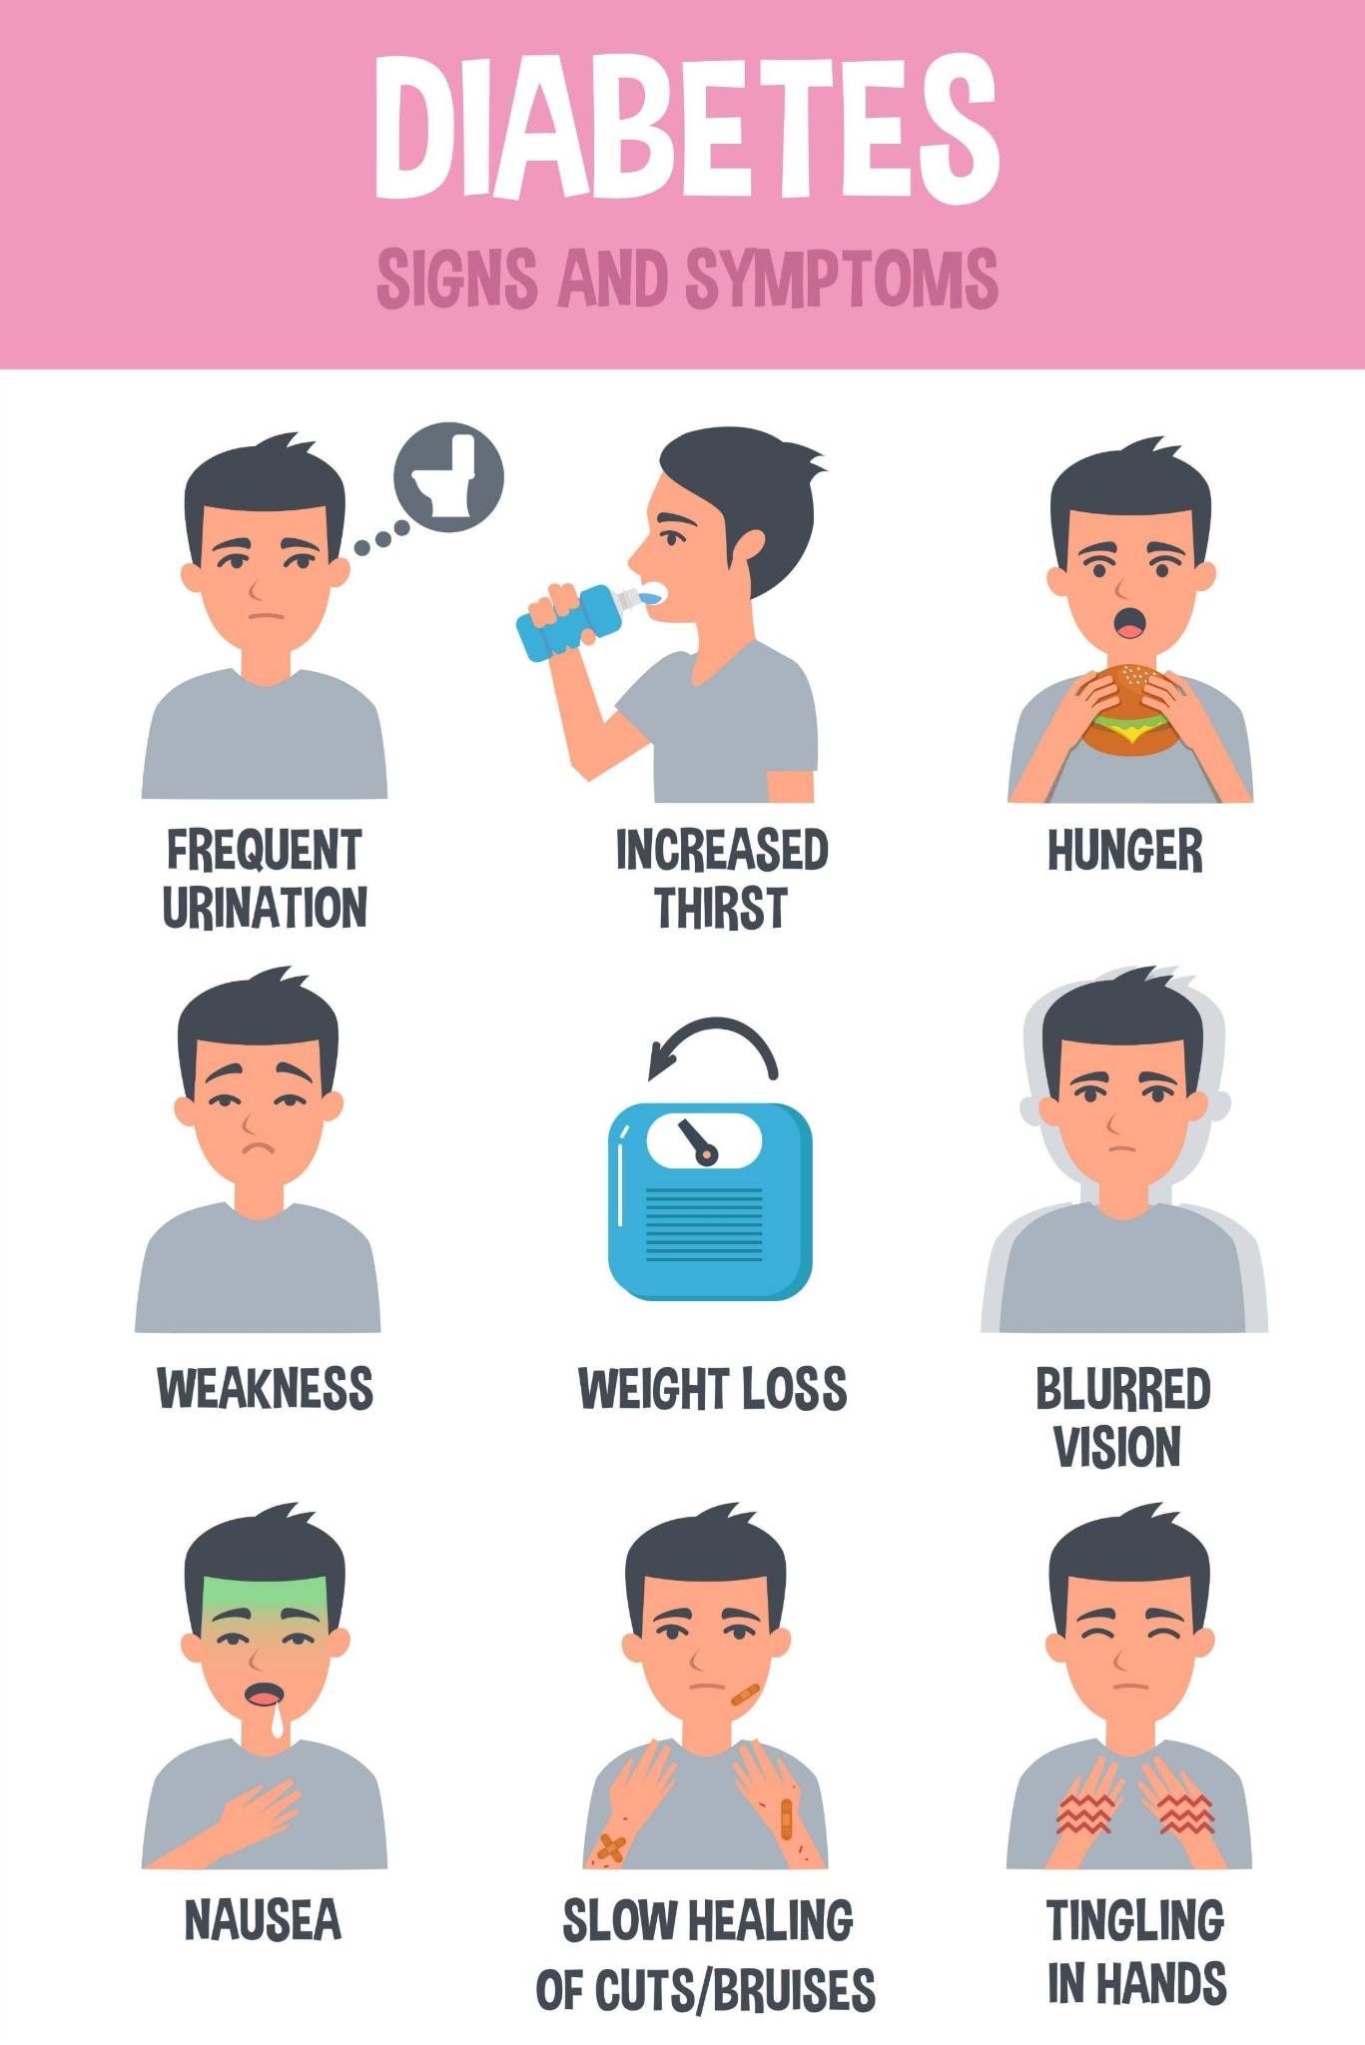
Diabetes Trends in India; Symptoms
1 in 3* have pre diabetes
1 in 4* have diabetes
1 in 10* have uncontrolled diabetes
Diabetes is silent, symptoms show later
Serious complications, controllable if detected early
*Source: Apollo Hospitals
My Health, My Responsibility

Slide 14
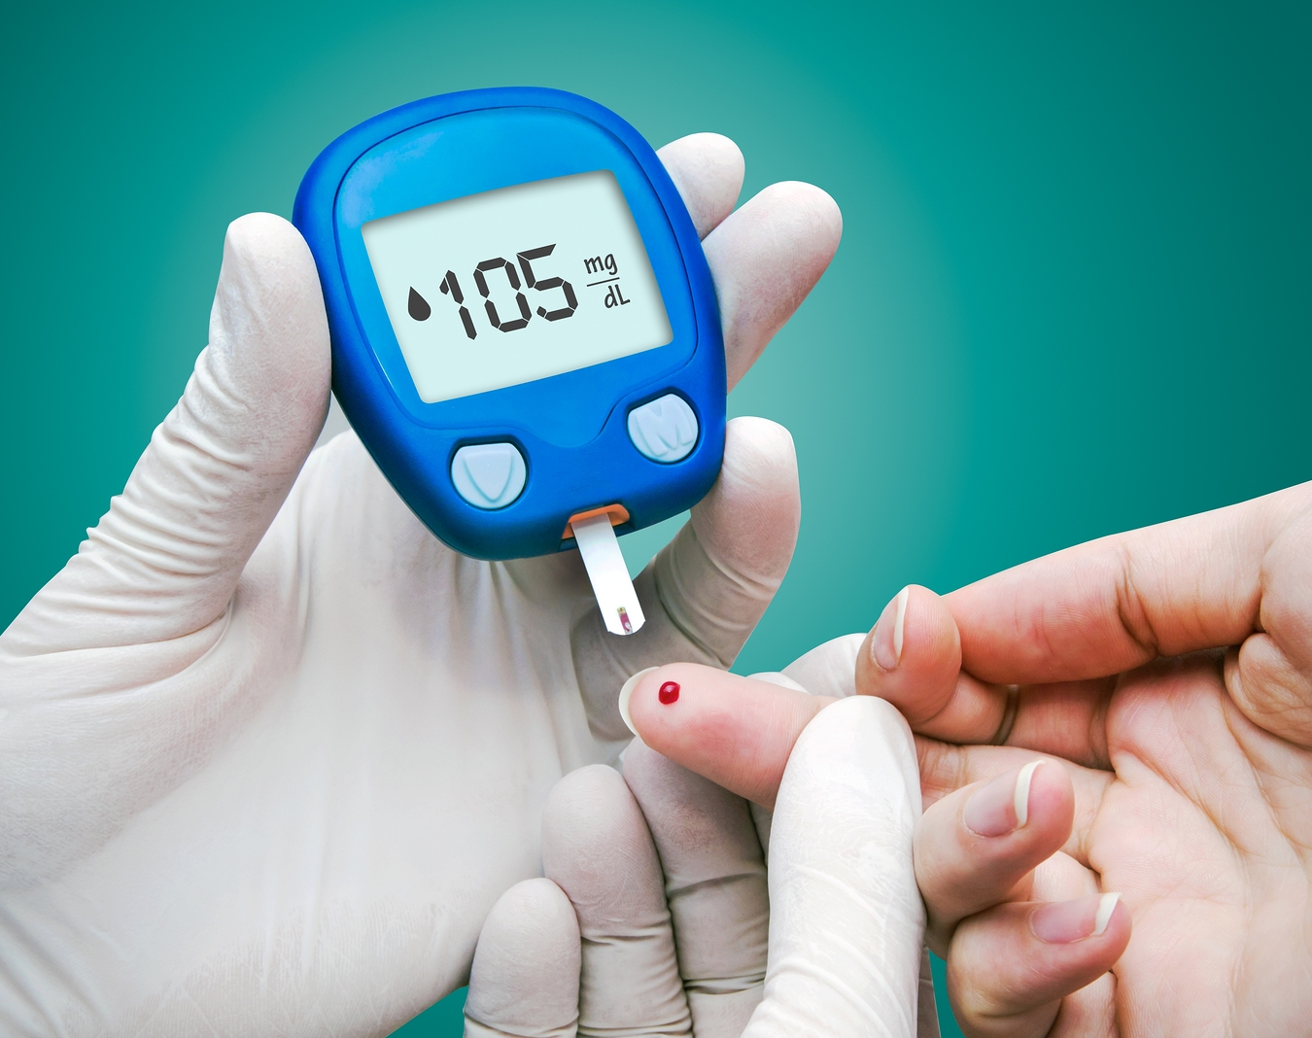
Who is at risk for Diabetes
Having a family history of a parent or sibling with diabetes
High blood pressure, high cholesterol,
Being physically inactive or obese
Both men & women can get diabetes,
Over 45 years age are more prone
Incidence in people between 20-45 years of age increasing
A Simple home test can detect
More than 50% of people are unaware of their diabetic status
My Health, My Responsibility

Slide 15
How to detect & Manage Diabetes
Be vigilant for common diabetes symptoms such as increased thirst, frequent urination, unexplained weight loss, and fatigue
Get a simple blood test - Sugar fasting/ HbA1c
If high slight changes in lifestyle required
If severe:
  Medication & Lifestyle changes
  Include high-fiber foods and reduce intake of refined sugars and carbohydrates
  Consider continuous glucose monitoring (CGM) systems
  Regularly Consult with Healthcare Providers
  Avoid walking barefoot to avoid injuries
My Health, My Responsibility

Slide 16
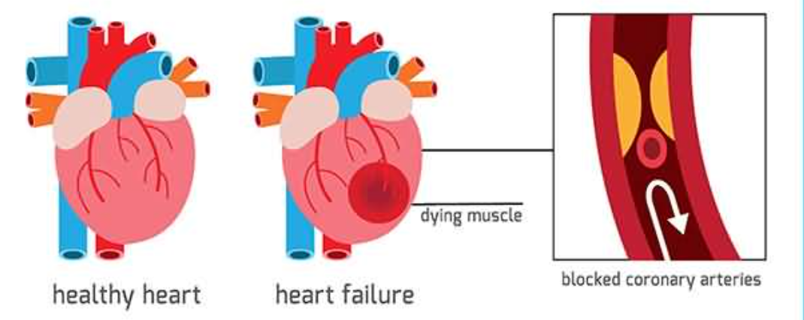
Heart Attack : Detection and Response
Heart Attack: Happens due to obstruction of blood flow to a portion of the heart muscles, caused by a clot in the blood vessels. Lack of blood flow causes heart tissues to die & impact other organs.
My Health, My Responsibility

Slide 17
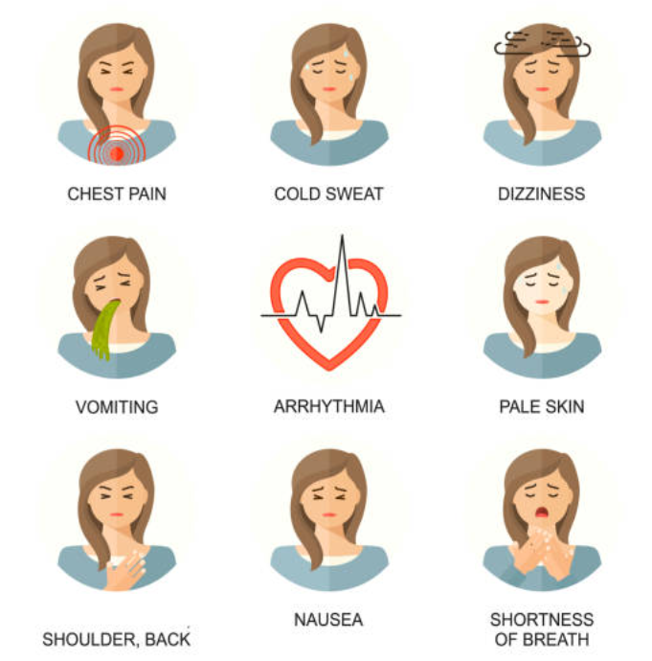
Symptoms of a Heart Attack (any one or several)
You may have early symptoms like breathlessness
Do not confuse these with other illnesses like gastric issues
My Health, My Responsibility

Slide 18
The First Response is Critical
If you are having a heart attack:
Inform someone nearby
Open front door if alone
Rest and stay calm
Call your physician
Chew Aspirin: If not allergic to Aspirin
Ask for Cardiac Ambulance, dial 102
If ambulance is delayed have someone drive you to the hospital (Do not drive yourself)
If someone else is having a heart attack:
Make the person lie down and be calm
If conscious, understand symptoms from the person
Call a physician for advice
If the person is not allergic to Aspirin, have them chew one
Ask for Cardiac Ambulance, dial 102
Perform CPR, if unresponsive and stops breathing
If ambulance is delayed drive patient to hospital
My Health, My Responsibility

Slide 19
Emergencies Cannot be Treated At Home
No time to lose - Do not Miss the Golden Hour¹
ACT NOW!
Be aware of symptoms & potential issues
Seek immediate help - family, neighbour, domestic staff & physician
Know which Medical facility to go to
Decide to drive or wait for Ambulance- Condition & Time
Be Calm; avoid medications unless advised;
Provide First Aid like CPR
¹ Golden hour is the first 60 minutes for rapid diagnosis and treatment given for a good outcome and to prevent further damage
My Health, My Responsibility

Slide 20
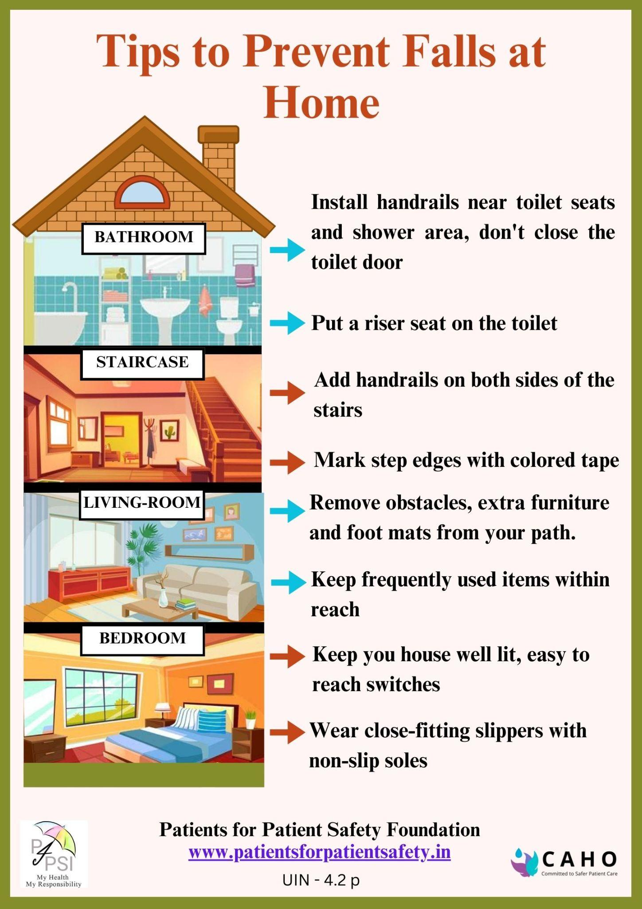
Fall Prevention At Home
According to WHO, ~ 6 lakh individuals die each year globally from falls.
It is the second leading cause of unintentional injury/death.
Why do falls happen?
Imbalance due to old age
Significant weakness after an illness
Side effects of certain medicines
Wearing shoes with inadequate grip
Wet or slippery surfaces
Cluttered living spaces
My Health, My Responsibility

Slide 21
Ensure Correct Diagnosis
You will get the Right Treatment
My Health, My Responsibility

Slide 22
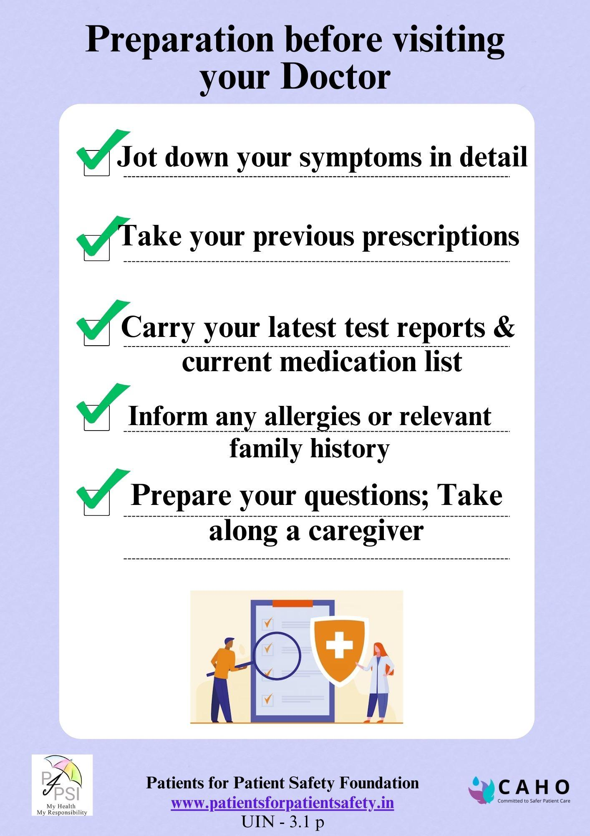
Help Your Doctor in Diagnosing
  Doctors are rushed and have limited time
  They take decisions based on the information you provide - symptoms, medical history/allergies, previous reports
  You have limited time to provide info
My Health, My Responsibility

Slide 23
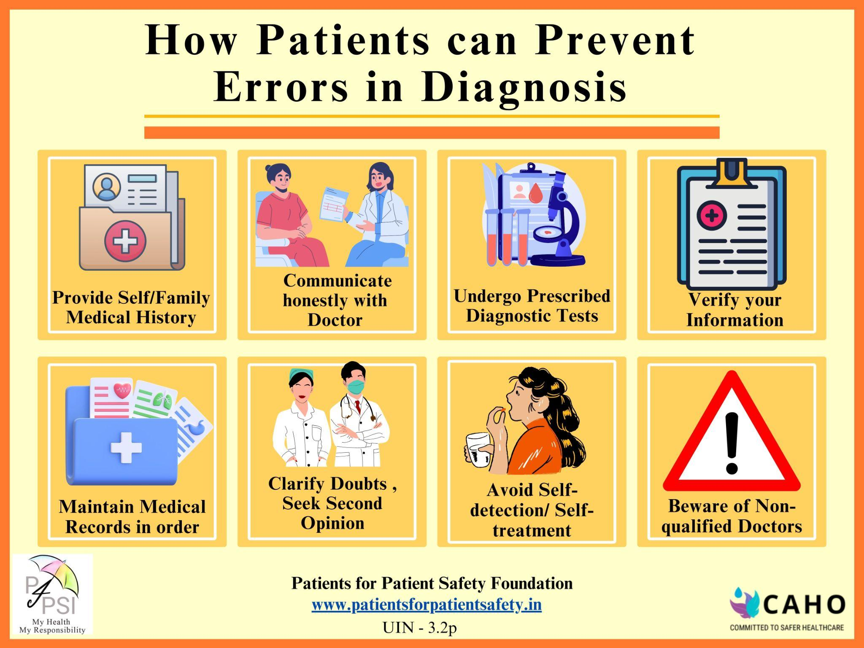
My Health, My Responsibility

Slide 24
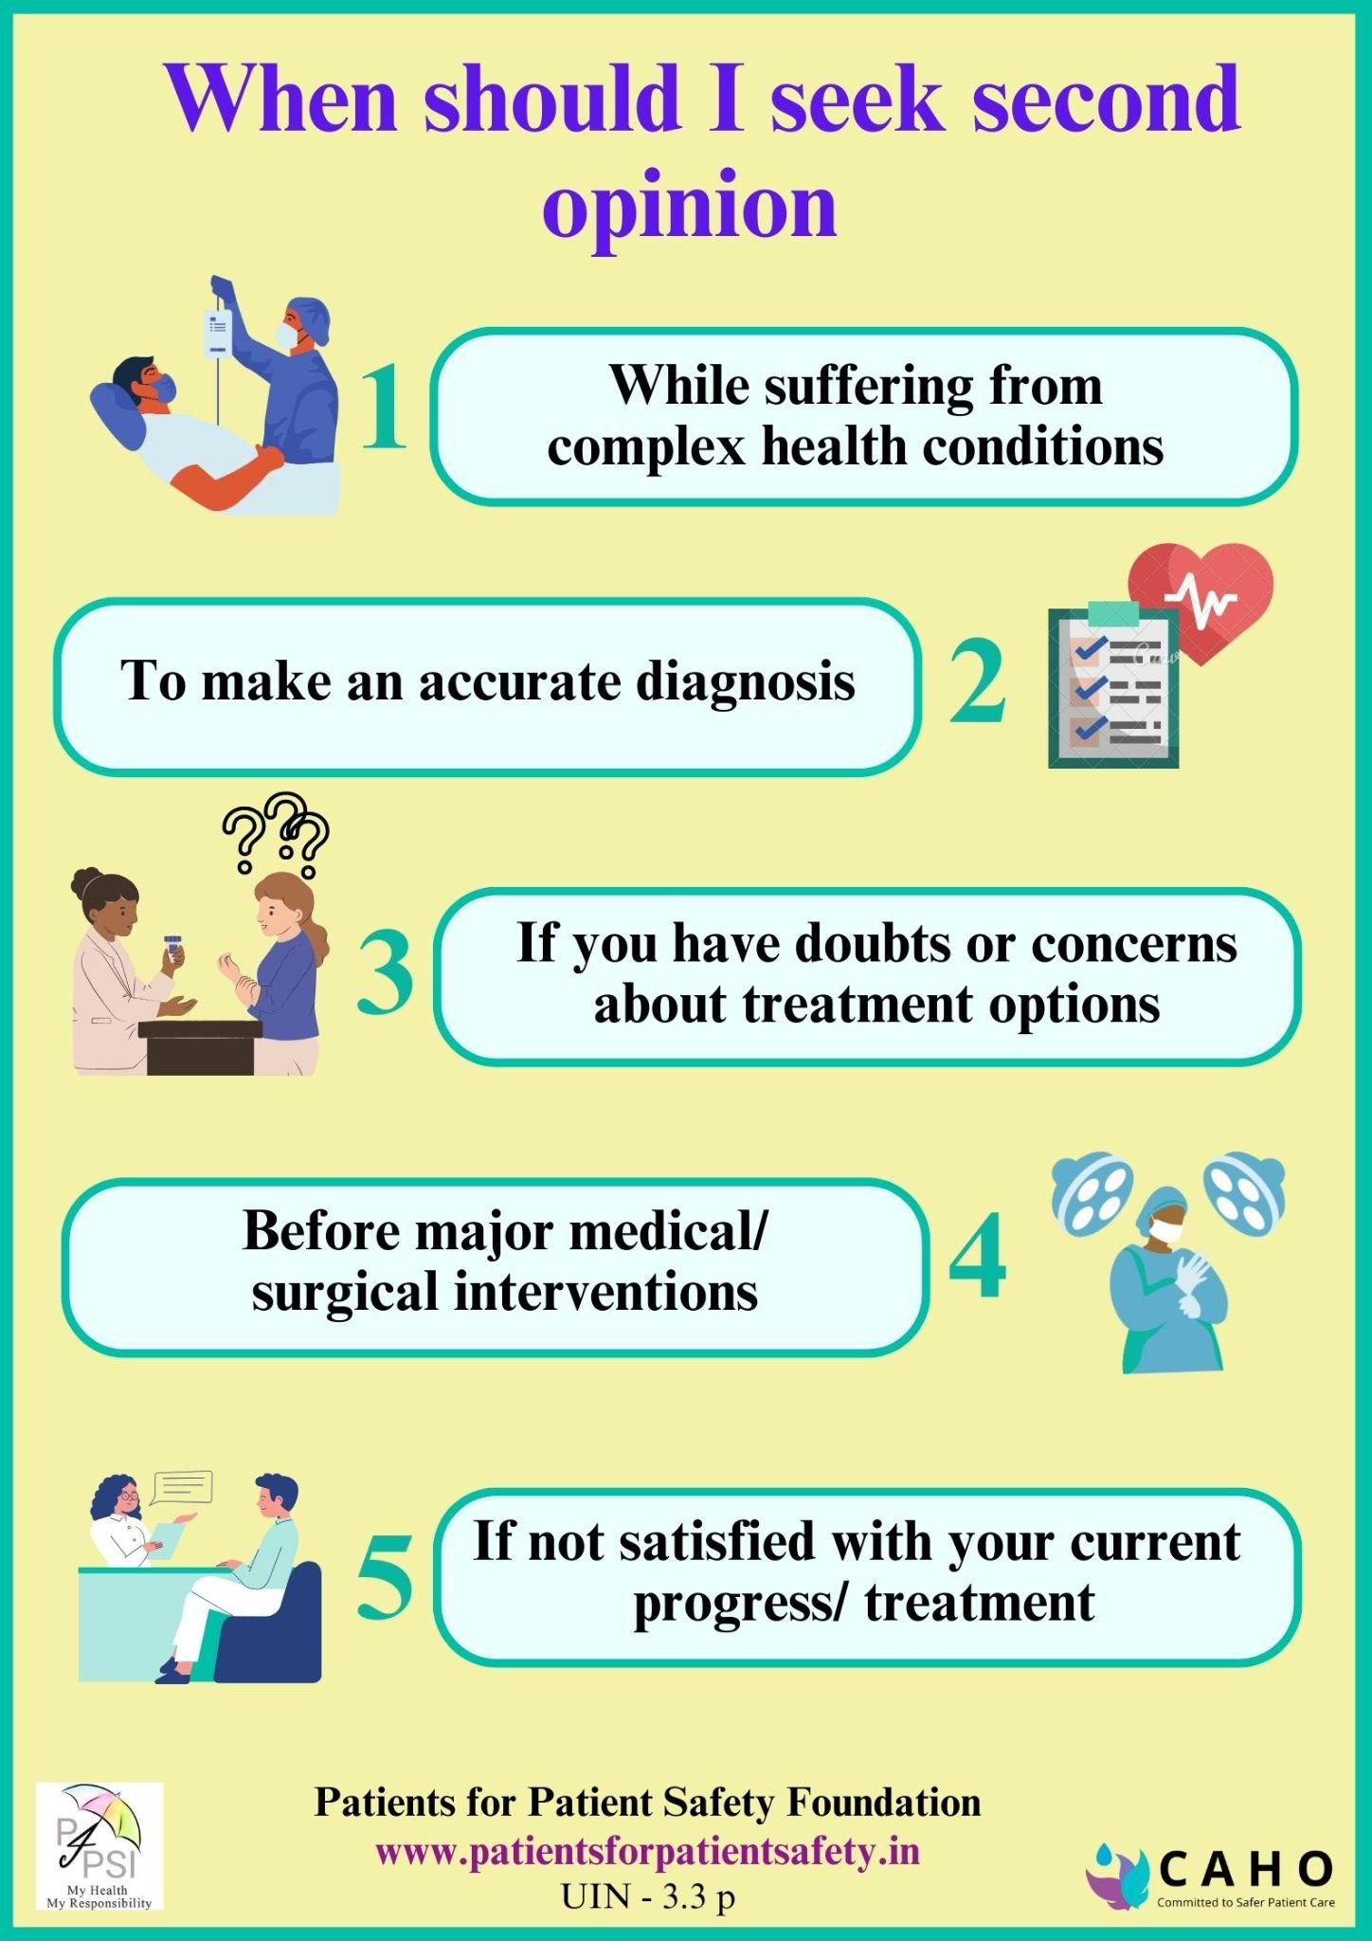
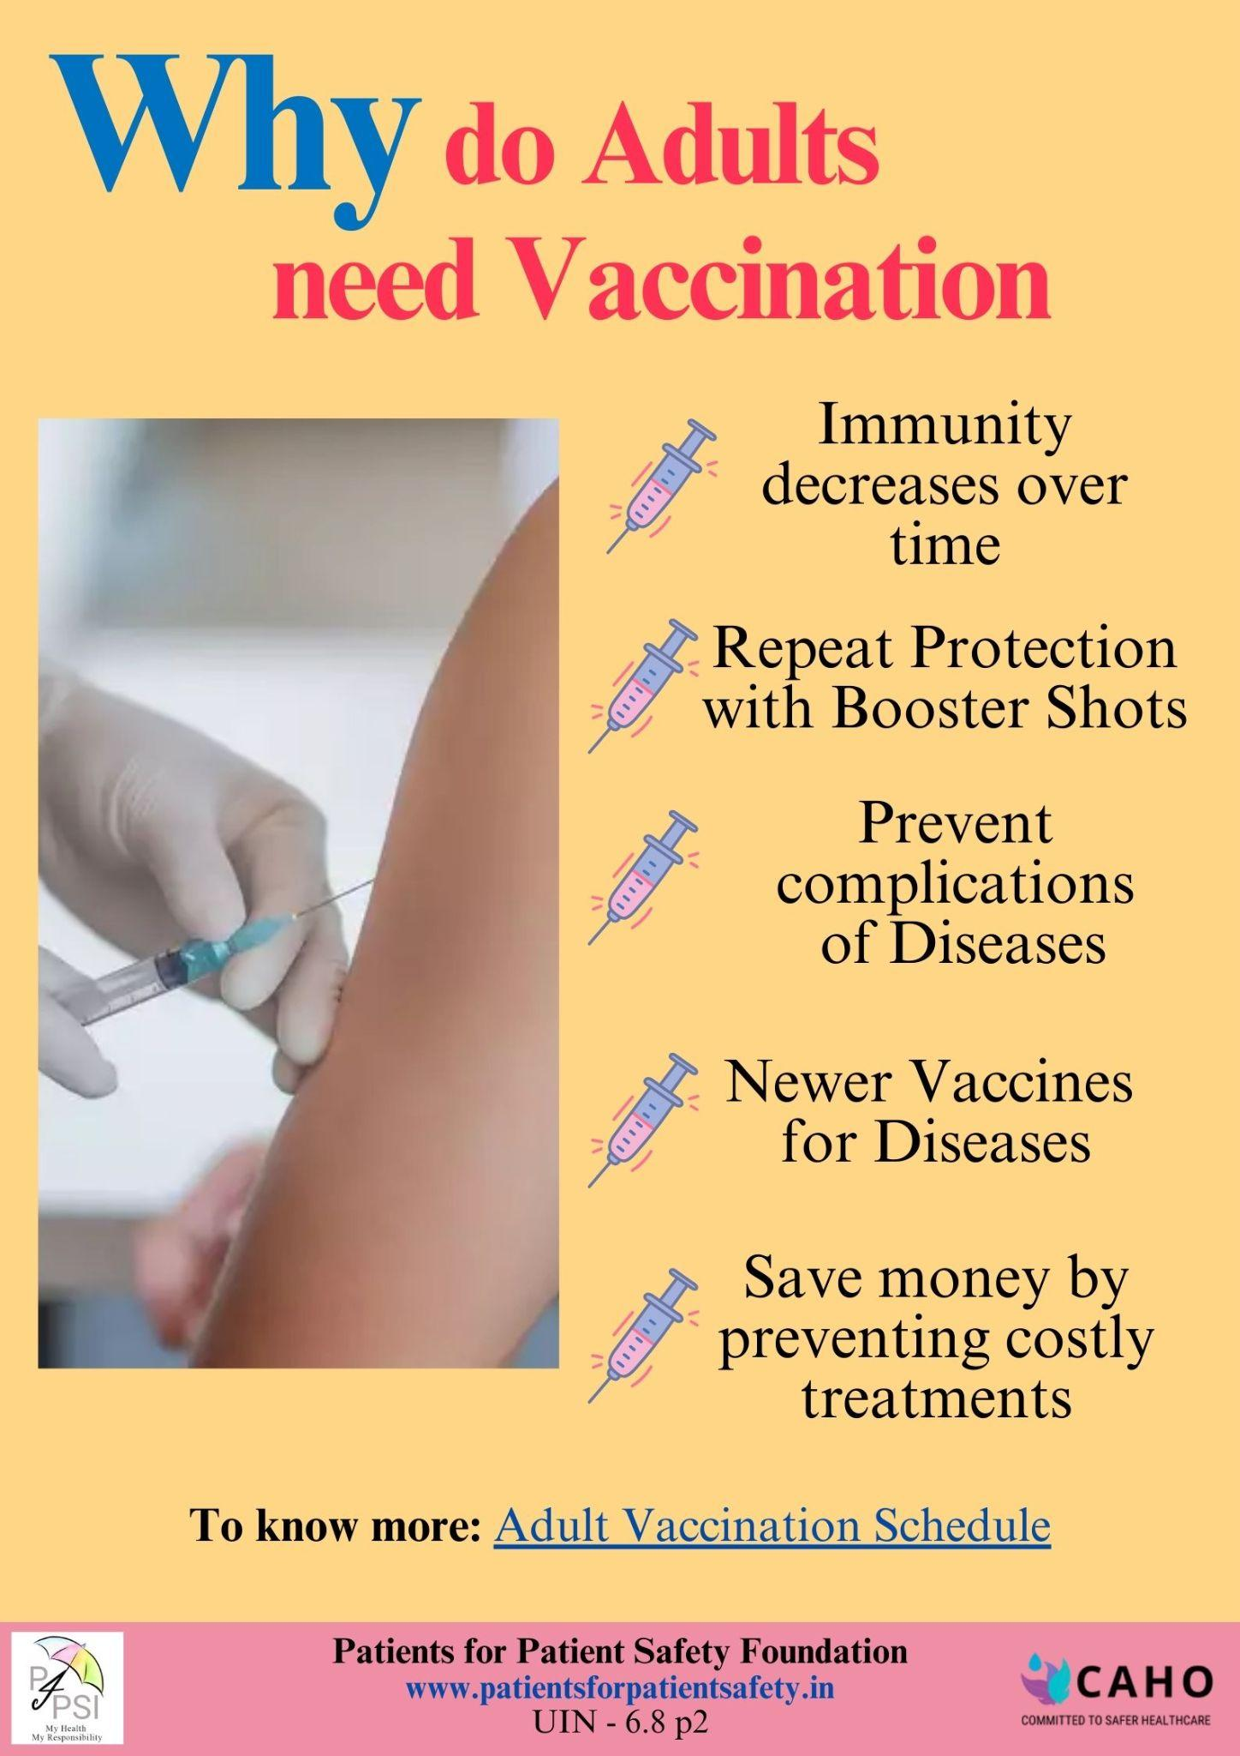
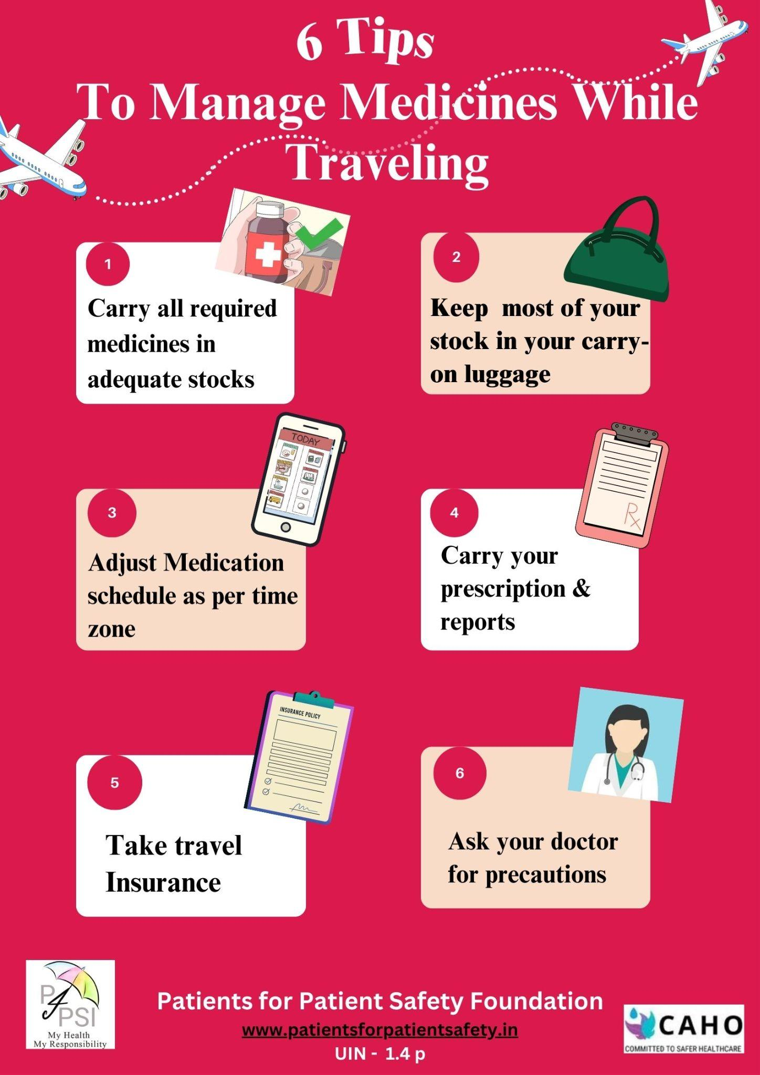
We will provide simple, Important Tips
My Health, My Responsibility

Slide 25
You can prevent Avoidable Harm
Your role both as Patient & Caregiver is critical
Get basic knowledge to deal with health issues
Know about the hospitals around you and facilities they have
Know about avoidable harm & prevention
Be alert and aware about symptoms
Get Preventive health check-ups
Follow wellness advice
My Health, My Responsibility

Slide 26
You can prevent Avoidable Harm
This is exactly what we do - equip you with correct, precise and well-researched information in a simple way - that you should absorb today
At the time of emergency you only have time to respond. There is no time to Google!
A well informed patient will be conscious about possible risks, watchful of symptoms, communicate clearly with health care provider and act/respond quickly
My Health, My Responsibility

Slide 27





Join the Patient Safety Movement
You can save yourself & your family from medical harm Your Health is Your Responsibility
Ask Questions, Clear your doubts, Send us your feedback@
info@patientsforpatientsafety.in
Explore our website: www.patientsforpatientsafety.in
Get more info @
PFPSF-india
patientsforpatientsafety
pfpsfindia
patientsafety22
+919289696709
Patients for Patient Safety Foundation
Contact # 92896 96709
D10 Ground Floor, Nizamuddin East, New Delhi, India, 110013

