Slide 1




World Patient Safety Day
ASQua– 26th September 2023
Patient Engagement for Patient Safety -
Patients Perspective
Patients for Patient Safety Foundation
This Photo by Unknown Author is licensed under CC BY-ND

Slide 2

Patient is more than his Disease
Are my symptoms
serious?
What all do I tell the
doctor?
Shall I take a second opinion?
When & How?
Is my diagnosis
correct?
How expensive is the
treatment?
Are all the tests
required?
How should I keep my
records?
Where can I get answers to
these questions?
Concerns Patients have

Slide 3

Harms, What, Where, why, who is responsible
Barriers in engagement
Patients and Caregivers
Vulnerable, stressed
Time shortage
God syndrome wrt Doctors
Lack of awareness of R and R
Confused about disease, treatment
Demographic challenges
Healthcare Providers
Time shortage
Lack of importance or awareness of benefits of patient engagement
Fear of reprisal if pateint is educated
Over worked, under staffed
Lack of pateint centricity

Slide 4







How Patients can help in their own care
Being Alert - Asking Questions
Providing Complete Information
Following Prescriptions/ Advise
Keeping Track of Medication/ Symptoms
Getting a Second
Opinion; Building Trust
Keeping Updated Medical Records
Giving
Valuable Feedback
My Health My Responsibility

Slide 5
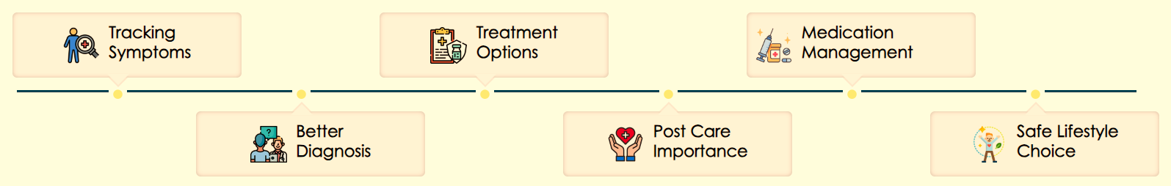
How PFPSF is Empowering Patients
Are both
Tablets same?
Are my symptoms serious?
When can I discontinue
Medication?
What should I
tell my doctor?
Shall I stop the Medicines?
What's the harm in smoking now?
Delayed diagnosis
Non
compliance
Dispensing
errors
Incomplete information
Respiratory disease
Recurrence

Slide 6
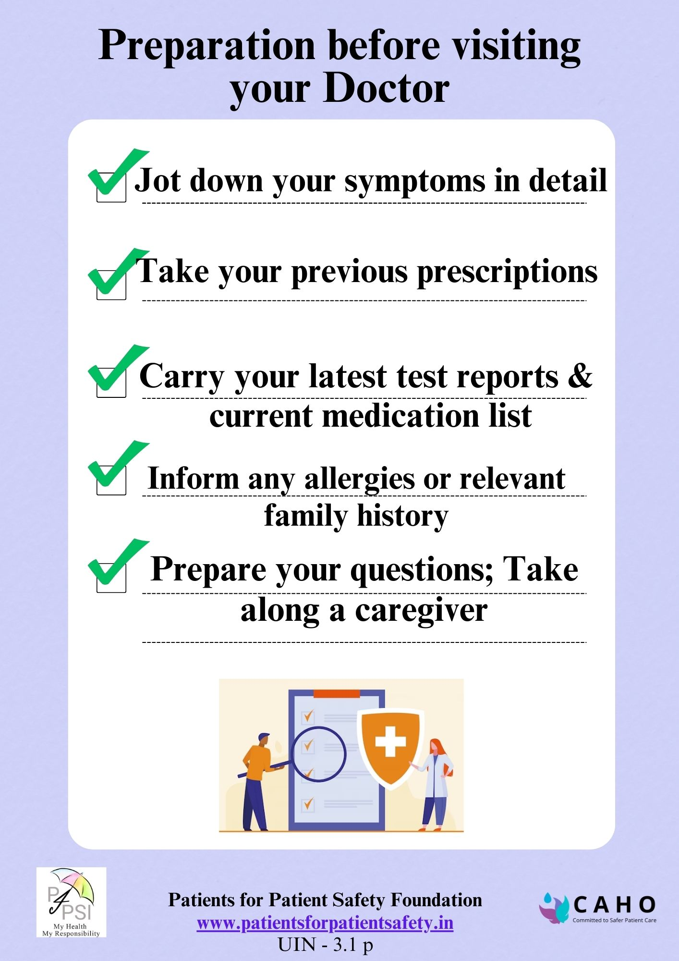
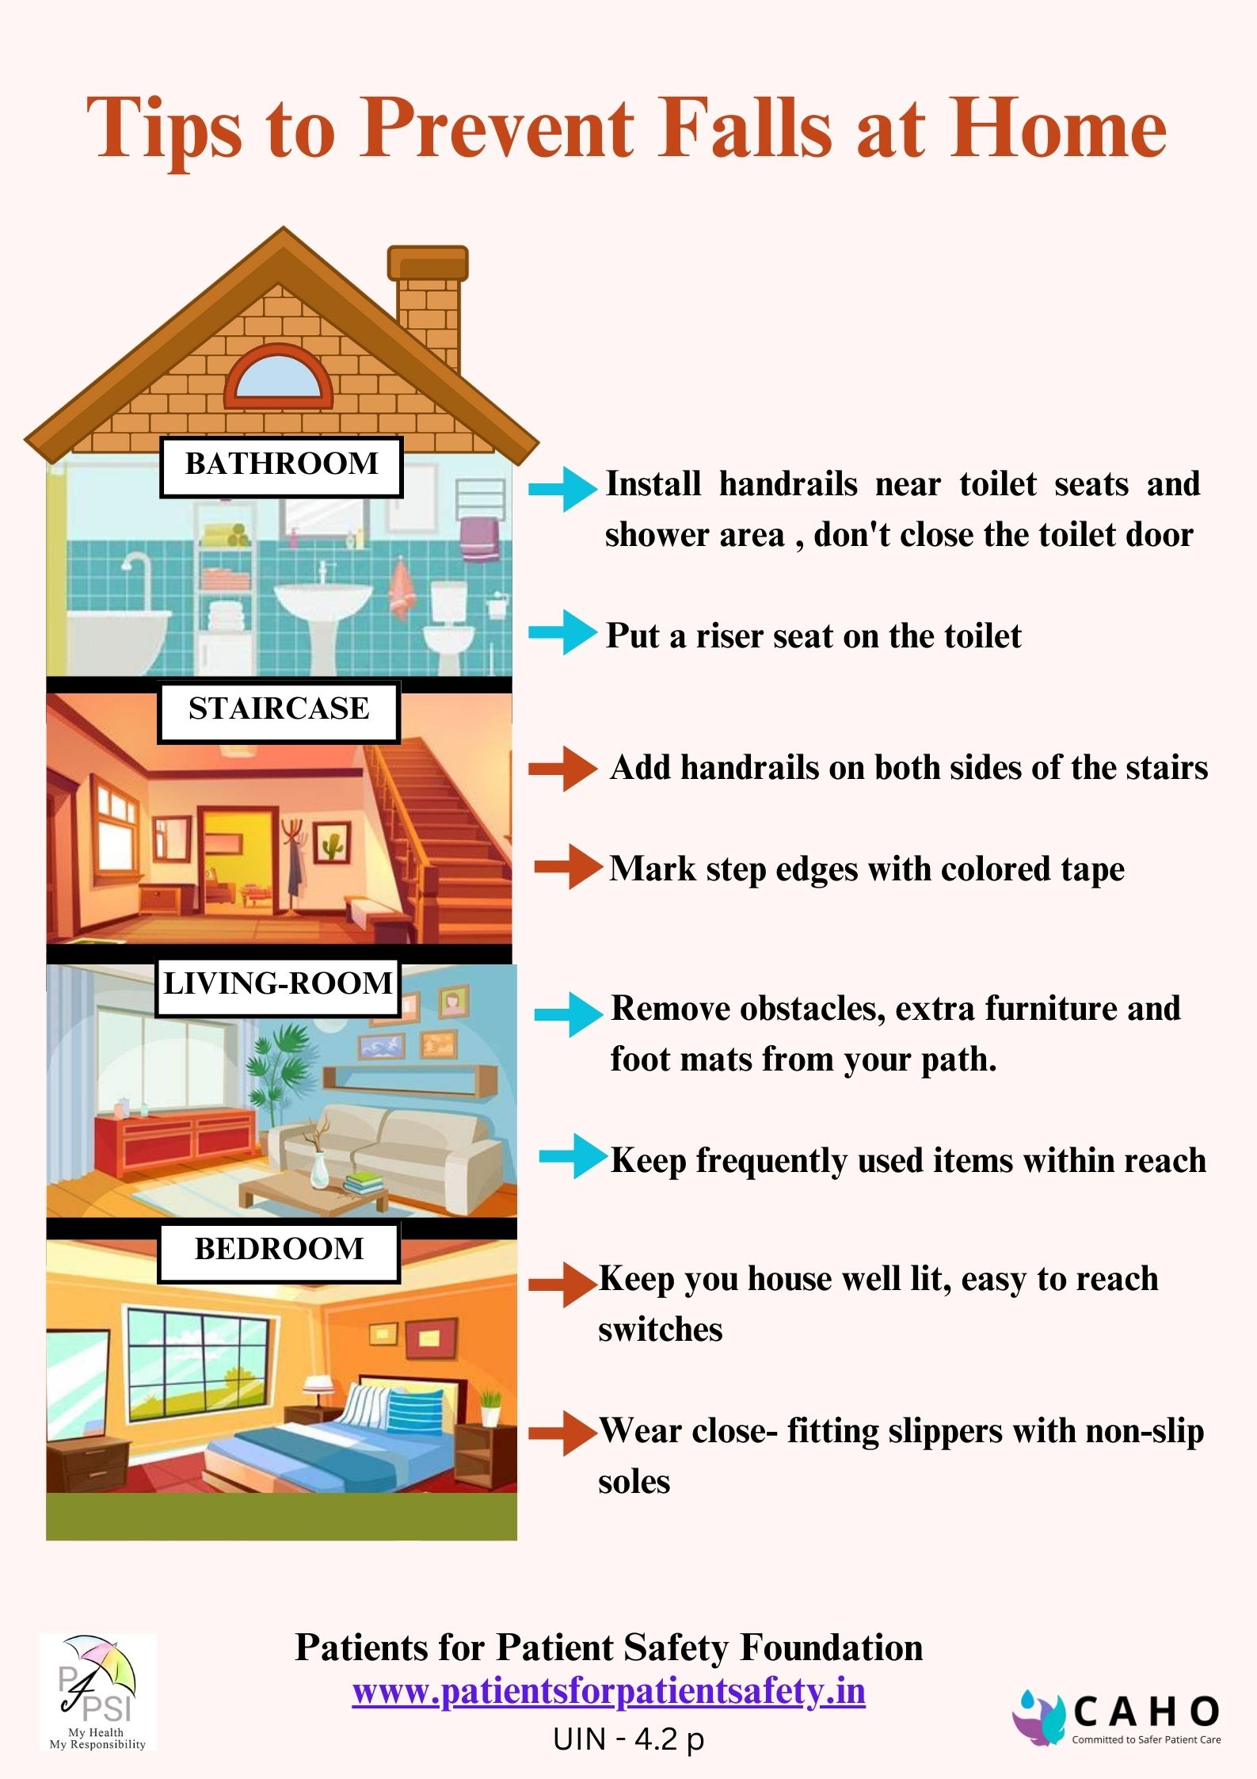
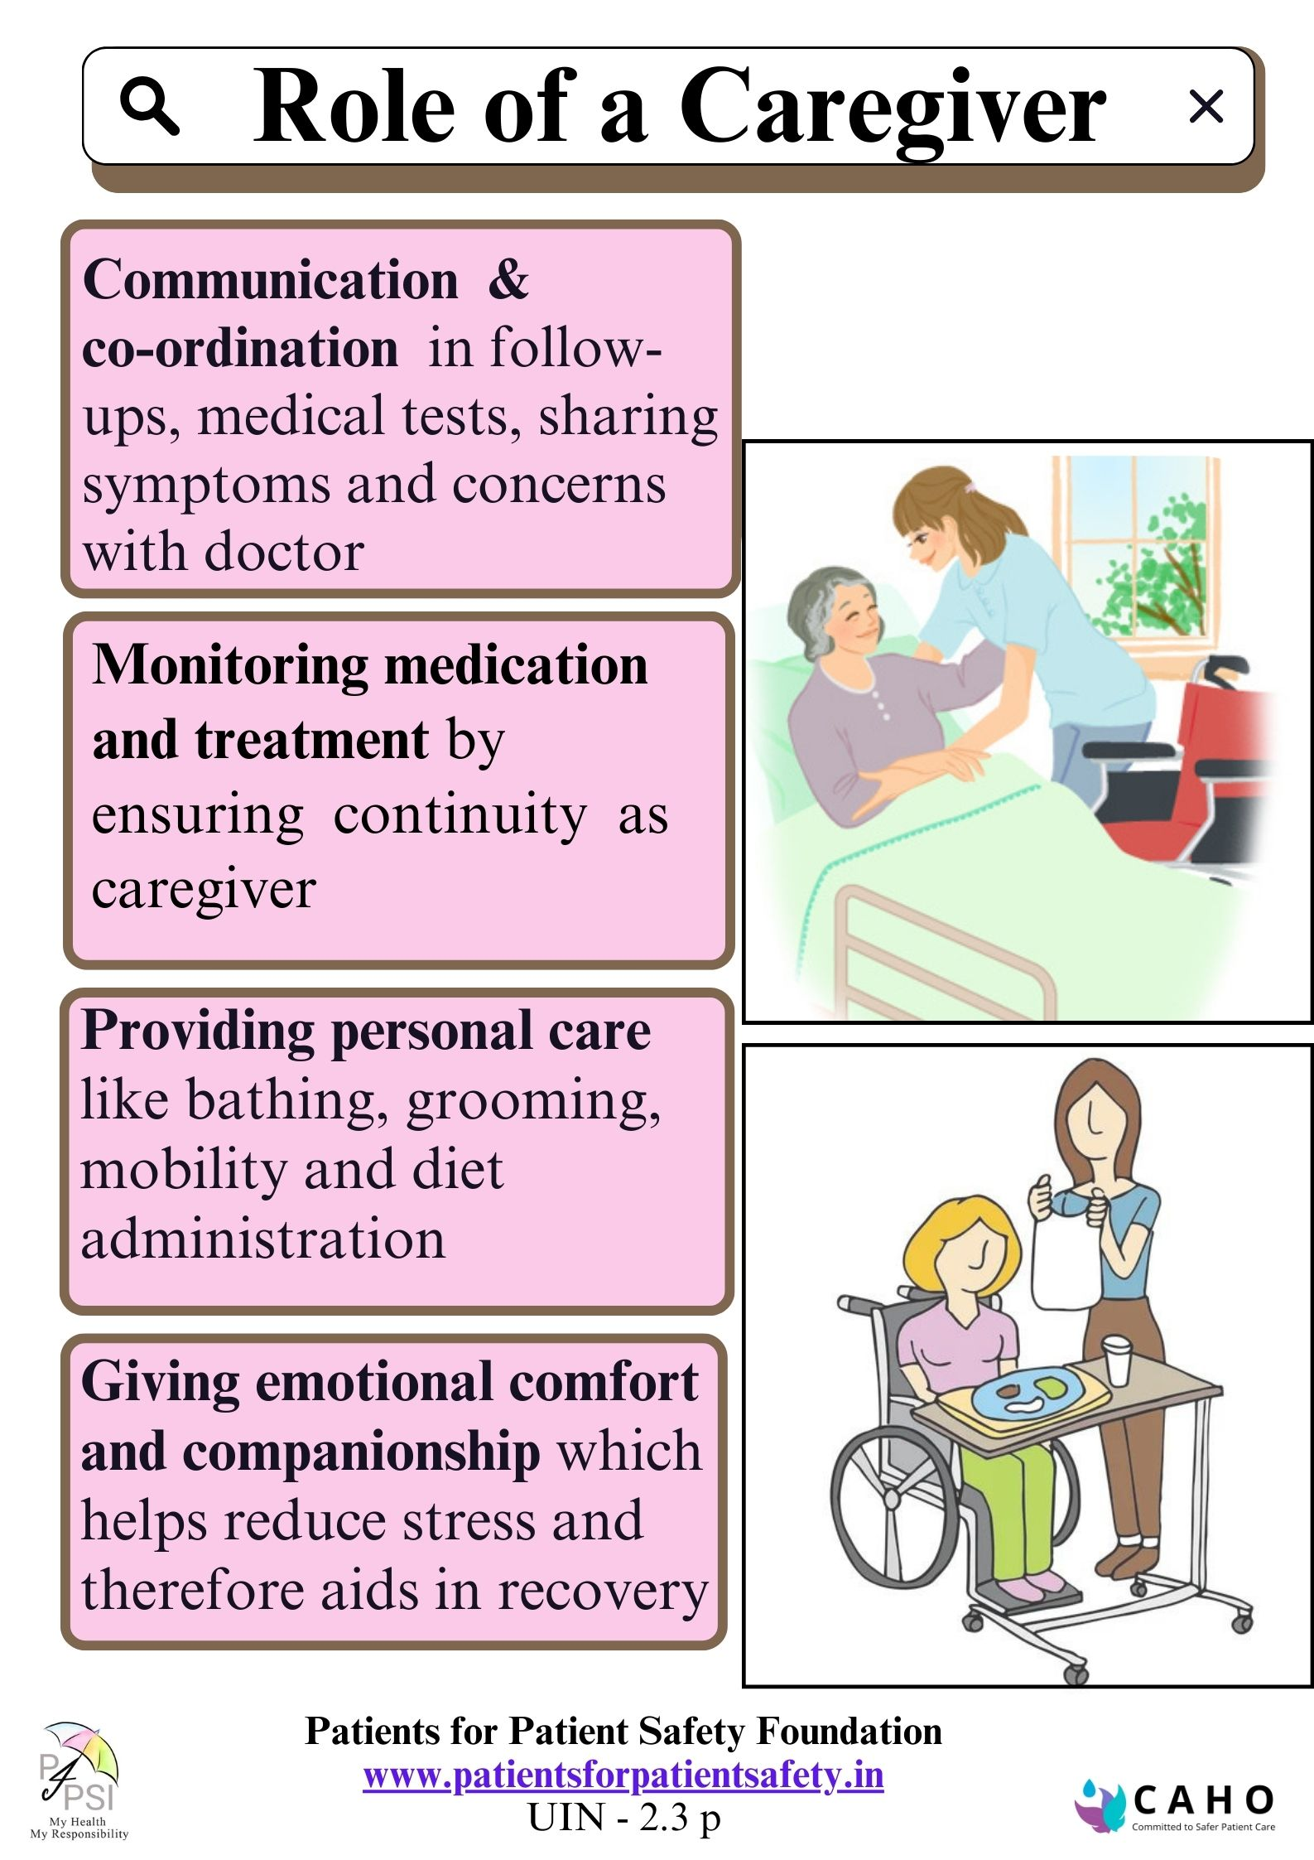
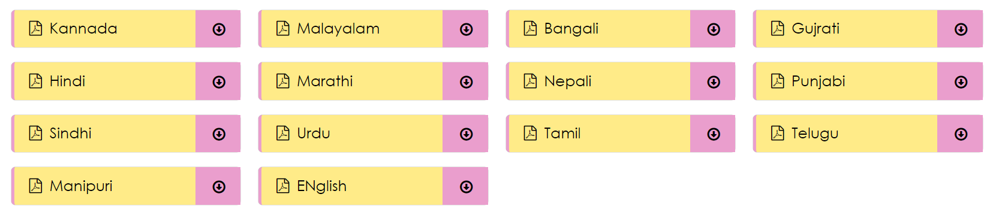
Patient Education Materials
Regional Language Translations are available on our websites

Slide 7




What Patients need from HCP
  Safe and Quality care without harm
  Clear and Effective Two-way Communication
  Response to Questions-WHAT &Why
  Receive Empathy, Respect, and Dignity
  Access to Information , Records, to help decide
  Coordination of care across specialties
  Patient Education, share best practices and advise for home-care

Slide 8










Advantages to HCP of Patient-Engagement
Early Detection & Prevention
Greater overall profitability
Better Outcomes & Reduced Medical errors
Increased Reputation
Improved Trust & Satisfaction
Improved Patient Loyalty & Referrals
Personal and Professional Fulfillment

Slide 9
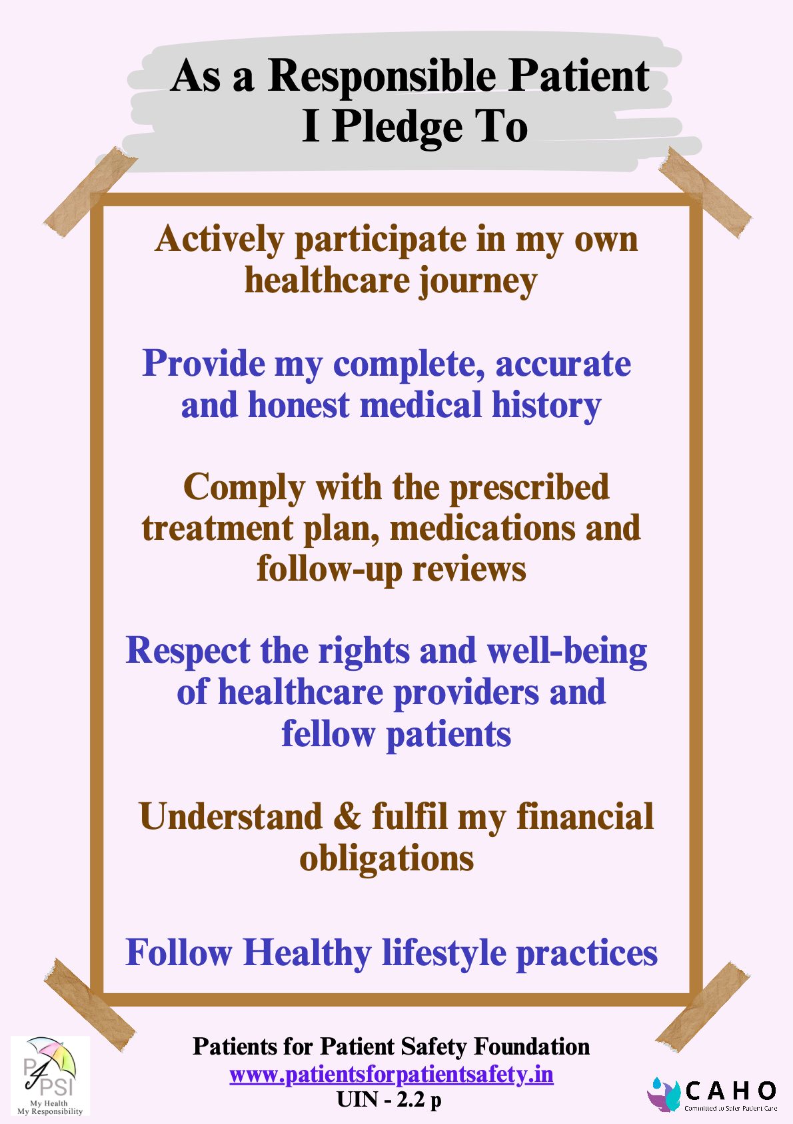
Partnership in safe care-take a pledge
www.patientsforpatientsafety.in

Slide 10
Patient Advisory Councils and Goals
Patient Advisory Council (PAC) is hospital sponsored boy of selected healthcare professionals, patients or caregivers who will collaborate to achieve the following goals:
Promote patient safety and reduce medical errors
Improve communication, collaboration of HCP & PC
Improve quality of care and patient satisfaction
Learning through patient experiences
Determine effective ways to educate Patient community

