Slide 1



Wrong Diagnosis, Wrong Treatment
Get it Right, Make it Safe
Patients for Patient Safety Foundation
Cyient Webinar - 27th September 2024

Slide 2


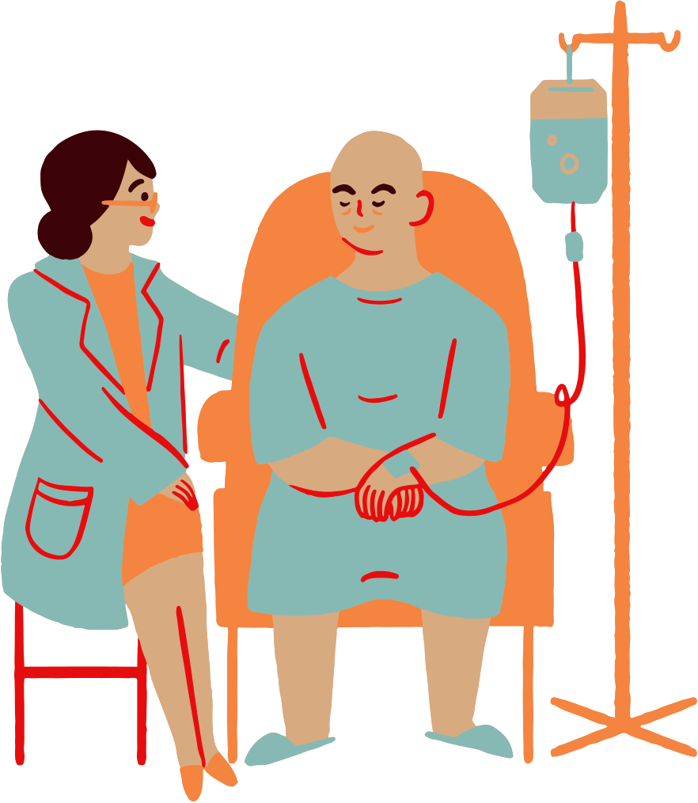




Medical Harm Happens - In Spite of Best Efforts
In OPD 4 out of 10 patients* are harmed due to missed/incorrect diagnoses, medication and prescriptions errors
1 in 10 patients* suffer harm during hospitalization
Medication Errors* constitute 50% of avoidable harm
Hospital Acquired Infections/ Transfusion/ Injection practices
and Many More
Unsafe Surgical Practices* cause
complications in 25% of patients
Lack of AWARENESS by Patients
Improper COMMUNICATION by Healthcare providers
Up to 50% of this avoidable harm can be prevented by us
*Source: WHO

Slide 3
Who Causes Medical Harm
At Hospital
At Home
Errors/Misses by Providers
Omissions by Patients
Patient & Caregivers
Medications Errors
Wrong Diagnosis
Surgical Mistake
Infections
Communication Errors
Ignore Symptoms
Late Presentation
Incomplete Info
Not being alert
Not asking questions
Lack of awareness
Lack of preparedness
Not following prescriptions
Self treatment
Missing clinical signs
Aware Patients/Caregivers can help Prevent Medical Harm

Slide 4
Errors in Patient Journey
Before, During & After Hospitalization
BEFORE Hospitalization:
Delay in reporting of symptoms,
Ignoring Diagnostic Tests
Preventive Health Checkup (Vaccination)
2. DURING Hospitalization:
Choice of hospital, taking second opinion
Medication Management
Infection control
3. AFTER Hospitalization:
Home care
Elderly care
Ignoring change in symptoms
Tracking Symptoms
Diagnosis
Treatment Options
Medication Management
Post Care Importance
Preventive
Choices

Slide 5
Causes of Diagnostic Errors
Missed Diagnosis: Condition not identified, inappropriate or no diagnostic tests resulting in no treatment.
Delayed Diagnosis: Significant time lag in diagnosis, worsening health.
Wrong or MisDiagnosis: Incorrect condition identified, leading to wrong treatment, causing harm and worsened patient situation
Technical Errors: Mistakes in diagnostic tests or procedures, including defective equipment or calibration issues , mix up in samples.
Communication errors, including misunderstandings between providers and patients or patient doubts about the diagnosis
Both Patients or Healthcare Professionals can be at fault, Errors can happen before, during and after treatment

Slide 6
Consequences of Diagnostic Errors
Wrong Diagnosis Wrong Treatment
Diagnostic errors can have significant consequences for patients, including physical harm, emotional distress, and financial burdens:
Delayed Treatment leading to Prolonged Suffering, worsening of patient condition, disability and even death
Wrong Treatment, worsening of condition, morbidity and mortality
Unnecessary Procedures leading to Increased Healthcare Costs
Loss of Trust in Healthcare and Psychological Impact on Patients

Slide 7
Fault is at both Ends
Oversights by Patients:
Incomplete or inaccurate sharing of medical history and symptoms.
Not following pre-test or post-test instructions properly, not taking tests.
Failure to ask questions about the purpose and necessity of tests.
Delayed follow-up on test results or missing follow-up appointments.
Reluctance to seek a second opinion when uncertain about the diagnosis.

Slide 8
Fault is at both Ends
Oversights by Healthcare and Diagnostic professionals:
Not capturing full history , inappropriate choice of tests
Incomplete communication between clinician and diagnostic professional or with patients
Incomplete information or implementation of pre test instructions
Calibration of apparatus, Method of taking tests
Reports not unclear, analysis before and after tests incomplete. Trend analysis missing
Patient identification goes wrong,mix up in samples

Slide 9

70% of clinical treatment decisions are based on diagnostic tests
Upto 20 % people suffered harm due to Poor Diagnosis
Healthcare
Patients in Healthcare Setting
Patients outside Healthcare Setting

Slide 10
Steps to Improve Diagnostic Safety
What Patients can do:
Provide complete medical history and describe your symptoms clearly.
Ask your healthcare provider about the purpose of the test—whether it's investigative, confirmatory, or to monitor a condition.
Follow pre-test and post-test instructions carefully, such as dietary restrictions or scheduling.
Keep a record and Track of your test results and ensure timely follow-up with your doctor to discuss them. Stay informed about your diagnostic options
Ask questions, Seek a second opinion if you're uncertain about the diagnosis or treatment.

Slide 11
Why Diagnostic Tests
1. To Determine focused treatment plan based on symptoms Open Investigation:
To explore unclear symptoms and gather detailed information.
To rule out multiple conditions, narrowing down real causes of the patient's symptoms.
Process of elimination of diseases , resulting in accurate treatment
2. To Confirm a Hypothesis or Diagnosis:
To confirm a suspected diagnosis after initial evaluations.
To provide definitive evidence that supports the healthcare provider's diagnosis /hypothesis.
3. To Monitor Progress of a Condition or Treatment:
To track how a patient is responding to treatment or managing a chronic condition.
Help healthcare providers adjust treatments based on progress and detect complications early.

Slide 12
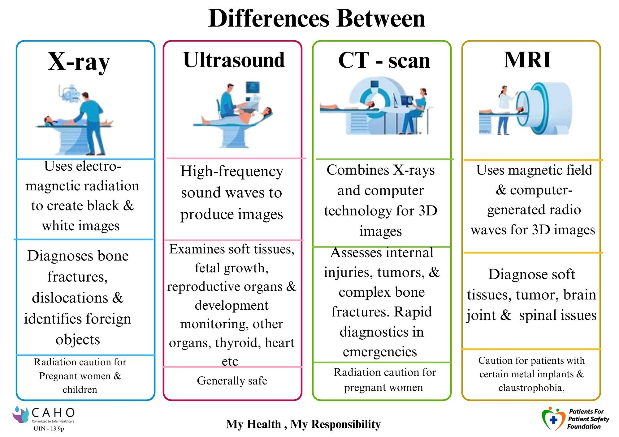
Power of Imaging Tests

Slide 13



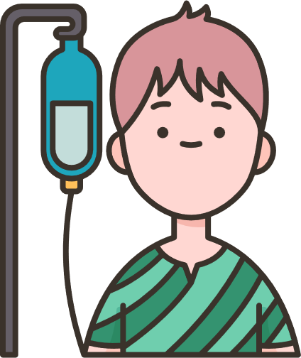
Role of PFPSF in Patient Safety
Spreads awareness on Definition, Symptoms for Early Detection of possible Harm
Shares knowledge about Risks, Causes & Consequences of Medical harm
Provides Actionable tips for Self Protection,
and Prevention
Guides on the Role that Patients/Caregivers can play throughout their Patient Journey
PFPSF is a non- profit Trust, promoted by CAHO.
PFPSF content is aggregated from world renowned experts and vetted by domain specialists, makes us Trustworthy - no commercials associated

Slide 14
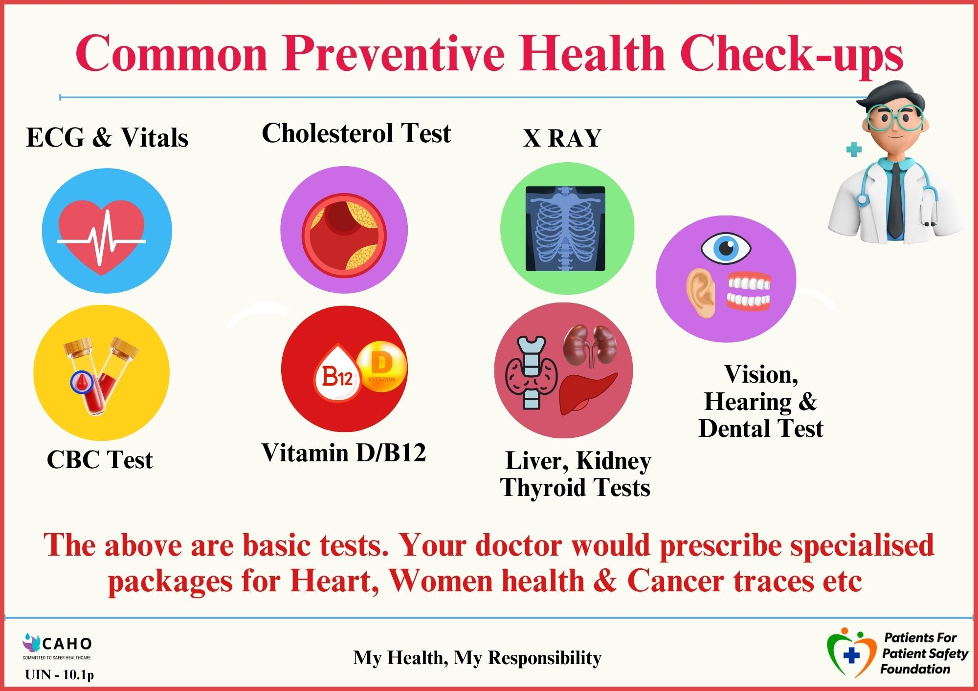
Prevention is Better than Cure

Slide 15
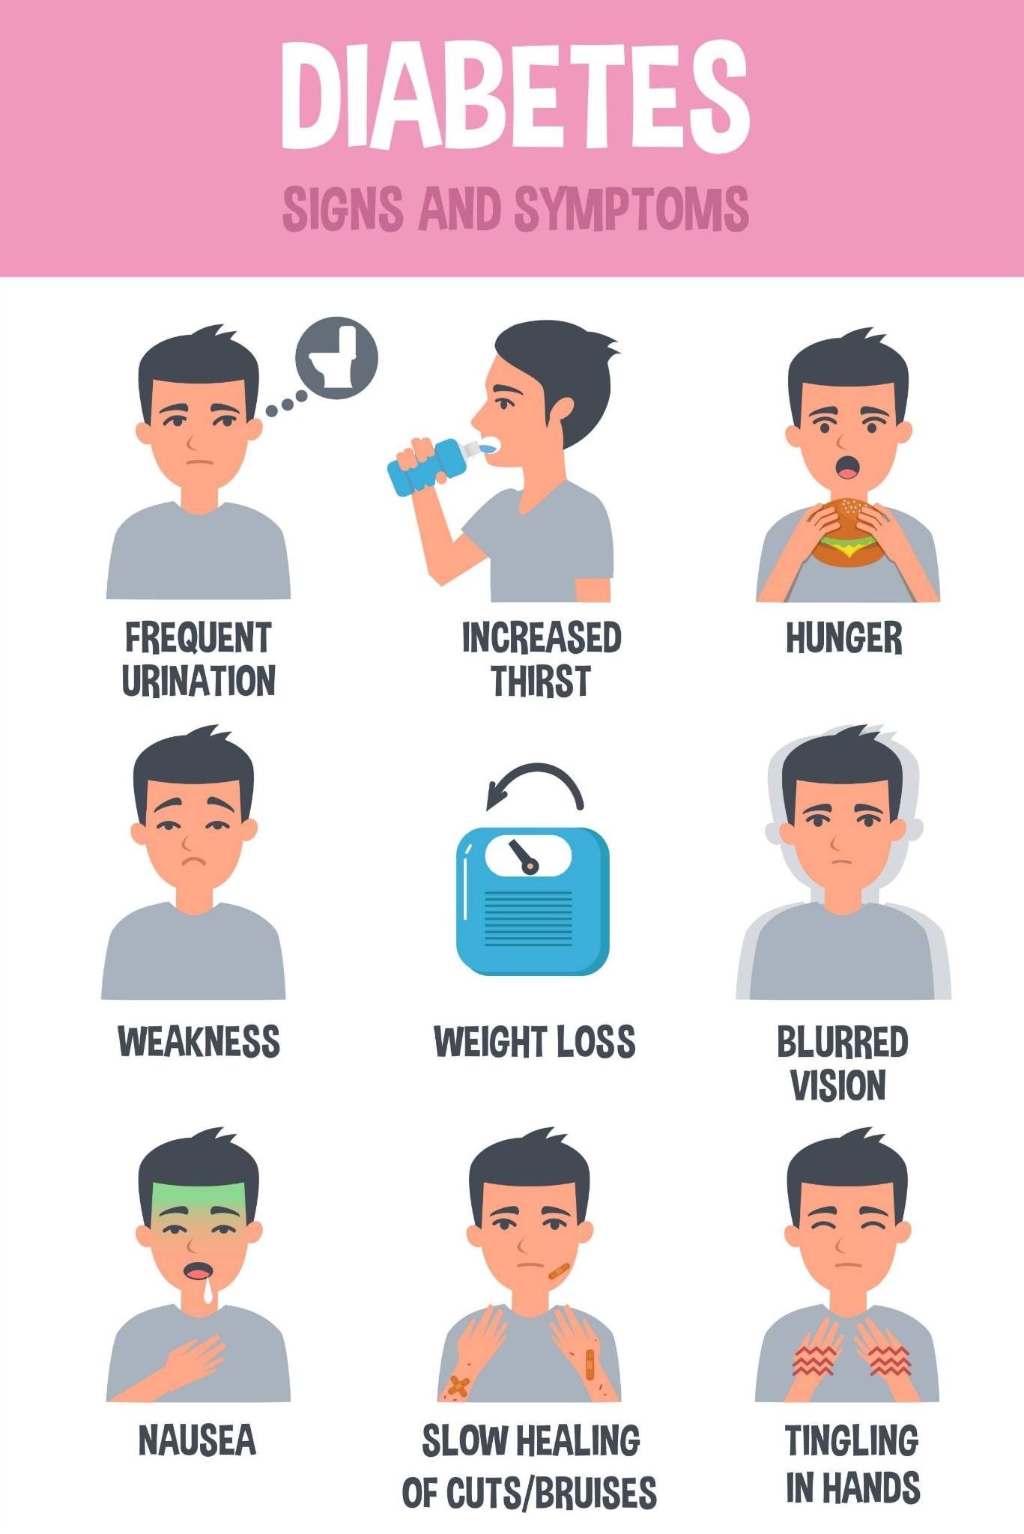
Diabetes Trends in India
Symptoms
1 in 3* have pre diabetes
1 in 4* have diabetes
1 in 10* have uncontrolled diabetes
Diabetes is silent, symptoms show later
Serious complications, controllable if detected early
*Source: Apollo Hospitals

Slide 16
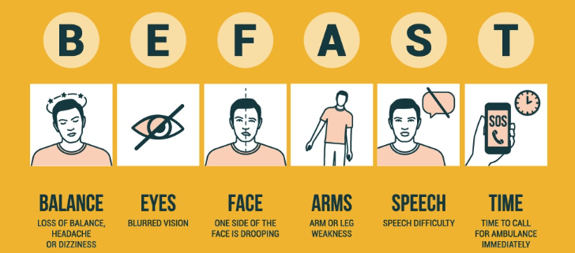
Stroke : Symptoms : Detection
Source: Semmes Murphy
Any One or Many - Condition Deteriorates Rapidly

Slide 17
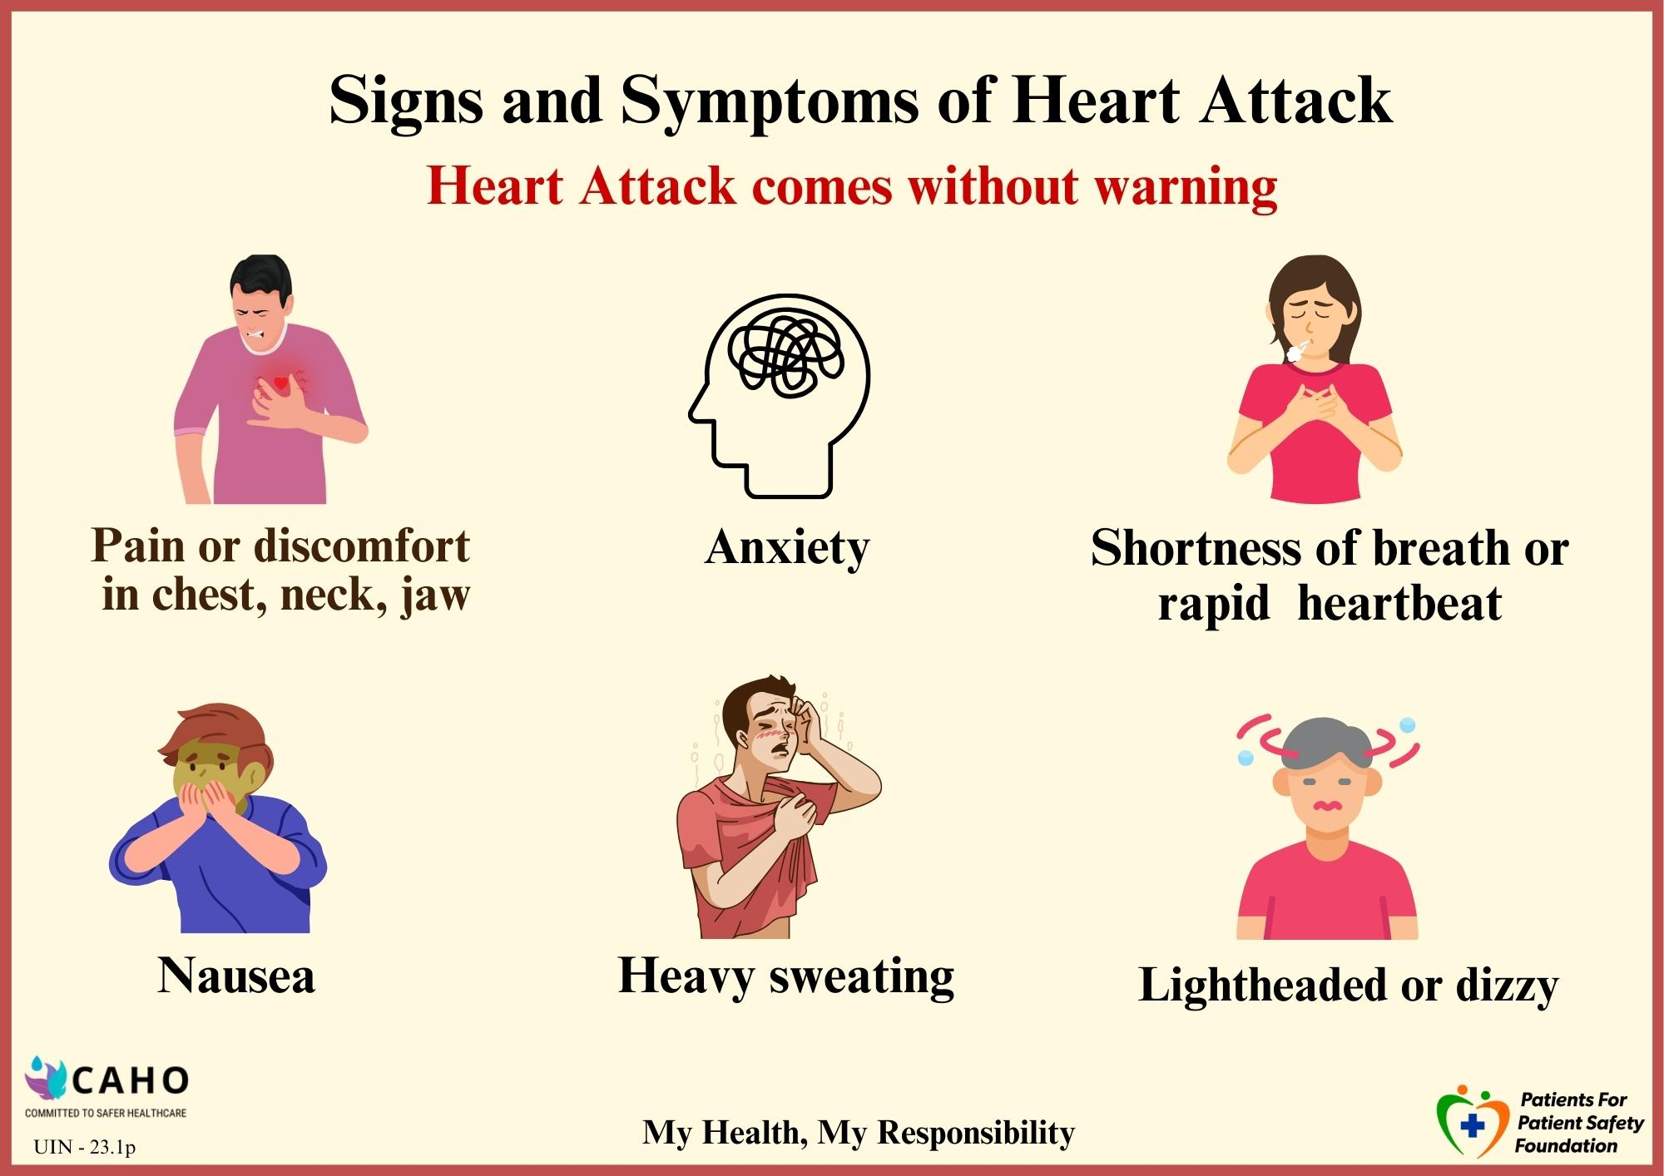
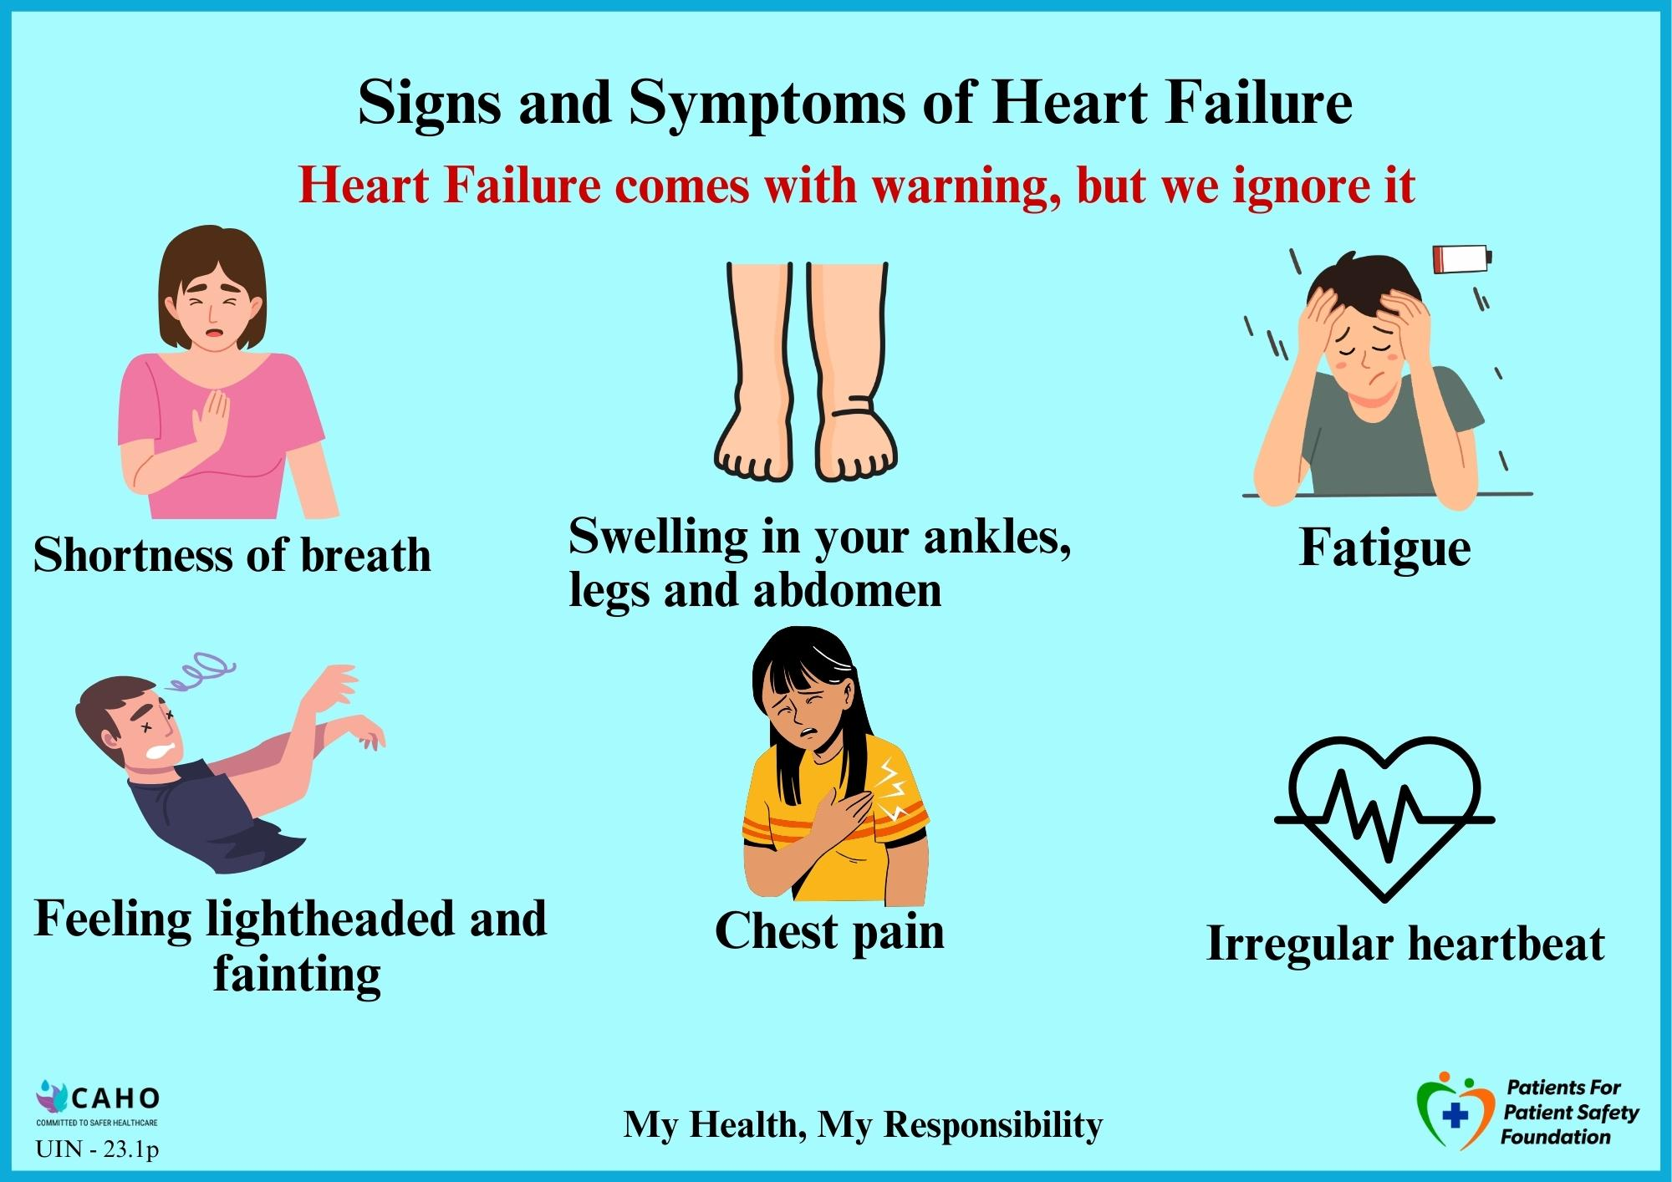
Heart Attack vs Heart Failure
Listen to your body

Slide 18
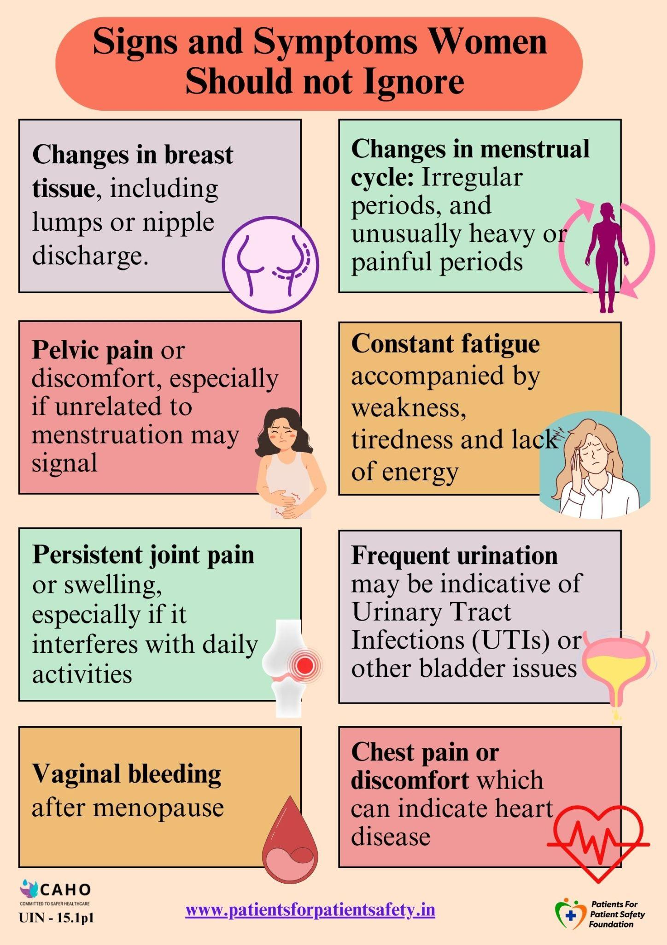

Prioritize Women’s Health

Slide 19
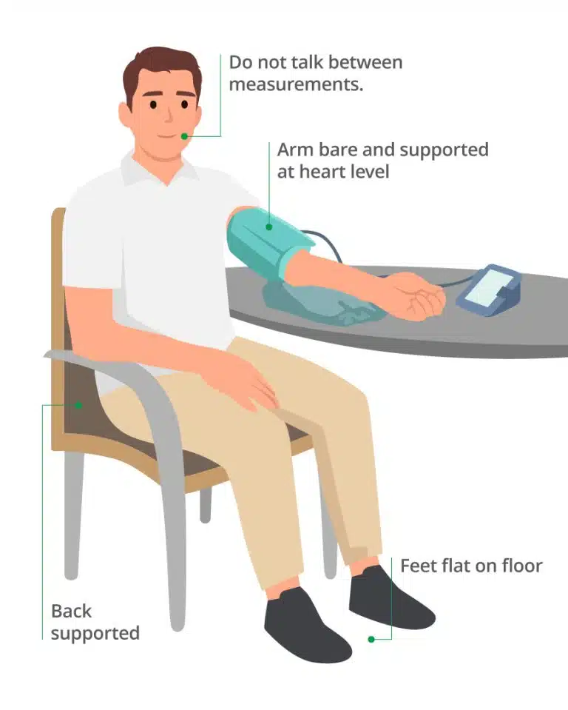
Measuring BP at home
Mistakes we make while measuring BP:
Incorrect Cuff Placement or Size
Improper Body Position
Not Resting Before Measurement
Talking or Moving During Measurement
Errors in Instruments- calibration

Slide 20
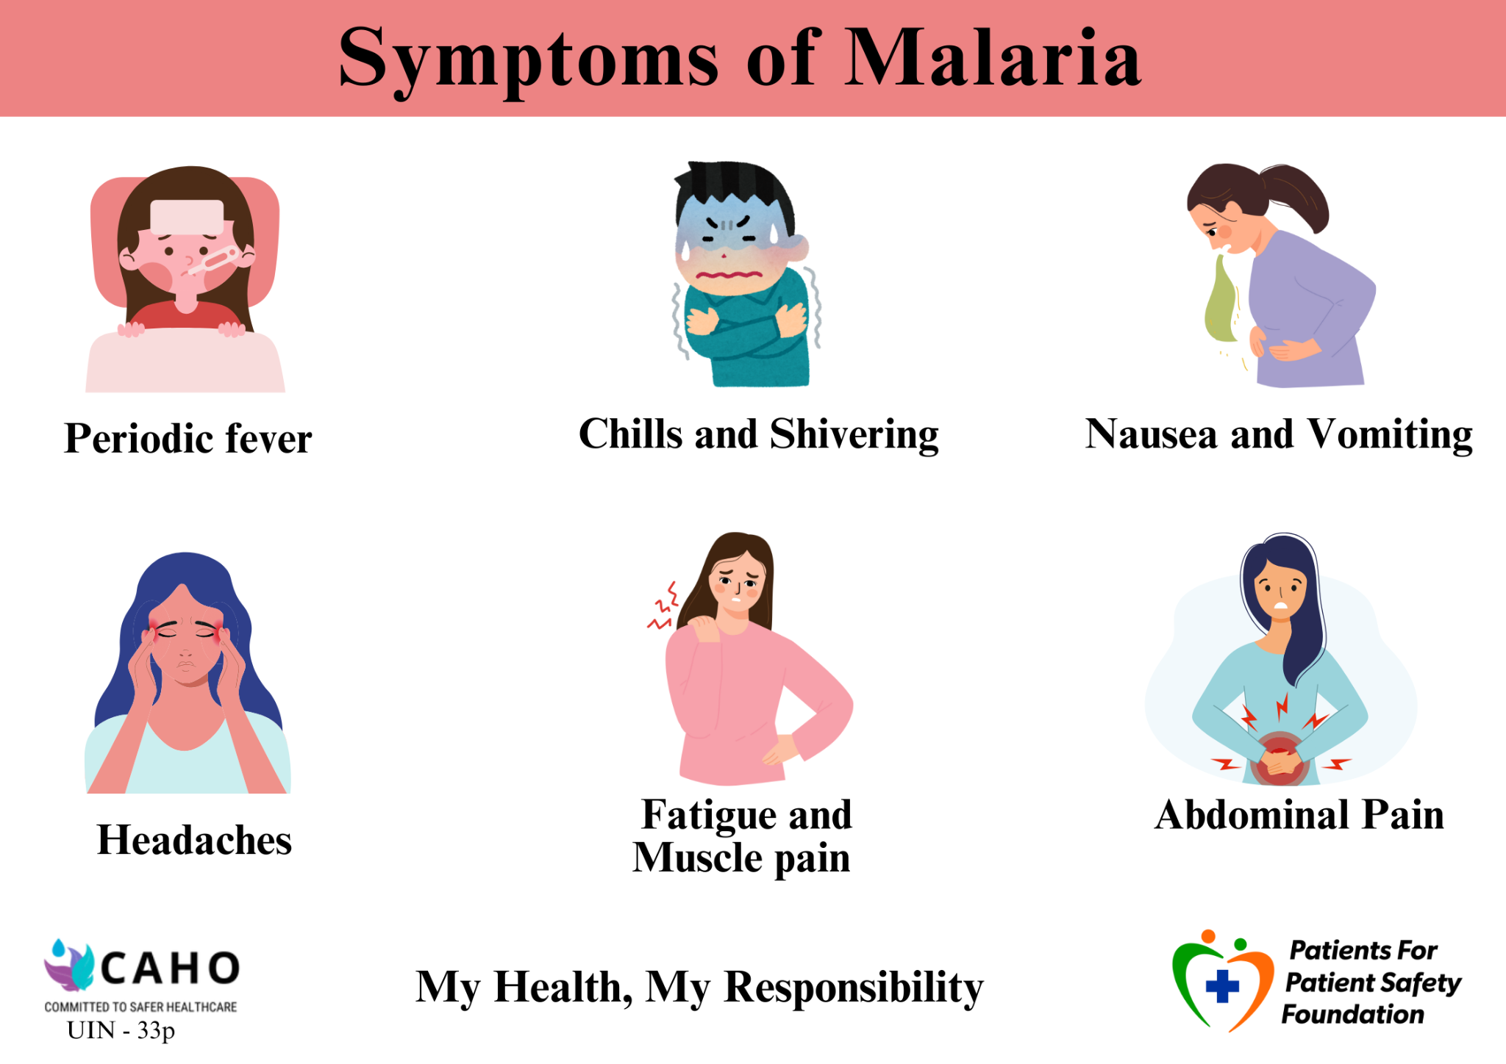
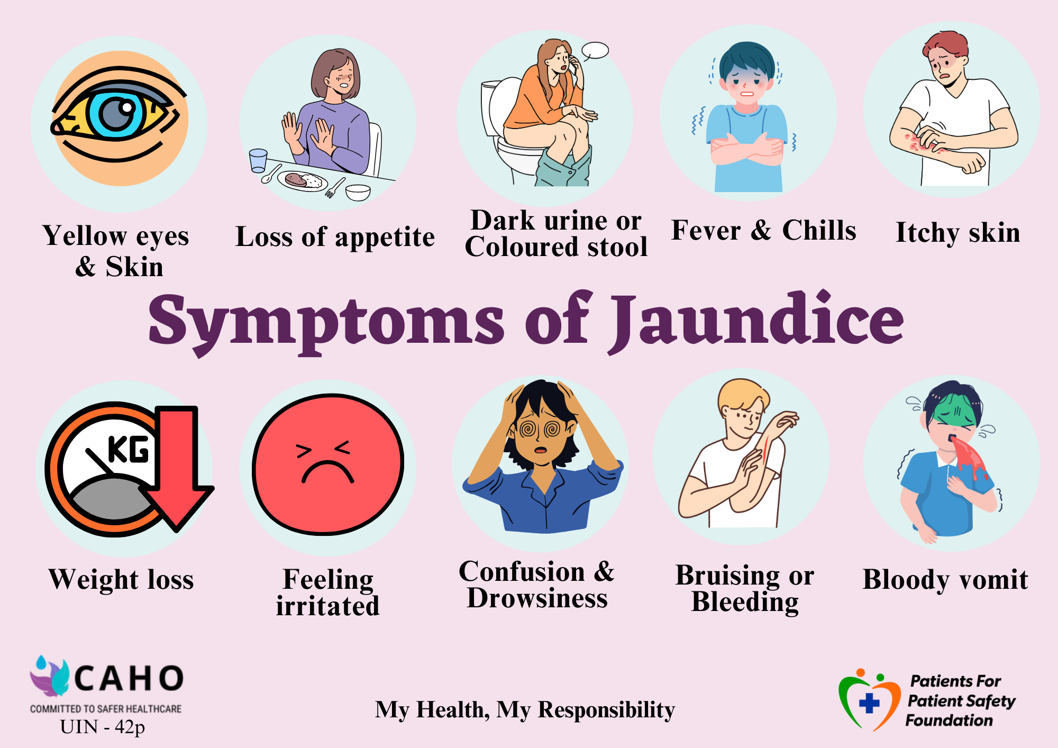
Communicable Diseases

Slide 21







Patients and Caregivers can help get safer outcomes
Keeping Track
of Symptoms
Providing Complete Information
Keeping Updated Medical Records
Being Alert - Asking Questions
Following Prescriptions/ Advise
Getting a Second
Opinion
Provide
Valuable Feedback

Slide 22
Stages of Patient Engagement, Feedback
At every Touch Point in OPD, IPD ,there is a Role for HCPs, Role for Patients.
Patient Feedback and Patient Education help to avoid potential Errors by Patients.
Before seeking the first appointment and prior to the doctor's consultation
Registration & Billing
Navigation in Hospital
OPD Consultation
Diagnostic tests followed by consultation
Admission and stay in hospital (IP)
Insurance - TPA
Pre & Post Surgery
Discharge and Transition to Home Care
Feedback

Slide 23
Conclusion "Get it Right, Make it Safe”
Improving diagnostic safety requires collaboration among healthcare providers, diagnostic professionals, patients, and caregivers. By understanding diagnostic safety, identifying errors, and taking action, we can ensure safer healthcare.
Advice to Patients
GET INVOLVED, BECOME AWARE, ASK QUESTIONS
My Health My Responsibility
A well informed patient will be conscious about possible risks, watchful of symptoms, communicate clearly with health care provider and act/respond quickly

Slide 24



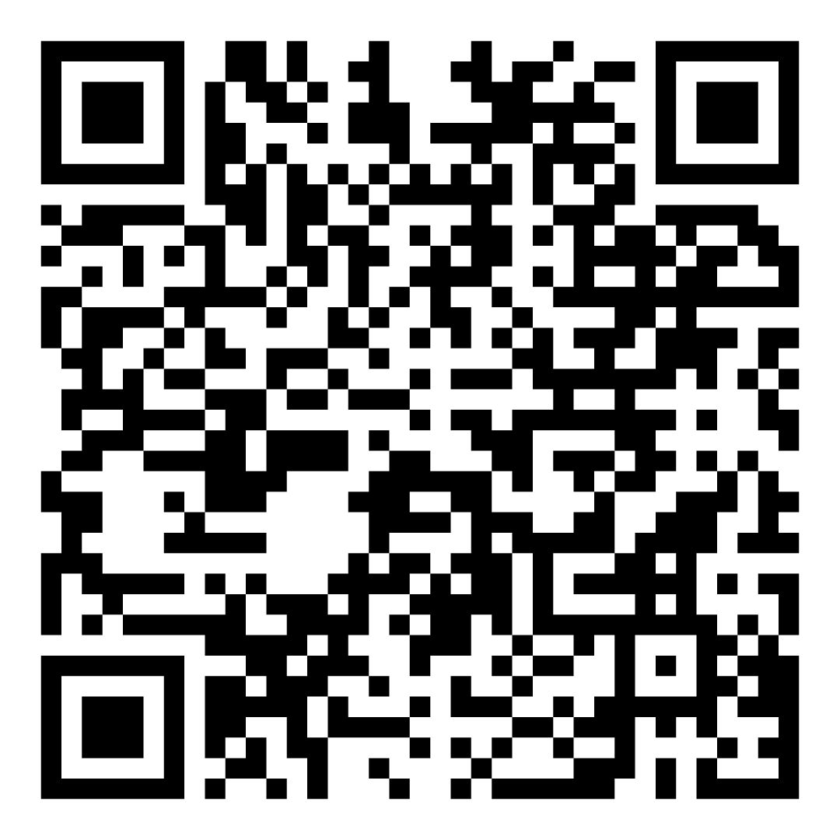
Scan to leverage Patient Education Material
Patients for Patient Safety Foundation
Health Library
Infographics
Subscribe here
Newsletters

Slide 25





Save yourself & your family from medical harm
Ask Questions, Send feedback@
info@patientsforpatientsafety.in
Explore our website: www.patientsforpatientsafety.in
Subscribe to our Newsletters: https://www.patientsforpatientsafety.in/subscribe-us.php
My Health, My Responsibility
PFPSF-india
patientsforpatientsafety
pfpsfindia
patientsafety22
+919289696709

