Slide 1


A Pre read -
How to Reach Patients
CAHO@Bangkok
Session on 19th July 2024. 3 pm to 3.45 pm
Moderators
Dr V Thulli, Dr Gracy Mathai, Mr Som Mittal
Scribe - Ms Nadira Chaturvedi
Patients for Patient Safety Foundation

Slide 2

CAHO wants to build Patient Provider Partnerships
Collaboration between PATIENTS with HOSPITALS and HCP
1. Patient Engagement with Patient Education in OPD, IPD, Labs, Pharmacies
2. Introducing Voice of Patient- sharing Patient Experience
3. Patient and Family Advisory Councils in hospitals PAC
HOW to leverage this for higher safety and better quality of outcomes:
Trainings of Staff
Research Projects PREM, PROM
Promoting Patient centricity in Health care settings

Slide 3
What is Patients For Patient Safety Foundation
We are sponsored by CAHO and backed by over 400 hospitals and diagnostic centers in India. Started in 2021
While CAHO works with Providers of care, PFPSF addresses Receivers of care
Patients for Patient Safety Foundation (PFPSF) is a non-profit independent Trust which aims to enhance patient safety and reduce medical harm that happens before, during or after treatment by involving patients/families and caregivers themselves. We do this with Patient Education and Patient Engagement.

Slide 4

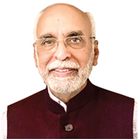

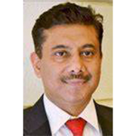
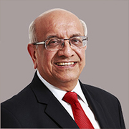

Board of Trustees
Dr. Anuradha Pichumani Executive Director- Sree Renga Hospital
Regulator Quality and Healthcare Standards
Dr. Vijay Agarwal
President – CAHO
Healthcare Advisor
Dr. Lallu Joseph
Secretary General – CAHO
Healthcare Administrator
Dr. BK Rana
Founder CEO – QAI
Quality and Accreditation Expert
Mr. Som Mittal
Chairperson – PFPSF
Management Advisor
Ms. Nadira Chaturvedi
Co-Chairperson – PFPSF
Academician, Social Entrepreneur and Management Consultant
Board Members

Slide 5
Governance
Managed through a non-profit independent registered Trust
We are governed by Trust by-laws, with a Board of Trustees and Advisory Councils
A Screening Committee of experts verifies content
We are led by the Ministry of Health, Govt. of India and WHO guidelines
We respect the knowledge, experience & judgment of healthcare providers
We do not prescribe, endorse, or deliver any medical services
This is not a grievance forum for the resolution of individual patient incident complaints, claims
All sources of patient or hospital-specific information are kept confidential and anonymized

Slide 6

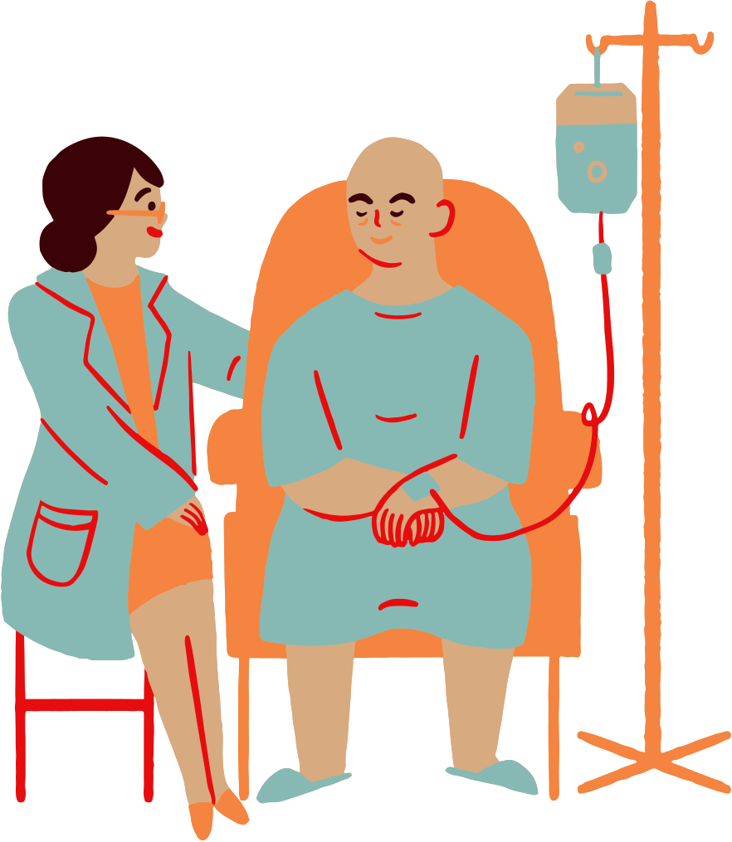
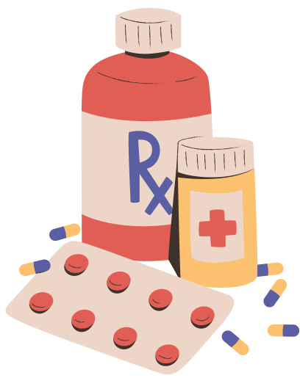
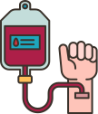

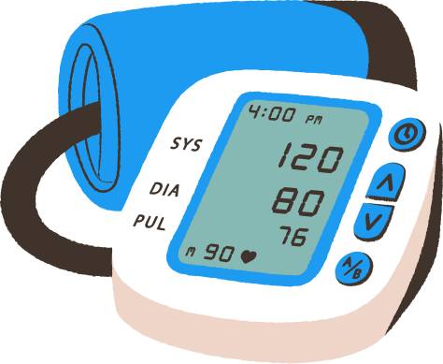
Harm happens inspite of best efforts
1 in 10 patients suffer harm during hospitalization
In OPD 4 out of 10 patients are harmed due to missed/incorrect diagnoses, medication and prescriptions errors
Medication Errors constitute 50% of avoidable harm
Unsafe Transfusion/ Injection practices can transmit infections such as HIV and Hepatitis
Unsafe Surgical Practices cause
complications in 25% of patients
Other causes include Hospital Acquired Infections, Sepsis, Blood clots, Radiation errors, Fragmented care settings-change in doctors, hospitals, or transition to home care
Inadequate cleaning, sterilization/ calibration can lead to Medical Device errors
Proper AWARENESS and better COMMUNICATION with Patients/Caregivers can improve Patient Safety
*Source: WHO

Slide 7
Who is responsible for Medical Harm
At Hospital
At Home
Errors/Misses by Providers
Omissions by Patients
Patient & Caregivers
Medications Errors
Wrong Diagnosis
Surgical Mistakes
Infections
Communication Errors
Ignore Symptoms
Late Presentation
Incomplete Info
Not being alert
Not asking questions
Lack of awareness
Lack of preparedness
Not following prescriptions
Self treatment
missing clinical signs
Patient Harm is caused due to ignorance of patients and non-involvement

Slide 8

Concerns Patients Have
How do I know if my symptoms are serious enough?
How do I know its an Emergency and how should I respond?
Is my diagnosis
correct?
Shall I take a second opinion?
When & How?
How can I prevent falls at home?
Is the diagnostic test prescribed necessary?
Why do Adults need Vaccination?
What are my rights as a patient?

Slide 9



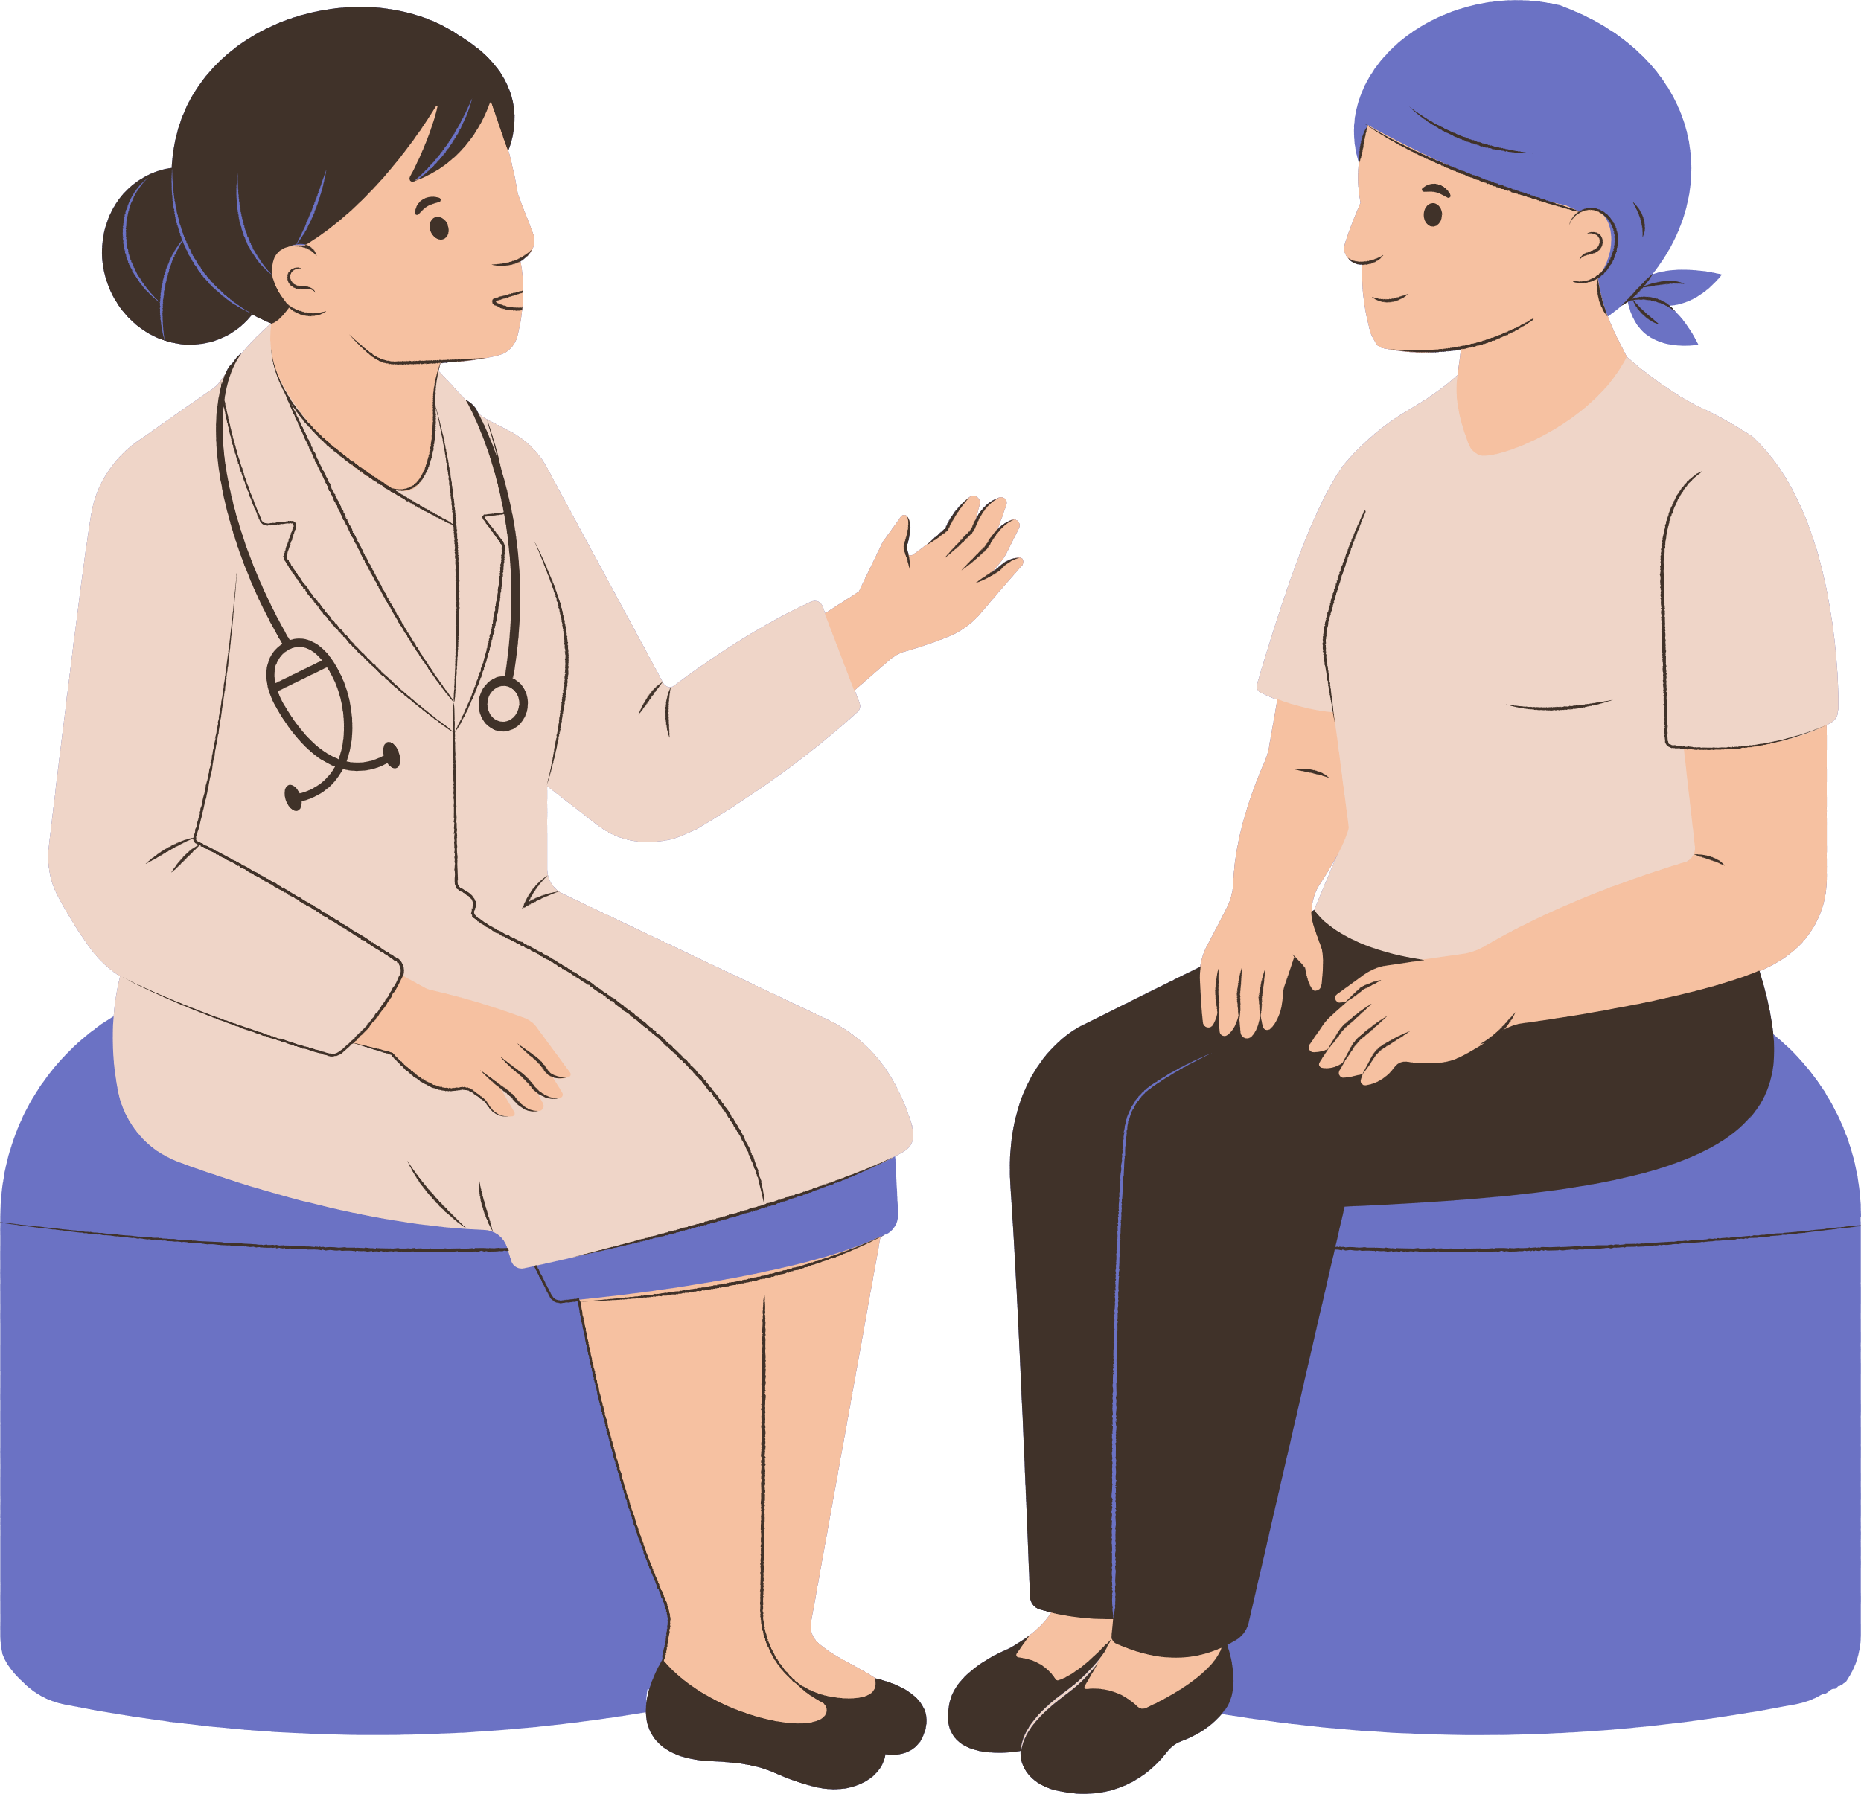



Expectations of Patients
Safe and Quick Recovery
Clear and Effective Two-way Communication
Receive Empathy, Respect, and Dignity
Encourage Questions & Respond
Access to Information
to help decide
Coordination of care across specialties
Transparent & Consistent billing - faster discharge

Slide 10

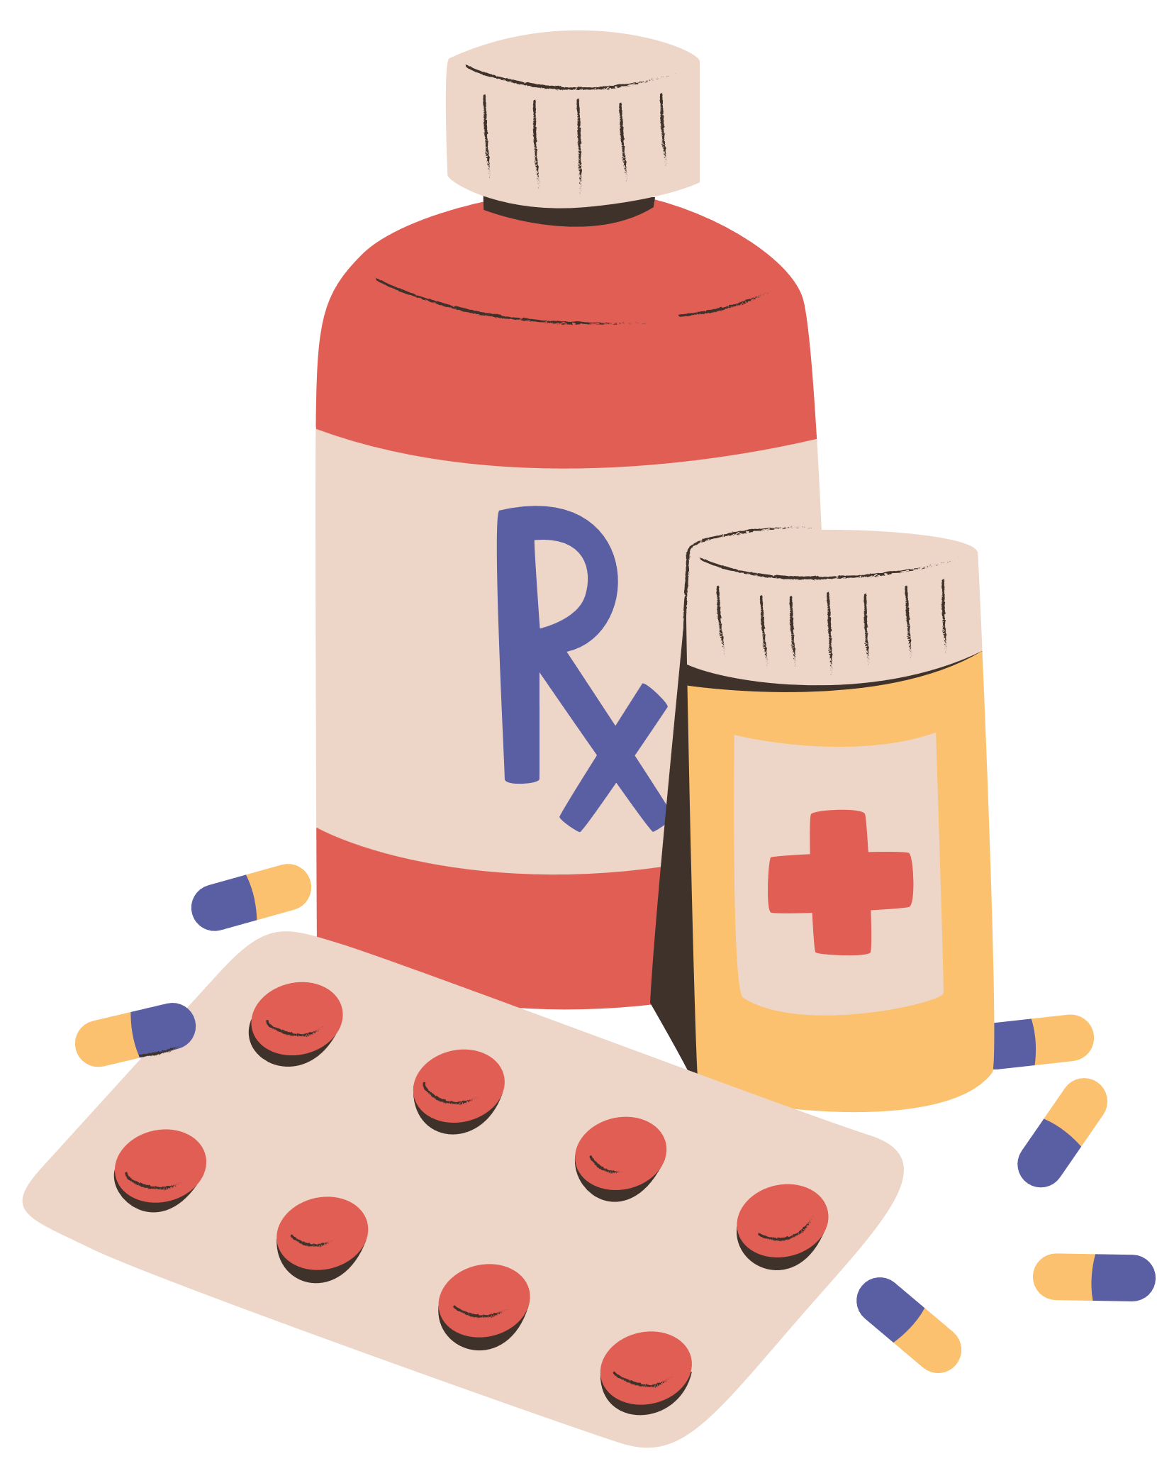

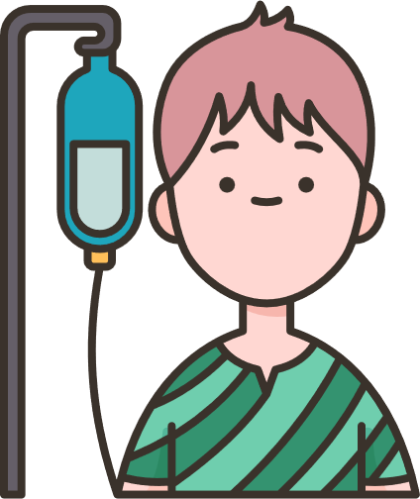
Our goal is to empower patients to engage in own care
Spread awareness on Definition, Symptoms for Early Detection of possible Harm
Know Risks, Causes & Consequences of Medical harm
Provide Actionable tips for Self Protection,
and Prevention
Guidance on the Role that Patients/Caregivers can play throughout their Patient Journey
Our content is aggregated from world renowned experts and vetted by domain specialists

Slide 11





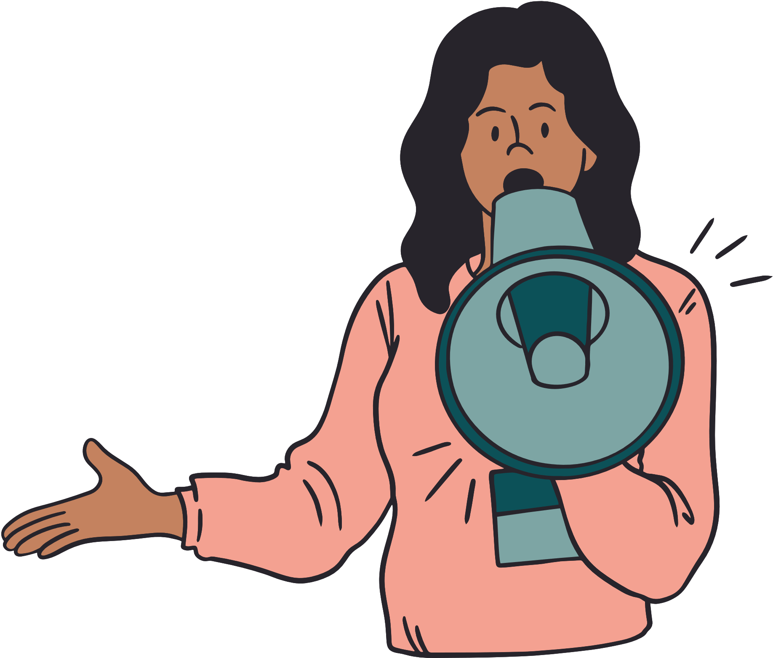

How Patients and Caregivers contribute to safer outcomes
Providing Complete Information
Being Alert - Asking Questions
Following Prescriptions/ Advise
Keeping Track
of Symptoms
Build trust
& provide
Valuable Feedback
Getting a Second
Opinion
Keeping Updated Medical Records

Slide 12









Benefits of Patient Engagement to Healthcare Providers
Early Detection & Prevention
Greater overall profitability
Better Outcomes & Reduced Medical errors
Increased Reputation
Improved Trust & Satisfaction
Improved Patient Loyalty & Referrals
Personal and Professional Fulfillment

Slide 13
Why is PFPSF Content Trustworthy
CAHO gives us access to Best Doctors and Best Hospitals in the country
Research Aggregated from Global & National Healthcare resources and screened by Senior Medical Subject Matter Experts
Customized for Indian context, simple, easy to understand in English, Hindi and Regional languages
Free of charge - available in text, graphical, video, audio-visual and
Accessible on Website, Emails, Social Media, WhatsApp, Webinar and Conferences

Slide 14
Collaboration for Outreach & Knowledge
Hospitals, HCP, Labs, Pharmacies
Share Outreach our PEd material to patients, caregivers, families , staff, communities and networks
Digital /physical display PEd posters, videos in common areas, IP, OPD, diagnostic labs, canteen, and pharmacy
Trainings of nurses, para medics, patient interface, floor and admin officers
Share Best Practices for safe and quality care with patients
Medical and MHA colleges
Students- Elective course in patient safety and Patient Centricity in all care settings
Alumni- Outreach our PEd material welfare of their staff, employees and families and networks
Staff - Outreach our PEd material to their families and networks

Slide 15
Our Existing Outreach Model
Collaboration with Corporates, Civic bodies, NGOs
Sharing Patient Education Material to employees families , staff, vendors and their networks
Digital /physical display of posters, videos in common areas, like canteen, first aid room, waiting rooms
Webinars on periodic basis
Outreach to Unknown audiences
Website has repository of Health Library, topics in form of text, and posters.
Regional language translations
Videos, and infographics for easy understanding
FAQs answered along the Patient Journey
Social media (just started)

Slide 16
Our topics cover Patient Journey -
Before, During & After Hospitalization
Some Examples:
Communication with doctors, aiding better diagnosis
Medication safety, purchase, storage, ingestion
Preventing Falls, Injuries, Infections -at Home and Hospitals
Choosing the Right Hospitals being prepared for Emergencies in advance
Disease specific information on Contagious or Non-contagious or Disease Agnostic issues like procedures
Multiple formats - Text, Graphics, Audio-visual, Audios, PPTs
Accessible thru Website, Emails, Social Media & WhatsApp

Slide 17
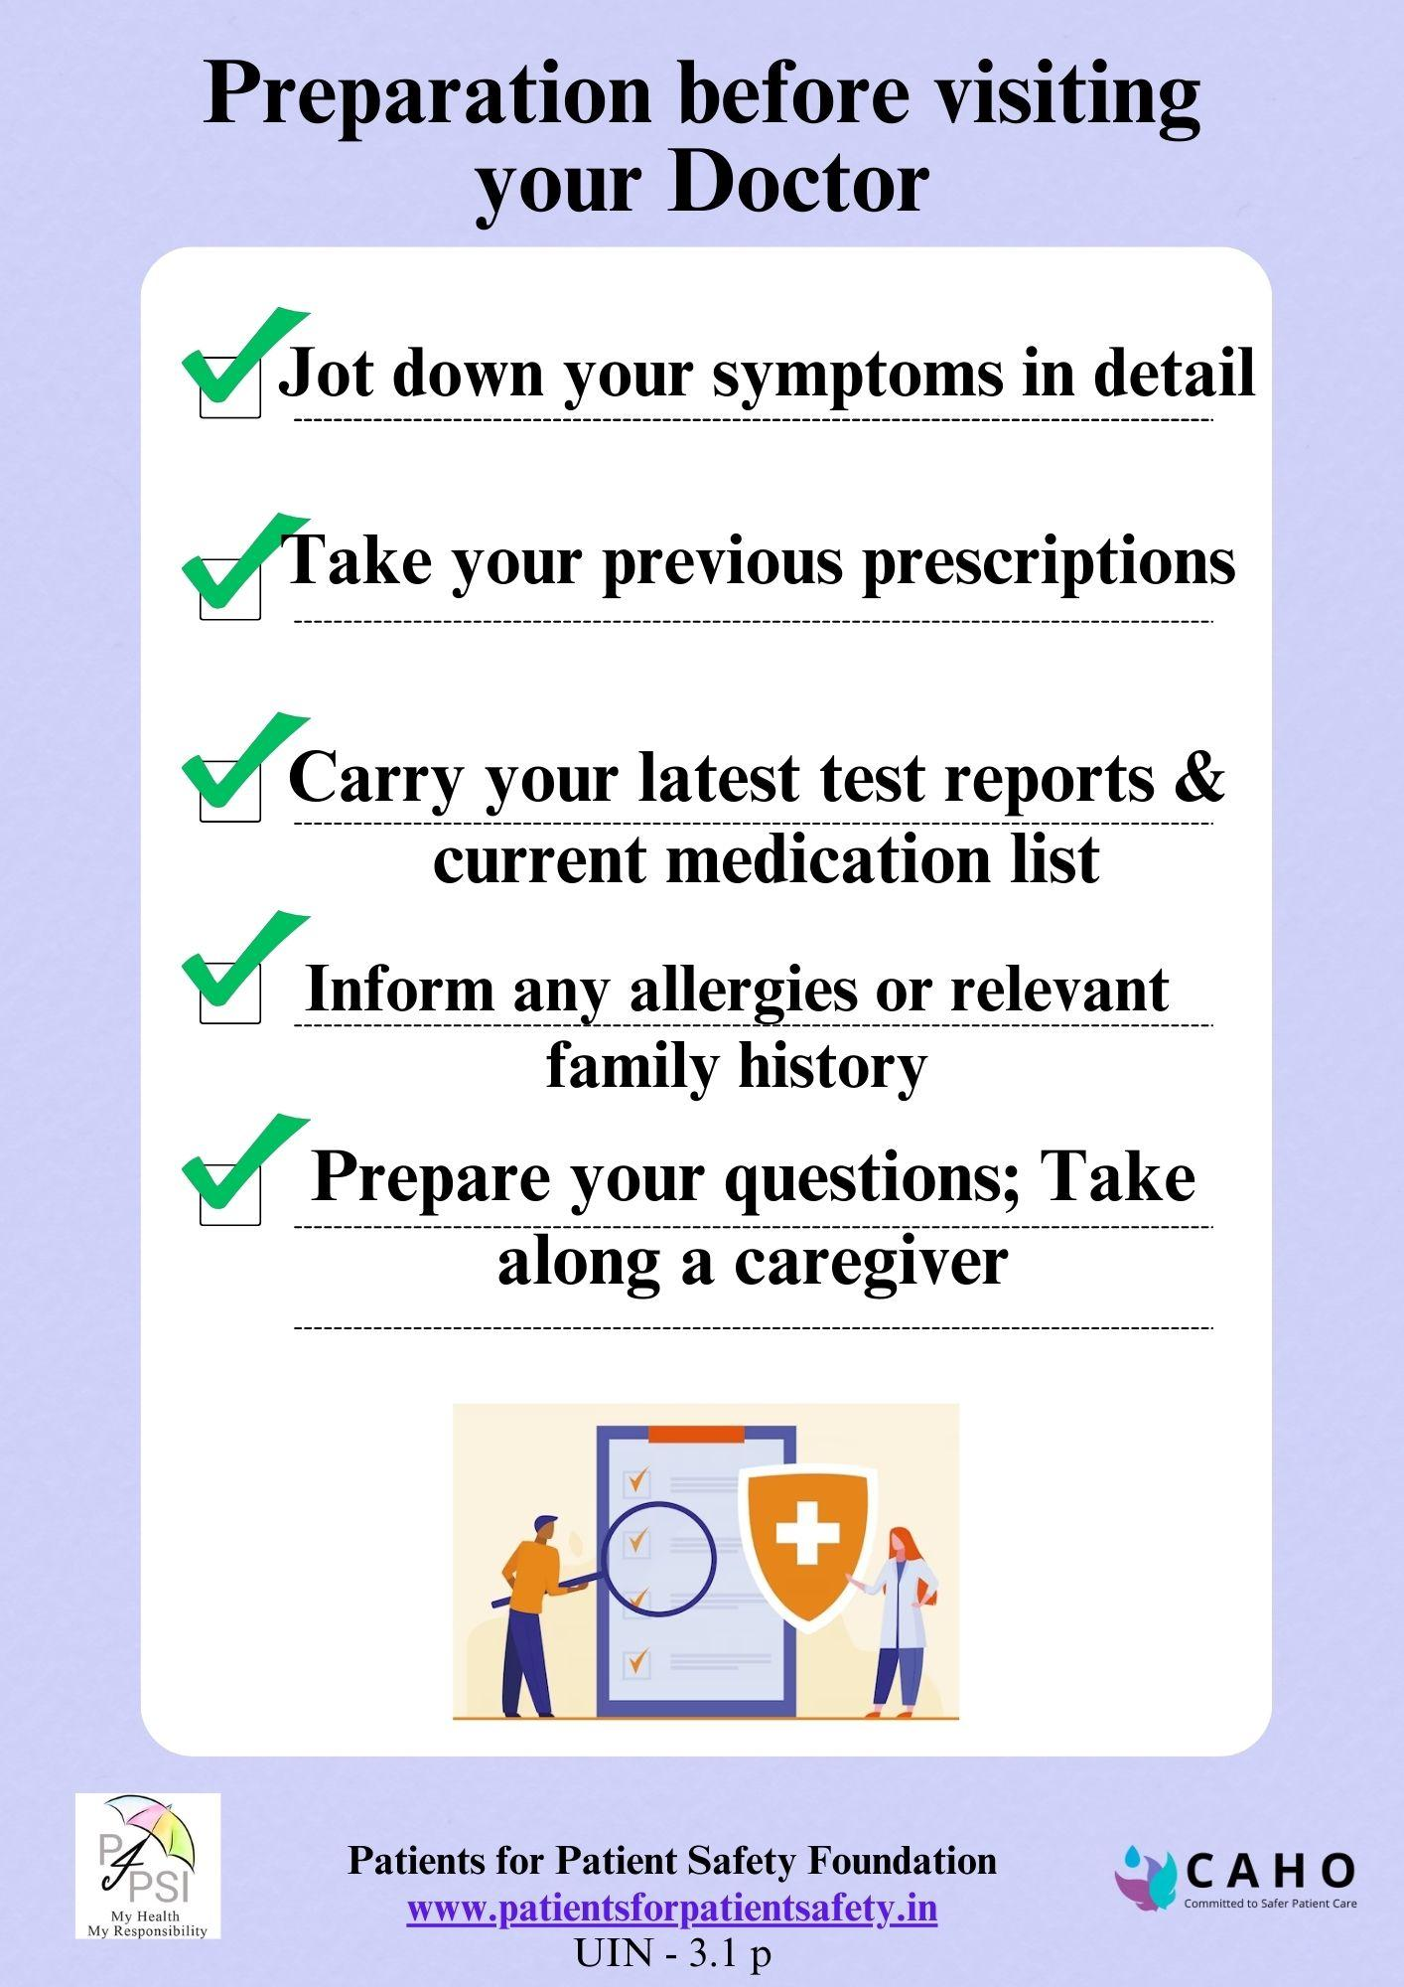
Example 1
Did you Prepare before meeting a doctor?
Due to stress, we forgot to inquire about important matters.
We forgot to mention symptoms.
We forgot to bring previous reports.
We spent a lot of time searching for the latest report.
We were unable to absorb all the information.
We were unsatisfied with the appointment.
They did not inform us about other medicines.

Slide 18
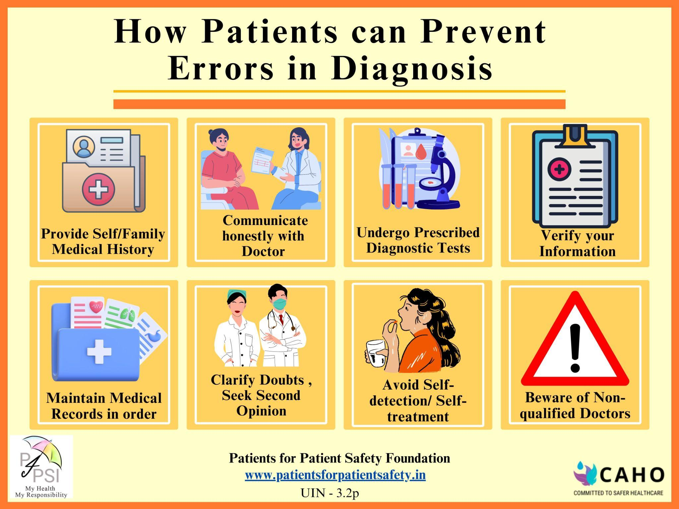
Can Patients prevent Diagnostic Errors
Example 2
Diagnostic errors can lead to:
Delayed or incorrect treatment
Progression of diseases
Prolonged suffering
Contribution to medical complications
Additional tests

Slide 19
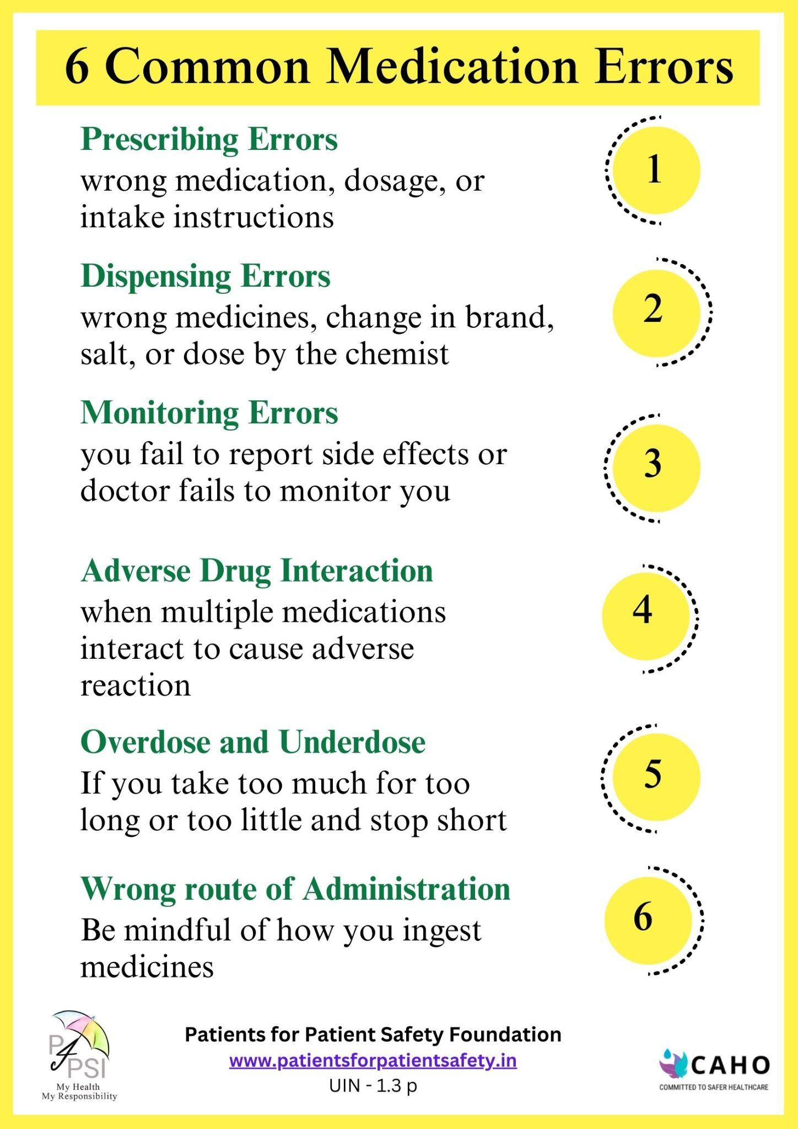
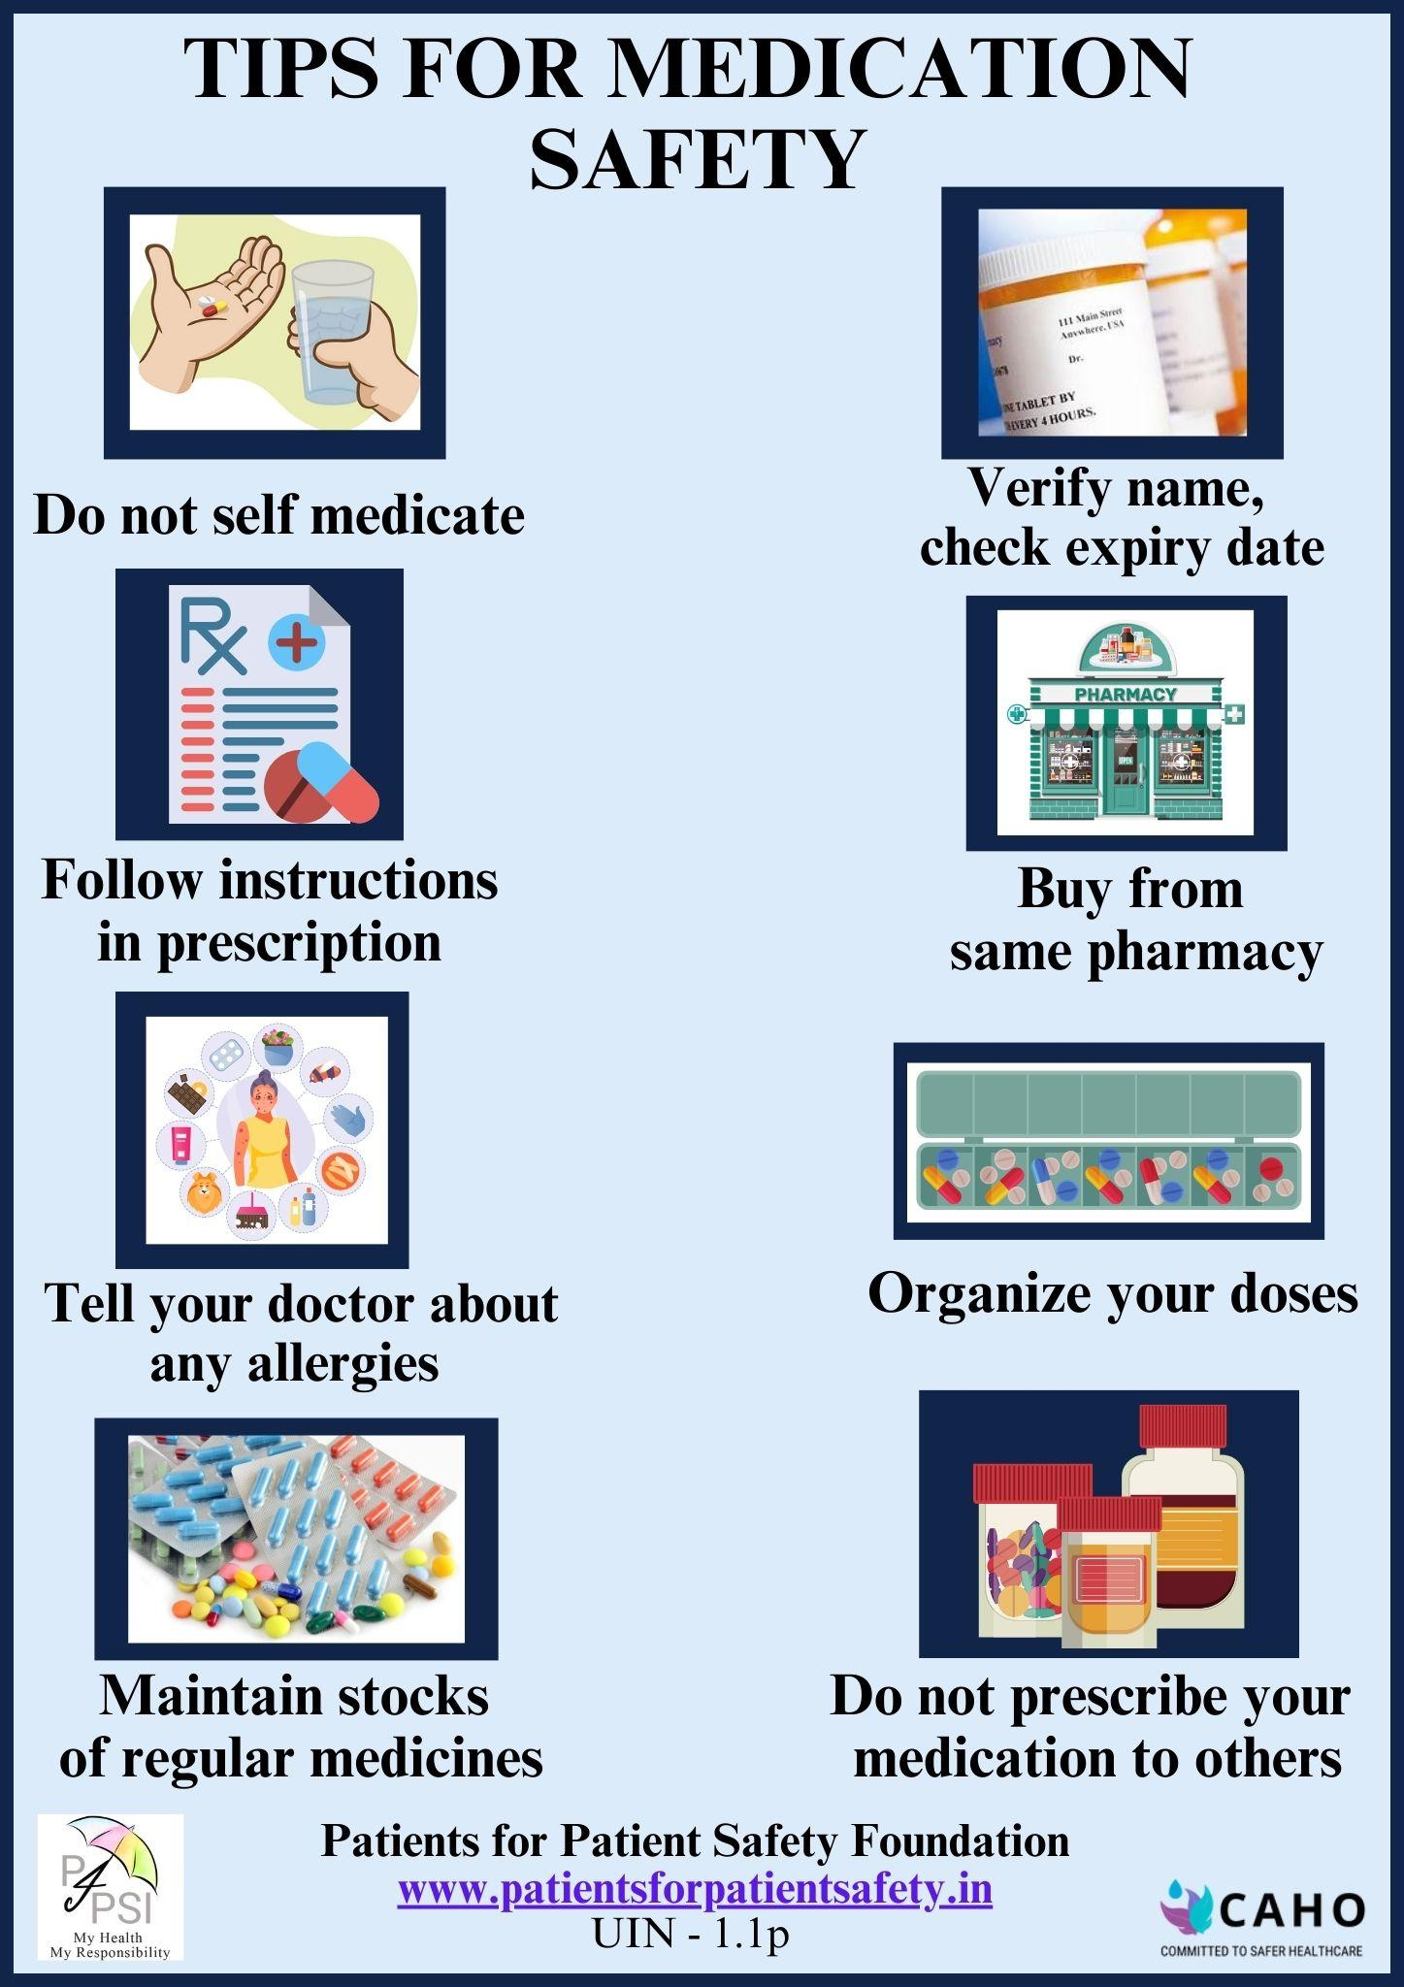
Medication errors
Example 3

Slide 20
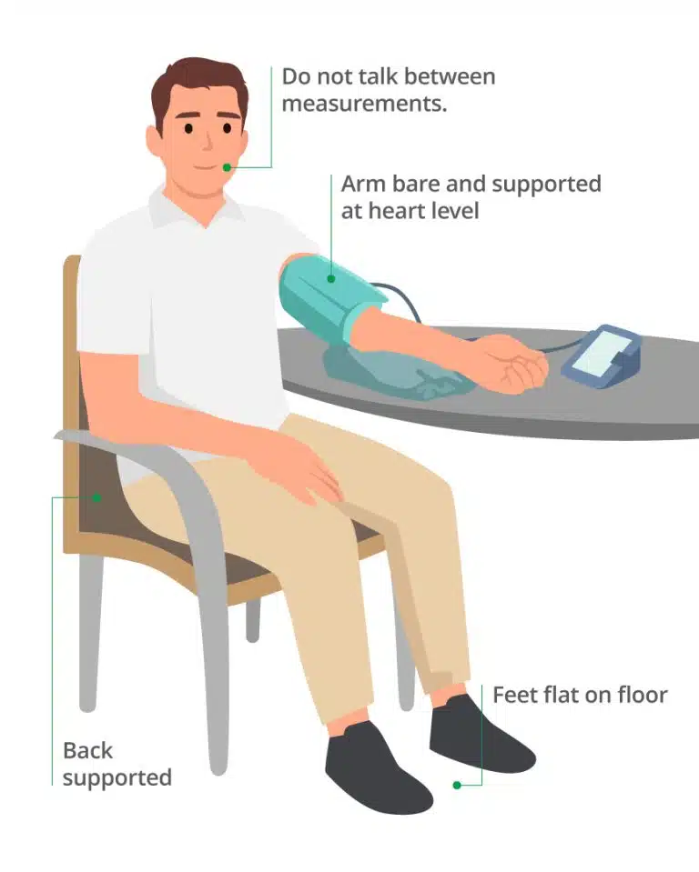
Correct way for measuring BP at home
Example 4
Mistakes we make while measuring BP:
Incorrect Cuff Placement or Size
Improper Body Position
Not Resting Before Measurement
Talking or Moving During Measurement
Errors in Instruments- calibration

Slide 21
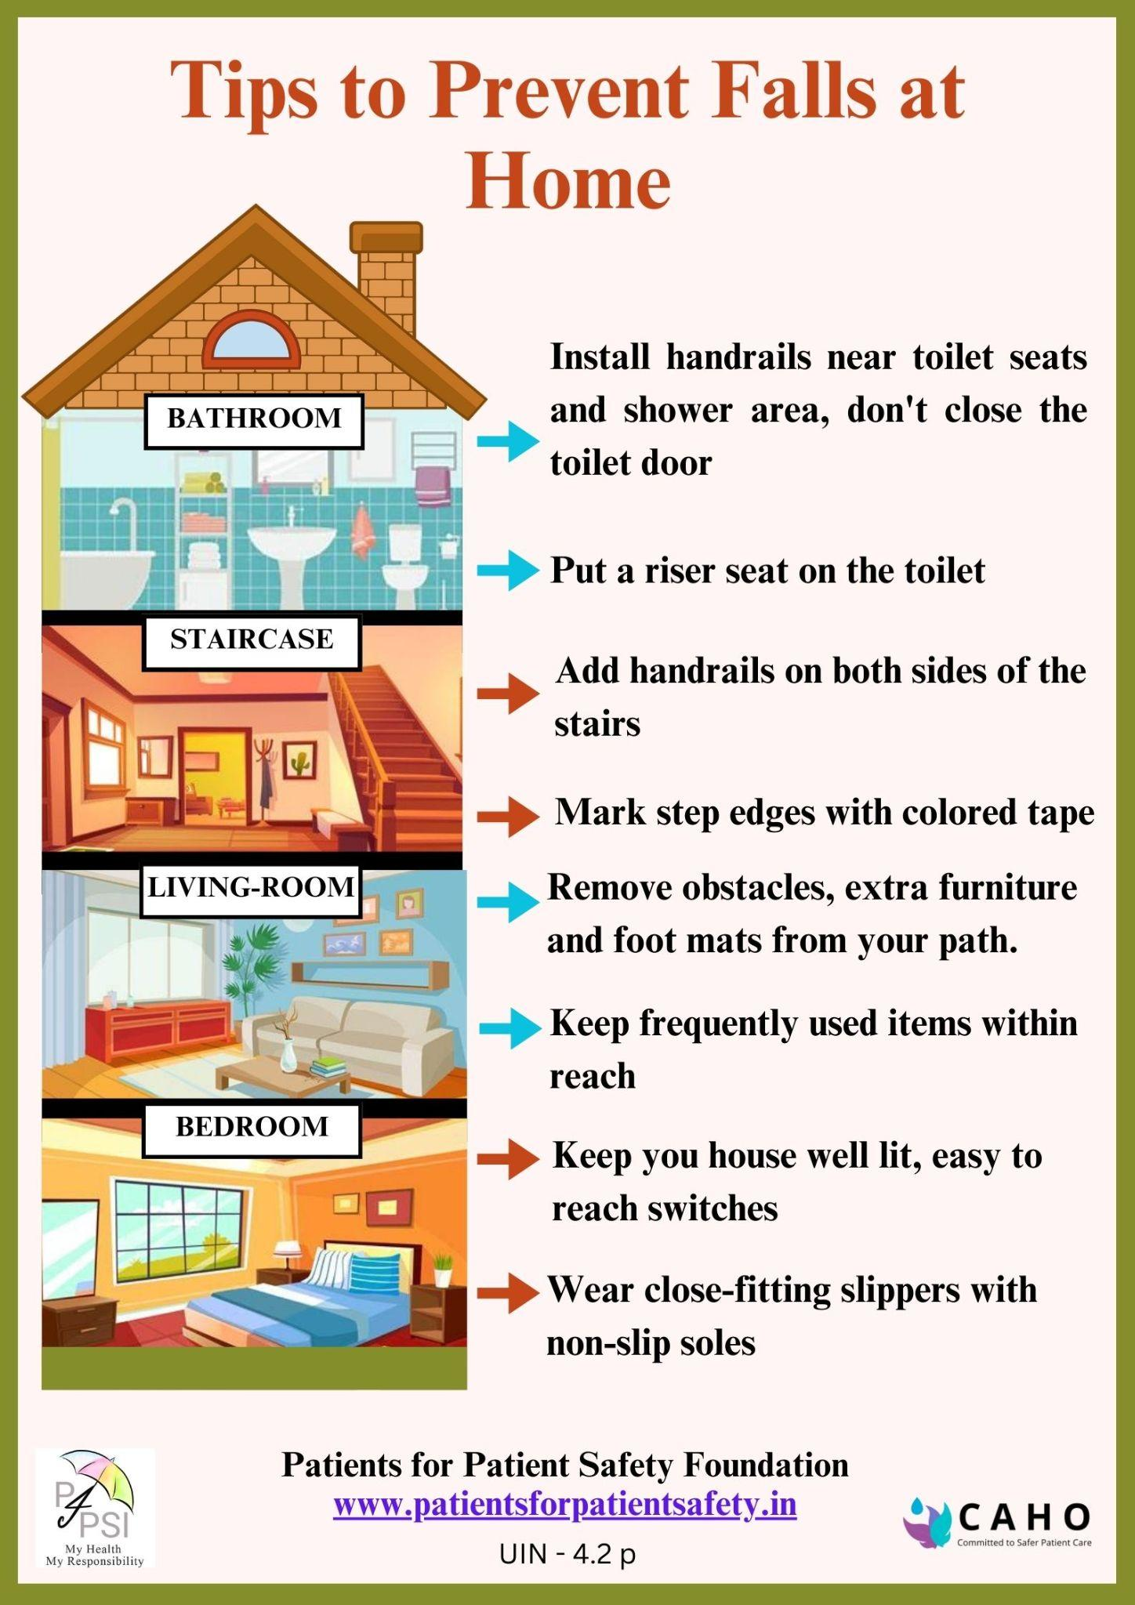
Falls lead to more problems
Example 5
Falls happens both at Home and Hospitals leading to complications
646,000 individuals die each year globally from falls (WHO), many more are hospitalized. It is the second leading cause of unintentional injury/death.
Why do falls happen?
Weakness & Frailty
Due to side effects of medicines
Cluttered living spaces
Wet or slippery surfaces
Wearing shoes with inadequate grip

Slide 22
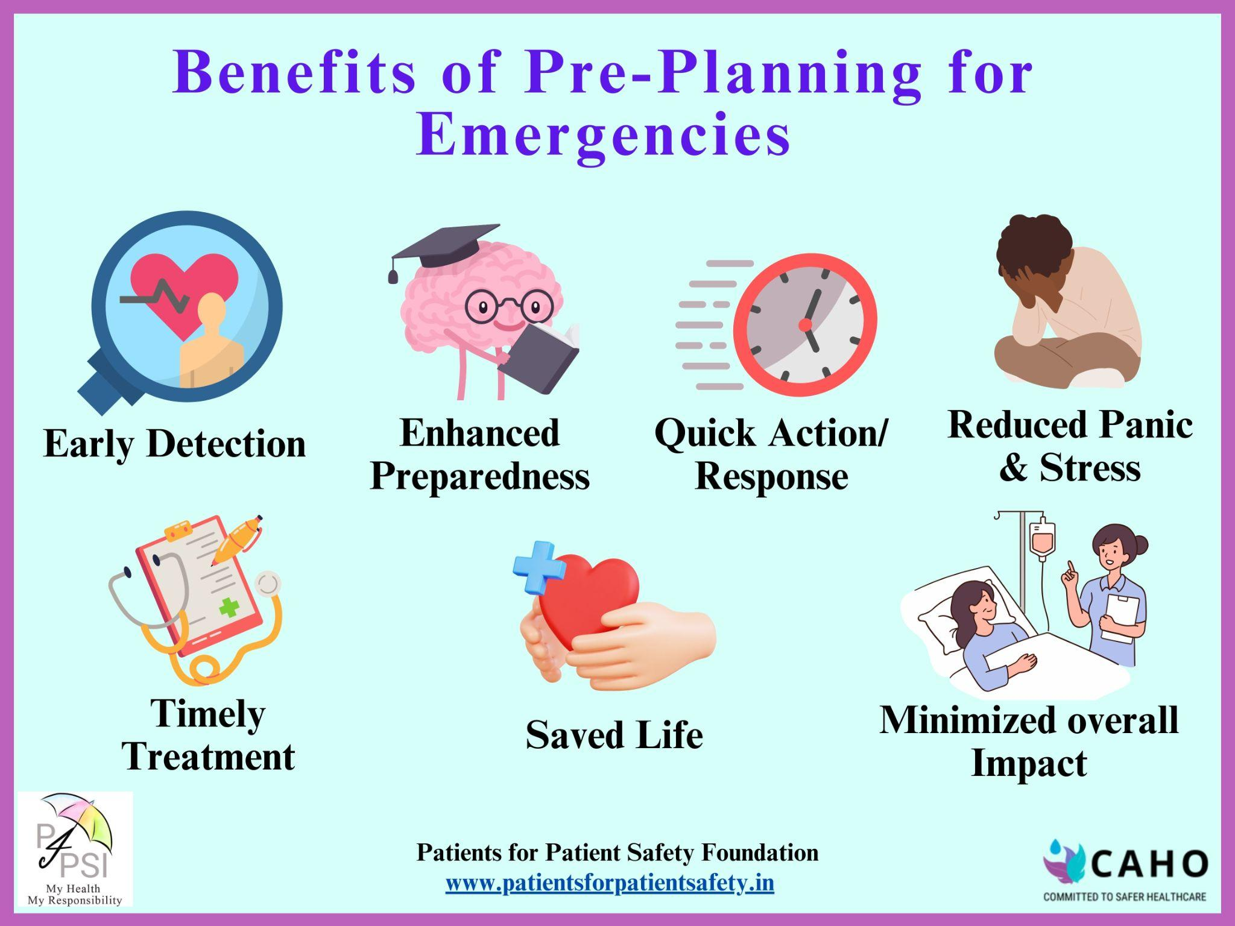
Handling Medical Emergencies
Example 6
An emergency is unannounced
Lack of awareness of symptoms
Unpreparedness, No First Aid Kit
Wasting golden hours
Not knowing where to go
How to select the right hospital for an emergency

Slide 23





Sponsored by -
Thank You for joining Patient Safety Movement
Remember - My Health, My Responsibility
Ask Questions, Clear your doubts, Send us your feedback:
info@patientsforpatientsafety.in
Explore our website: www.patientsforpatientsafety.in
Follow us on social media
PFPSF-india
patientsforpatientsafety
pfpsfindia
patientsafety22
+919289696709
Patients for Patient Safety Foundation
Contact - 92896 96709
D10 Ground Floor, Nizamuddin East, New Delhi, India, 110013

