Slide 1




Patient-Centered Care:
Engaging Patients for Safety
Speaker: Prof. Nadira Chaturvedi
Co-Chairperson
Patients for Patient Safety Foundation
16th November 2024
Sarvodaya Hospital, Sector-8, Faridabad
‹#›

Slide 2
Content of Presentation:
  Patient Centricity - definition, benefits
  3 Pillars of Patient-Centric Care for Patient Engagement
  Opportunities for HCP in OPD, IPD and at Discharge
  Touch points of Patient-Centric care for HCP
  Smart Feedback Techniques - Gathering patient insights
  Effective Communication with Patients - Educating patients
  Patient Awareness Material by Patients for Patient Safety Foundation (PFPSF)
Sarvodaya Hospital, Sector-8, Faridabad
‹#›

Slide 3


Patient Centric Care vs Disease Centric Care
Sarvodaya Hospital, Sector-8, Faridabad
‹#›

Slide 4
Patient Centric Care vs Disease Centric Care
While Disease centric care focuses on clinical needs and services, Patient centric care emphasizes patient’s preferences, emotional needs and social values.
Advantages of Patient Engagement
  Enhances patient satisfaction and builds trust through collaborative engagement
  Improves health outcomes through personalized treatment plans
  Encourages shared decision-making, leading to better treatment compliance
Sarvodaya Hospital, Sector-8, Faridabad
‹#›

Slide 5

Empathy helps
Where is the lab?
May I take you to the doctor.
Which doctor should I go to?
This is the way to lab.
Do I need to follow up at all?
If you are hungry can I offer you a snack.
I am feeling tired and exhausted.
You can call me even after you go home.
Sarvodaya Hospital, Sector-8, Faridabad
‹#›

Slide 6










Benefits of Patient centric care to HCP
Early Detection & Prevention
Greater overall profitability
Better Outcomes & Reduced Medical errors
Increased Reputation
Improved Trust & Satisfaction
Improved Patient Loyalty & Referrals
Personal and
Professional Fulfillment
Sarvodaya Hospital, Sector-8, Faridabad
‹#›

Slide 7
3 Pillars of Patient Centric Care
  Creating Awareness among Patients - Patient Education
  2 way Communication between Patients and Healthcare providers
  Building a Patient-centric Culture across all functions, all levels
Sarvodaya Hospital, Sector-8, Faridabad
‹#›

Slide 8
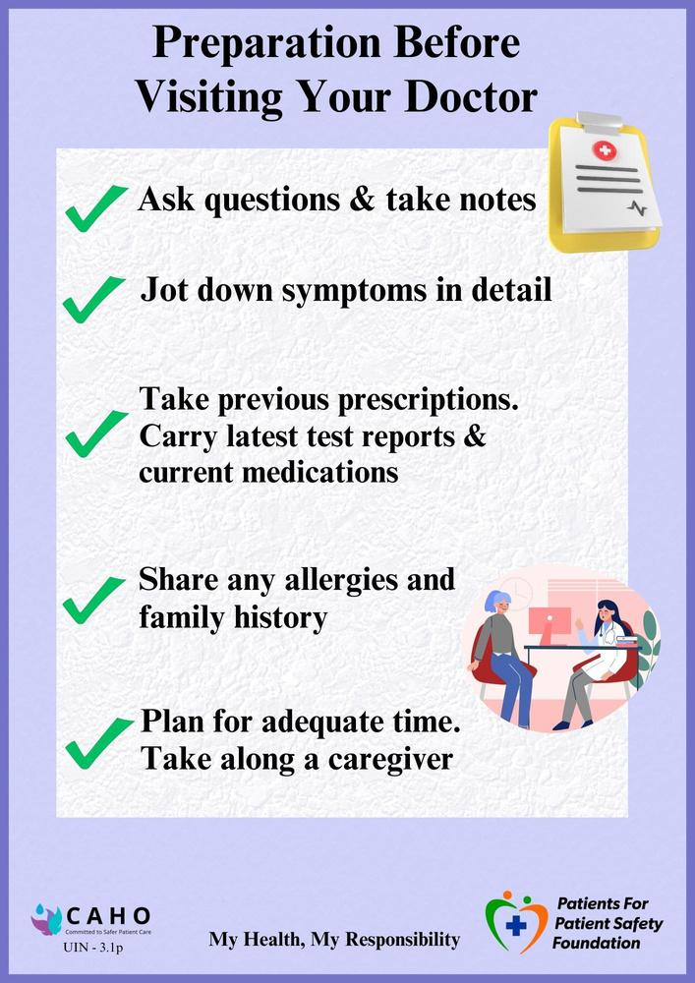
1st Pillar of Patient Centric Care -
Patient Awareness
    Avoiding medical errors
    Taking ownership of medical care, treatment compliances
    Awareness of disease and treatment protocol with timely reporting of symptoms for early detection and timely treatment
    Adopting healthier lifestyle and preventive healthcare practices
    My Health, My Responsibility
Sarvodaya Hospital, Sector-8, Faridabad
‹#›

Slide 9

Sarvodaya Hospital, Sector-8, Faridabad
‹#›

Slide 10
Where does Medical Harm happen
At Hospital
At Home
Errors/Misses by Providers
Omissions by Patients
Patient & Caregivers
  Medications Errors
  Wrong Diagnosis
  Surgical Mistake
  Infections
  Communication Errors
  Ignore Symptoms
  Late Presentation
  Incomplete Info
  Not being alert
  Not asking questions
  Lack of awareness
  Lack of preparedness
  Not following prescriptions
  Self treatment
  Missing clinical signs
Aware Patients/Caregivers can help Prevent Medical Harm
Sarvodaya Hospital, Sector-8, Faridabad
‹#›

Slide 11
2nd Pillar - Two way Communication
for Patient Engagement
  Listening with empathy to patients - gathering insights
  Feedback at every stage
  Patient Education - creating awareness
  Teach back of best practices with patients
Sarvodaya Hospital, Sector-8, Faridabad
‹#›

Slide 12
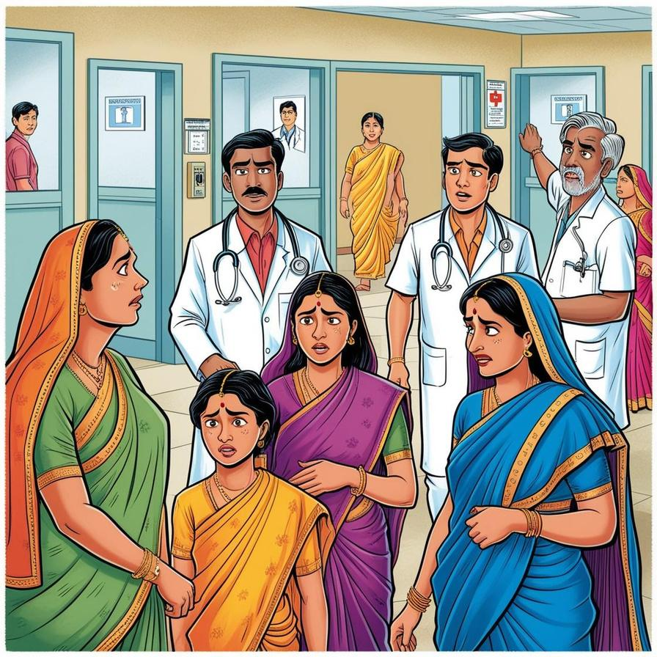
Engagement Opportunities for HCP in OPD
  Front Desk: documents, fees, billing, and insurance.
  Signages: clear, multilingual signs
  Wait Times: inform of wait times, ensure punctuality.
  Consultation Guidance: Direct to appropriate doctor
  Diagnostics: instructions costs, easy report access.
  Treatment Instructions and Care Continuum: Explain diagnosis and treatment; give written summaries.
Sarvodaya Hospital, Sector-8, Faridabad
‹#›

Slide 13
Engagement Opportunities for HCP
in IPD, at Discharge
  Patient’s Rights and Responsibilities: Costs and Financial counseling, consent forms, risks, alternatives.
  Room Orientation: Guide on room facilities, schedules, visitor timings, and dietary policies.
  Medication and Infection Management: Reconcile medications, document allergies, assess dietary needs.
  Pre and post Procedure guidelines for Surgical patients: Explain procedure, risks, recovery.
  Clear Discharge Instructions and Transition to Home: Checklist for home care, emergency protocols, lifestyle changes.
  Post-Discharge Follow-Up: Schedule appointments, follow-up calls
  Patient Feedback: Collect feedback at all touch points to improve services.
Sarvodaya Hospital, Sector-8, Faridabad
‹#›

Slide 14
Touch points of Patient Centric care
1
Planning Before the First Appointment, Registration and Billing
2
Navigation to OPD and OPD Consultation with Specialized doctor
3
Diagnostic tests and post-diagnostic consultation
6
Discharge Process and Transition to Home Care,
Follow-up after discharge
5
Pre and Post-Anesthesia check-up for Surgery and Post surgical care
4
Admission IP and Financial Counseling, Room orientation
Sarvodaya Hospital, Sector-8, Faridabad
‹#›

Slide 15
Smart Feedback Techniques -
Where, When and How
  Collect Feedback at every touch point
  Real-time: Daily "Mood-o-Meter" check-ins during stay
  Post-Discharge: 1 day before discharge, 7-10 days after discharge
  Ongoing (long term): Periodic check-ins (2, 6 months, 1 year) for outcomes, PREM and PROM techniques
  Active Methods: Grievance cells, Counselling rooms, Patient Advisory Councils (PACs)
  Passive Methods: Online monitoring, Surveys and feedback forms
  Who will take feedback - PROs or Healthcare workers?Who will respond?
Sarvodaya Hospital, Sector-8, Faridabad
‹#›

Slide 16

3rd Pillar -
Building a Patient - Centric Culture
  Leadership and Top management involvement
  Mindset of Doctors, nurses and para medical staff to align with patient centricity
  Training of Human resources - all levels, all functions
  Patient-Centered Building Design with clear navigation and signages
  Patient Advisory Council (PAC): Platform for voice of patients
  Use Patient Education Material in local languages
Sarvodaya Hospital, Sector-8, Faridabad
‹#›

Slide 17
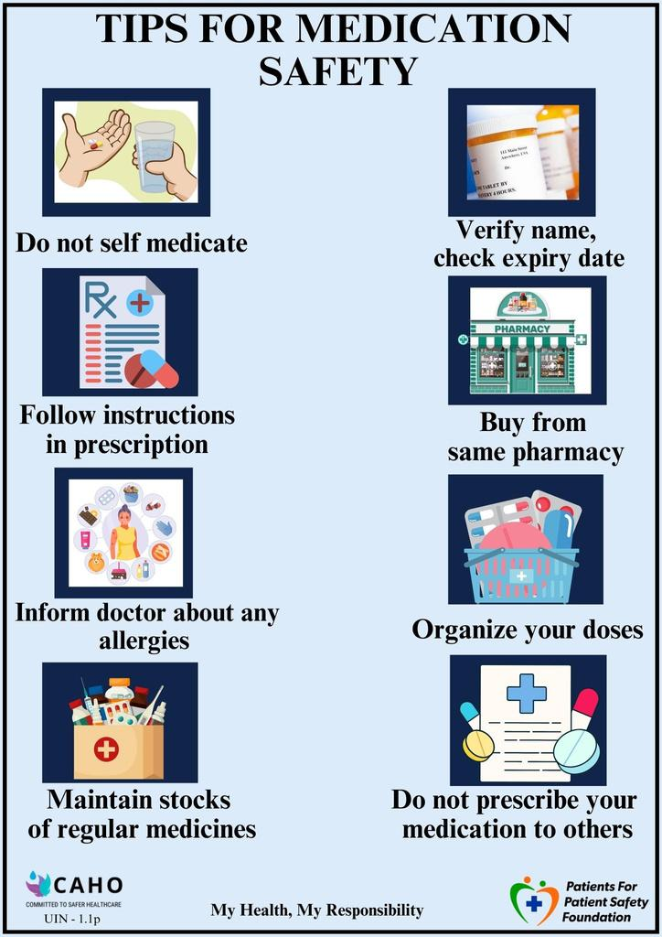
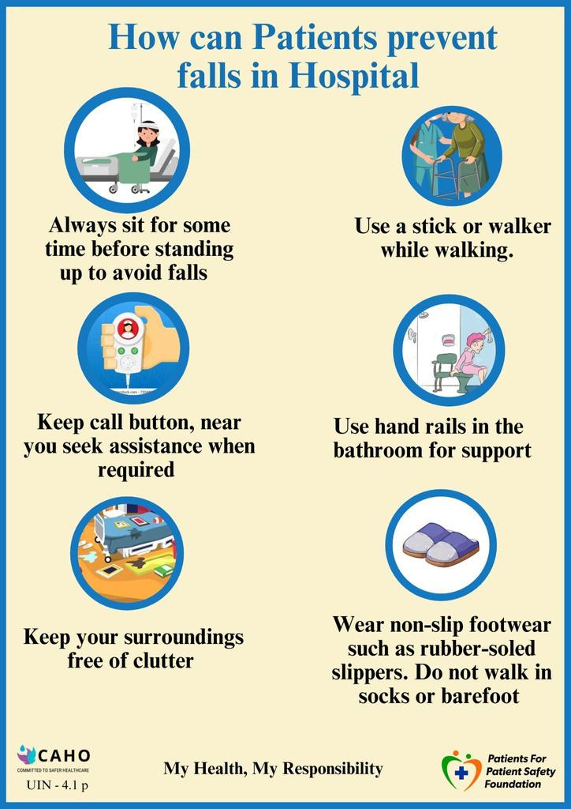

Patient Engagement with Patient Education
‹#›
Sarvodaya Hospital, Sector-8, Faridabad
‹#›

Slide 18

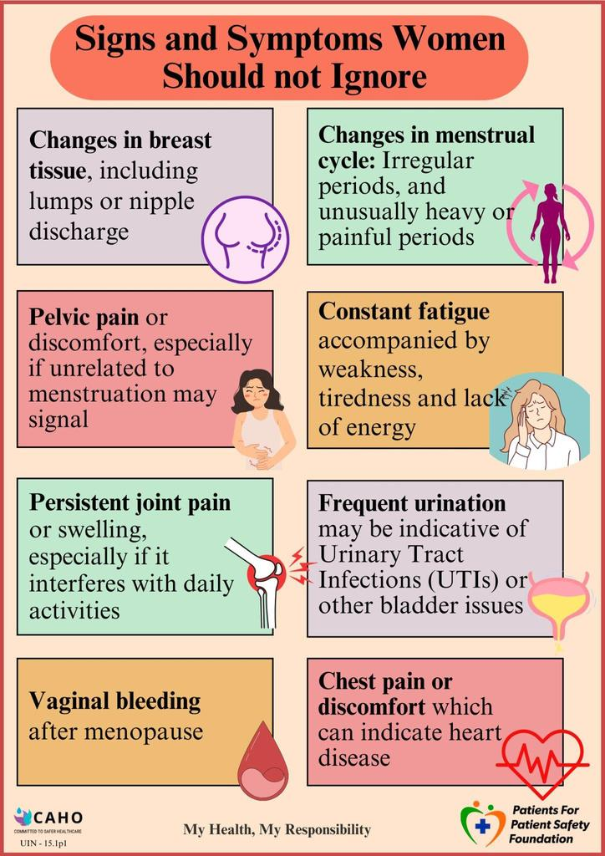
Patient Engagement with Patient Education
‹#›
Sarvodaya Hospital, Sector-8, Faridabad
‹#›

Slide 19
Dissemination of Patient Education Material
Use multiple communication methods to maximize impact:
  Face-to-Face Communication: Treating professionals and staff should explain information clearly at each stage, using local language and simple terms.
  Visual & Digital Displays: Place posters, charts, videos and standees in key areas. Use TV screens in canteens, waiting rooms, and pharmacies for graphical and video information.
  Printed Handouts: Provide educational materials at front desks, admission/discharge points, and with discharge papers.
Sarvodaya Hospital, Sector-8, Faridabad
‹#›

Slide 20






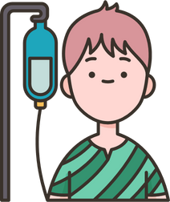


How PFPSF can help you in creating Patient Awareness
Spreads awareness on Definition, Symptoms for Early Detection of possible Harm
Shares knowledge about Risks, Causes & Consequences of Medical harm
Provides Actionable tips for Self Protection,
and Prevention
Guides on the Role that Patients/Caregivers can play throughout their Patient Journey
PFPSF is a non- profit Trust, promoted by CAHO.
PFPSF content is aggregated from world renowned experts and vetted by domain specialists, makes us Trustworthy - no commercials associated
Sarvodaya Hospital, Sector-8, Faridabad
‹#›

Slide 21

Engaging Patients to Enhance Patient Safety -
A White paper by CAHO & PFPSF
  Outlines strategies to strengthen collaboration between patients, caregivers, and healthcare providers to reduce medical errors
  Analyzes risks and identifies medical errors across the care pathway
  Provides actionable solutions for timely intervention by healthcare providers
  Addresses both OPD and IP settings, as well as discharge processes, and emphasizes the importance of patient feedback
Sarvodaya Hospital, Sector-8, Faridabad
‹#›

Slide 22



Scan to leverage Patient Education Material
Health Library
Infographics
Newsletters
Thank You
My Health, My Responsibility
Sarvodaya Hospital, Sector-8, Faridabad
‹#›

