Slide 1




Enabling Patients in Patient Safety: - A Glimpse of the Future
Ms. Nadira Chaturvedi & Mr. Som Mittal
Co-Chairs
Patients for Patient Safety Foundation

Slide 2
About PFPSF
Patients for Patient Safety Foundation (PFPSF) is a non-profit trust.
Our aim is to reduce medical harm that happens before, during or after treatment with active engagement of patients and caregivers.
Sponsored by CAHO and we are backed by over 400 hospitals and diagnostic centers in India and large no. of Sr. Physicians & experts.
We are Patient-Centric and leverage work done by WHO, HCPs aggregate information relevant in Indian context.

Slide 3

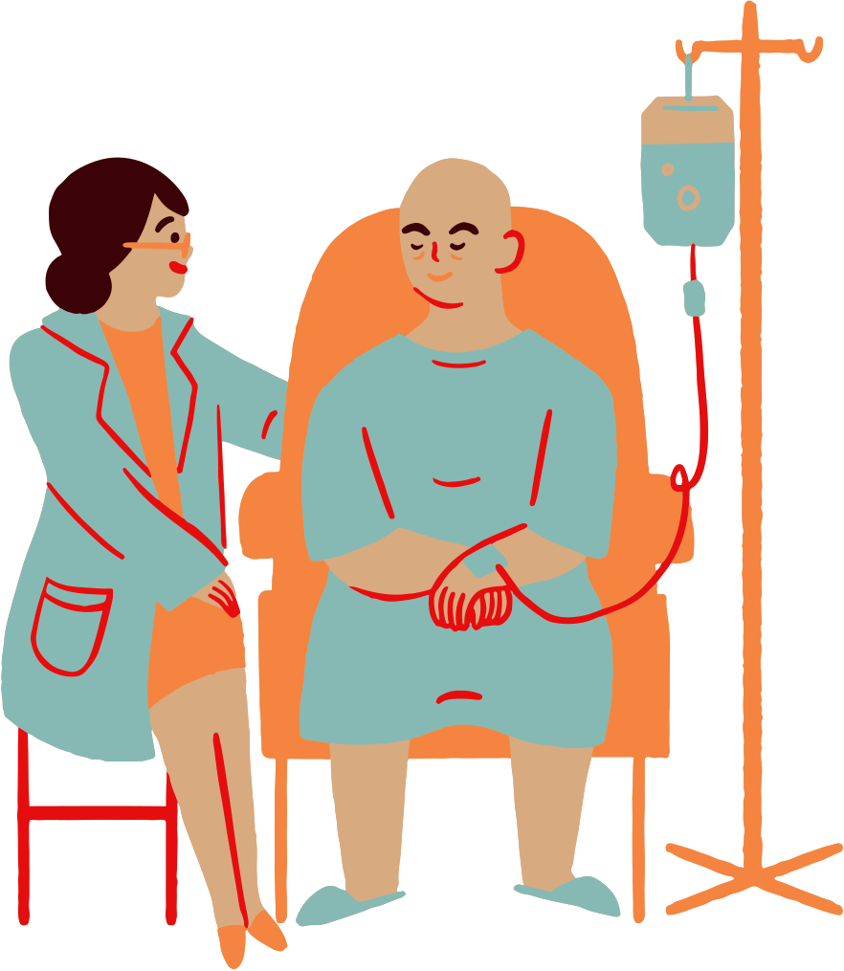




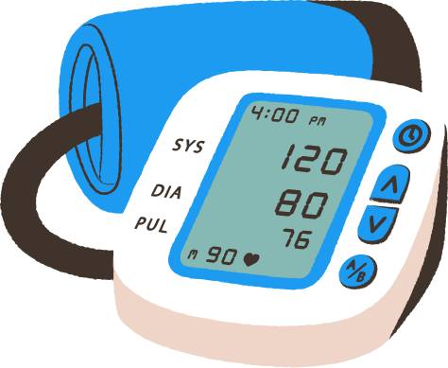
Why the work we do is Critical
1 in 10 patients suffer harm during hospitalization
In OPD 4 out of 10 patients are harmed due to missed/incorrect diagnoses, medication, prescriptions and communication errors
Medication Errors constitute 50% of avoidable harm
Unsafe Transfusion/ Injection practices
Unsafe Surgical Practices cause complications in 25% of patients
Patient Harm is caused due to ignorance of patients and non-involvement
Calibration of Medical Device leads to errors
Up to 50% of this avoidable harm can be prevented
*Source: WHO

Slide 4

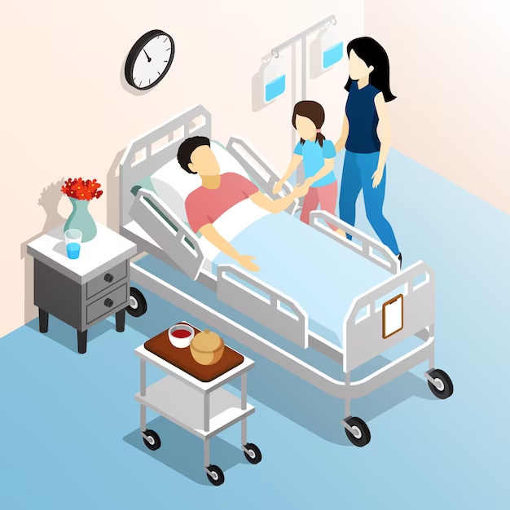
Why do Medical Errors happen
At Healthcare Providers end
To err is Human
Too many patients
Overworked, under staffed
Inadequate communication
Less engagement with patients
At Patients and Caregivers end
Lack of awareness & engagement
Ignoring symptoms
Confused about disease, treatment
Not asking right questions
Language/ Cultural barriers

Slide 5



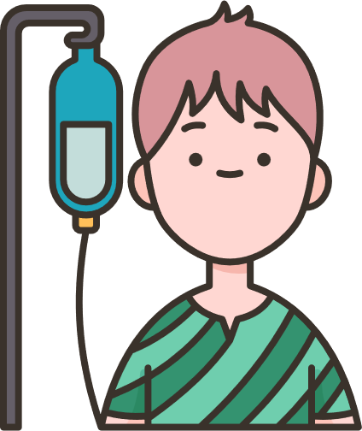


We help by engaging Patients & Caregivers
Understand their Rights, Roles and Responsibilities
Know Risk & Causes of Medical harm & guidelines to help prevent
Guidance on the Role that Patients can play
Provide alerts, tips, and advice for a Safe Patient Journey
Knowledge of healthy lifestyle choices

Slide 6
Harm at different stages of Healthcare
Are my symptoms serious enough?
Why do I need a
follow-up visit?
Surgery vs tests, should I take a Second Opinion?
Are preventive health checkups really helpful?
How should I prepare for my Doctor’s visit?
Shall I discontinue Medicines?
Tracking Symptoms
Treatment Options
Post Care Importance
Better Diagnosis
Medication Management
Preventive
Choices
Delayed diagnosis
Recurrence
Unsatisfactory Treatment Outcomes
Incomplete information
Incomplete Treatment
Severe illness
Ignorance, doctor is God-syndrome and lack of involvement by patients can lead to errors

Slide 7







Patients and Caregivers can help get safer outcomes?
Providing Complete Information
Being Alert - Asking Questions
Following Prescriptions/ Advise
Keeping Track
of Symptoms
Build trust
& provide
Valuable Feedback
Getting a Second
Opinion
Keeping Updated Medical Records

Slide 8
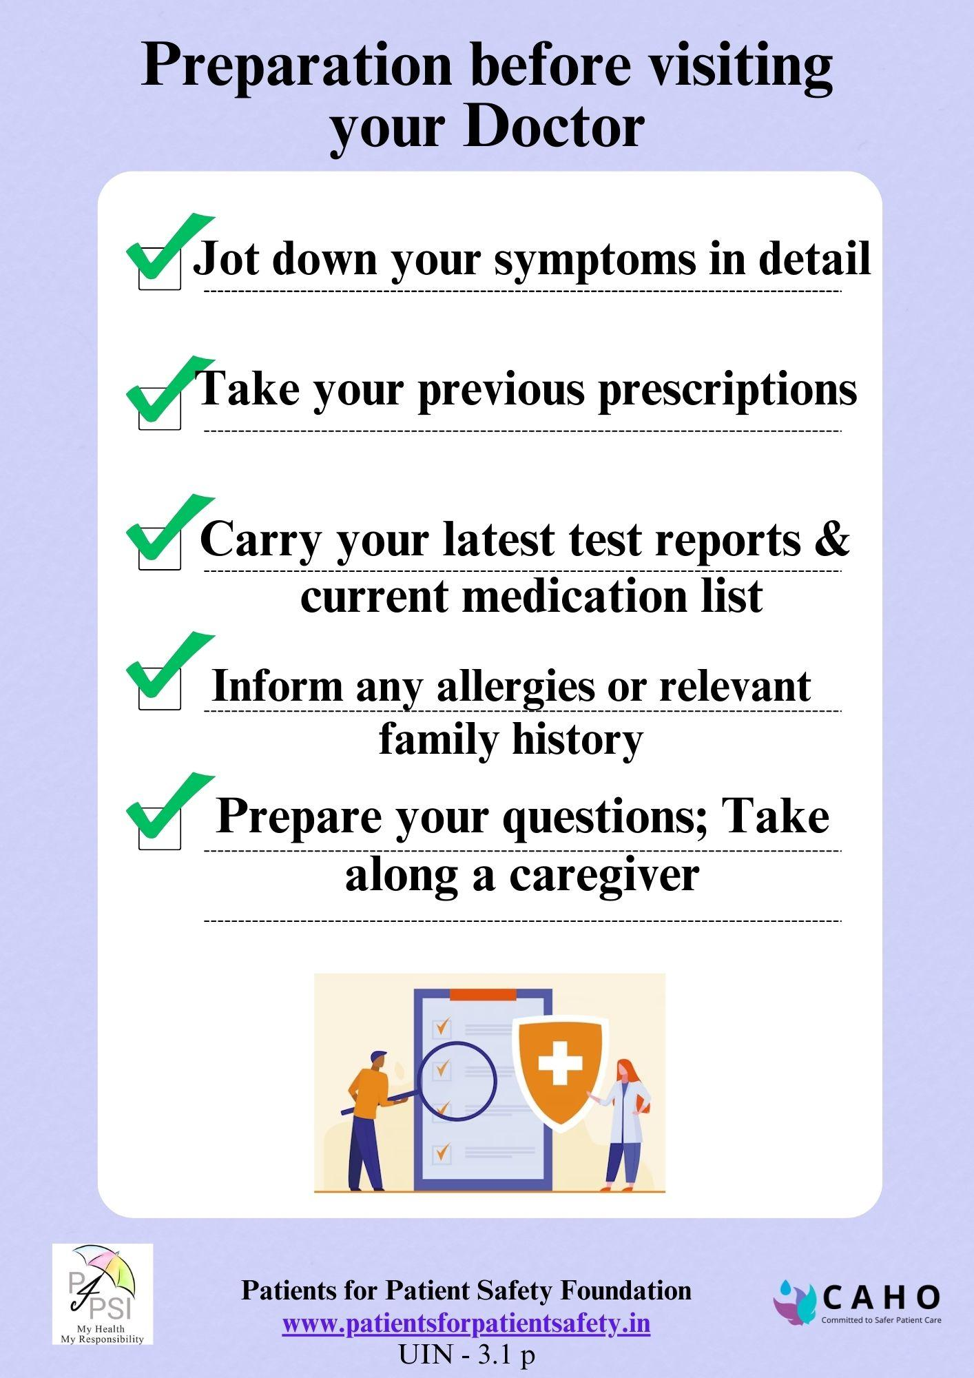
Preparing for meeting a doctor?
Due to stress; incomplete communication
Forget to mention all symptoms; bring previous reports; medical history
We were unable to absorb all the information & guidance
Don’t ask important questions

Slide 9
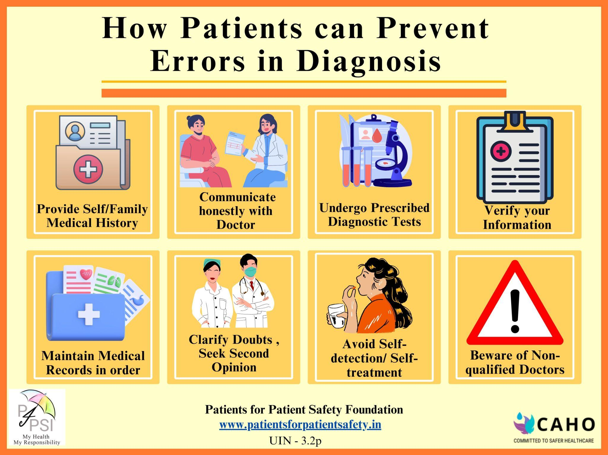
Diagnosis Errors Make Ailment Worse
Why do they happen:
Provide incomplete or inaccurate medical history
Hesitation to disclose sensitive information
Self-diagnosis and reliance on internet information
Lack of communication
Failure to follow medical advice
Not verifying personal details

Slide 10
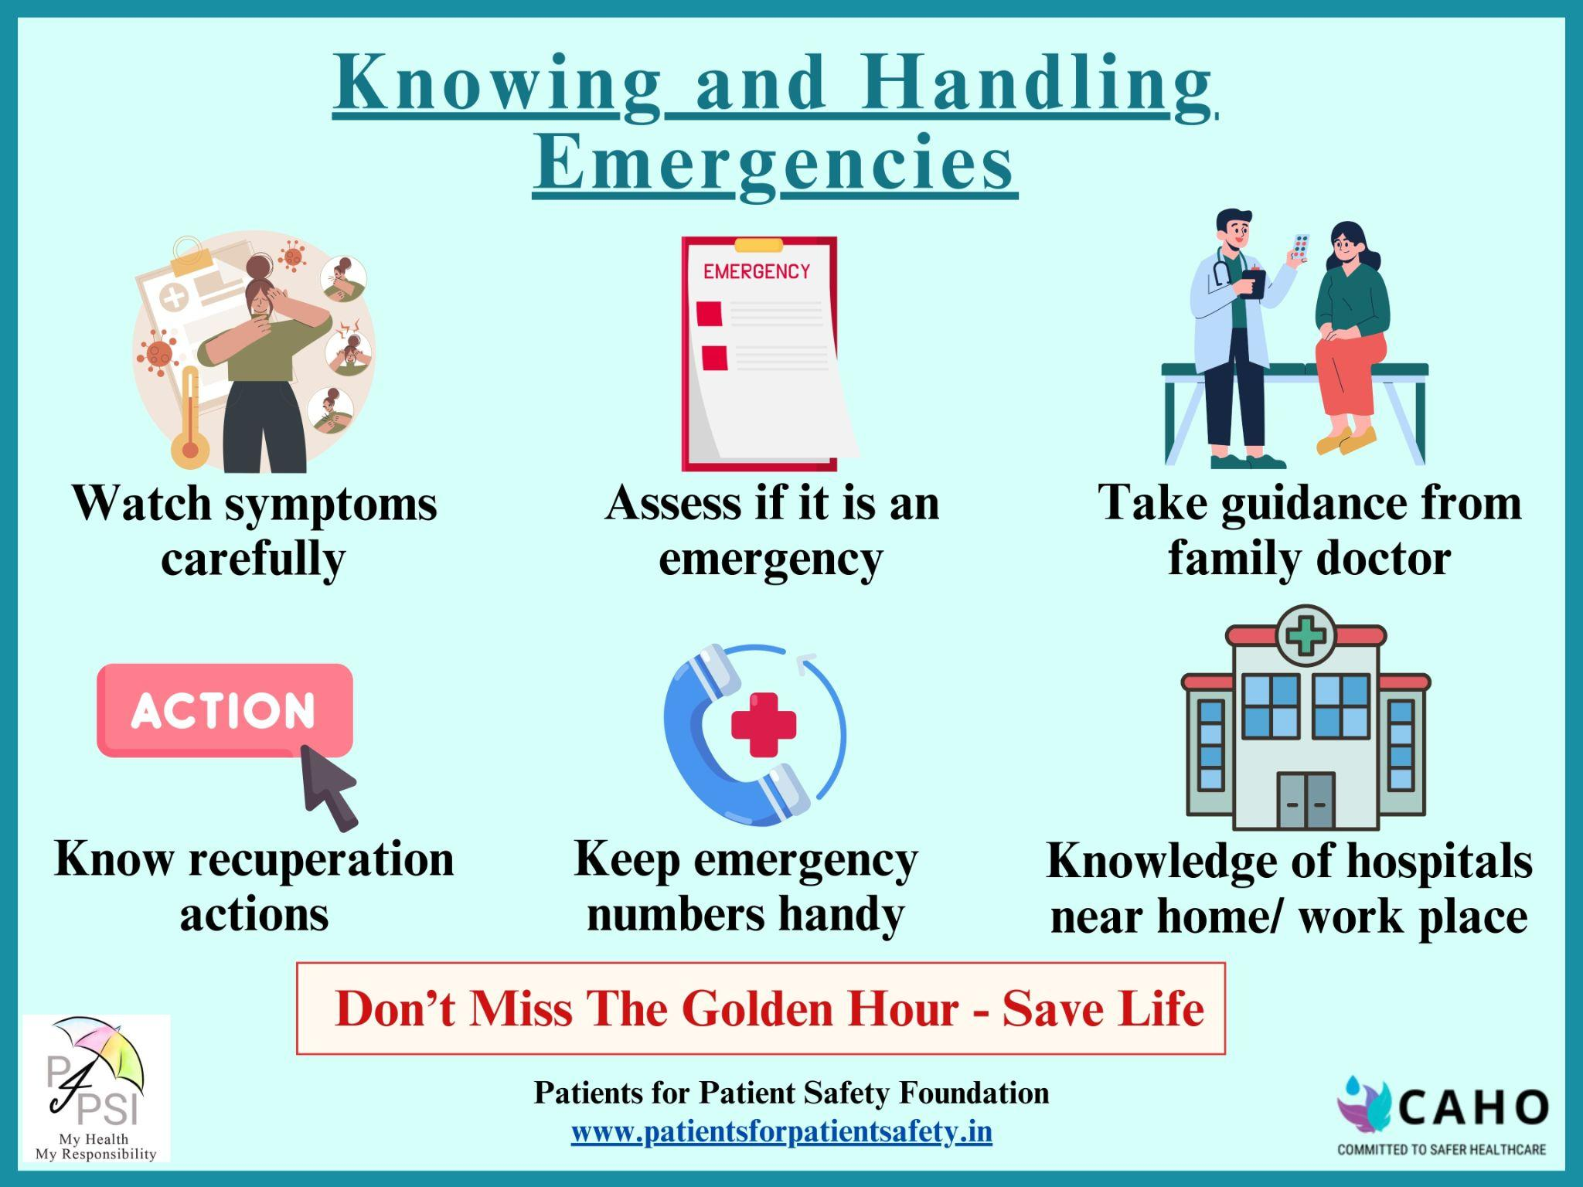
Emergencies Come Unannounced
Are we prepared:
We don’t know - it is an emergency
What type of emergency
Who to contact for help
Which hospital to take
What to do while we wait for help

Slide 11
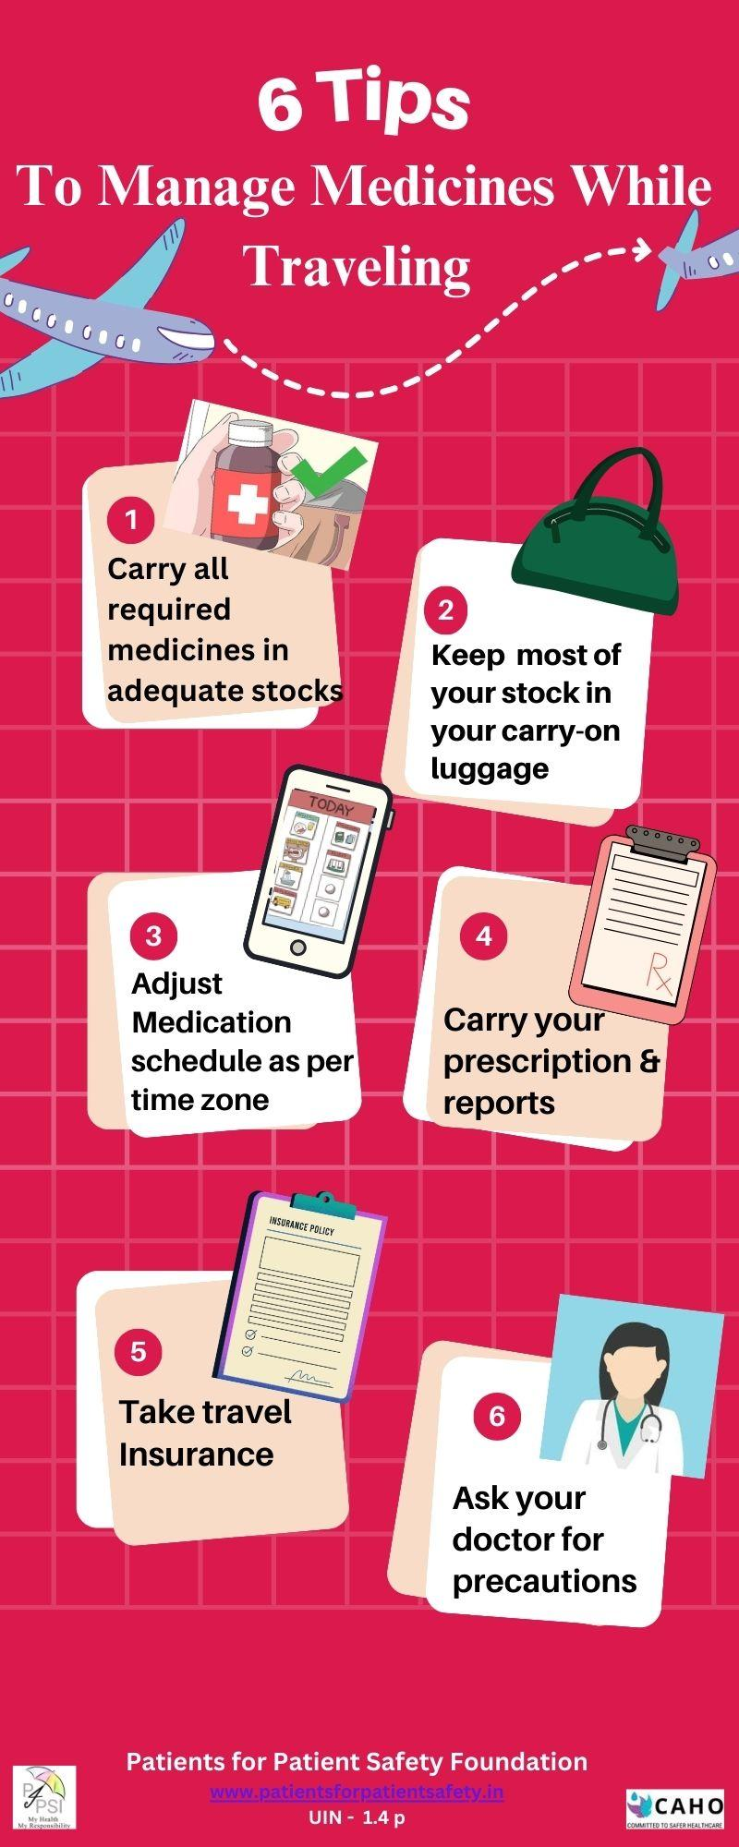
Keeping Safe While Traveling
Common mistakes while traveling:
Forgetting to pack medications
Medicines in checked in - lost baggage/ delayed
Not carrying prescriptions/ reports
Adjusting dosage or timing to time zone
Insufficient supply - extended stay

Slide 12









Advantages of Patient Engagement
to HCP
Early Detection & Prevention
Improved profitability
Better Outcomes & Reduced Medical errors
Increased Reputation
Improved Trust & Satisfaction
Higher Patient Loyalty/ Referrals
Personal and Professional Fulfillment

Slide 13
Strategies to Engage Patients in Safe Care
Getting Patient centricity across the Organization
Establish Patient Advisory Councils -bridge build partnerships
Establish Patient centred education and awareness program- shared decision making for better compliance
Establish Feedback and Experience sharing platforms- learn from your customer
Two way Communication – bridge the trust deficit
Will help to improve patient outcomes, increase satisfaction and build trusted relationship

Slide 14
What will Patient Advisory Council do
Improve communication and build trust between HCP and PC
Promote patient safety and reduce medical errors
Foster two-way collaboration between both parties, work towards common goals
Improve quality of care and patient satisfaction by HCP, by incorporating feedback/ suggestions and learnings from Patient experience.
Determine effective ways to educate Patient community

Slide 15
How will PAC benefit HCPs
Formal engagement with patients & discussing their experiences, needs and ideating with HCP would help bridge the Trust gap.
A constructive way to get valuable patient feedback, patient insights and voice to improve service experience and clinical outcomes.
Provide a platform for improved two-way communication.
Better understanding of patient expectations and areas of improvement
Increased loyalty & patients-satisfaction
Helps becoming patient centric
`

Slide 16
How will PAC benefit Patients & Caregivers
Awareness of disease symptome, treatment protocols and preventive measures for better health
Opportunity to share experiences & expectations in a structured way
Bring in patient perspective/ voice in HCP decision making
Be part of the improvement plan & its execution
Help get patient relevant information & improve awareness
Will enhance experience & outcomes; build trust

Slide 17
Patient Advisory Council (PAC): Formation & Steps
CAHO has created a manual on PAC which covers all steps:
Create PAC, Commit Resources, Define meeting protocols
Orientation of PAC members, Hospital staff, Roles and Responsibilities
Identify Priority Areas for Improvement taking HCP/Patient inputs
Conduct PAC Meetings; Review work done; firm up plans
Implement the improvements & Report back
Communicate, Share impact, adopt best practices & encourage patient feedback

Slide 18
Success factors to be effective PAC
Leadership support -Involvement of hospital leadership in creating and managing PAC, Strong support & demonstrate actions
Structure - Structure of the PAC, Seniors representation from HCP & Patients; committed resources & secretariat; clarity of objectives, execution process
Formal & Regular - Determine frequency of meetings, formal agenda involvement of all departments
Communication - Communication with the patients, communication with the healthcare team members, and hospital leadership.
Celebrate - Evidence of PAC’s contribution; impact of PAC on patient experiences & outcomes

Slide 19





Your Health,
Your Responsibility
Patients for Patient Safety Foundation
www.patientsforpatientsafety.in

