Slide 1





Improving Diagnosis for Patient Safety
Get it Right, Make it Safe
Patients for Patient Safety Foundation

Slide 2

Causes of Diagnostic Errors
Missed Diagnosis: Condition not identified, resulting in no treatment.
Delayed Diagnosis: Significant time lag in diagnosis, worsening health.
Wrong or MisDiagnosis: Incorrect condition identified, leading to harmful treatment.
Technical Errors: Mistakes in diagnostic tests or procedures, including equipment issues.
Communication errors, including misunderstandings between providers and patients or patient doubts about the diagnosis
Both Patients or Healthcare Professionals can be at fault, Errors can happen before, during and after treatment

Slide 3
Consequences of Diagnostic Errors
Wrong Diagnosis Wrong Treatment
Diagnostic errors can have significant consequences for patients, including physical harm, emotional distress, and financial burdens:
Delayed Treatment leading to Prolonged Suffering
Unnecessary Procedures leading to Increased Healthcare Costs
Loss of Trust in Healthcare and Psychological Impact on Patients
Wrong Treatment, Disability, Loss of Life

Slide 4
Who Causes Medical Harm
At Hospital
At Home
Errors/Misses by Providers
Omissions by Patients
Patient & Caregivers
Medications Errors
Wrong Diagnosis
Surgical Mistake
Infections
Communication Errors
Ignore Symptoms
Late Presentation
Incomplete Info
Not being alert
Not asking questions
Lack of awareness
Lack of preparedness
Not following prescriptions
Self treatment
Missing clinical signs
Aware Patients/Caregivers can help Prevent Medical Harm

Slide 5
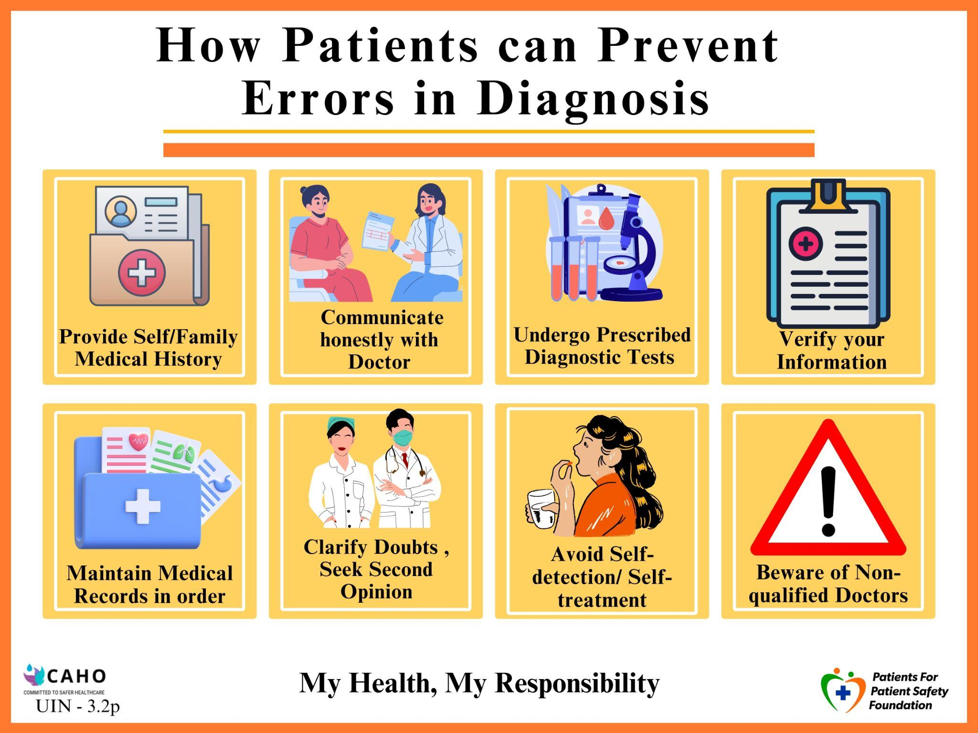
We blame HCP for poor Diagnosis
Errors from Patients
Providing incomplete or inaccurate information
Ignoring early Symptoms
Failure to follow Pre-Test Instructions,
Skipping tests, Missing Appointments
Over-Reliance on Internet and Self Medication

Slide 6
Errors in Patient Journey
Before, During & After Hospitalization
BEFORE Hospitalization:
Delay in reporting of symptoms,
Ignoring Diagnostic Tests
Preventive Health Checkup (Vaccination)
2. DURING Hospitalization:
Choice of hospital, taking second opinion
Medication Management
Infection control
3. AFTER Hospitalization:
Home care
Elderly care
Ignoring symptoms
Tracking Symptoms
Diagnosis
Treatment Options
Medication Management
Post Care Importance
Preventive
Choices

Slide 7







How Can Patients and Caregivers help get safer outcomes?
Providing Complete Information
Being Alert - Asking Questions
Following Prescriptions/ Advise
Keeping Track
of Symptoms
Build trust
& provide
Valuable Feedback
Getting a Second
Opinion
Keeping Updated Medical Records

Slide 8



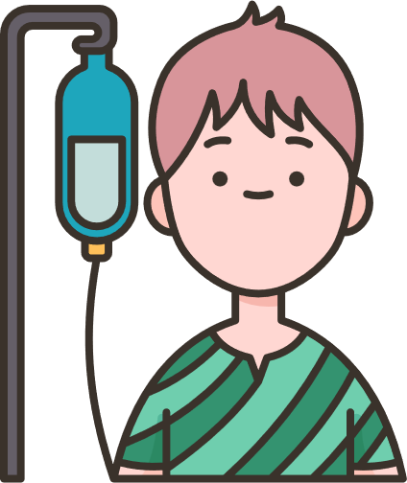
Role of PFPSF in Patient Safety
Spreads awareness on Definition, Symptoms for Early Detection of possible Harm
Shares knowledge about Risks, Causes & Consequences of Medical harm
Provides Actionable tips for Self Protection,
and Prevention
Guides on the Role that Patients/Caregivers can play throughout their Patient Journey
PFPSF is a non- profit Trust, promoted by CAHO.
PFPSF content is aggregated from world renowned experts and vetted by domain specialists, makes us Trustworthy - no commercials associated

Slide 9
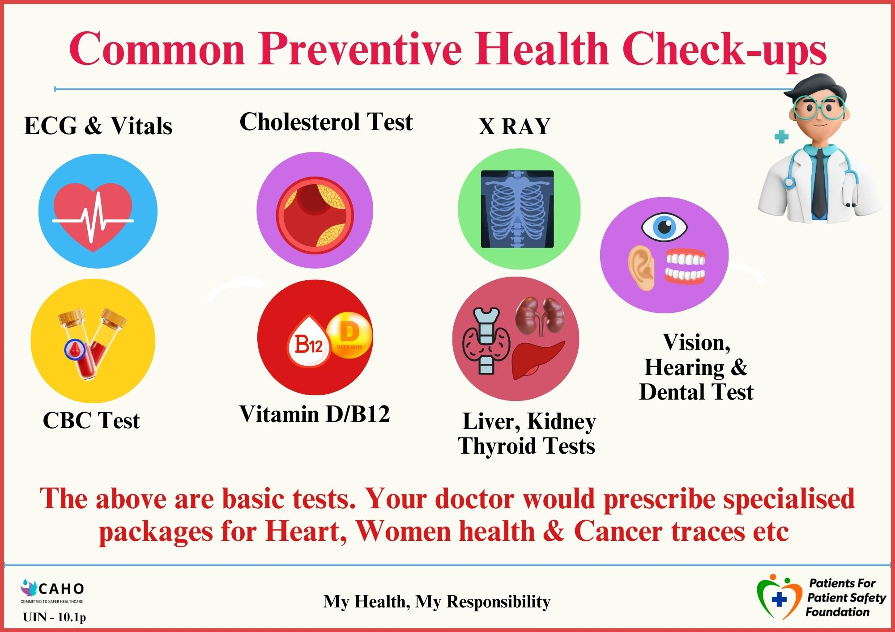
Prevention is Better than Cure

Slide 10
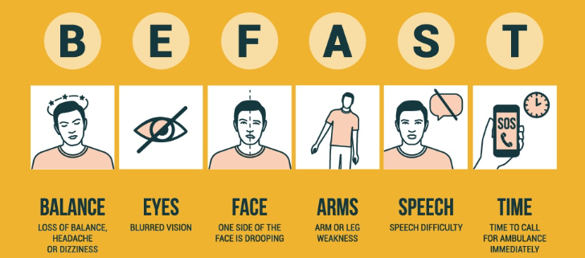
Stroke : Symptoms : Detection
Source: Semmes Murphy
Any One or Many - Condition Deteriorates Rapidly

Slide 11
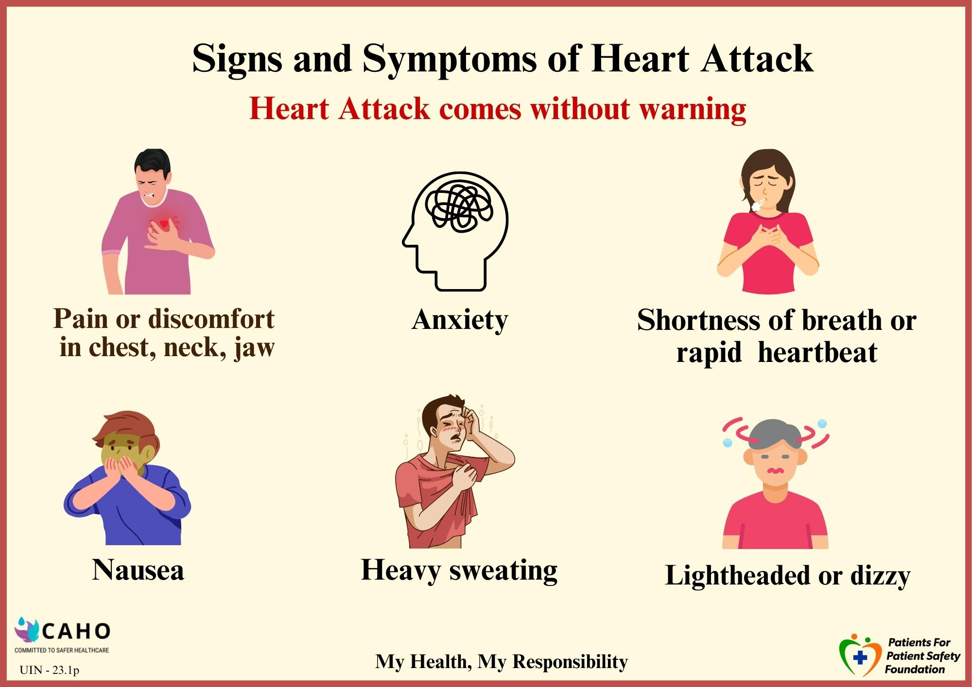
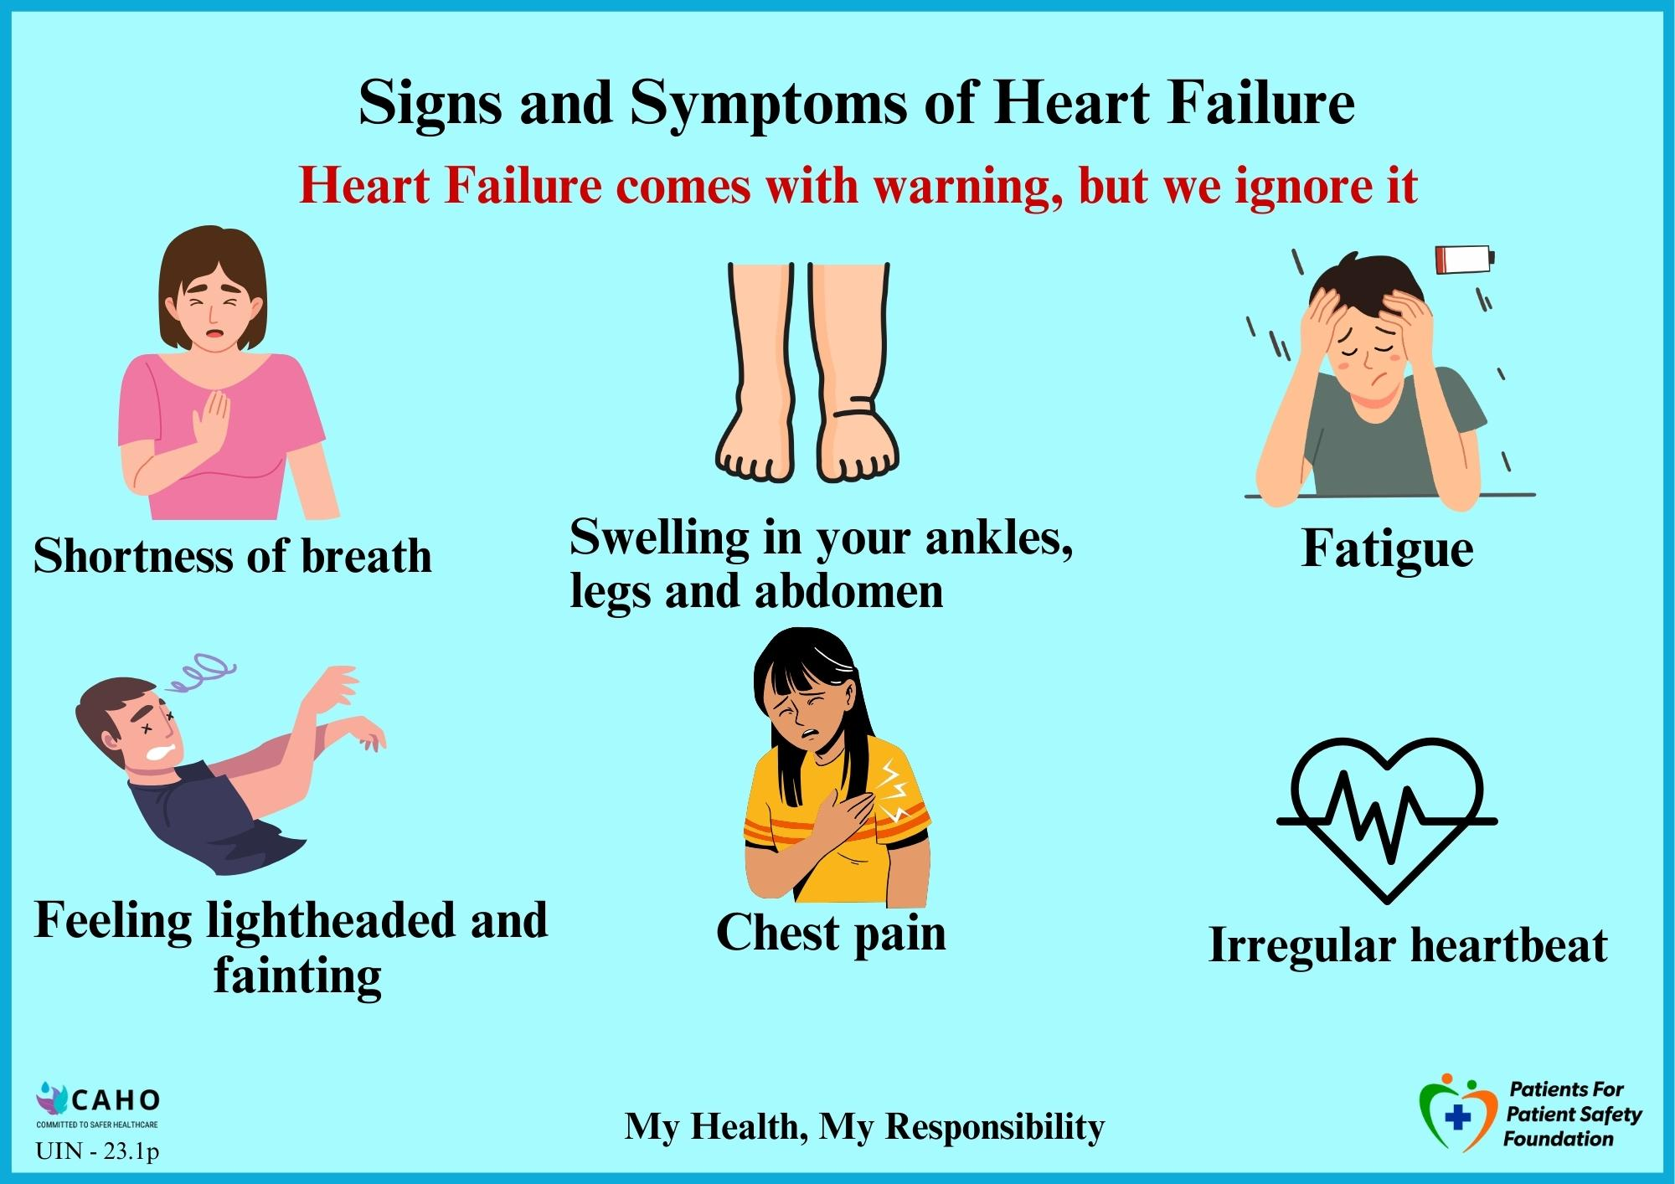
Heart Attack vs Heart Failure
Listen to your body

Slide 12
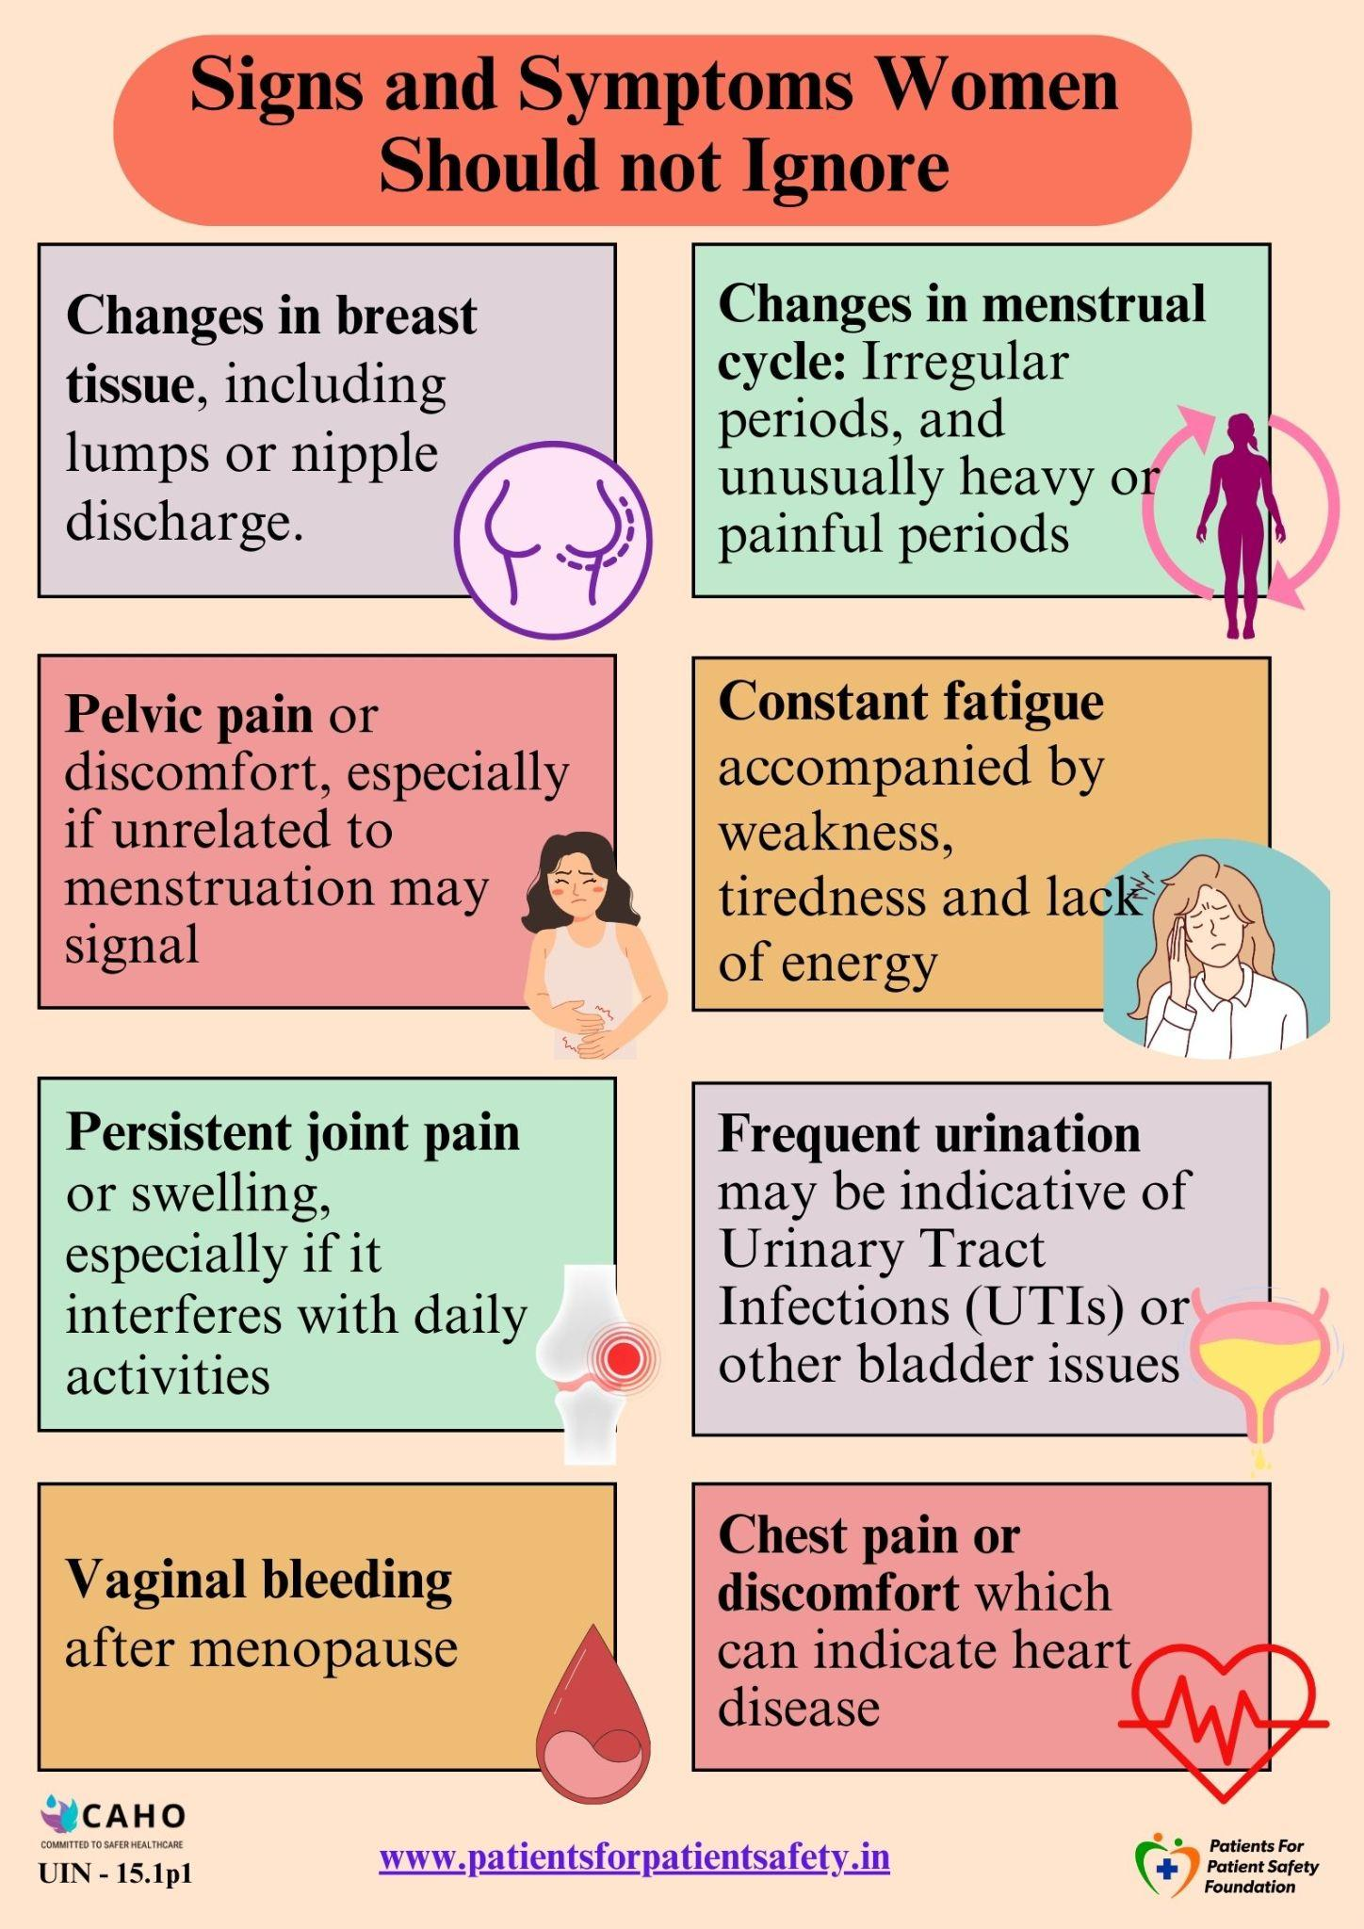

Prioritize Women’s Health

Slide 13
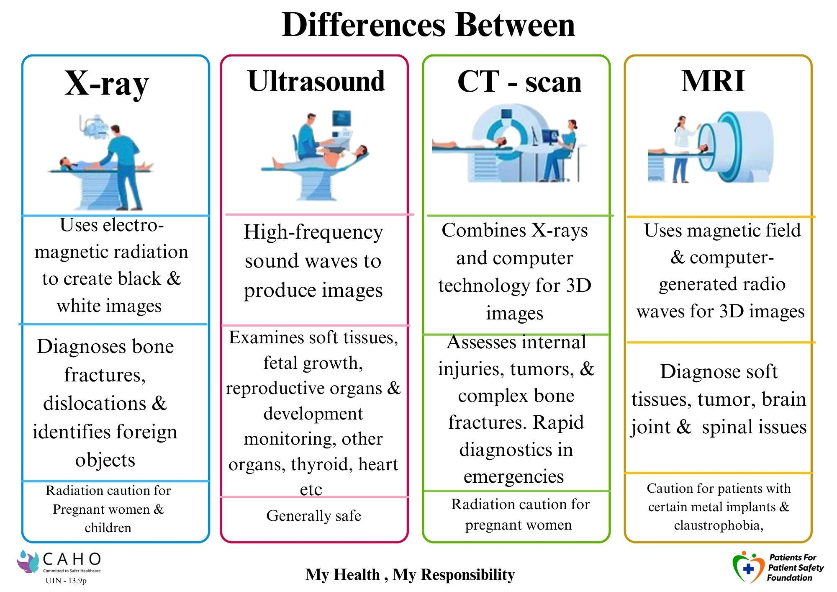
Power of Imaging Tests

Slide 14
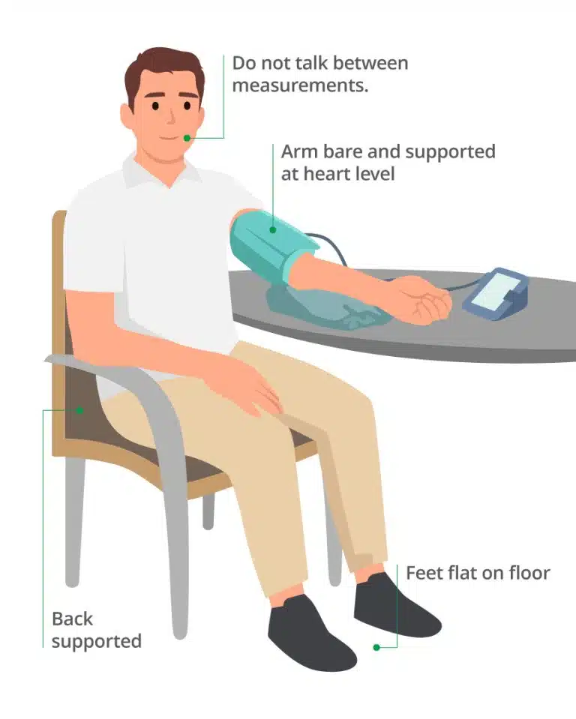
Measuring BP at home
Mistakes we make while measuring BP:
Incorrect Cuff Placement or Size
Improper Body Position
Not Resting Before Measurement
Talking or Moving During Measurement
Errors in Instruments- calibration

Slide 15
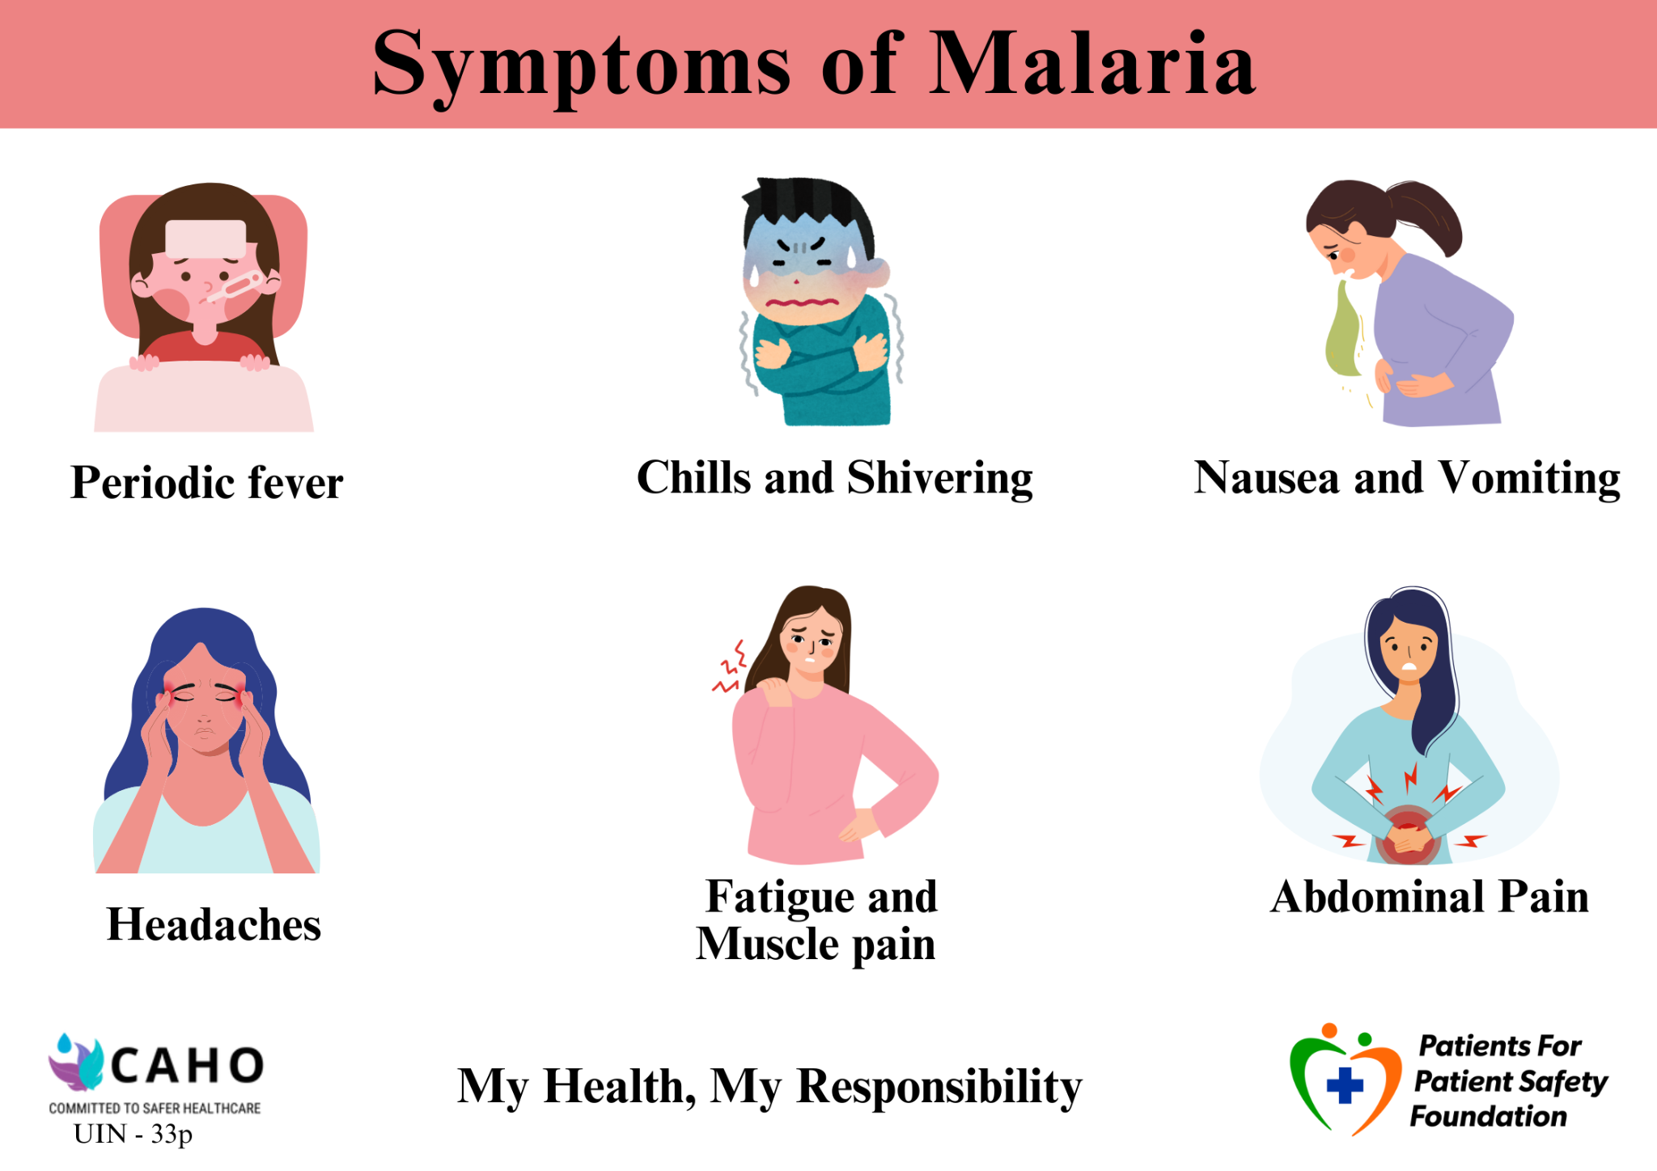
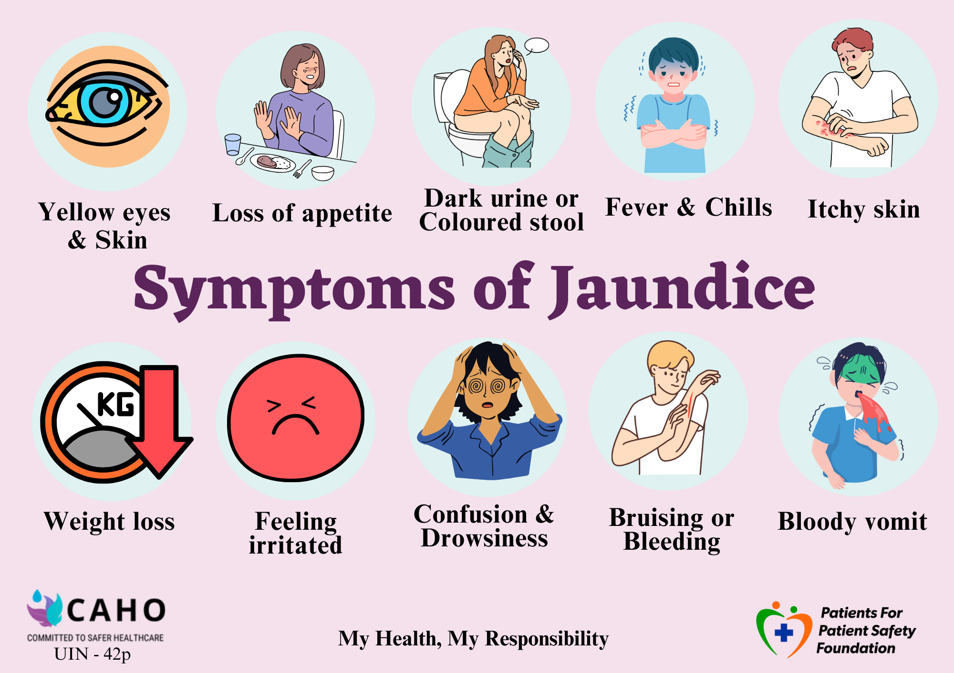
Communicable Diseases

Slide 16
Steps to Improve Diagnostic Safety
What Healthcare Providers can do:
Enhance communication with patient for pre test instructions, timing, reminders and explanation of reason and benefit of the test
Use diagnostic checklists and decision support tools to reduce human errors, ensuring accurate diagnosis
Promote a Team-based approach to gather multiple perspectives in diagnostic process.
Stay updated on emerging diagnostic techniques and conditions

Slide 17
Steps to Improve Diagnostic Safety
What Patients can do:
Provide complete medical history and describe symptoms clearly
Understand need for test, follow pre test instructions,
Keep track of your test results
Follow up doctor appointments with test reports
Ask questions to your healthcare provider about the diagnosis
Take Second Opinion if in doubt of diagnosis or treatment

Slide 18









Benefits to Healthcare Providers
Early Detection & Prevention
Greater overall profitability
Better Outcomes & Reduced Medical errors
Increased Reputation
Improved Trust & Satisfaction
Improved Patient Loyalty & Referrals
Personal and Professional Fulfillment

Slide 19
Improve Diagnostic Safety by Collaboration with Patients
The White paper is launched by Chairman of Kims Hospital Dr Achuto Samata, Dr Girdhar Gyani, Dr. Vijay Agarwal and Dr. Lallu Joseph on the occasion of WPSD’24 in Bhubaneswar conducted by CAHO East Zone
Title of White Paper
Engaging Patients to Enhance Patient Safety:
A Comprehensive Approach for Healthcare Providers
https://www.caho.in/files/White%20Paper-%20Engaging%20Patients%20To%20Enhance%20Patient%20Safety.pdf

Slide 20
Conclusion "Get it Right, Make it Safe”
Improving diagnostic safety requires collaboration among healthcare providers, diagnostic professionals, patients, and caregivers. By understanding diagnostic safety, identifying errors, and taking action, we can ensure safer healthcare.
Advice to Patients
GET INVOLVED, BECOME AWARE, ASK QUESTIONS
My Health My Responsibility
Advice to Healthcare Workers
Don’t just TREAT us, REACH us, TEACH us

Slide 21




Scan to leverage Patient Education Material
Patients for Patient Safety Foundation
Health Library
Infographics
Subscribe here
Newsletters

Slide 22





Save yourself & your family from medical harm
Ask Questions, Send feedback@
info@patientsforpatientsafety.in
Explore our website: www.patientsforpatientsafety.in
Subscribe to our Newsletters: https://www.patientsforpatientsafety.in/subscribe-us.php
My Health, My Responsibility
PFPSF-india
patientsforpatientsafety
pfpsfindia
patientsafety22
+919289696709

