Slide 1


















11TH INTERNATIONAL PATIENT SAFETY CONFERENCE
Panel Discussion
Patient Advocacy in Action:
Amplifying Patient Voices for Systemic Change
23rd February 2024 IPSC Bangalore
Ms Nadira Chaturvedi - Co-Chair,
Patients for Patient Safety Foundation(PFPSF)

Slide 2









Disease centric or patient centric?
11TH INTERNATIONAL PATIENT SAFETY CONFERENCE
How do I know if my symptoms are serious enough?
How do I know its an Emergency and how should I respond?
Shall I take a second opinion?
When & How?
Is my diagnosis
correct?
Is the diagnostic test prescribed necessary?
How can I prevent falls at home?
Why do Adults need Vaccination?
What are my rights as a patient?

Slide 3
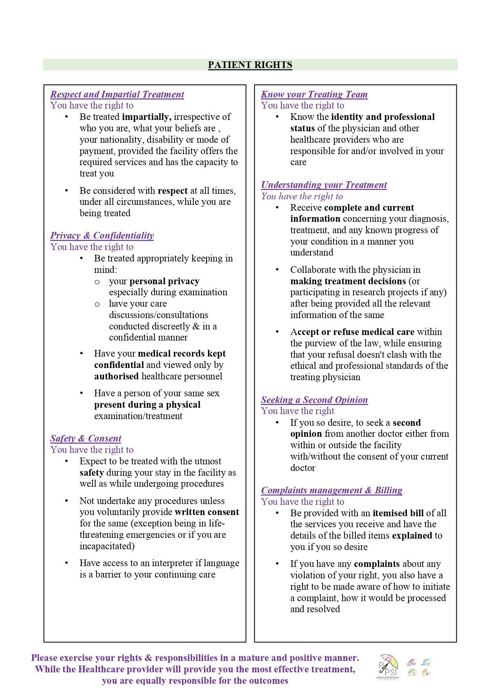
Patient Rights - English
11TH INTERNATIONAL PATIENT SAFETY CONFERENCE

Slide 4
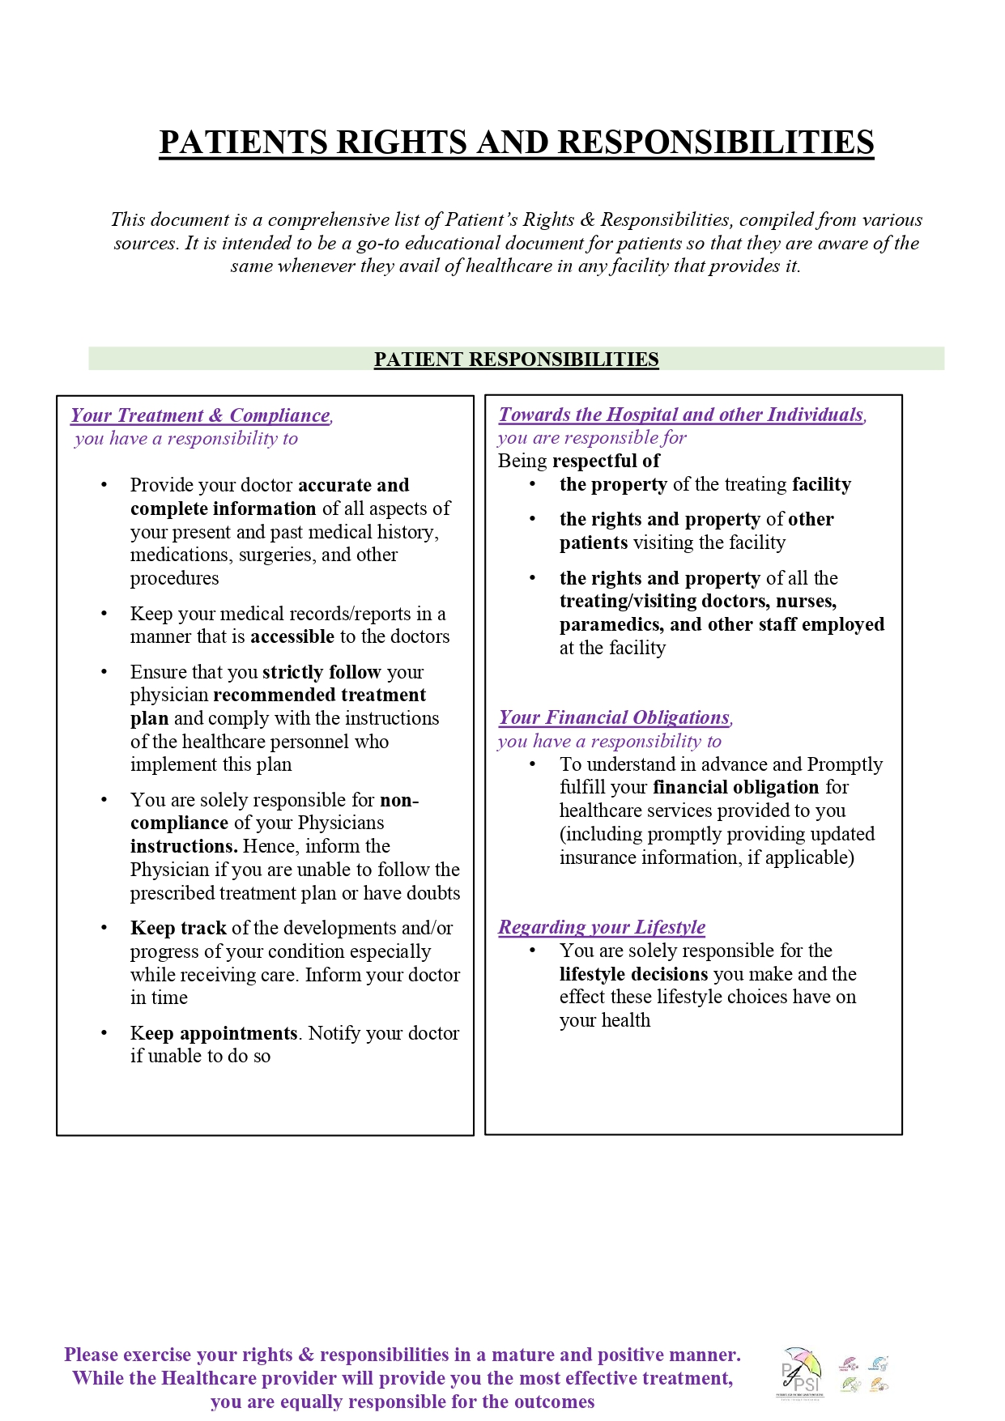
Patient Responsibilities - English
11TH INTERNATIONAL PATIENT SAFETY CONFERENCE

Slide 5


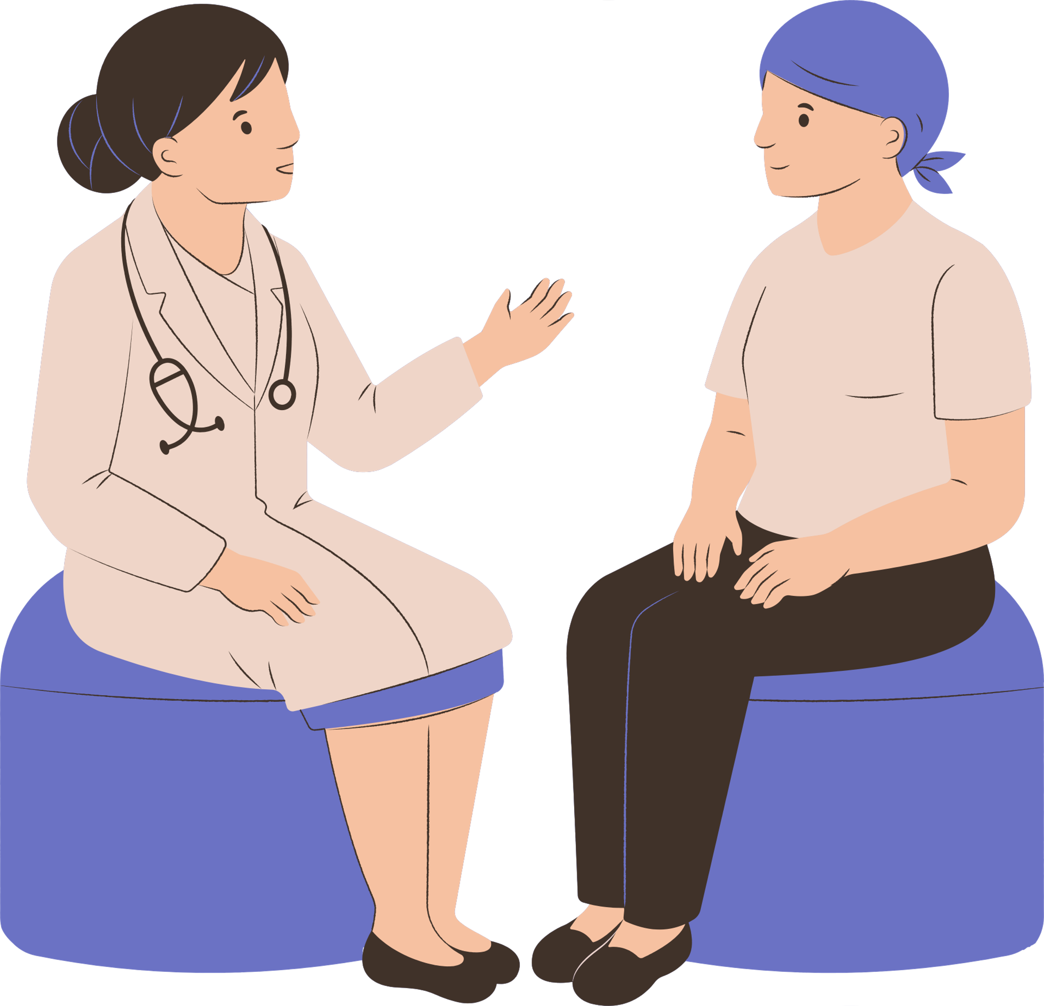
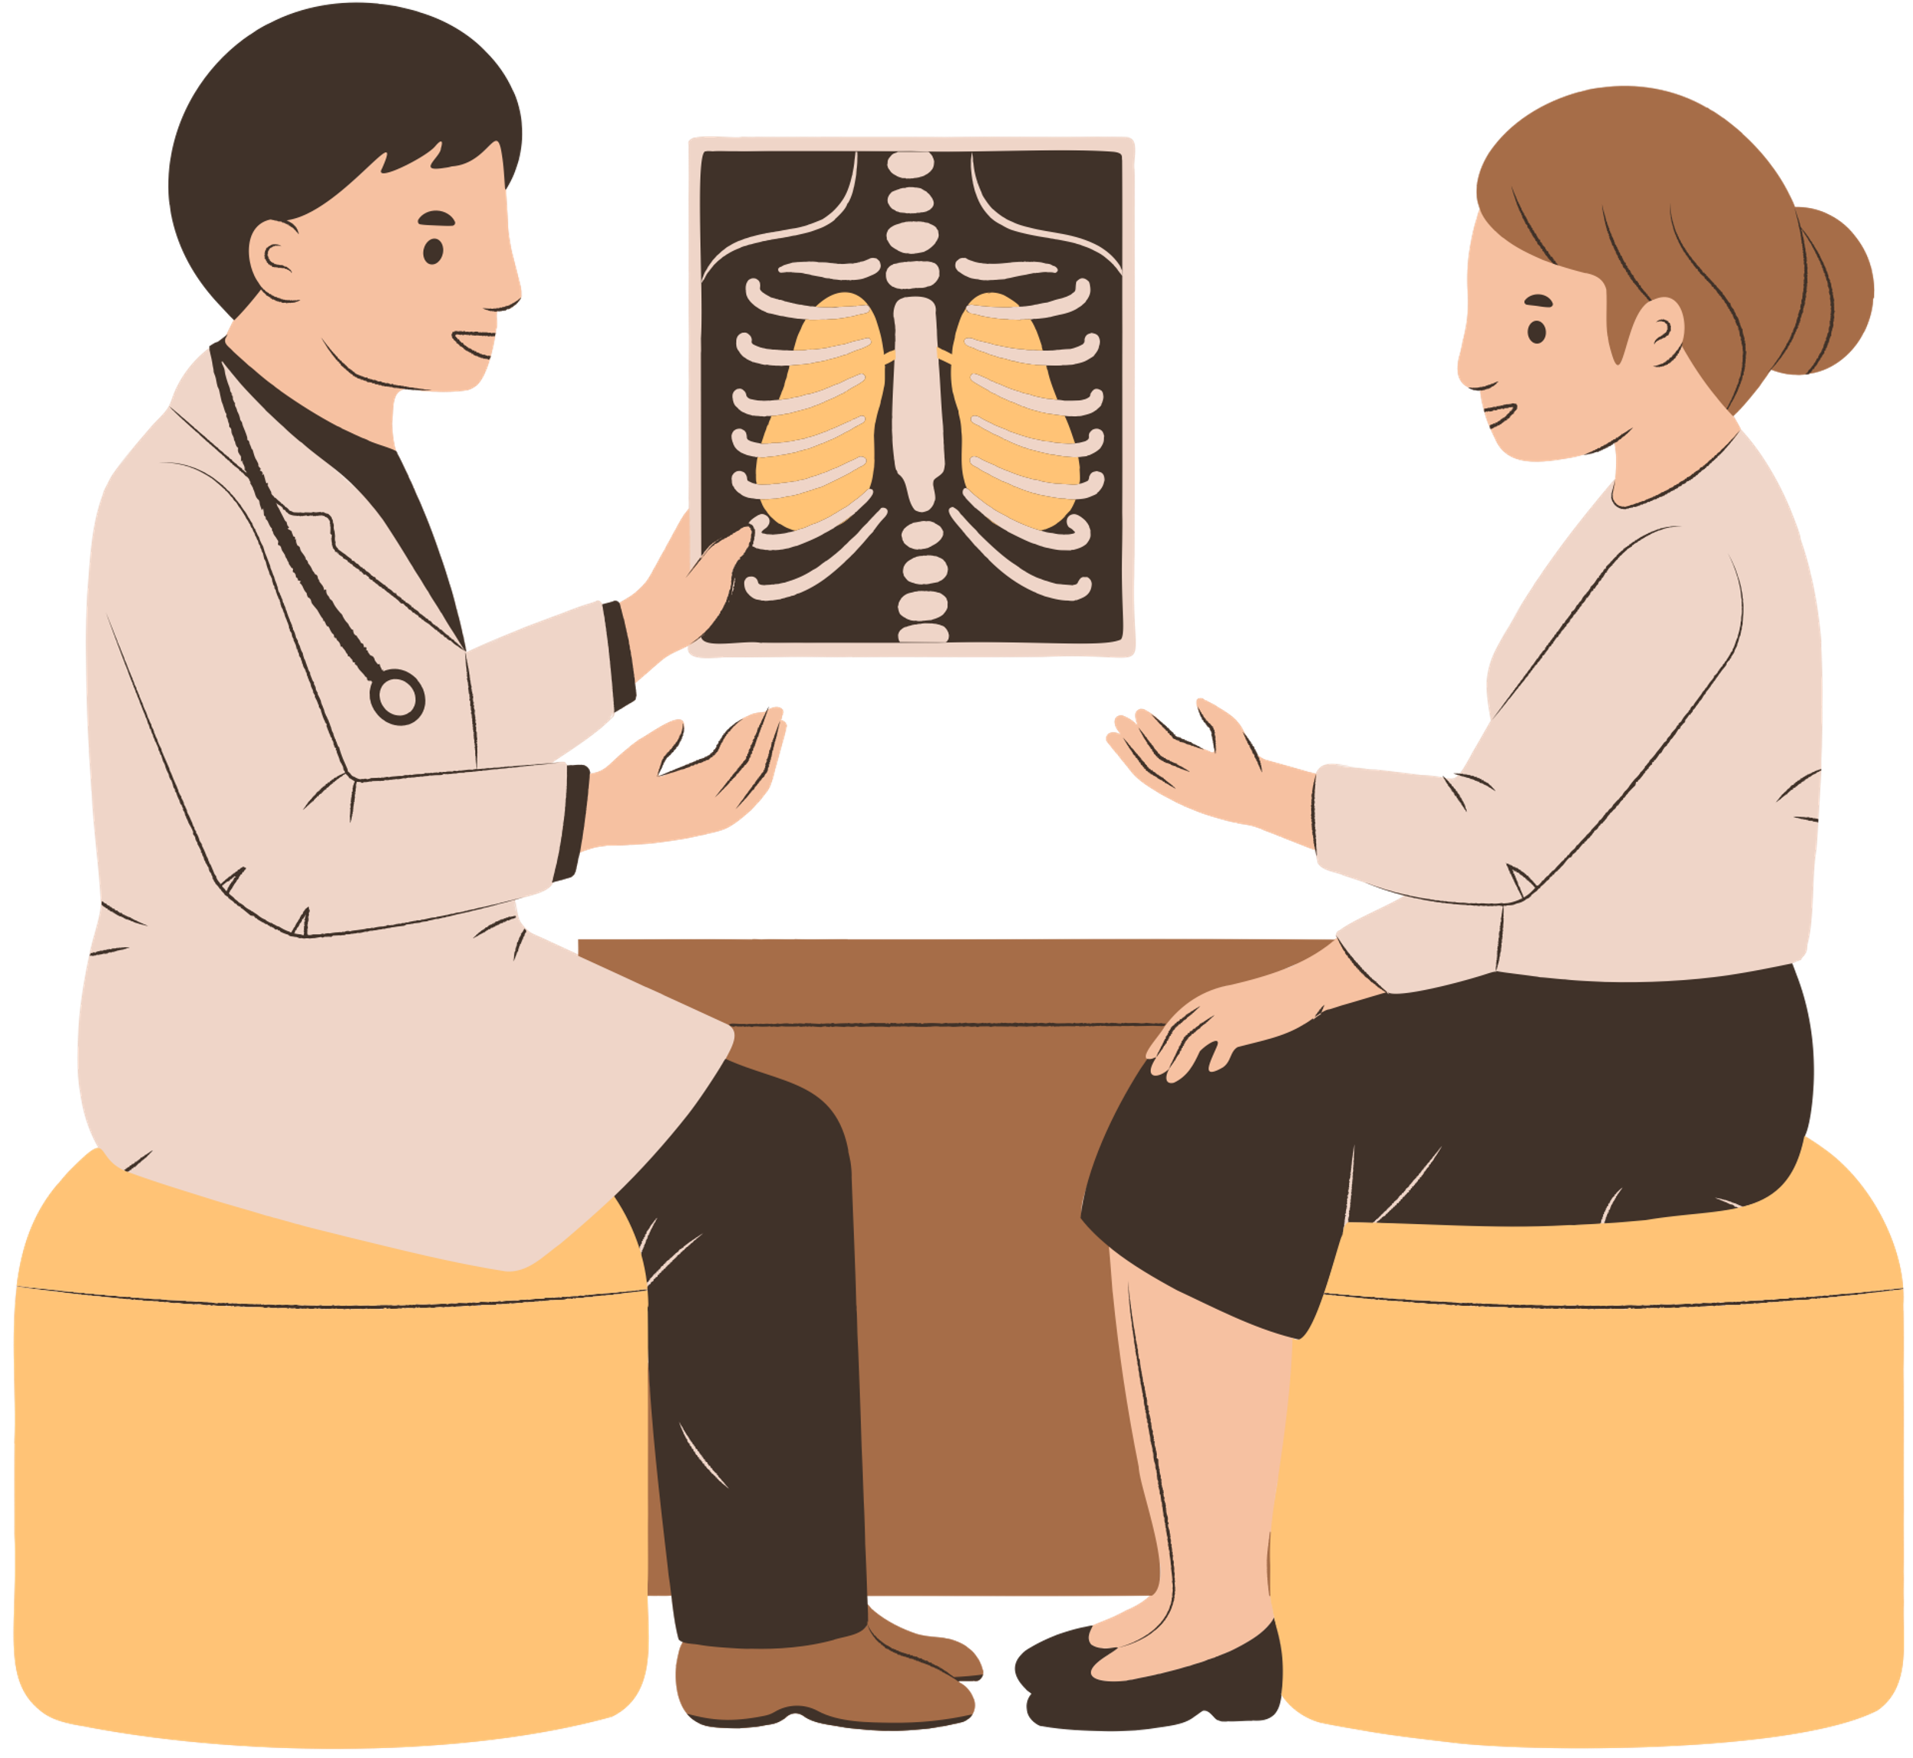
Patient has a Right to
11TH INTERNATIONAL PATIENT SAFETY CONFERENCE
Safe and Quick Recovery
Clear and Effective Two-way Communication
Receive Empathy, Respect, and Dignity
Access to Information , Records, to help decide
Response to Questions, proactive education
Coordination of care across specialties
Transparent & Consistent billing - faster discharge

Slide 6
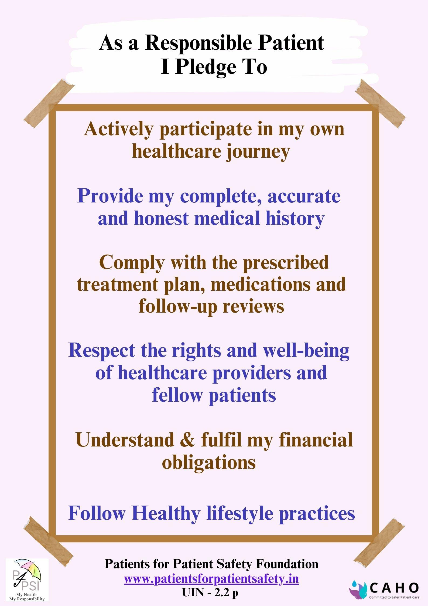
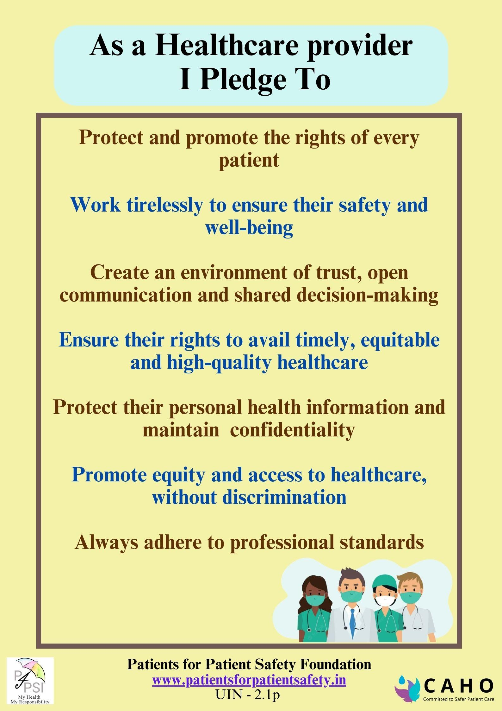
Patient - Provider Partnership
11TH INTERNATIONAL PATIENT SAFETY CONFERENCE

Slide 7
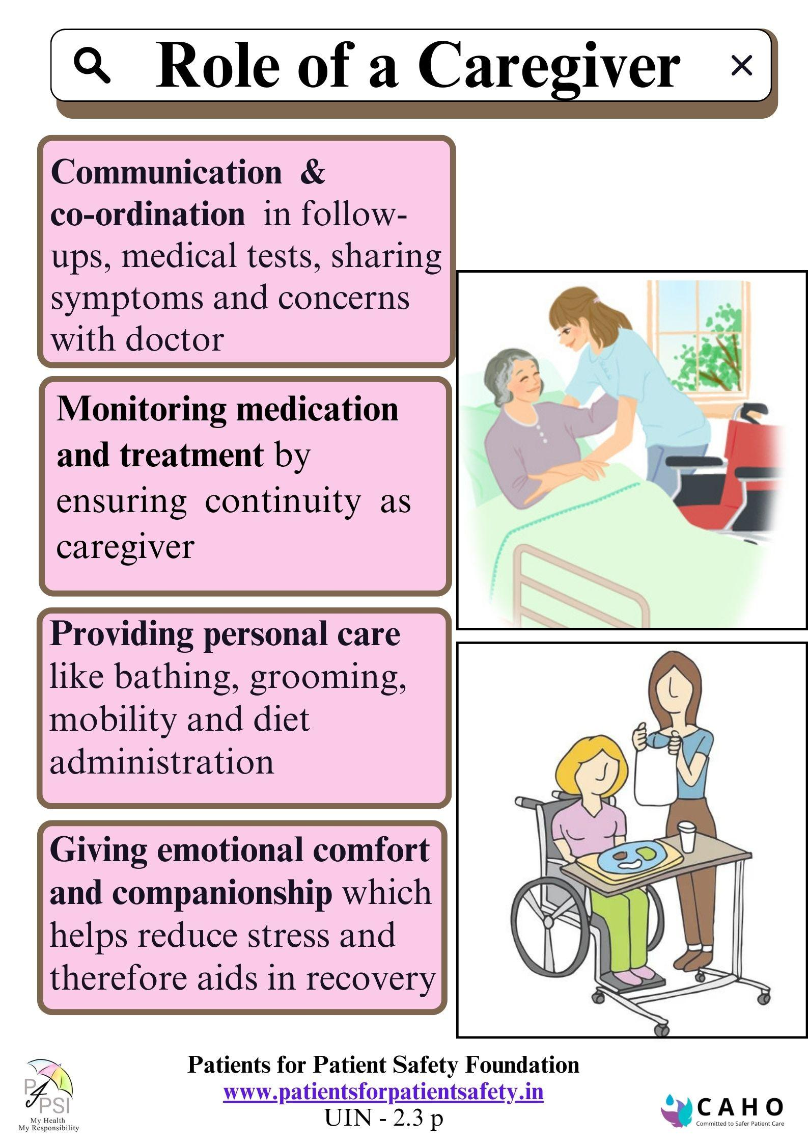
Role of a Caregiver
11TH INTERNATIONAL PATIENT SAFETY CONFERENCE

Slide 8
Strategies to Engage Patients in Safe Care
11TH INTERNATIONAL PATIENT SAFETY CONFERENCE
Getting Patient centricity across the Organization
Establish Patient Advisory Councils -bridge build partnerships
Establish Patient centred education and awareness program- shared decision making for better compliance
Establish Feedback and Experience sharing platforms- learn from your customer
Two way Communication – bridge the trust deficit
Will help to improve patient outcomes, increase satisfaction and build trusted relationship

Slide 9


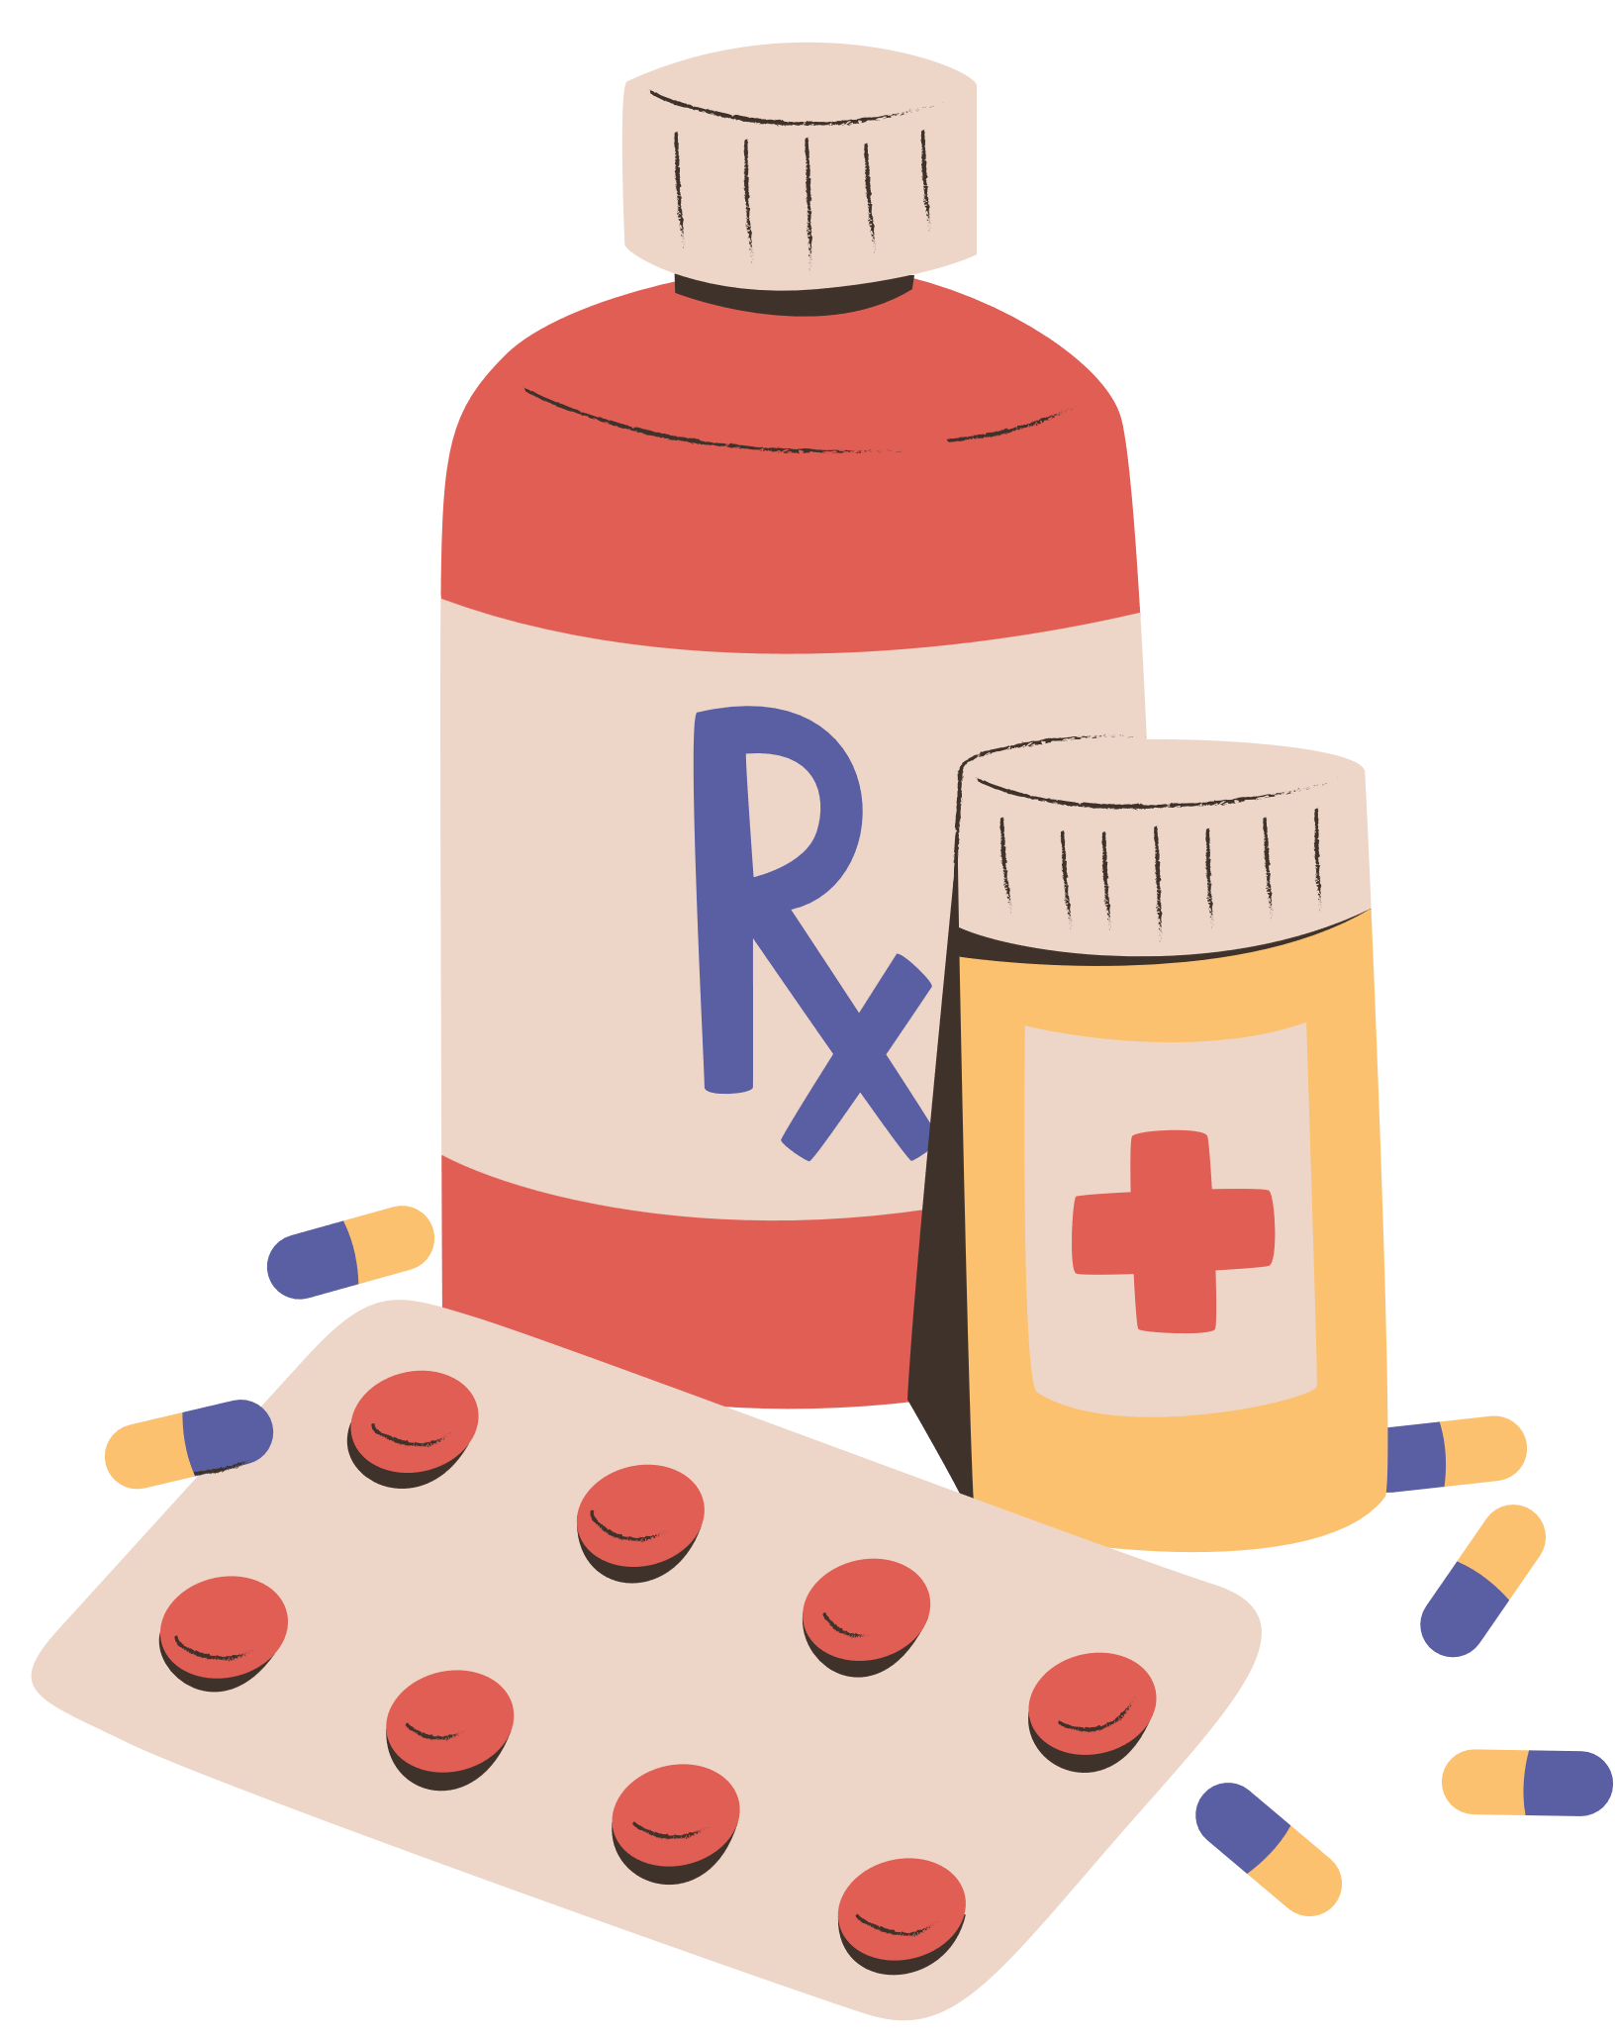
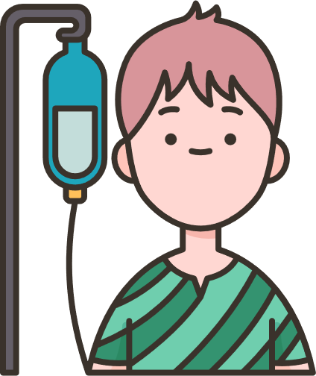


We help by engaging Patients & Caregivers
11TH INTERNATIONAL PATIENT SAFETY CONFERENCE
Understand their Rights, Roles and Responsibilities
Know Risk & Causes of Medical harm & guidelines to help prevent
Guidance on the Role that Patients can play
Provide alerts, tips, and advice for a Safe Patient Journey
Knowledge of healthy lifestyle choices

Slide 10
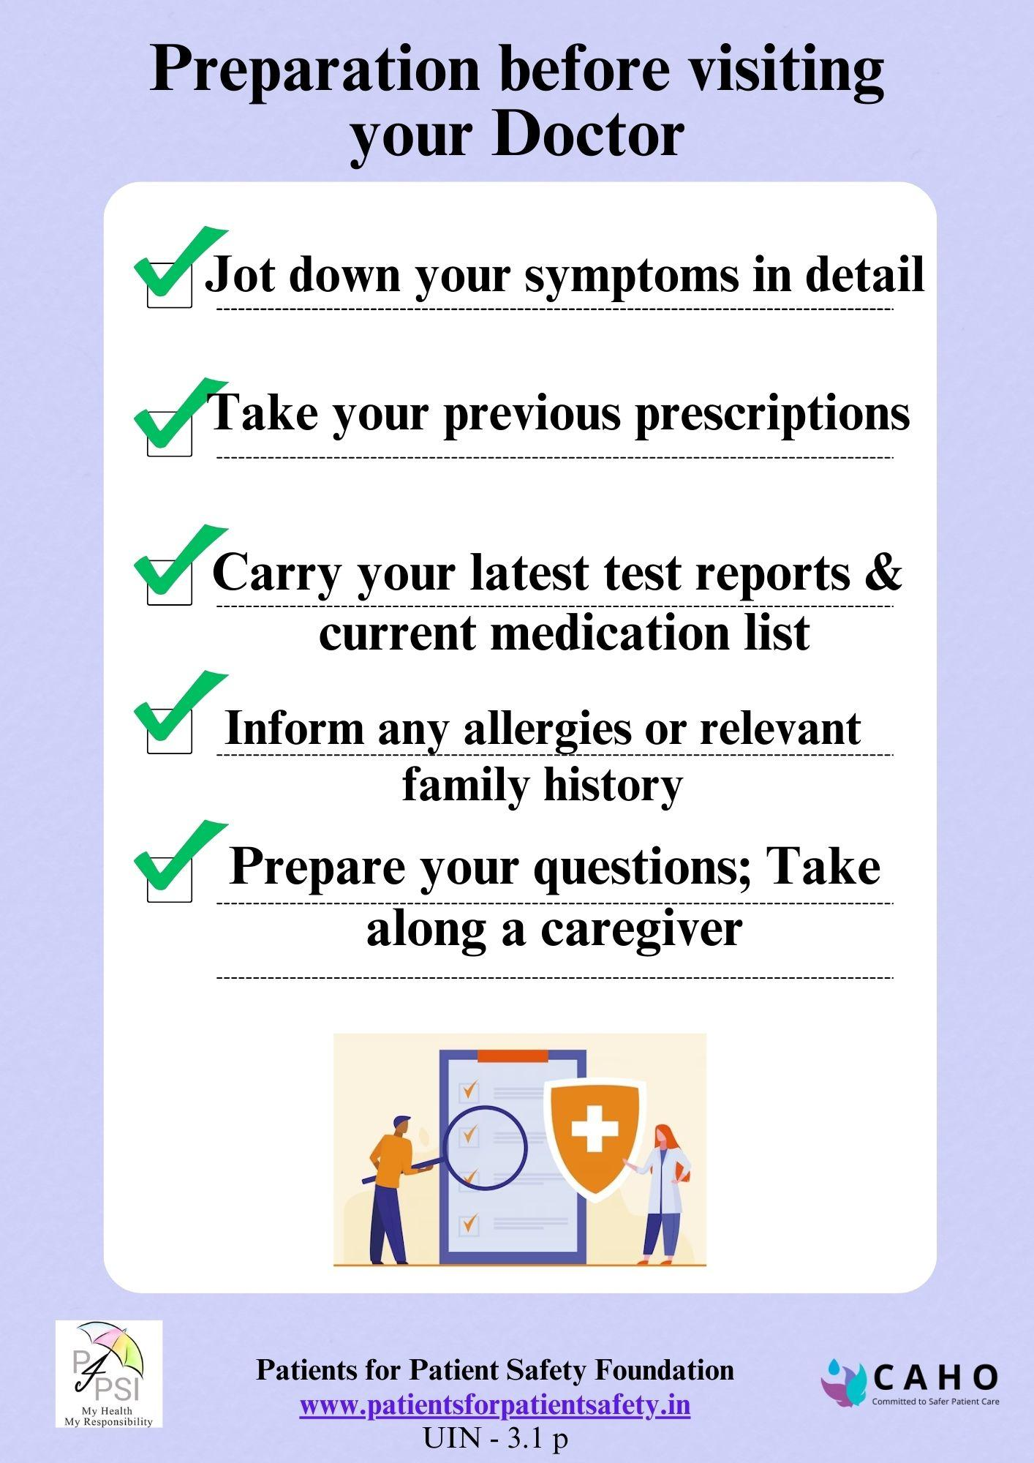
Preparing for meeting a doctor?
11TH INTERNATIONAL PATIENT SAFETY CONFERENCE
Due to stress; incomplete communication
Forget to mention all symptoms; bring previous reports; medical history
Unable to absorb all the information & guidance
Not asking important questions

Slide 11
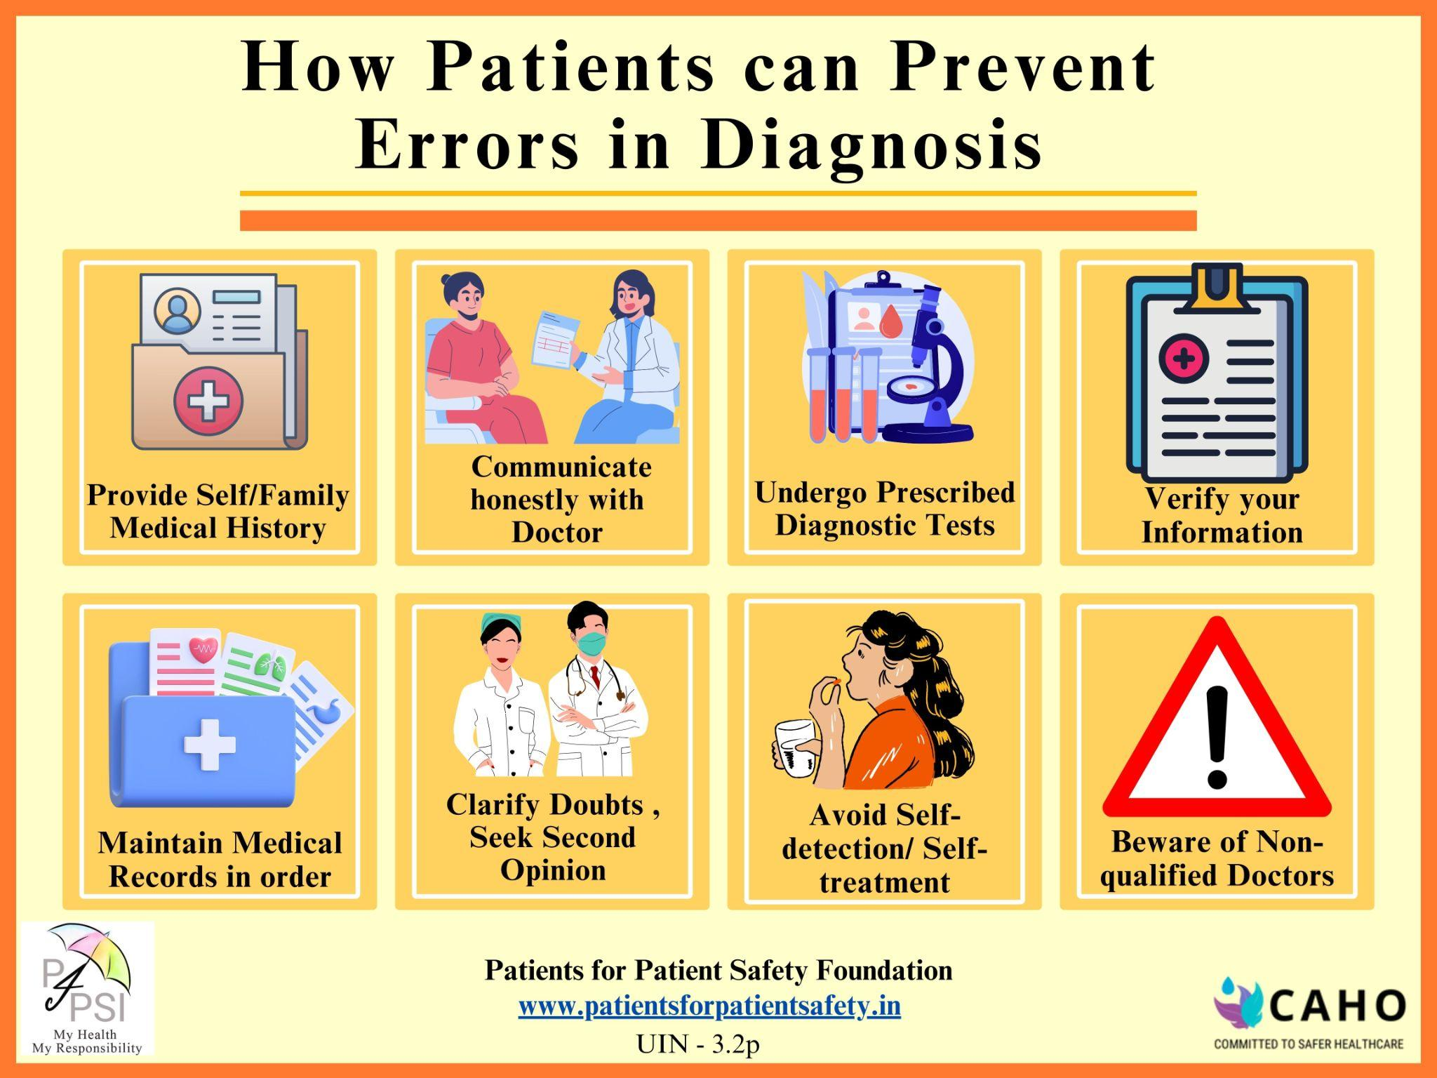
Diagnosis Errors Make Ailment Worse
11TH INTERNATIONAL PATIENT SAFETY CONFERENCE
Why do they happen:
Provide incomplete or inaccurate medical history
Hesitation to disclose sensitive information
Self-diagnosis and reliance on internet information
Lack of communication
Failure to follow medical advice
Not verifying personal details

Slide 12
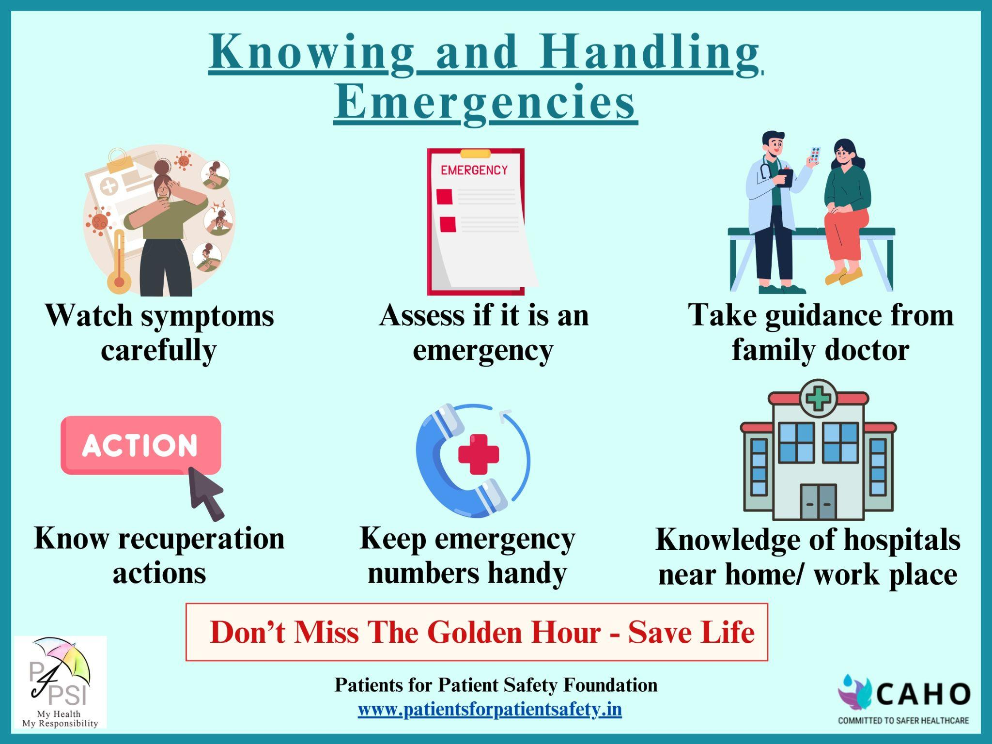
Emergencies Come Unannounced
11TH INTERNATIONAL PATIENT SAFETY CONFERENCE
Are we prepared:
We don’t know - it is an emergency
What type of emergency
Who to contact for help
Which hospital to take
What to do while we wait for help

Slide 13
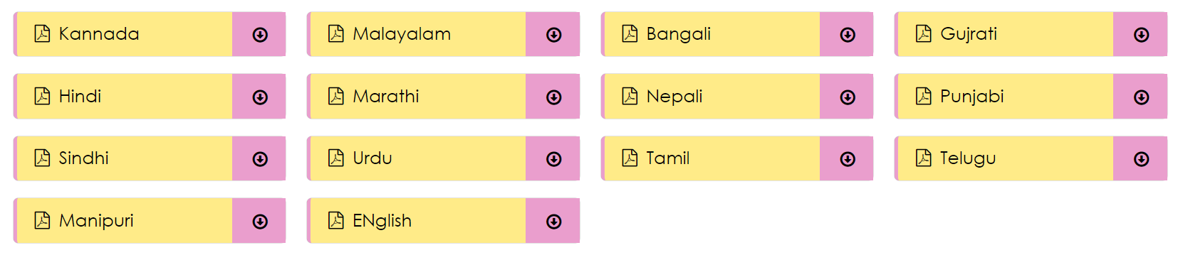

Patients for Patient Safety Foundation
www.patientsforpatientsafety.in
Regional Language Translations are available on our website
Bengali
Gujarati
English

