Slide 1



Elevate the Voice of Patients
Is Patient a Customer?
Patients for Patient Safety Foundation

Slide 2
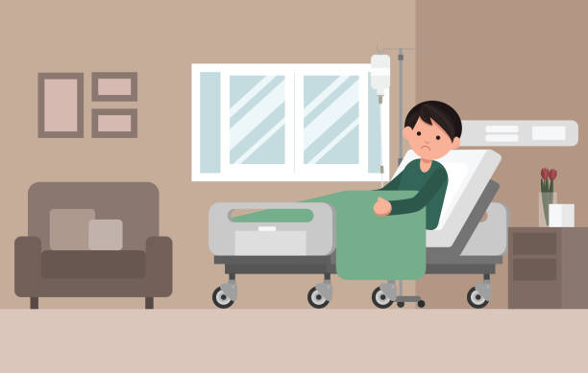

Several Moments of Truth - In a Patients Journey
General
Physicians
Pharmacies
Pharma
Companies
Hospitals, Doctors/
Nurses
Path Labs
Specialists
Insurance
Companies/TPA
Diagnostic Centres
Families/ Caregivers
Most Interventions focussed on Treatment/ Diseases
Notes:
1. Errors can happen at each stage
2. Patients are rarely involved in their own care
3. Several “Moments of Truth” during patient's journey

Slide 3

Concerns Patients Have
Are my symptoms
serious?
What all do I tell the
doctor?
Shall I take a second opinion?
When & How?
Is my diagnosis
correct?
How expensive is the
treatment?
Are all the tests
required?
Where can I get
answers to these
questions?
How should I keep my
records?

Slide 4



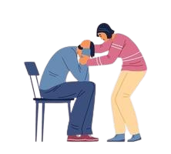

Patients are Customer - and more
A customer is someone who pays for a product or service she/he receives
Patients are Customers but much mor﻿e
  Do not come by choice; are compelled/ is an Emergency
  Do not understand the complexity of either illness or treatment
  They are Anxious; Concerned; Disturbed; Vulnerable
  The Healthcare expenses are sudden, unknown & unplanned
  All Family members affected and in distress
  Depends on good faith and trust in the Healthcare provider.
Only expectations is safe & and quick recovery, attention, and empathy

Slide 5





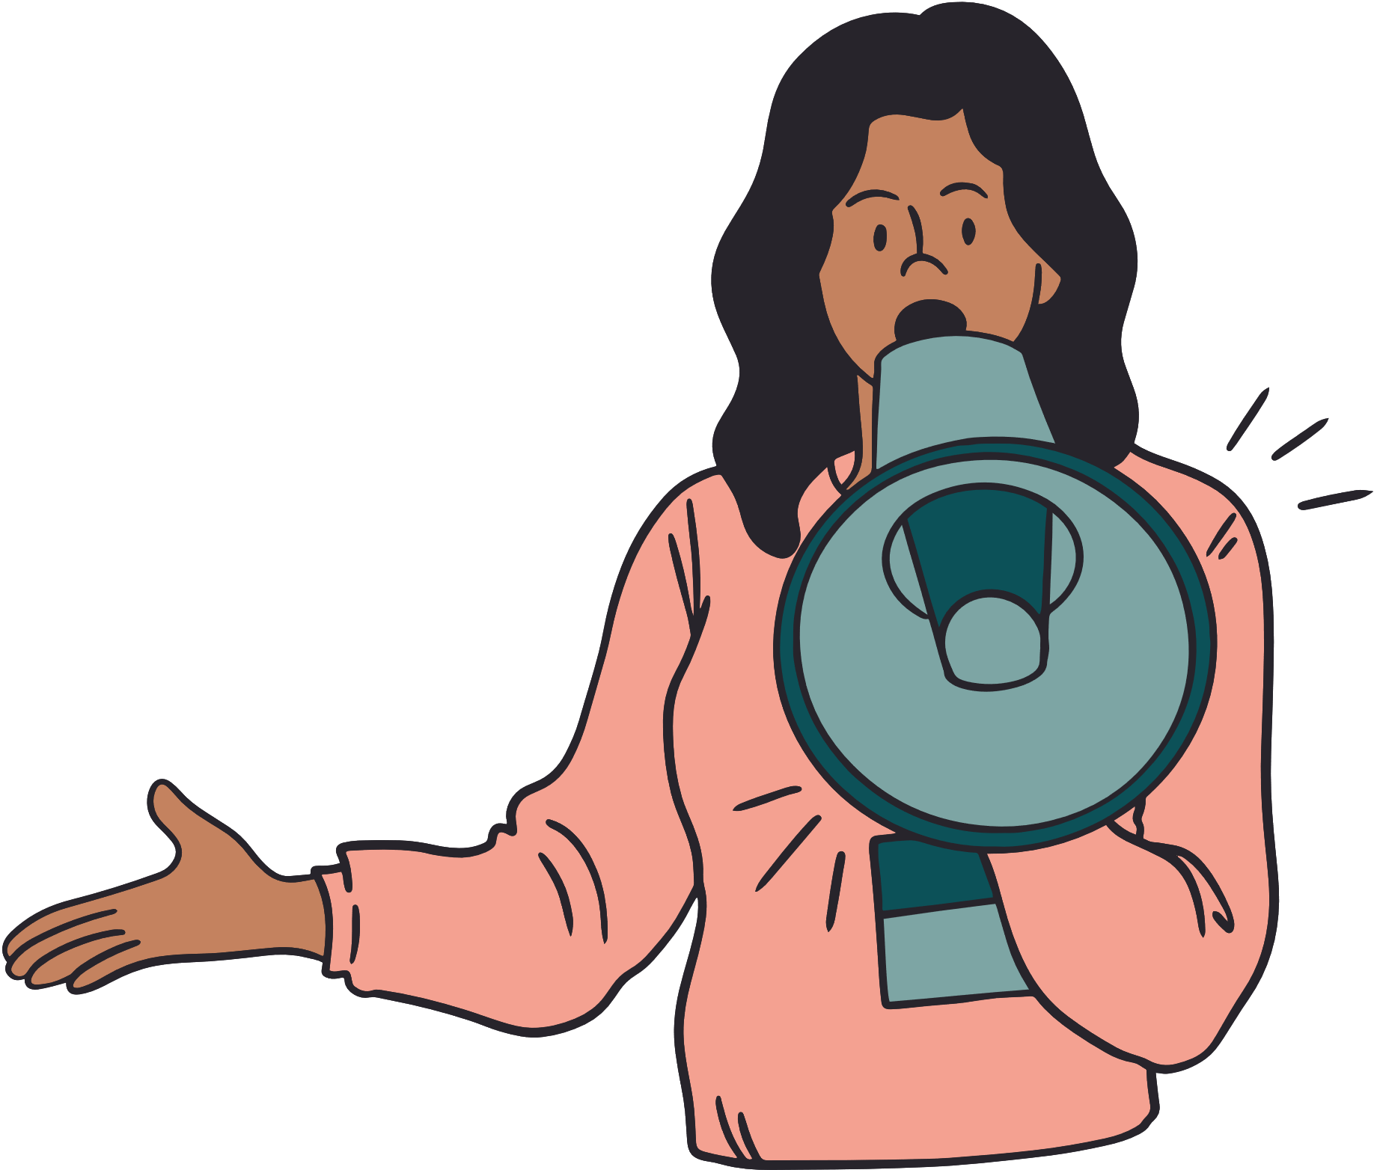

Patients and Caregivers can help to improve safer outcomes?
Being Alert - Asking Questions
Providing Complete Information
Following Prescriptions/ Advise
Keeping Track of Medication/ Symptoms
Getting a Second
Opinion; Building Trust
Keeping Updated Medical Records
Giving
Valuable Feedback

Slide 6



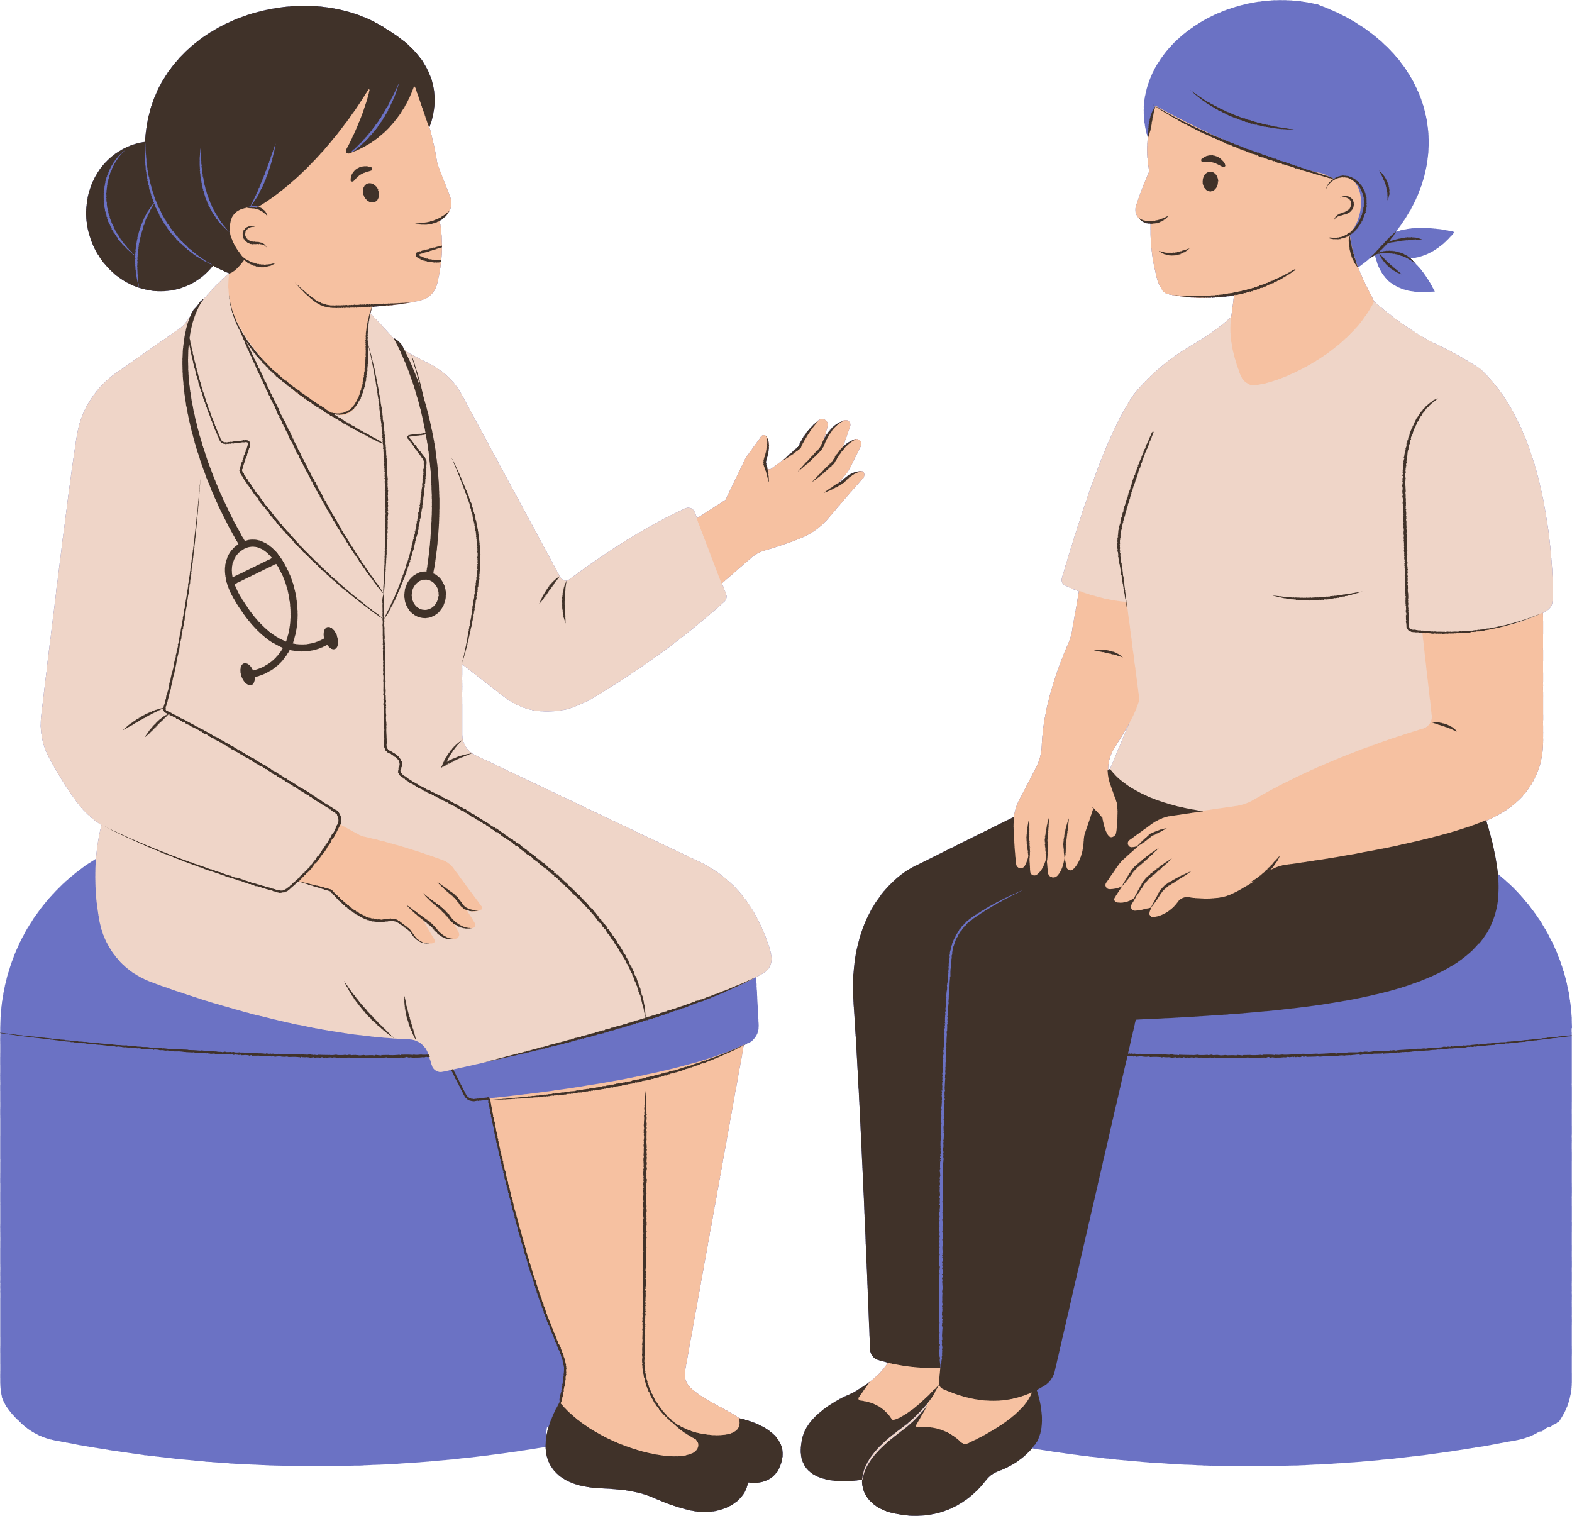



Expectations of Patients
Safe and Quick Recovery
Clear and Effective Two-way Communication
Receive Empathy, Respect, and Dignity
Encourage Questions & Respond
Access to Information
to help decide
Coordination of care across specialties
Transparent & Consistent billing - faster discharge

Slide 7








Advantages of Patient-Centricity
Early Detection & Prevention
Greater overall profitability
Better Outcomes & Reduced Medical errors
Increased Reputation
Improved Trust & Satisfaction
Improved Patient Loyalty & Referrals
Personal and Professional Fulfillment

Slide 8


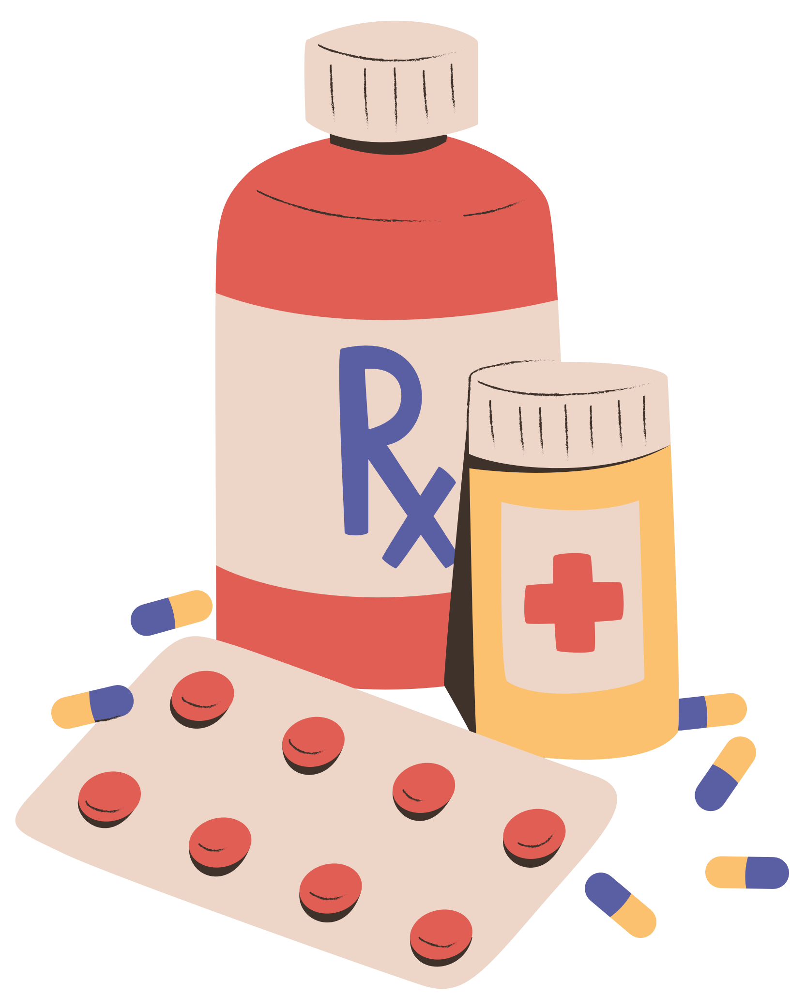
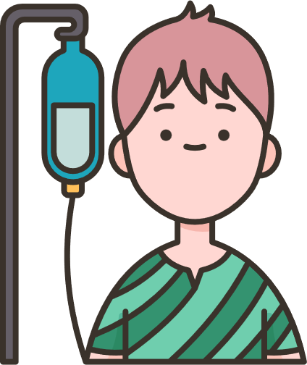


How will PFPSF help the cause
Make patients understand their Rights and Responsibilities
Risk & Causes of Medical harm, Guidelines to help prevent
Guidance on the Role that Patients can play
Provide alerts, tips, and advice for a Safe Patient Journey
Knowledge of healthy lifestyle choices

Slide 9
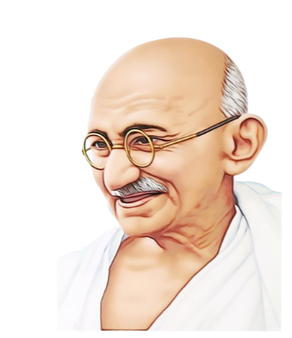
Patient is a Customer
A customer is the most important visitor on
our premises, he is not dependent on us.
We are dependent on him.
He is not an interruption in our work.
He is the purpose of it.
He is not an outsider in our work.
He is a part of it.
We are not doing him a favor by serving him.
He is doing us a favor by giving us an
opportunity to do so.
Let’s all become Patient Centric

