Slide 1

World Patient Safety Day Patna – 17th September 2023
Why is patient engagement challenging to HCP
How can we work towards it
Patients for Patient Safety Foundation

Slide 2









HCP-Disease centric or Patient centric?
Are my symptoms
serious?
Is my diagnosis correct?
What all do I tell the doctor?
Shall I take a second opinion?
When & How?
How expensive is the treatment?
Where can I get answers to these questions?
Are all the tests
required?
How should I keep my records?

Slide 3
Challenges in Patient Engagement
full faith, but trust deficit
For Healthcare Providers
Time shortage
Lack of importance or awareness of benefits of patient engagement
Fear of reprisal if pateint is educated
Over worked, under staffed
Lack of pateint centricity
For Patients and Caregivers
Vulnerable, stressed
Time shortage
God syndrome wrt Doctors
Lack of awareness of R and R
Confused about disease, treatment
Demographic challenges

Slide 4
Way forward – build Patient- Centric culture
Behavioural Re- orientation of entire staff, refresher trainings
Shared decision making – keep patient fully informed ,involved
Structural aspects- Patient Advisory Councils PAC
Patient education on early prevention and intervention
Gathering patient experience and feedback for futrue improvements
Local support groups

Slide 5
Some Tools of Engagement
Promote Rights and Responsiblities
Patient education material outreached to patients, vendors, associates-prints, digital display, visual literacy
Forums to gather patient expereince, feedback, provide counselling
Make multi- departmental and cross hierarchy groups for continuous improvement with patient insights
Training progrms and currculums in nursing, medical, administrative colleges

Slide 6







My Health My Responsibility
how can patients engage
Being Alert - Asking Questions
Keeping Track of Medication/ Symptoms
Providing Complete Information
Following Prescriptions/ Advise
Getting a Second Opinion; Building Trust
Keeping Updated Medical Records
Giving
Valuable Feedback

Slide 7
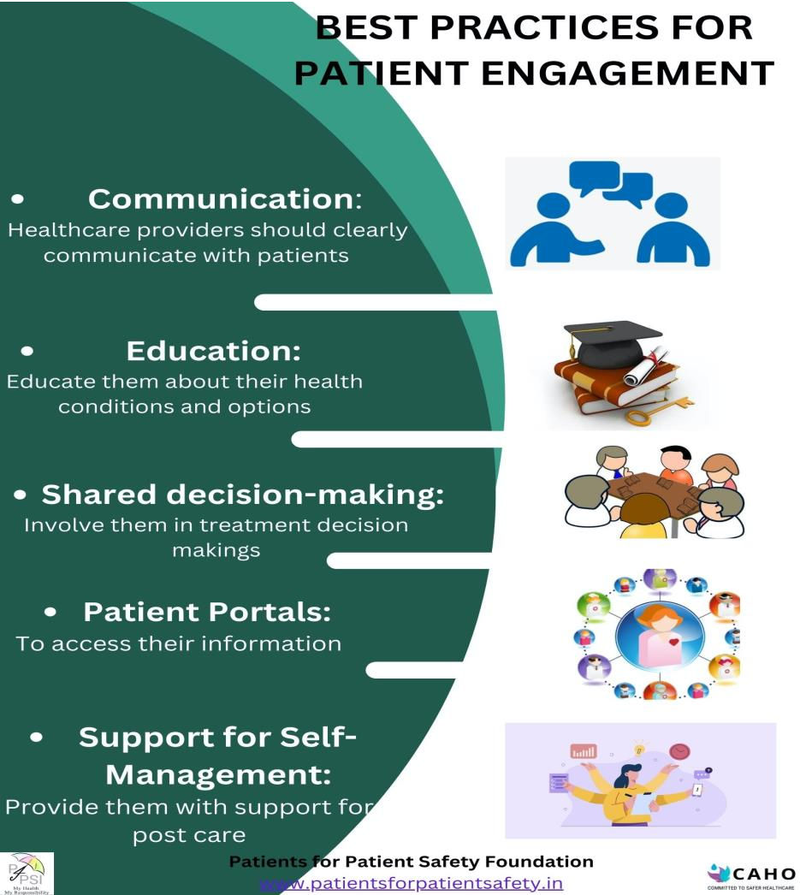
Your Health My Responsibility
How can HCP engage

Slide 8

How will PFPSF help
Make patients understand their Rights and Responsibilities
Risk & Causes of Medical harm, Guidelines to help prevent
Guidance on the Role that Patients can play
Provide alerts, tips, and advice for a Safe Patient Journey
Knowledge of healthy lifestyle choices

Slide 9
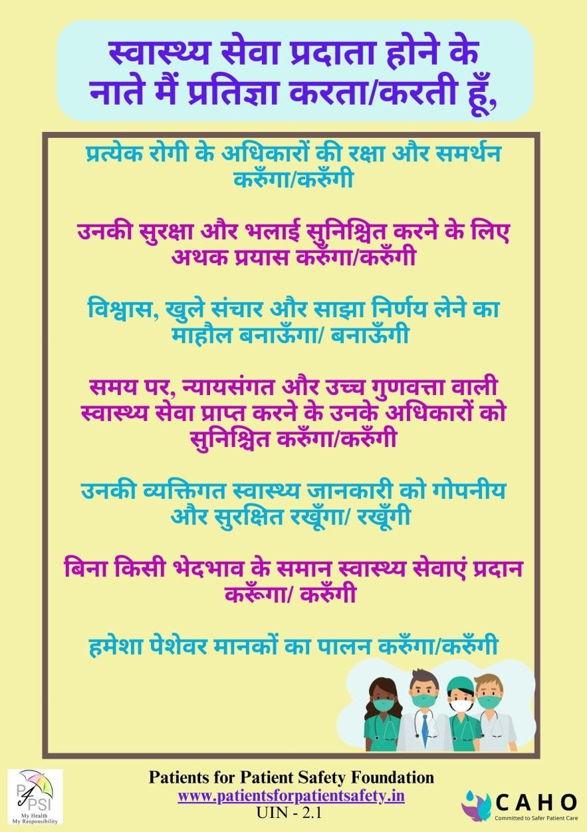
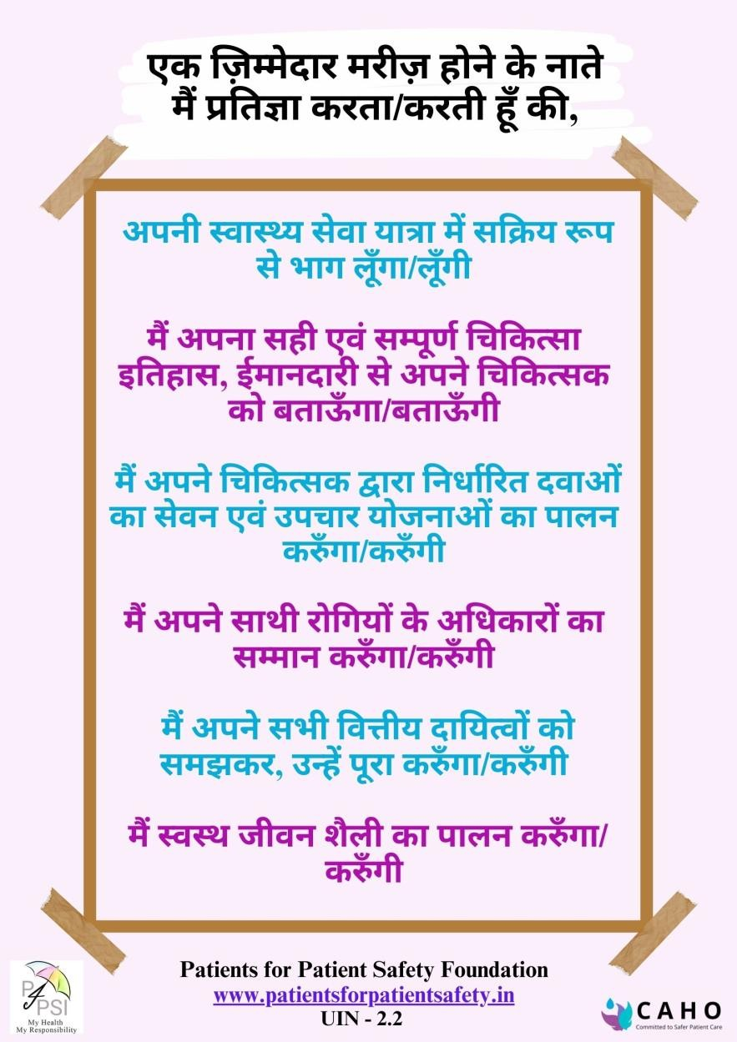
Partnership in safe care-take a pledge

Slide 10
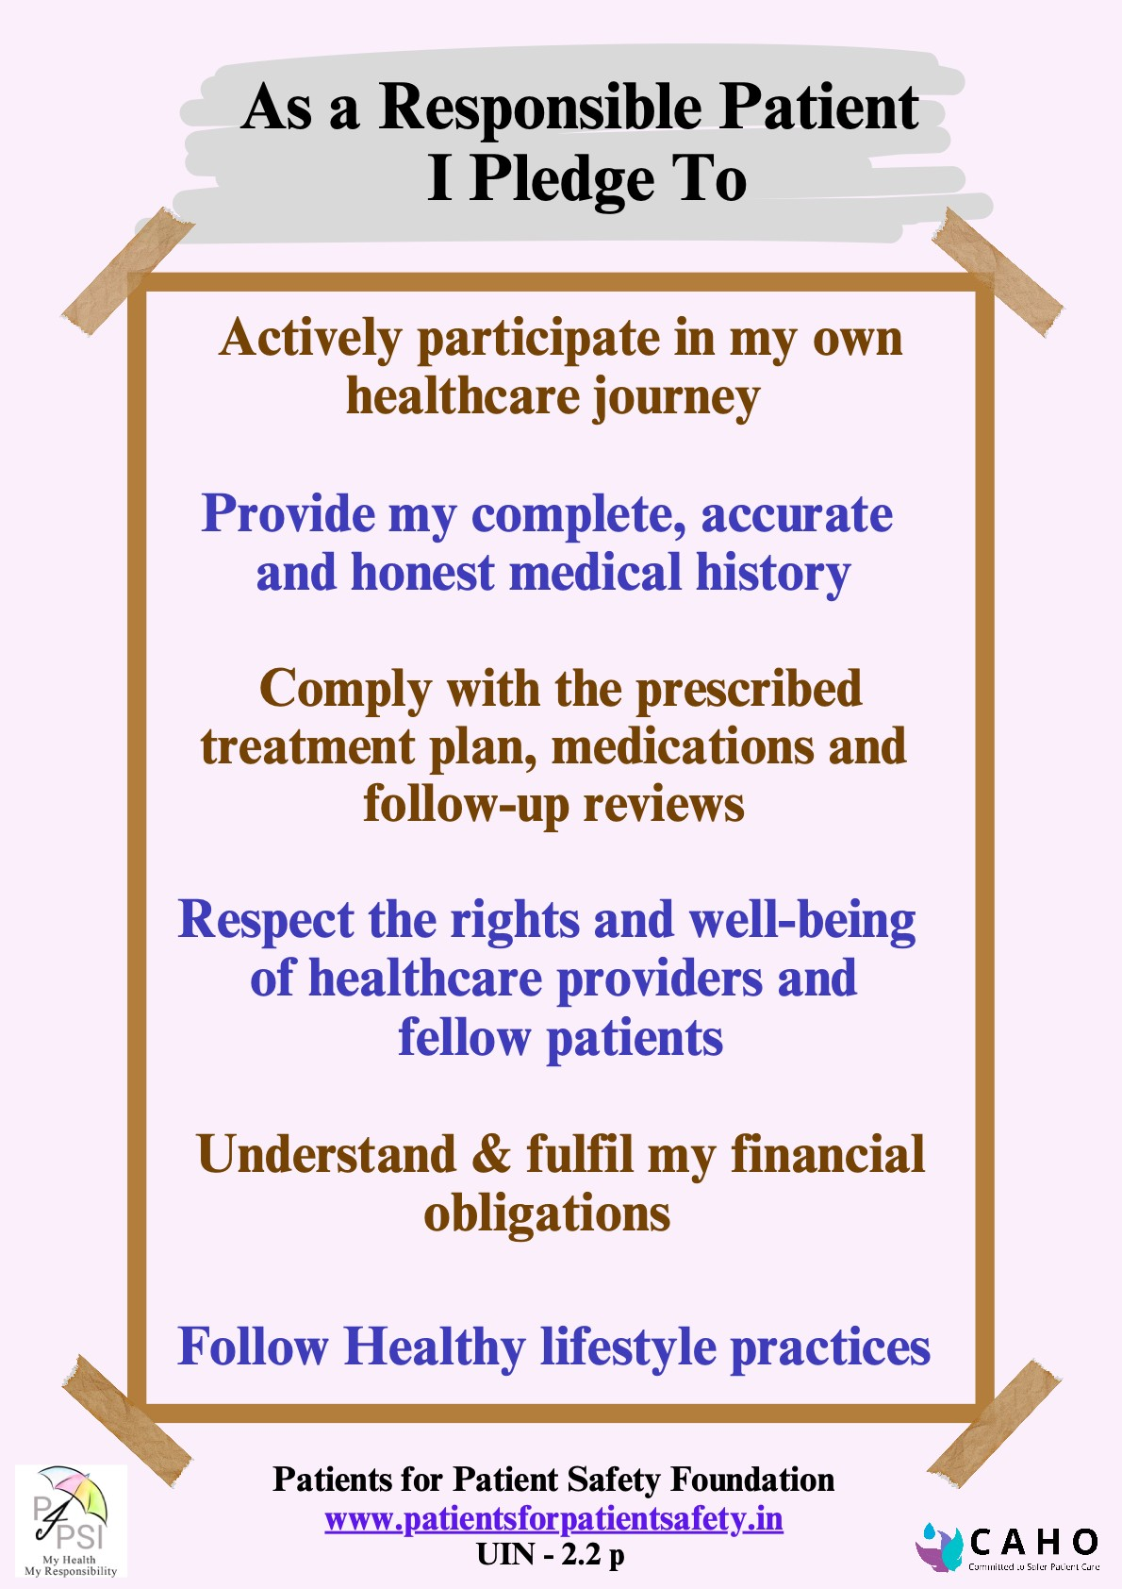



Partnership in safe care-take a pledge
Asa H ealthcare provider I Pledge To
Protect and promote the rightsof every patient
Work tirelessly to ensure their safety and well-being
Create an environment of trust, open communication and shared decision-making
Ensure their rightsto avail timely, equitable and high-quality healthcare
Protect their personal health information and maintain confidentiality
Promote equity and accessto healthcare, without discrimination
Alwaysadhere to professional standards
Patientsfor Patient Safety Foundation
www.patientsforpatientsafety.in
UIN - 2.1p

Slide 11
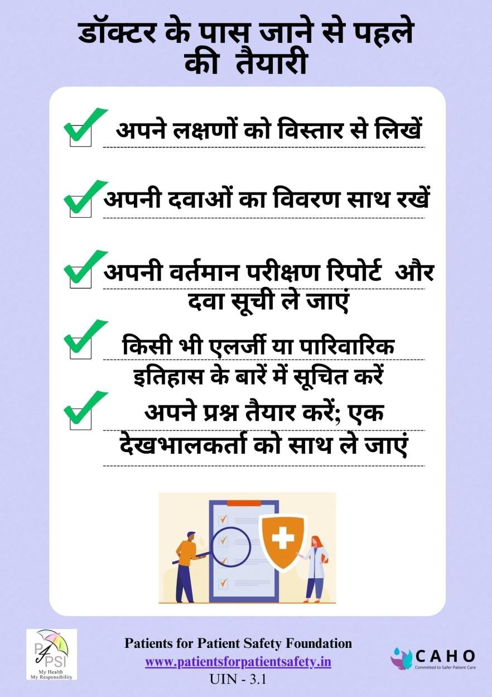
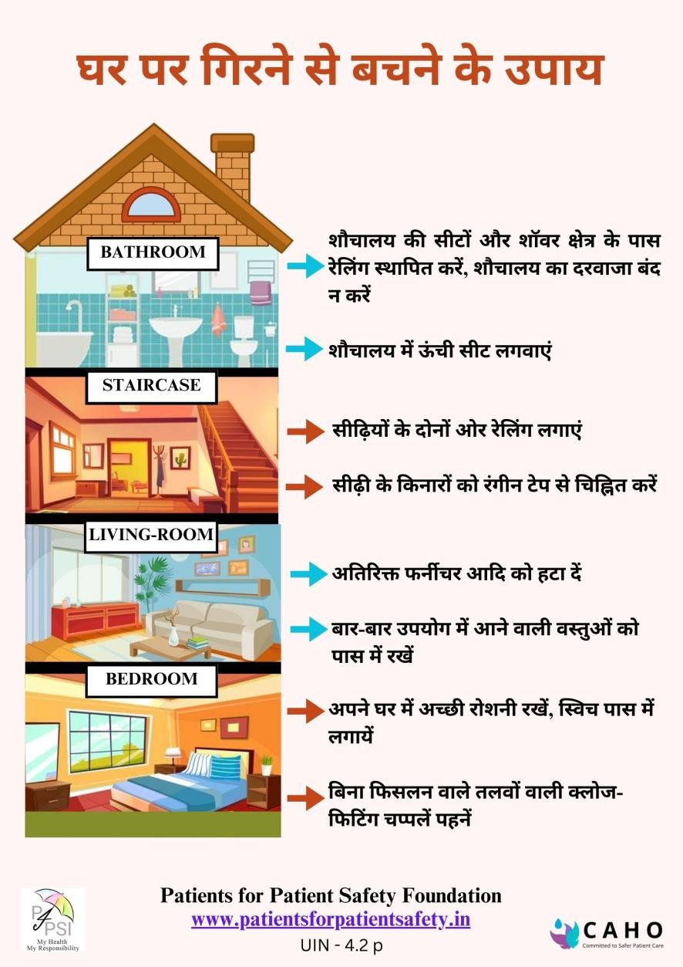
Hindi Infographics

Slide 12
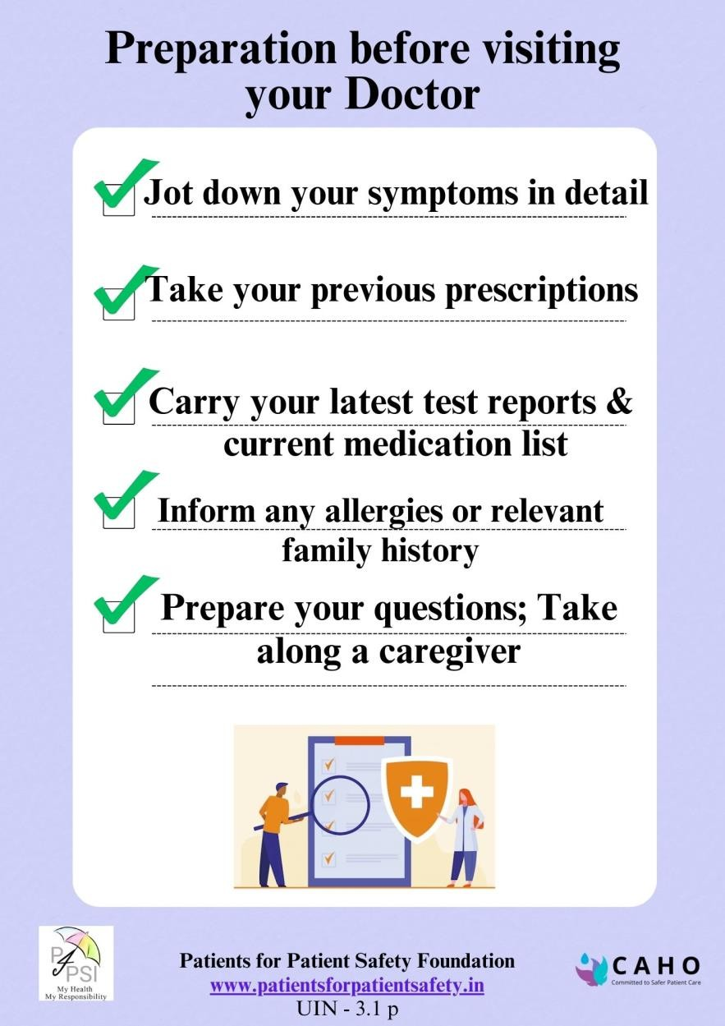
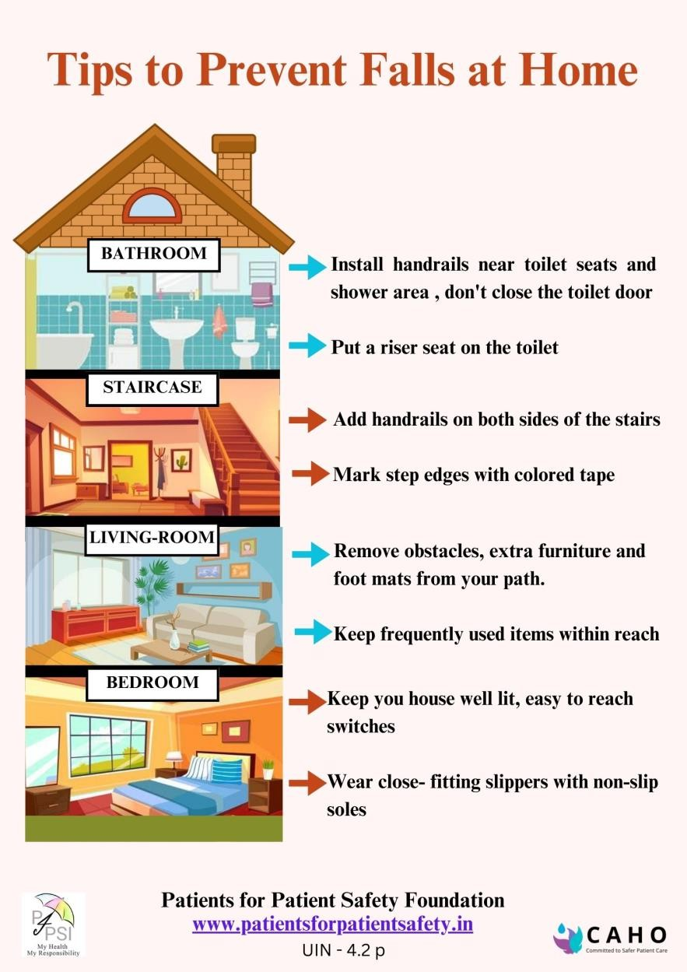
English Infographics

Slide 13
Patients for Patient Safety Foundation
www.patientsforpatientsafety.in

