Slide 1


Strategies for Engaging and Empowering Patients
Patient centric Education
Nadira Chaturvedi
Patients for Patient Safety Foundation

Slide 2
Strategies to Engage Patients in Safe Care
Getting Patient Centricity across the Organization
Establish Patient focused education and awareness program- shared decision making
Establish Feedback and Experience sharing platforms- learn from your customer
Two way Communication – bridge the trust deficit
Establish Patient Advisory Councils - build partnerships
Will help improve patient outcomes, increase satisfaction and build trust

Slide 3
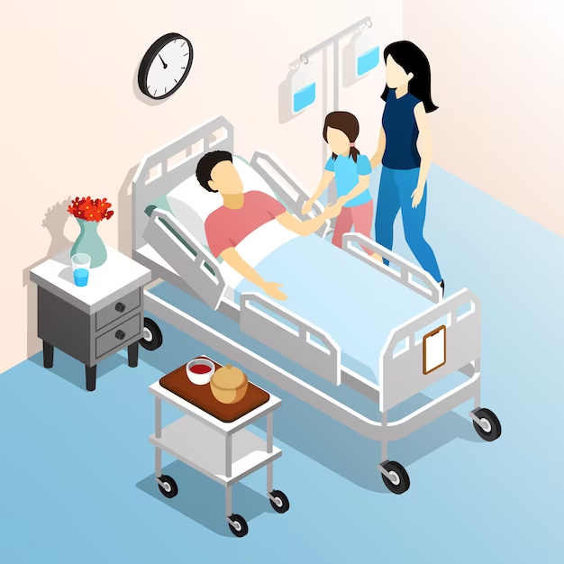
Patients have the Right to:
Be treated with respect, and dignity without discrimination.
Be informed of your health status, diagnosis, treatment options, and expected outcomes.
Express your concerns, complaints, provide feedback and your experiences.
Patients are Responsible to:
Providing complete information to your doctor
Asking questions and clarifying doubts
Respect your healthcare team and other patients
Lack of Engagement due to
Lack of awareness & engagement
Ignoring symptoms
Confused about disease, treatment
Not asking right questions
Language/ Cultural barriers

Slide 4
Patient Journey - What to ask
Are my symptoms serious enough?
Surgery vs tests, should I take a Second Opinion?
Why do I need a
follow-up visit?
How should I prepare for my Doctor’s visit?
Are preventive health checkups really helpful?
Shall I discontinue Medicines?
Tracking Symptoms
Treatment Options
Post Care Importance
Better Diagnosis
Medication Management
Preventive
Choices
Delayed diagnosis
Recurrence
Unsatisfactory Treatment Outcomes
Incomplete information
Incomplete Treatment
Severe illness
Ignorance, doctor is God-syndrome and lack of involvement by patients can lead to errors

Slide 5


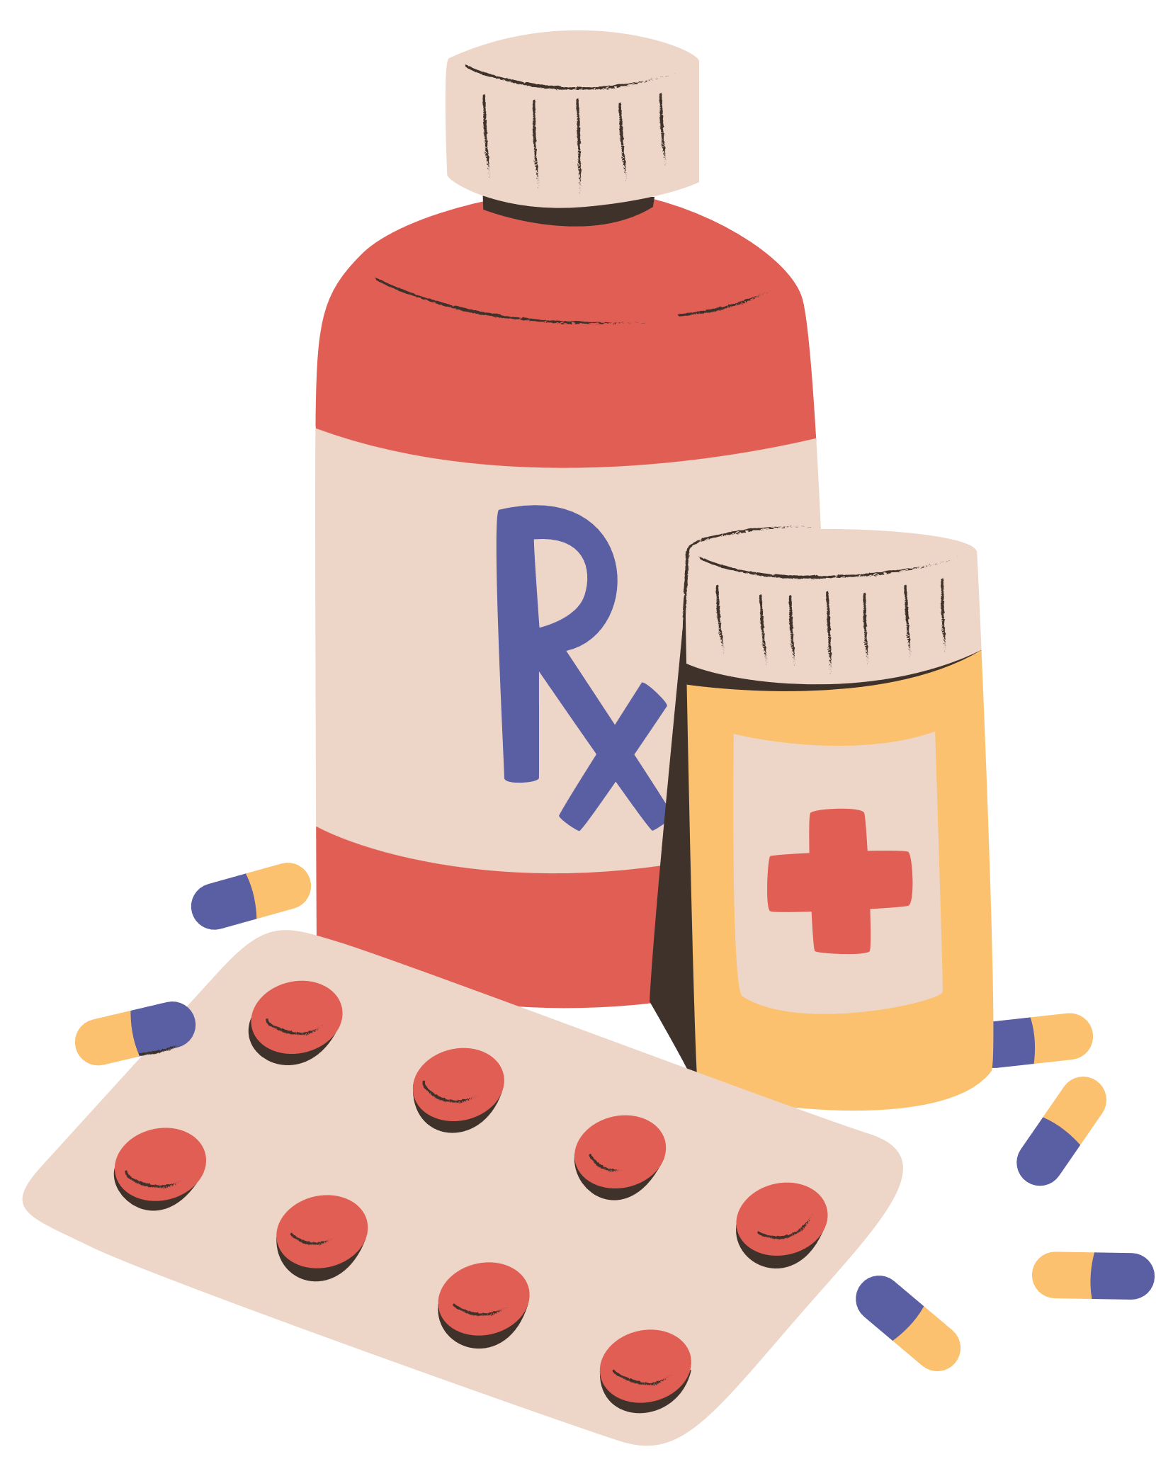

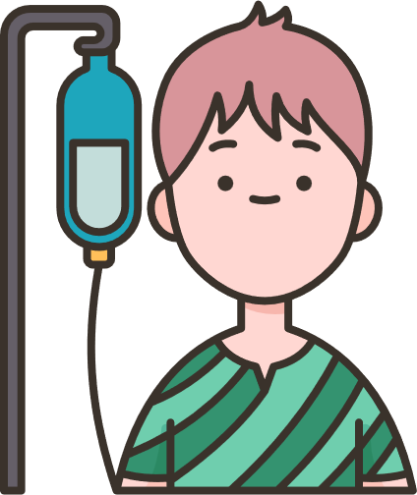

What Patient education includes
Orientation - MY HEALTH, MY RESPONSIBILITY
Understand their Roles, Rights and Responsibilities
Know Risk & Causes, Consequences of Medical harm
Provide alerts, tips, and advice on generic issues during Patient journey
Guidelines for early Detection, Prevention or protection from harm on disease specific topics
Knowledge of healthy lifestyle choices

Slide 6
What PFPSF Patient Education is not
Guidance & not Prescribing - nothing clinical*
No promotion of any brand, product or hospital
*clinical matters are handle by doctors only
Confidentiality on patient or hcp specific information
No medical or legal guidance
No financial dispute resolutions

Slide 7
Why PFPSF Content is Trustworthy
Aggregated from Global & National Healthcare resources
Screened by Senior Medical Subject Matter Experts
Customized for Indian context
Simple, easy to understand in English and Regional languages
Practical and actionable advice that patients/families can adopt

Slide 8
Factors for effective patient education material
Self engagement - MY HEALTH MY RESPONSIBILITY
Patient centric, with empathy- focus for both patients and caregivers
Reliable, verifiable, and authentic content
Use simple, self explanatory, understandable, non-technical language, supported by visuals and local languages
Provide clear, actionable, and useful tips with a call to action

Slide 9







Desired Outcomes of Patient Education
Early detection, timely treatment, protection & prevention of from further harm
Being Alert - Asking Questions
Providing Complete Information
Following Prescriptions/ Advise
Keeping Track
of Symptoms
Getting a Second
Opinion
Keeping Updated Medical Records
Build trust & provide
Valuable Feedback

Slide 10
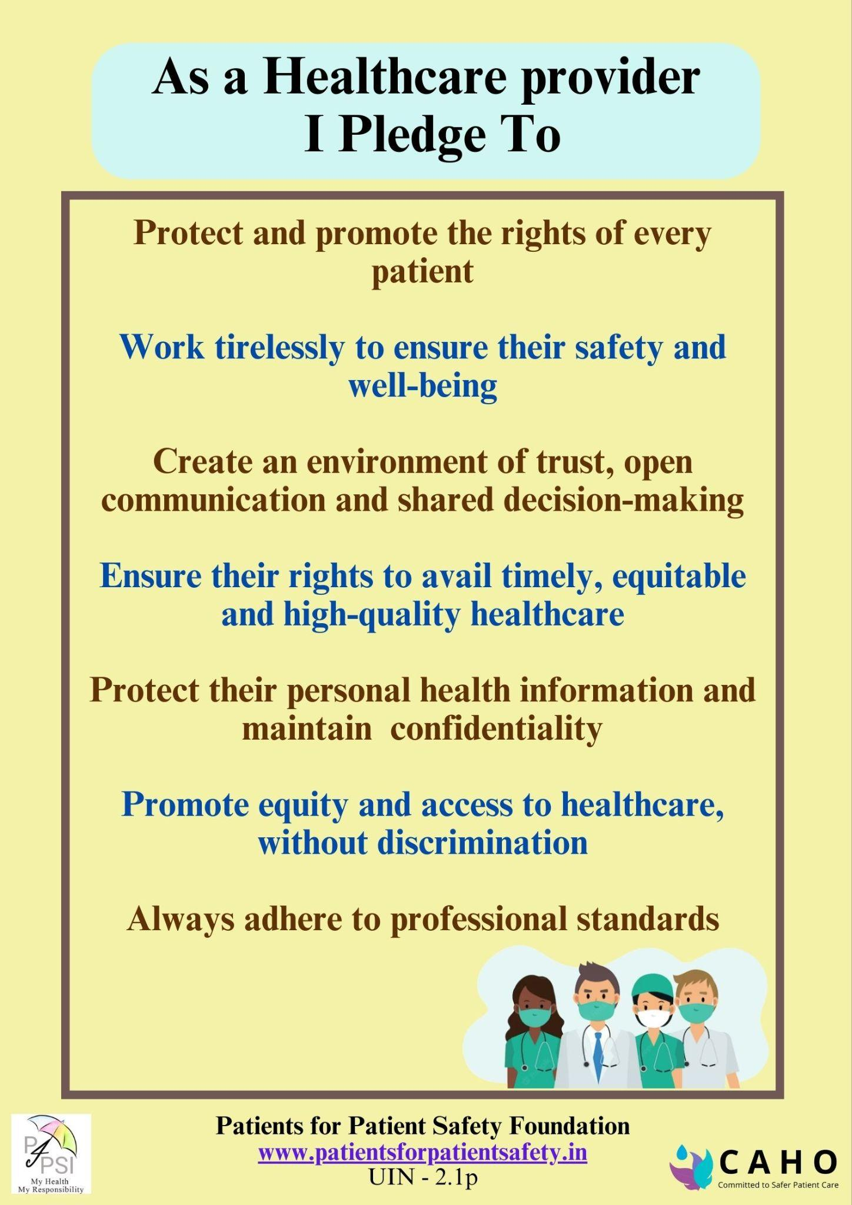
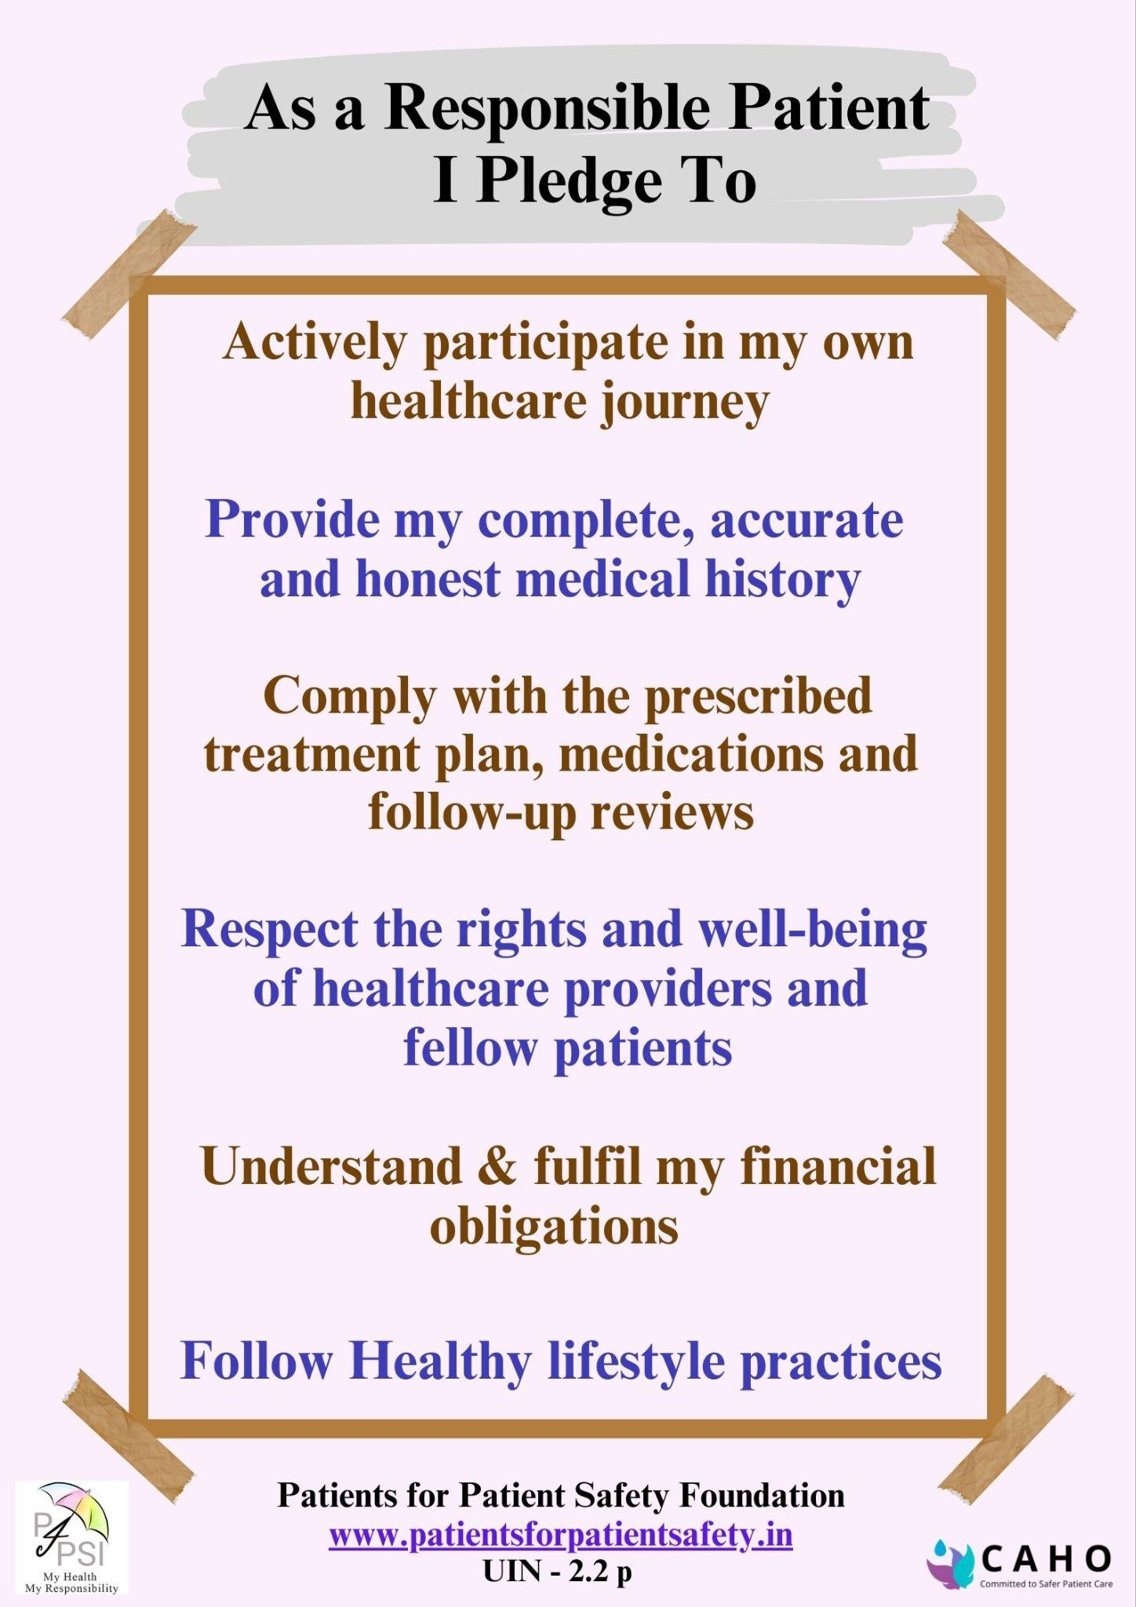
Patients & Caregivers can work together

Slide 11
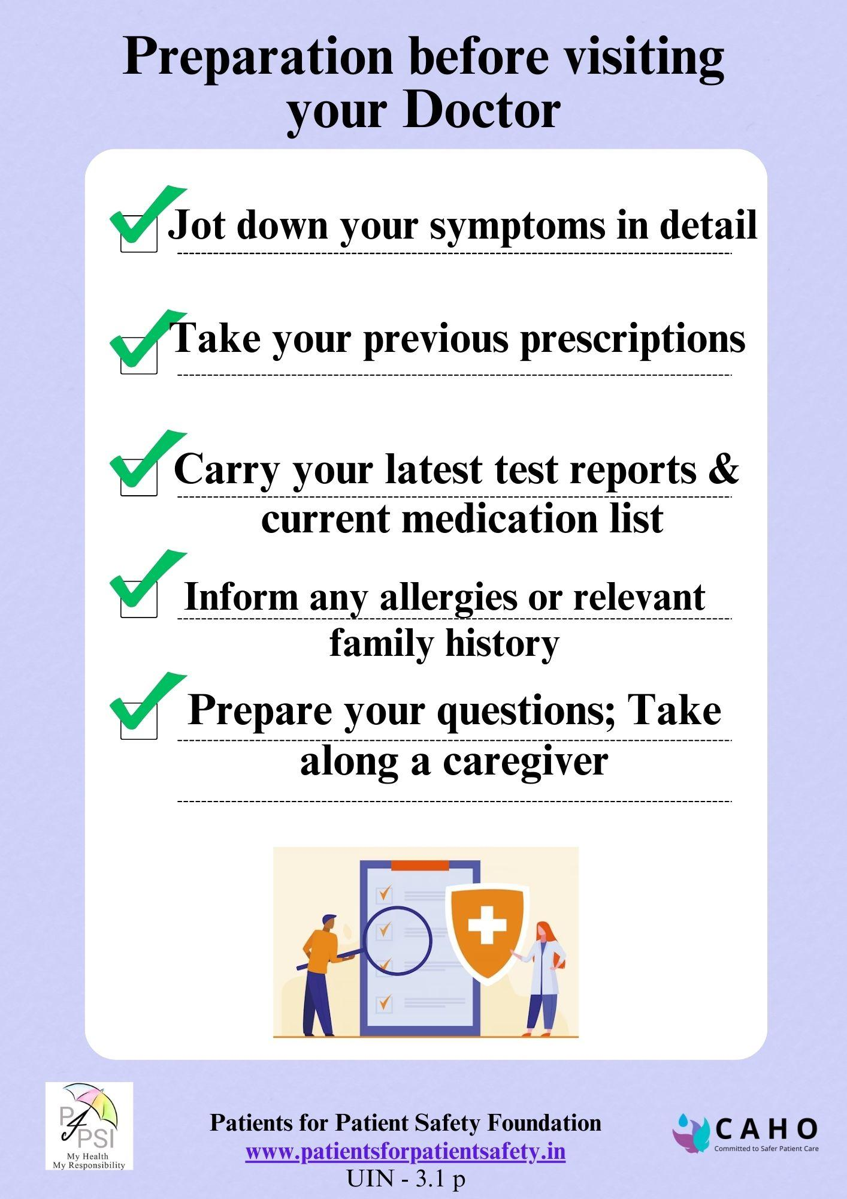
Preparing for meeting
a doctor?
Due to stress; incomplete communication
Forget to mention all symptoms; bring previous reports; medical history
We were unable to absorb all the information & guidance
Don’t ask important questions

Slide 12
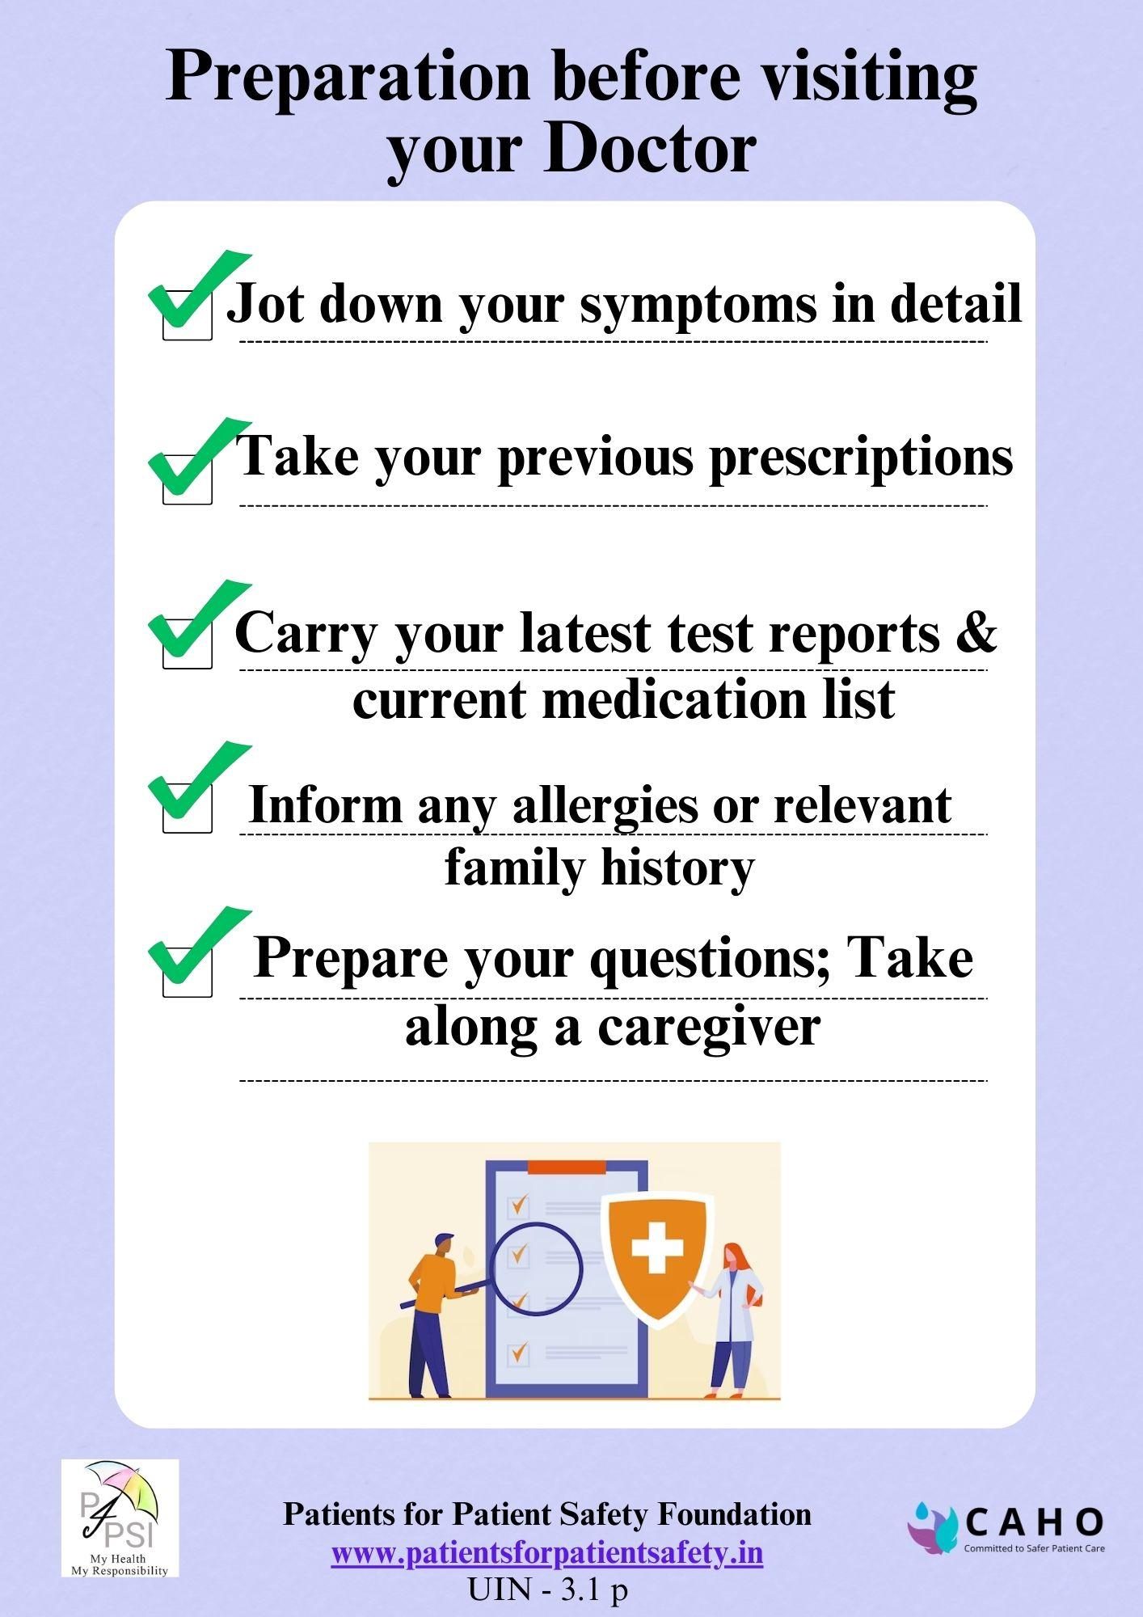
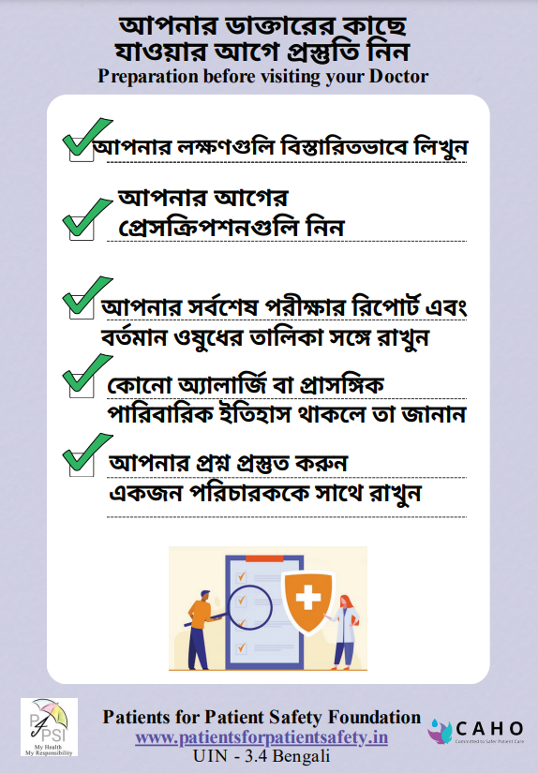
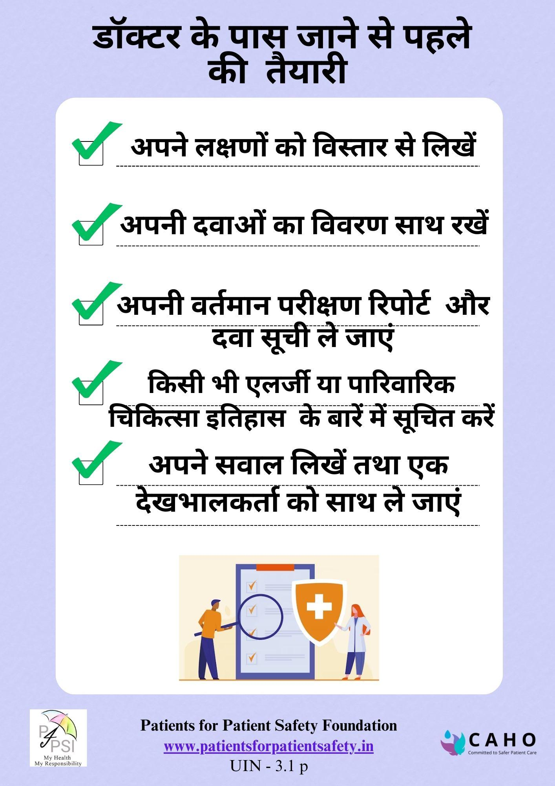
Patient Education Material in Different Languages

Slide 13
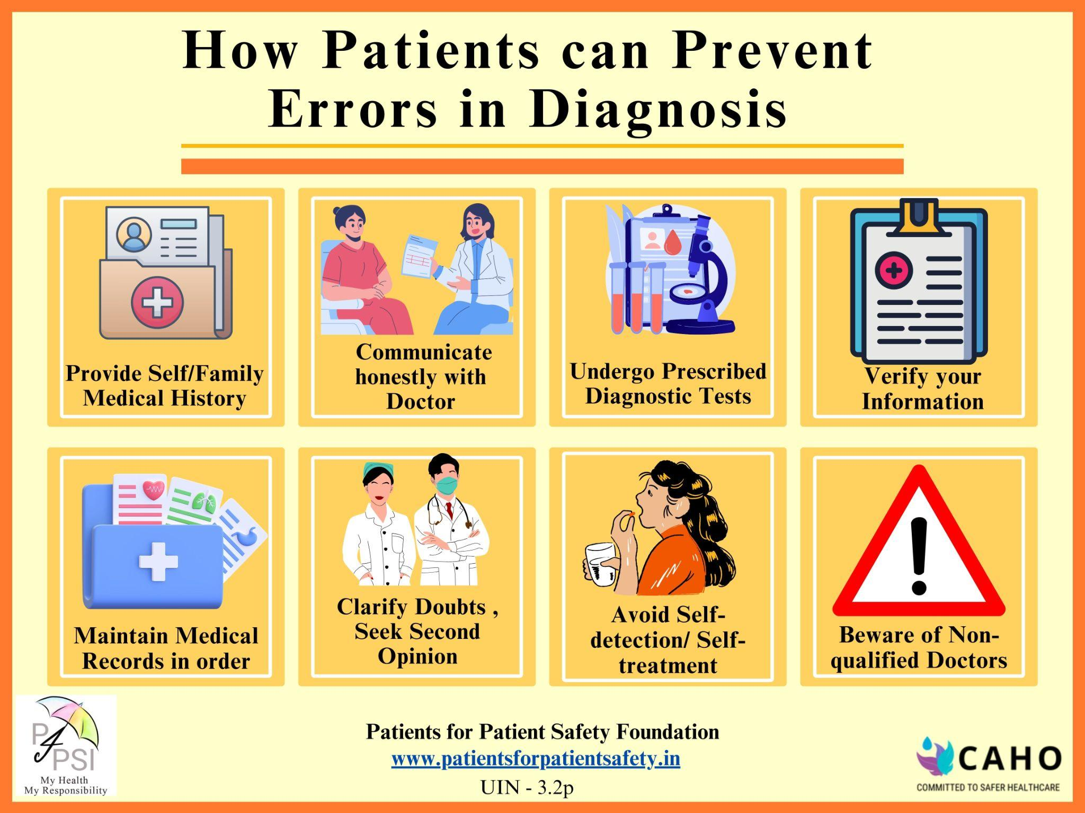
Diagnosis Errors Make Ailment Worse
Why do they happen:
Provide incomplete or inaccurate medical history
Hesitation to disclose sensitive information
Self-diagnosis and reliance on internet information
Lack of communication
Failure to follow medical advice
Not verifying personal details

Slide 14
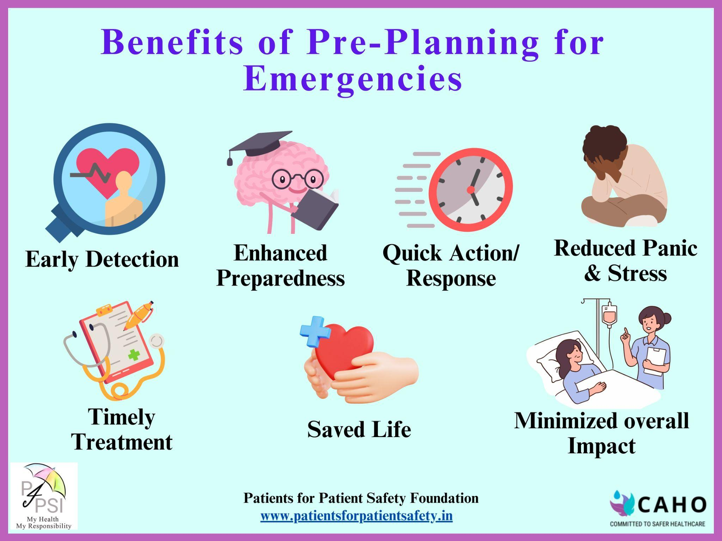
Panic and helplessness during emergencies?
An emergency is unannounced:
Lack of awareness of symptoms
Unpreparedness
Lack of knowledge in First-Aid,wasting golden hours
Not knowing where to go
How to select the right hospital for an emergency

Slide 15
Outreach Strategies to promote PE
What PFPSF is doing
Sending weekly newsletters
Sharing content through Social Media
NudgesWhatsapp message
Target audience - all demographics
Regional penetrateion with local language
Collaborating with institutions
Collaboration with print media
What hcp can do
Training Patient Education for of staff
Digital display of patient education in footfall areas
Physical display outside OPD, pharmacy, ICU, IP couridors etc, front desk
Handouts with OPD, IP admissions, Discharge points, diagnostic labs
Share in their pateint and care provider networks

Slide 16
Nothing about us without us
Let’s work together with Patients for Safer Health & better Outcomes
My Health, My Responsibilities
Patients for Patient Safety Foundation

