Slide 1
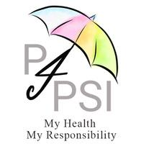
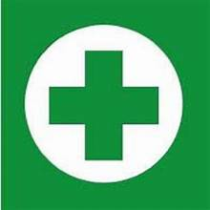
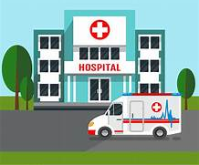
Medical Emergencies
Preparedness : Detection : Response
My Health, My Responsibility
Patients for Patient Safety Foundation

Slide 2
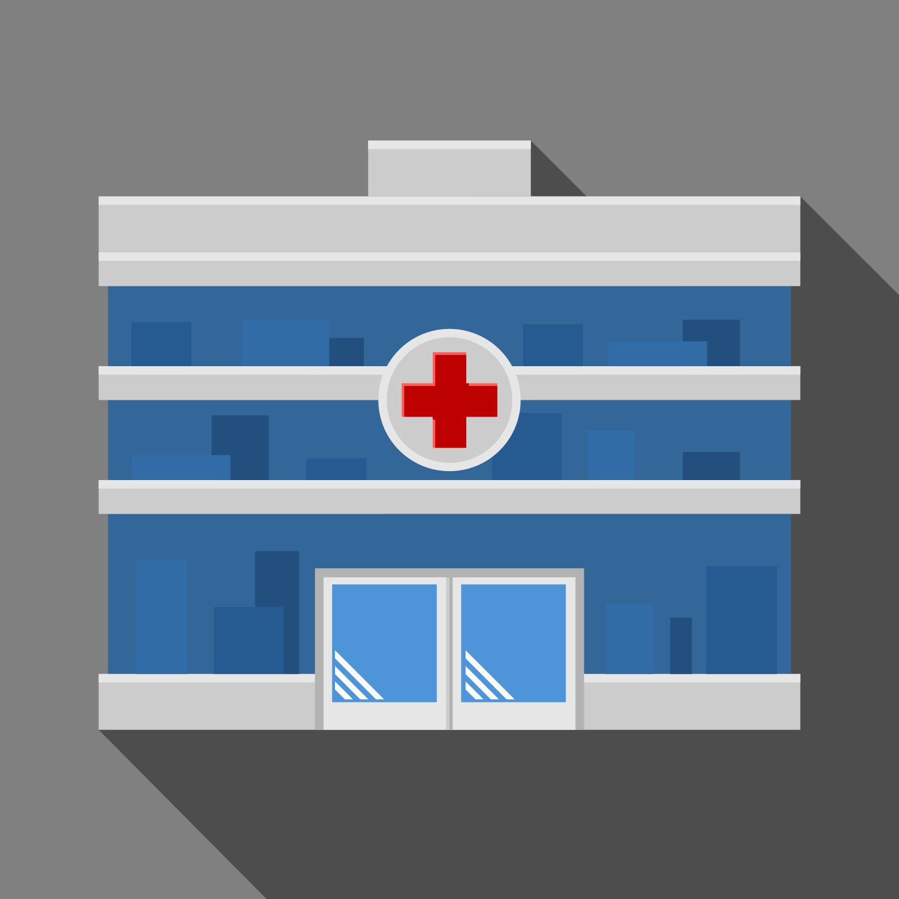
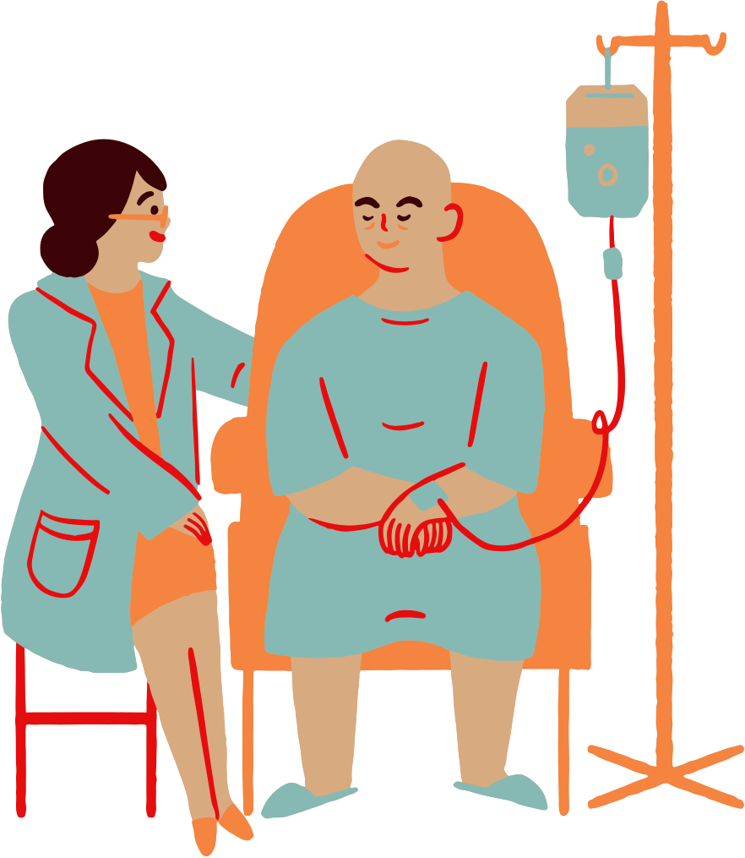
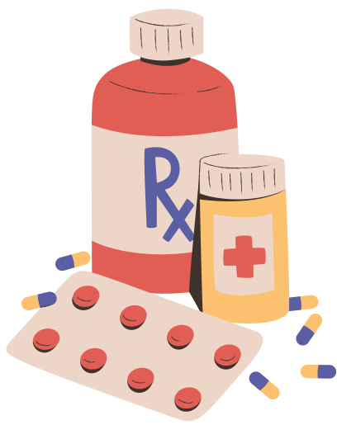
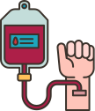
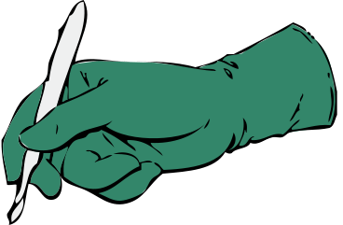
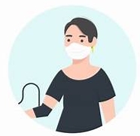
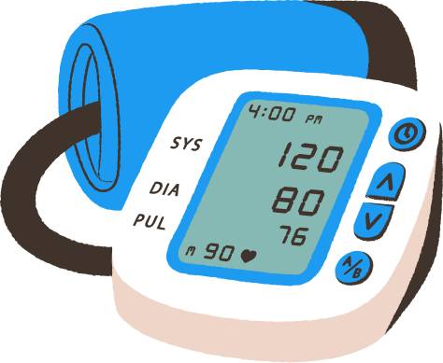
Medical Harm Happens - Inspite of Best Efforts
1 in 10 patients* suffer harm during hospitalization
In OPD 4 out of 10 patients* are harmed due to missed/incorrect diagnoses, medication and prescriptions errors
Medication Errors* constitute 50% of avoidable harm
Unsafe Transfusion/ Injection practices
Unsafe Surgical Practices* cause
complications in 25% of patients
Patient Harm is also caused due to ignorance of patients and non-involvement
Calibration of Medical Device leads to errors
Up to 50% of this avoidable harm can be prevented by us
*Source: WHO
Patients for Patient Safety Foundation

Slide 3
Why Does Medical Harm Happen
Individual : Patient : Caregiver
At Hospital : OPD
At Home
Errors/Misses by HCP
Omissions by Patients
By Patient & Caregivers
Medications Errors
Wrong Diagnosis
Surgical Mistake
Infections
Communication Errors
Ignore Symptoms
Late Presentation
Incomplete Info
Not being alert
Not asking questions
Lack of awareness
Lack of preparedness
Not following prescriptions
Self treatment
missing clinical signs
Aware Patients/Caregivers can help Prevent Medical Harm
Patients for Patient Safety Foundation

Slide 4
What is a Medical Emergency
All of us will be unwell sometime; Our response depends on kind of illness
Builds gradually
Persistent
Long Treatment
Mostly Diagnosed
Examples
Blood pressure
Diabetes
Joint pains
Asthma
Digestive issues
Acute Illness
Chronic Illness
Common & frequent
Rapid sudden onset
Normally short period
Recovery within weeks
Examples
Cold flu
Heartburn
Infections
Fracture
Life threatening
Affects long term health
Need immediate response
Sudden/ unannounced
First time; unprepared
Examples
Heart attack
Stroke
Seizure/ unconsciousness
Head Injury
Choking
Medical Emergency
Medical Emergencies - Most Critical, Least Prepared , Least Aware
Patients for Patient Safety Foundation

Slide 5
Handling Medical Emergencies -
Emergencies Cannot be Treated At Home
No Time to Lose - Do not Miss Golden Hour
ACT NOW:
ACT NOW:
ACT NOW:
Be aware of Symptoms & potential Issue
Seek immediate Help - call family, neighbour, domestic staff & physician
Know which Medical facility to go to
Decide to drive or wait for Ambulance- Condition & Time
Be Calm; avoid medications unless advised; provide First Aid like CPR
Patients for Patient Safety Foundation

Slide 6
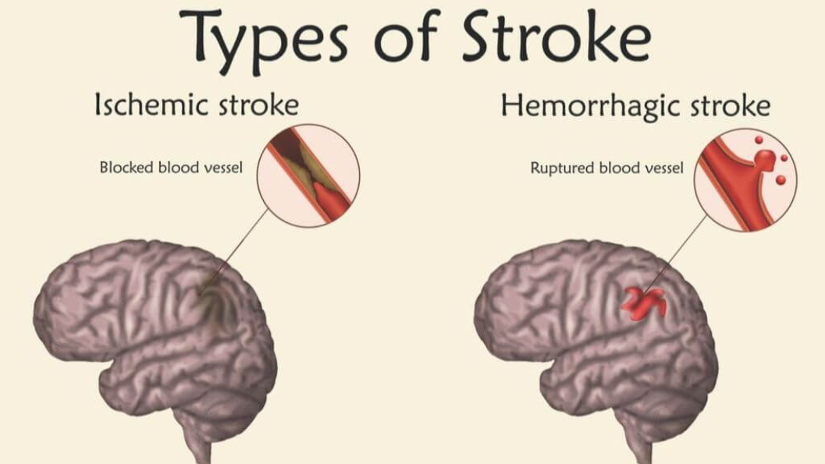
Stroke : What is it : Detection : Response
When brain does not get enough blood flow, because of a blocked artery or bleeding in the brain. It immediately impacts functioning of the brain.
Patients for Patient Safety Foundation

Slide 7
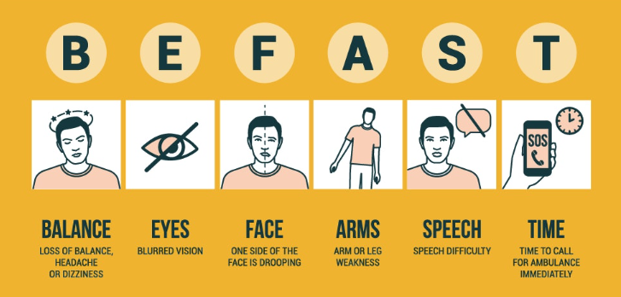
Stroke : Symptoms : Detection
Any One or Several: Rapidly Gets Worse
Patients for Patient Safety Foundation

Slide 8
Stroke : Response
Stroke can happen to anyone. People having blood pressure, cholesterol, sleep apnea, smoking, obesity & diabetes are at higher risk.
Act Fast:
If you are the one having symptoms; immediately tell family members, neighbour & staff.
Encourage person to lie down & stay calm
Talk to the patient, gather more info; will help in hospital.
Call Family physician (Video call); share symptoms, take advice.
Avoid giving them food, drink or medication unless advised
Drive the patient to recommended hospital. Ask your doctor to inform the emergency Deptt.
There is no home treatment for strokes. Select a hospital where facilities of MRI & CT Scan are available
Patients for Patient Safety Foundation

Slide 9
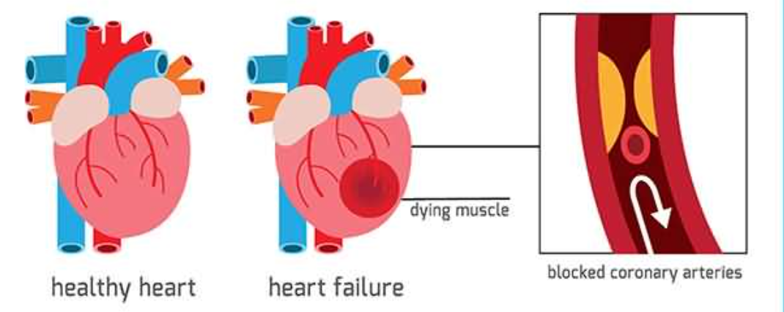
Heart Attack : What is it : Detection : Response
Heart Attack: Happens due to obstruction of blood flow to a portion of the heart muscles, caused by a clot in the blood vessels. Lack of blood floe causes heart tissues to die & impact other organs.
Patients for Patient Safety Foundation

Slide 10
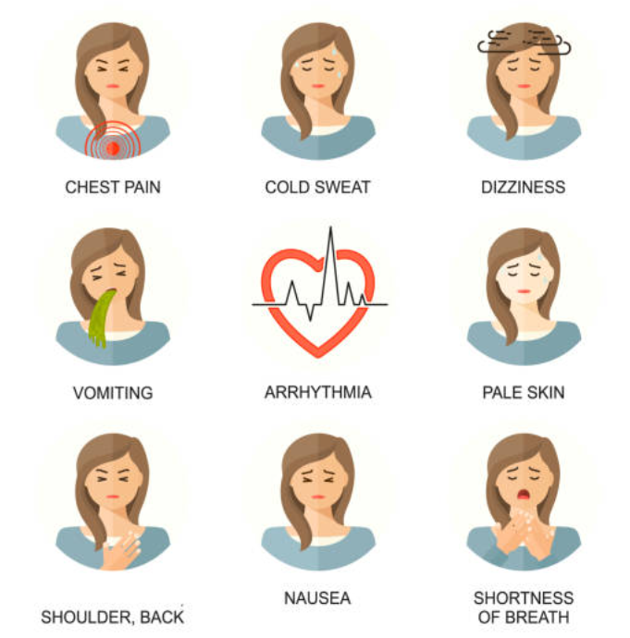
Heart Attack : Symptoms : Detection
You may have earlier symptoms like breathlessness
You could confuse these with other illness like gastric
Patients for Patient Safety Foundation

Slide 11
Heart Attack : Response
If I am having an a heart attack:
Inform someone nearby to be
Open front door if alone
Rest and stay calm
Chew Aspirin: If not allergic to Aspirin
Speak to your physician
Ask for Cardiac Ambulance; Dial 108
If ambulance delayed have someone drive you
If someone is having a heart attack:
Keep the person calm
Call a physician for advice.
If the person is not allergic to aspirin, have them chew one regular strength.
Perform CPR. If unresponsive and stops breathing,
Call for Cardiac ambulance 108. If delayed drive patient to hospital.
Call a physician for advice
Patients for Patient Safety Foundation

Slide 12
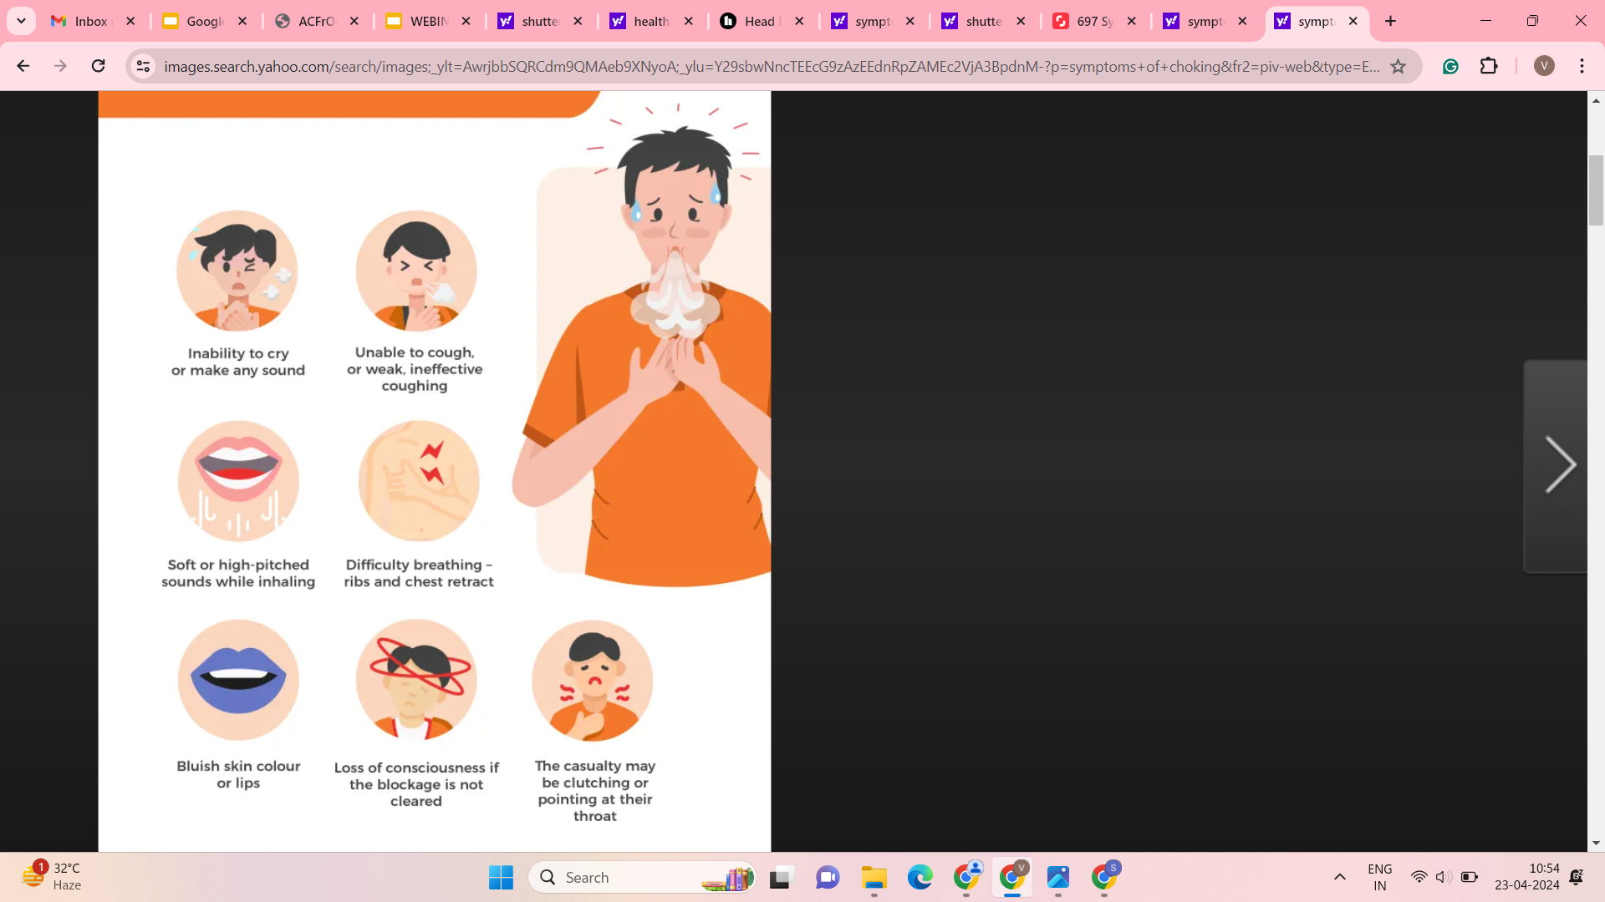
Choking : What is it : Detection : Response
Choking happens when an object lodges in the throat or windpipe, blocking the flow of air. In adults, it may be a piece of food and in young children often choke on small objects. Choking prevents normal breathing which means supply of oxygen the brain is interrupted, leading to other serious issues.
Symptoms of Choking
Patients for Patient Safety Foundation

Slide 13
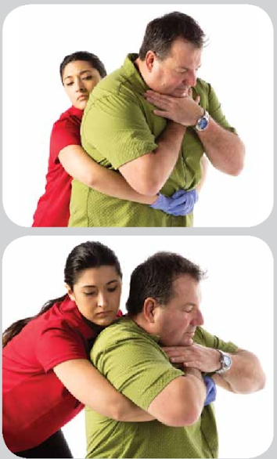
Choking : Response For Adult
How to perform abdominal thrusts:
Stand behind the person: Place one foot slightly in front of the other for balance. Wrap your arms around their waist. Tip the person forward slightly.
Make a fist with one hand: Place it just above the person's navel.
Grasp your fist with the other hand: Press into the stomach with a quick, upward thrust as if trying to lift the person up.
After giving five abdominal thrusts check if the blockage has been removed. Repeat as needed to dislodge the blockage.
Patients for Patient Safety Foundation

Slide 14
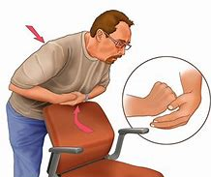
Choking : Response For Adults
If you are alone and choking:
Place a fist slightly above your navel.
Grasp your fist with the other hand.
Bend over a hard surface. A countertop or chair will do.
Shove your fist inward and upward. Try to cough it out.
Patients for Patient Safety Foundation

Slide 15
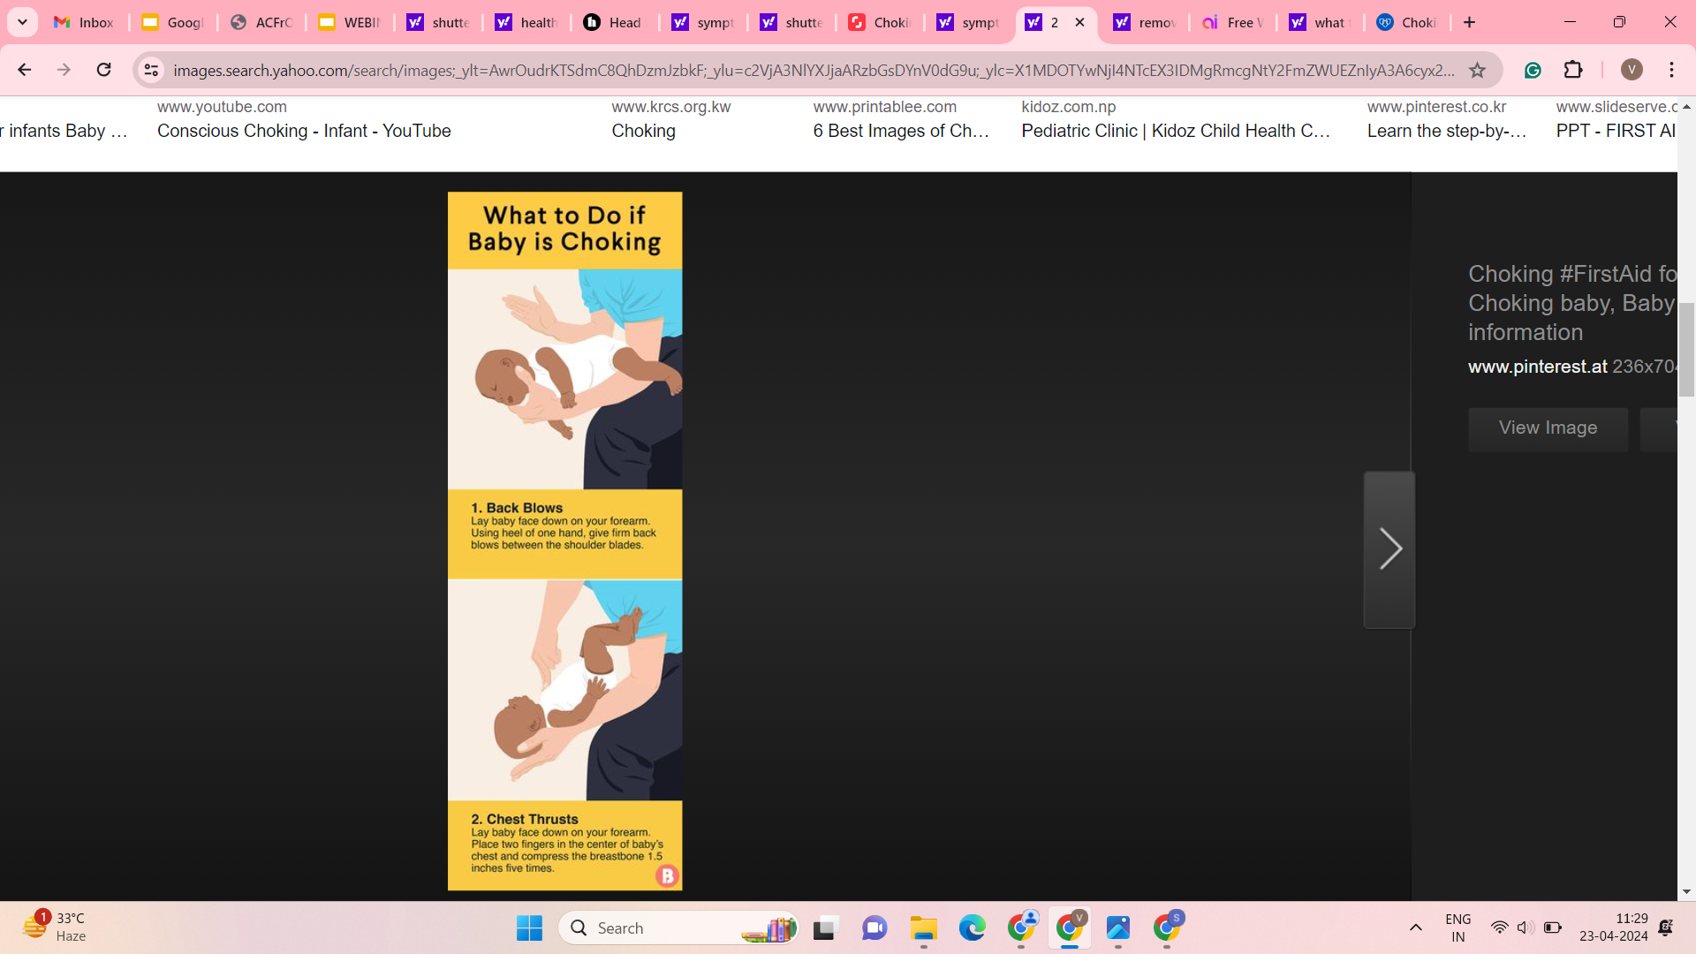
Choking : Response For Children
Choking is a serious and life-threatening emergency, particularly in children, between the ages of 1 and 5 years, who are more susceptible to choking due to their natural curiosity and tendency to explore the world orally.
What to do if a baby is choking
Patients for Patient Safety Foundation

Slide 16
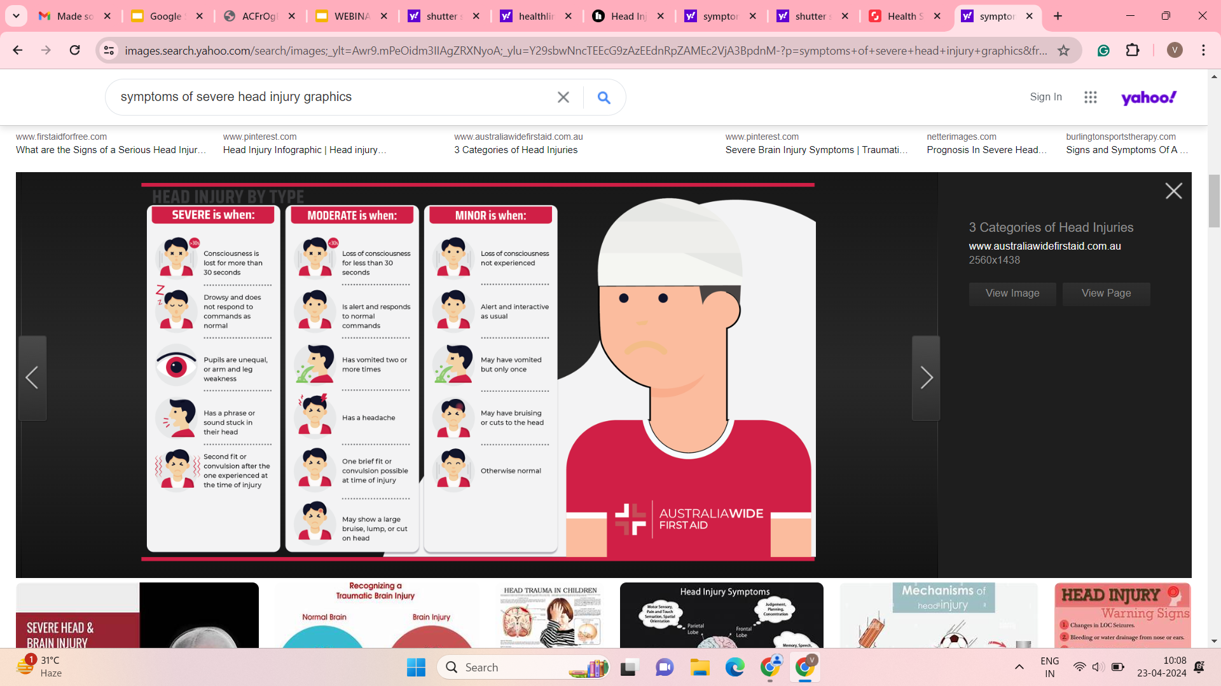
Head Injury : Detecting Severity : Response
A head injury is any sort of injury to your brain, skull, or scalp. This may range from a mild bump to a traumatic brain injury. Consequences and treatments vary greatly, depending on what caused your head injury and how severe it is.
Severe is when
In severe cases, loss of consciousness and fluid drainage from the nose or ears
Patients for Patient Safety Foundation

Slide 17
Head Injury : Response
We can not manage head injury at home. While waiting for help do the following:
Do’s:
Keep the person still
Show the situation to a doctor on video call.
Take advise on how to stop bleeding & where to take.
Call 108 for an Ambulance or drive to equipped hospital if advised.
Don’ts:
Wash a head wound that is deep or bleeding a lot.
Remove any object sticking out of a wound.
Move the person unless absolutely necessary.
Shake the person if they seem dazed.
Remove a helmet if you suspect a serious head injury as it can worsen the condition.
Patients for Patient Safety Foundation

Slide 18
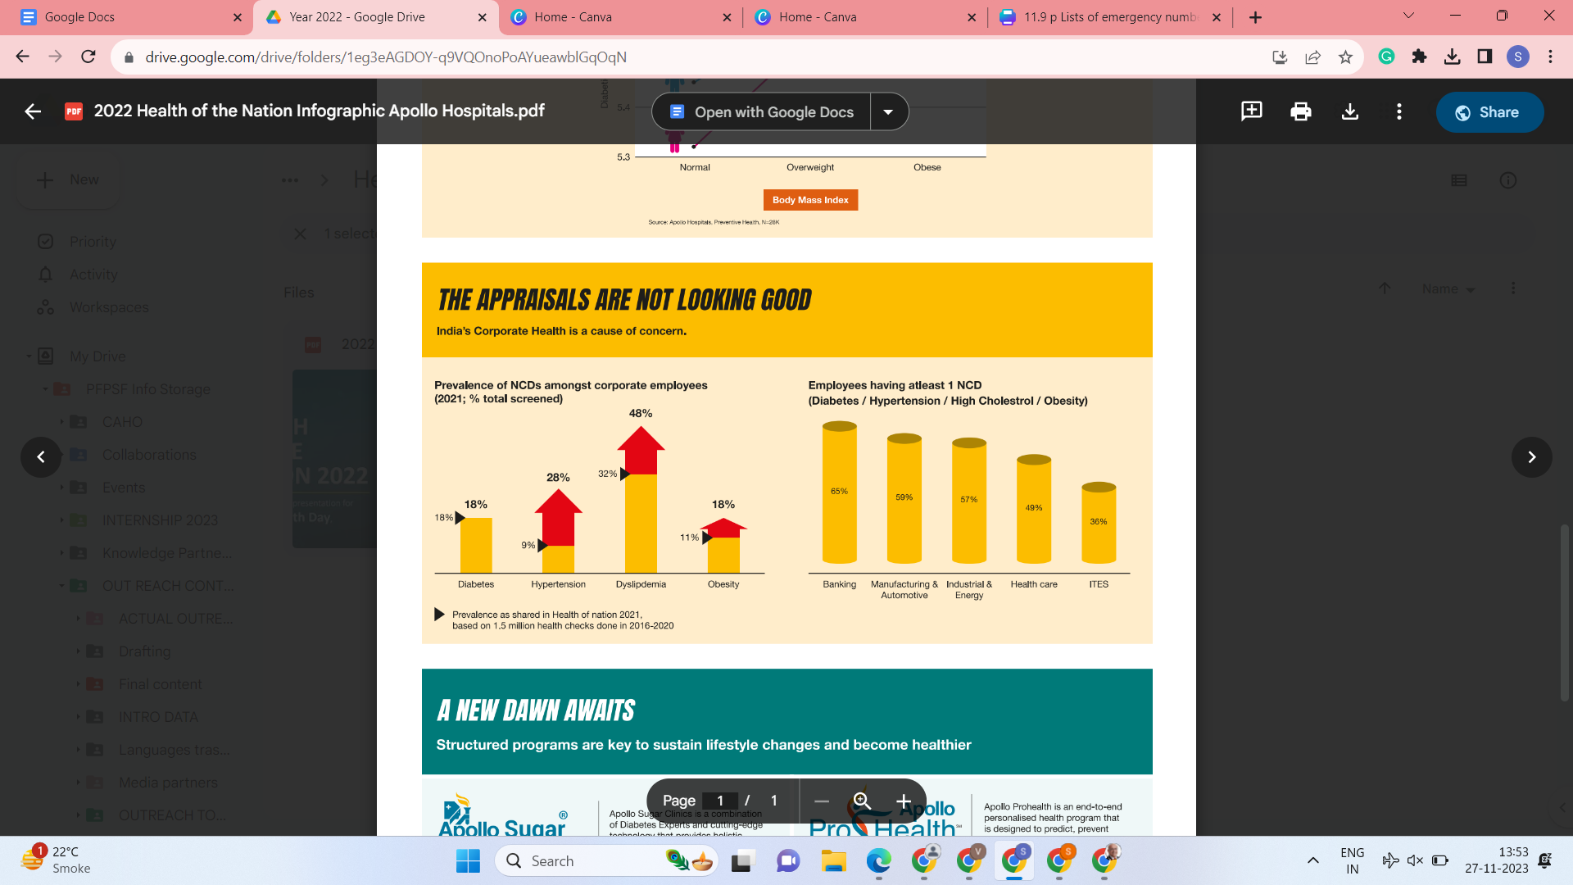
Corporate Health - A Source of Concern
Higher prevalence of NCDs among employees
Onset at an Early age is mostly ignored

Slide 19
In Conclusion:
Emergencies come Unannounced
Right response and Speed is critical
Be aware of an Emergency and how to Respond
Be Calm & do not Panic
Be aware of nearest well equipped hospital. Do not rush to the nearest hospital
Away keep emergency numbers handy
Do not always wait for ambulance
Inform someone close by about your situation & seek help
Patients for Patient Safety Foundation

Slide 20





You can save yourself & your family from medical harm
Be Aware : Be Alert
Give us a Missed call : 92896 - 96709
My Health, My Responsibility
PFPSF-india
patientsforpatientsafety
pfpsfindia
patientsafety22
+919289696709
www.patientsforpatientsafety.in

