Slide 1


Strategies for Engaging and Empowering Patients
Patient Centric Safe Care
Som Mittal
Patients for Patient Safety Foundation

Slide 2

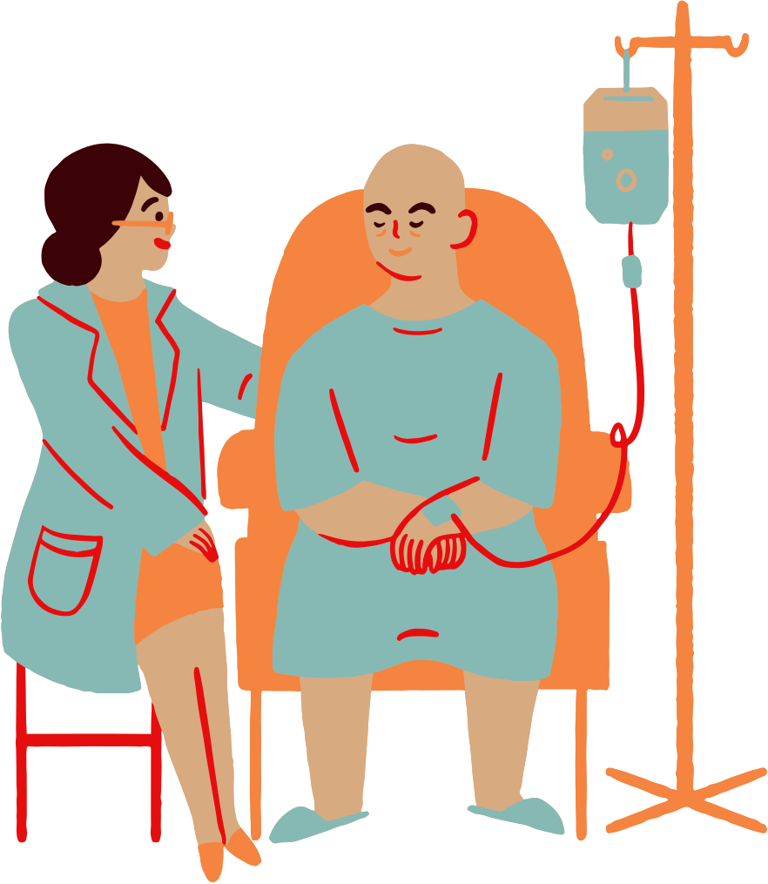




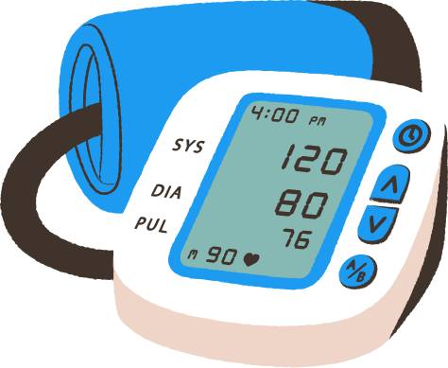
Why is this Critical
1 in 10 patients suffer harm during hospitalization
In OPD 4 out of 10 patients are harmed due to missed/incorrect diagnoses, medication, prescriptions and communication errors
Medication Errors constitute 50% of avoidable harm
Unsafe Transfusion/ Injection practices
Unsafe Surgical Practices cause complications in 25% of patients
Patient Harm is also caused due to ignorance of patients and non-involvement
Calibration of Medical Device leads to errors
Up to 50% of this avoidable harm can be prevented
*Source: WHO

Slide 3

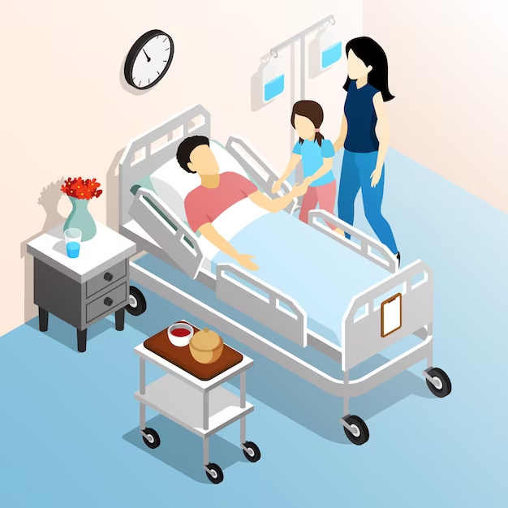
Why do Medical Errors happen
At Healthcare Providers End
To err is Human
Too many patients
Overworked, under staffed
Inadequate communication
Less engagement with patients
At Patients and Caregivers End
Lack of awareness & engagement
Ignoring symptoms
Confused about disease, treatment
Not asking right questions
Language/ Cultural barriers

Slide 4







Patients and Caregivers can help get safer outcomes?
Providing Complete Information
Following Prescriptions/ Advise
Being Alert - Asking Questions
Keeping Track
of Symptoms
Getting a Second
Opinion
Keeping Updated Medical Records
Build trust & provide
Valuable Feedback

Slide 5









Advantages of Patient Engagement to HCP
Early Detection & Prevention
Improved profitability
Better Outcomes & Reduced Medical errors
Increased Reputation
Improved Trust & Satisfaction
Higher Patient Loyalty/ Referrals
Personal and Professional Fulfillment

Slide 6
Advantages of Patient Engagement to HCP
Early Detection & Prevention
Improved profitability
Better Outcomes & Reduced Medical errors
Increased Reputation
Improved Trust & Satisfaction
Higher Patient Loyalty/ Referrals
Personal and Professional Fulfillment

Slide 7
Strategies to Engage Patients in Safe Care
Getting Patient Centricity across the Organization
Establish Patient focused education and awareness program- shared decision making
Establish Feedback and Experience sharing platforms- learn from your customer
Two way Communication – bridge the trust deficit
Establish Patient Advisory Councils - build partnerships
Will help improve patient outcomes, increase satisfaction and build trust

Slide 8
What can Patient Advisory Council do
Improve communication and build trust between HCP and PC
Foster two-way collaboration between both parties, work towards common goals
Improve quality of care and patient satisfaction, Incorporate feedback/ suggestions/ learnings from Patient experience.
Determine effective ways to educate Patient community
Promote patient safety and reduce medical errors

Slide 9
How will PAC benefit HCPs
Formal engagement with patients & discussing their experiences, needs and ideating with HCP would help bridge the Trust gap.
Helps becoming patient centric
A constructive way to get valuable patient feedback, patient insights and voice to improve service experience and clinical outcomes.
Provide a platform for improved two-way communication.
Better understanding of patient expectations and areas of improvement
Increased loyalty & patients-satisfaction

Slide 10
How will PAC benefit Patients & Caregivers
Provides a formal platform to interact and engage constructively
Opportunity to share experiences & expectations in a structured and constructive way
Bring in patient perspective/ voice in HCP decision making
Be part of the improvement plan & its execution
Help get patient relevant information & improve awareness
Will enhance experience & outcomes; build trust

Slide 11
Patient Advisory Council (PAC):
Formation & Steps
CAHO has created a manual on PAC which covers all steps:
Step 1: Create PAC, Commit Resources, Define meeting protocols
Step 2: Orientation of PAC members, Hospital staff, Roles and Responsibilities
Step 3: Identify Priority Areas for Improvement taking HCP/Patient inputs
Step 4: Conduct PAC Meetings; Review work done; firm up plans
Step 5: Implement the improvements & Report back
Step 6: Communicate, Share impact, adopt best practices & encourage patient feedback, celebrate success

Slide 12
Step 1- Formation of PAC; Scope of work
Forming PAC Committee after top leadership has agreed to the concept of PAC:
Designate staff at senior position to lead as Chairperson and appoint other cross-functional HCP members including Doctors, Nurses
Select Patient Representatives (PR) from Patient community- Co-chair can be PR
Set meeting protocol – frequency, annual schedule /calendar, agenda, documentation, minutes and follow up
Appoint a facilitator/ secretariat to coordinate meetings
Define initial scope of PAC; Keep adding to it
Allocate meeting space, infrastructure, budgets.

Slide 13
Step 2 - Orientation of PAC members, Hospital staff
CEO will initiate the entire project of PAC, as the Sponsor
Introduction of PAC , its importance and benefits to all hospital staff
Orientation of PAC members- both HCP and PR:
Scope of work, Do’s and Don’ts, Roles, Responsibilities, meeting schedules and attendance norms, discipline in execution of agreed actions with timelines, team work, confidentiality, cordiality
Include PAC orientation in current training programs and for new hires
Socialise and promote PAC in all sub committees and quality improvement forums

Slide 14
Step – 3- Identify initial focus areas
for improvements
Identify common issues faced by patients at various touch points
Identify known issues faced by hospitals while dealing with patients
Include issues identified by PFPSF, WHO etc.
Select the most common issues as priorities for improvement
Focus on low hanging fruit with maximum impact on patients
Most of these can emerge from internal data or feedback already available, including candid discussions with own hospital staff. Patients feedback can be used here.

Slide 15
Step 4 – PAC meetings – Suggested Agenda
Keep previous ATR (action taken report) and minutes
Presentation on specific topic showing work done, improvements made, seek feedback
Status of various initiatives by hospitals to enhance patient experience
Take suggestions and patient feedback
Agree on priorities for next improvement projects
Report on internal and external communication for patient education

Slide 16
Step 5 - Implementation process
within Hospitals
Share minutes of PAC meeting with concerned internal departments for action to be taken with timelines to HOD and PAC Champion
PAC Champion to be appointed in each department for coordination of PAC work, (intra or inter departmental follow up) and reporting achievements with data present to PAC
Set criteria for success, timelines, percentages etc.
Regularly assess the effectiveness & impact of PAC through feedback surveys or evaluation forms, both with hospital staffs and patients
Share achievements in next PAC meeting as ATR (action taken report)

Slide 17
Step 6– External & Internal Communication
(a) Communication with Patient Community:
Publicize PAC benefits and successes
Share information internally and externally
Install suggestion boxes in prominent hospital areas
Gather patient education material from Health Library of PFPSF
Distribute educational materials in public areas like front desk, billing, TV screens
(b) 2-way Communication within Hospital:
Host inter-departmental communication events every 2-3 months for PAC progress sharing
Establish "KBC" (Kaun Banega Champion) suggestion box for monthly best practices collection
Designate a monthly feedback day for inpatients and outpatients
Conduct monthly campaign to gather staff and patient experience stories to promote recognition and motivation

Slide 18
Success factors to be effective PAC
Leadership support - Involvement of hospital leadership in creating and managing PAC, Strong support & demonstrate actions
Structure - Structure of the PAC, Seniors representation from HCP & Patients; committed resources & secretariat; clarity of objectives, execution process
Formal & Regular - Determine frequency of meetings, formal agenda involvement of all departments
Communication - Communication with the patients, communication with the healthcare team members, and hospital leadership.
Celebrate - Evidence of PAC’s contribution; impact of PAC on patient experiences & outcomes

Slide 19
In Conclusion:
Only form PAC if there is commitment and belief both in letter and spirit
This is not a grievance redressal forum nor one for expressing difficulties
Look for small gains and publicize them - keep building on the success
Encourage PR (Patient Representatives) to connect with the patient community
Seek patient inputs and avoid being defensive
Give it the status and importance that a key stakeholder - a PATIENT - deserves
Make it a win-win situation

Slide 20
Combine Patient Centricity with Disease Sensitivity
Engage with Your Key Stakeholder
Patients for Patient Safety Foundation

Slide 21

WORKSHOP with AUDIENCE

Slide 22
Making PAC works
S.No. | BARRIERS | POSSIBLE SOLUTIONS

Slide 23
PAC: Formation & Steps
CAHO has created a manual on PAC which covers all steps:
Step 1: Create PAC, Commit Resources, Define meeting protocols - Leadership & Strategies
Step 2: Orientation of PAC members, Hospital staff, Roles and Responsibilities - Selection of Members & Operationalizing PAC
Step 3: Identify Priority Areas for Improvement taking HCP/Patient inputs - Project selection
Step 4: Conduct PAC Meetings; Review work done; firm up plans - Conducting Meetings
Step 5: Implement the improvements & Report back - Integrating learnings
Step 6: Communicate, Share impact, adopt best practices & encourage patient feedback, celebrate success - Communications - HCP/PC

