Slide 1
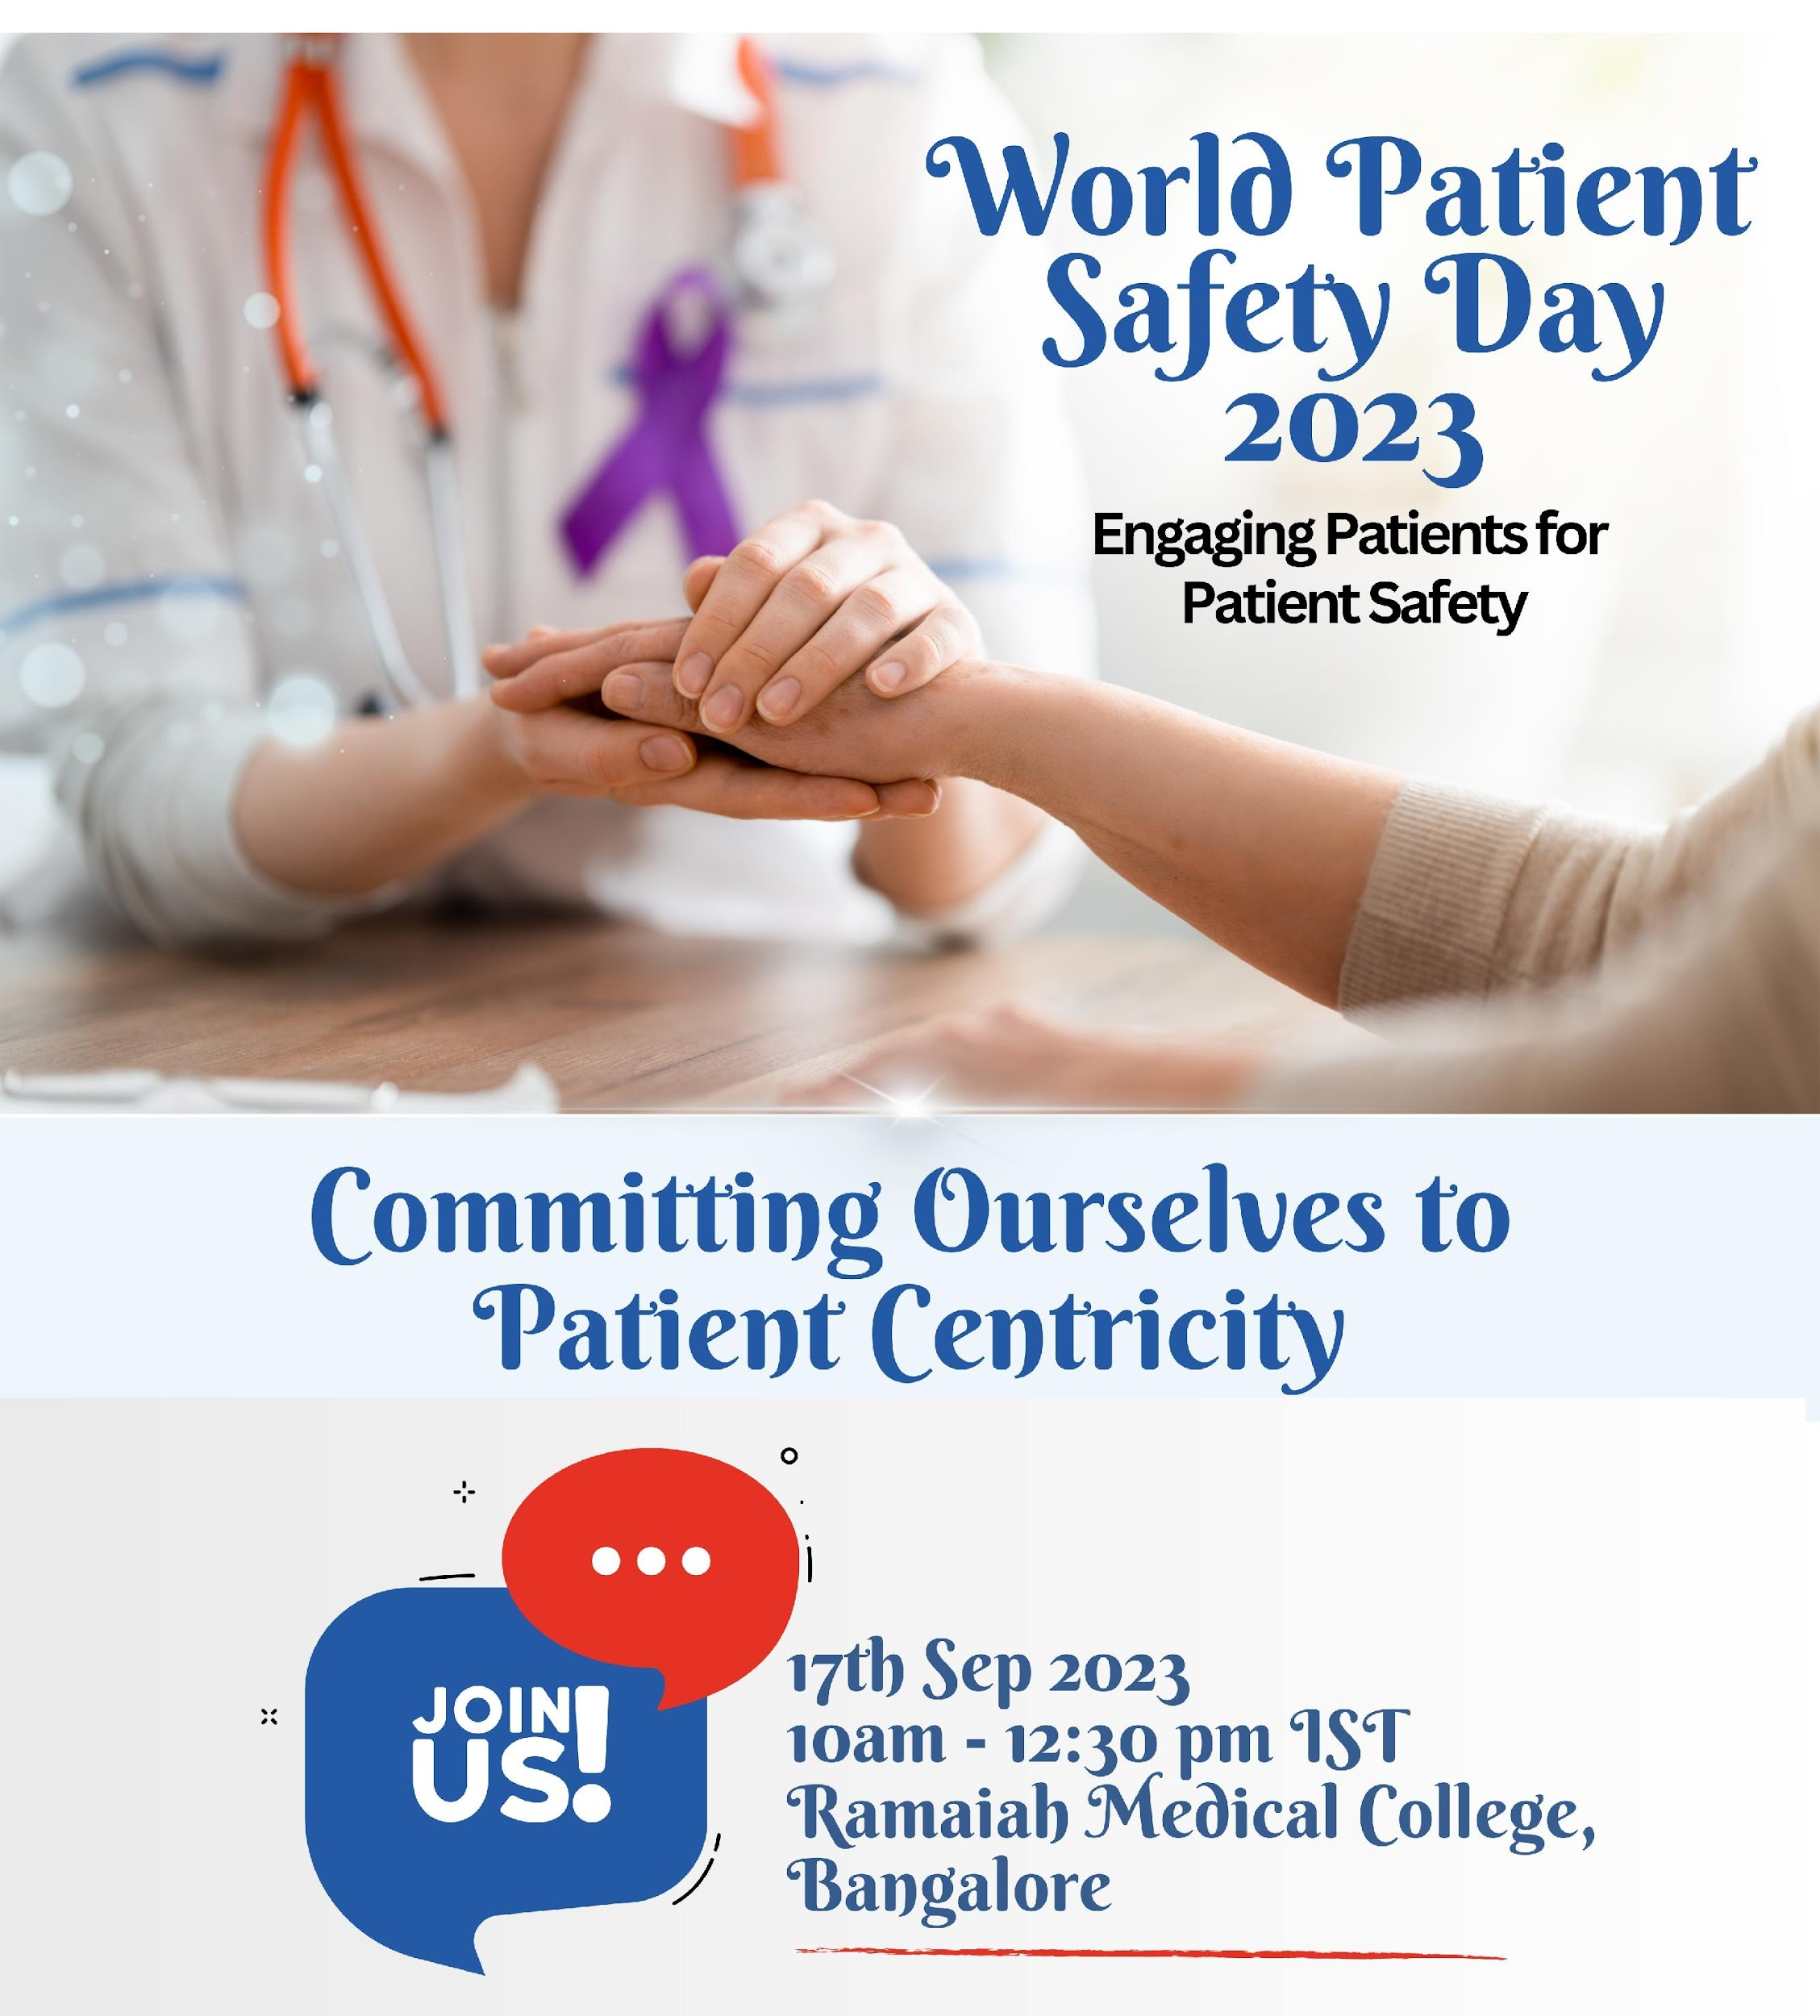

Slide 2
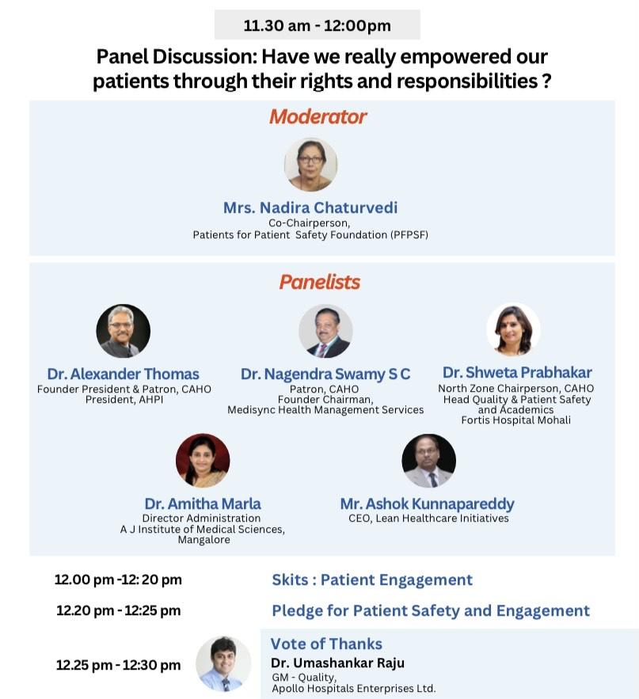

Slide 3
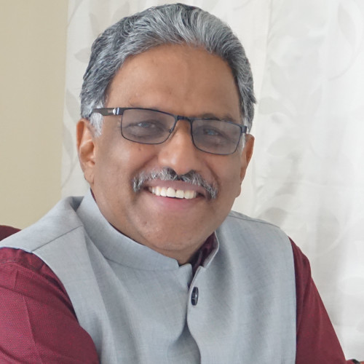
Dr. Alexander Thomas
Rights and Responsibilities – the What & the Why
WHY Patient Rights and Responsibilities?
Communication and trust between patient and health care professionals.
Who benefits- Hospitals, Patients, Mutual Benefit?

Slide 4


Disease centric or patient centric?
Are my symptoms
serious?
What all do I tell the
doctor?
Is my diagnosis
correct?
Shall I take a second opinion?
When & How?
How expensive is the
treatment?
Are all the tests
required?
Where can I get answers
to these questions?
How should I keep
my records?

Slide 5
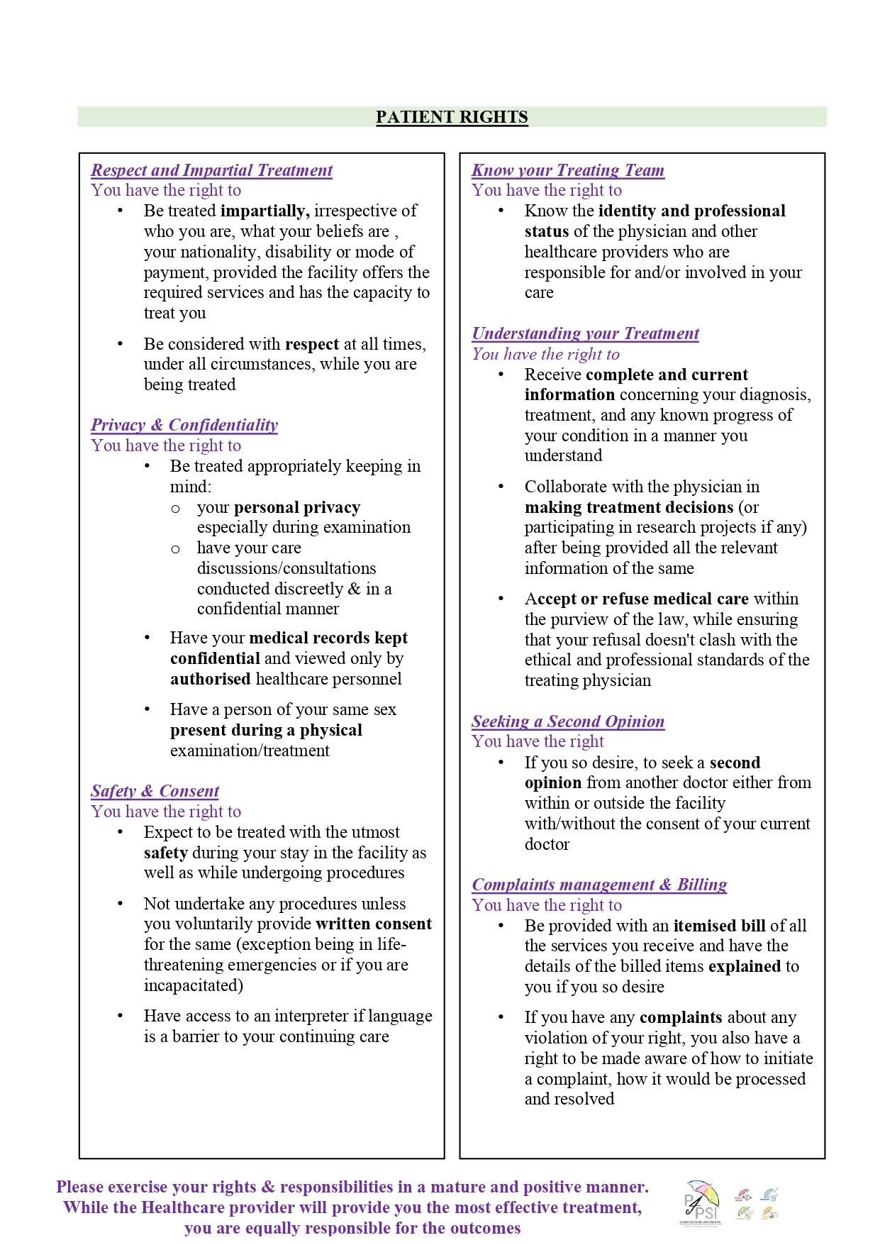
Patient Rights - English

Slide 6
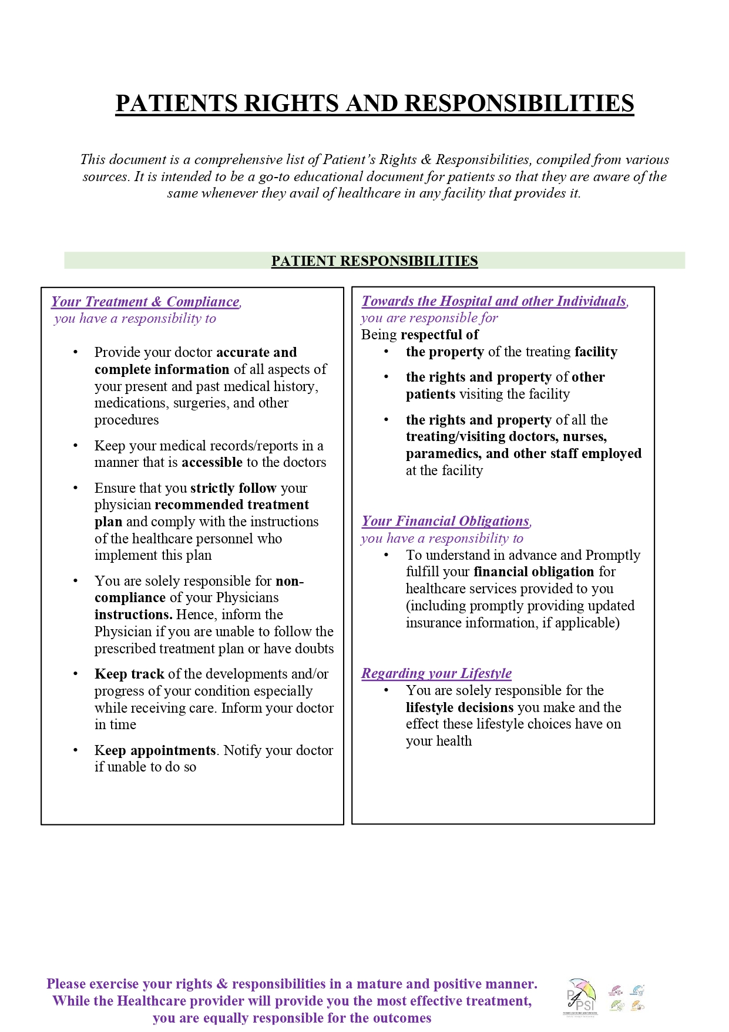
Patient Responsibilities - English

Slide 7
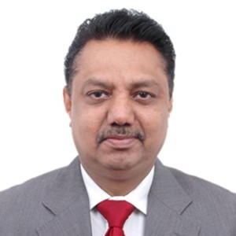
Dr Nagendra Swamy
Role of Patient Community- My Health My Responsibility
Importance and Role of Patients in understanding and applying R and R, 2
Patient ownership, responsibility in own care
Caregivers responsibility

Slide 8





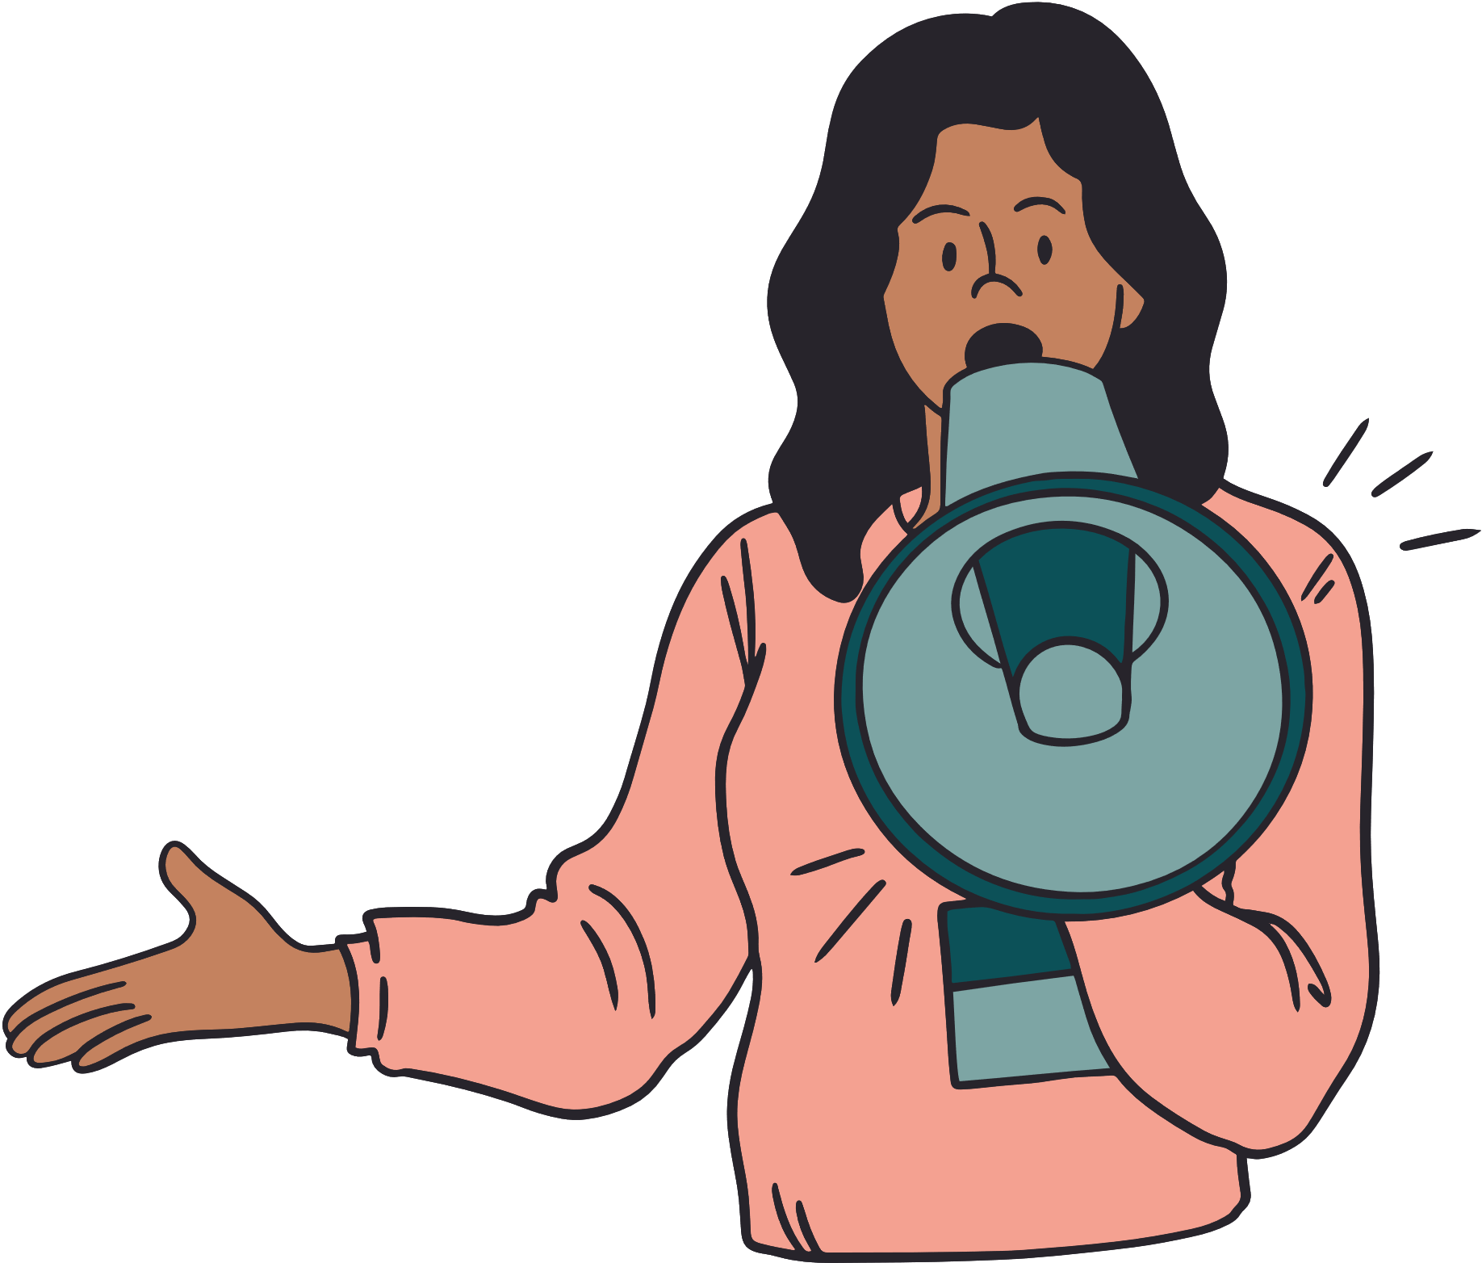

Patients have a role to play
Being Alert - Asking Questions
Providing Complete Information
Following Prescriptions/ Advise
Keeping Track of Medication/ Symptoms
Getting a Second
Opinion; Building Trust
Keeping Updated Medical Records
Giving
Valuable Feedback

Slide 9
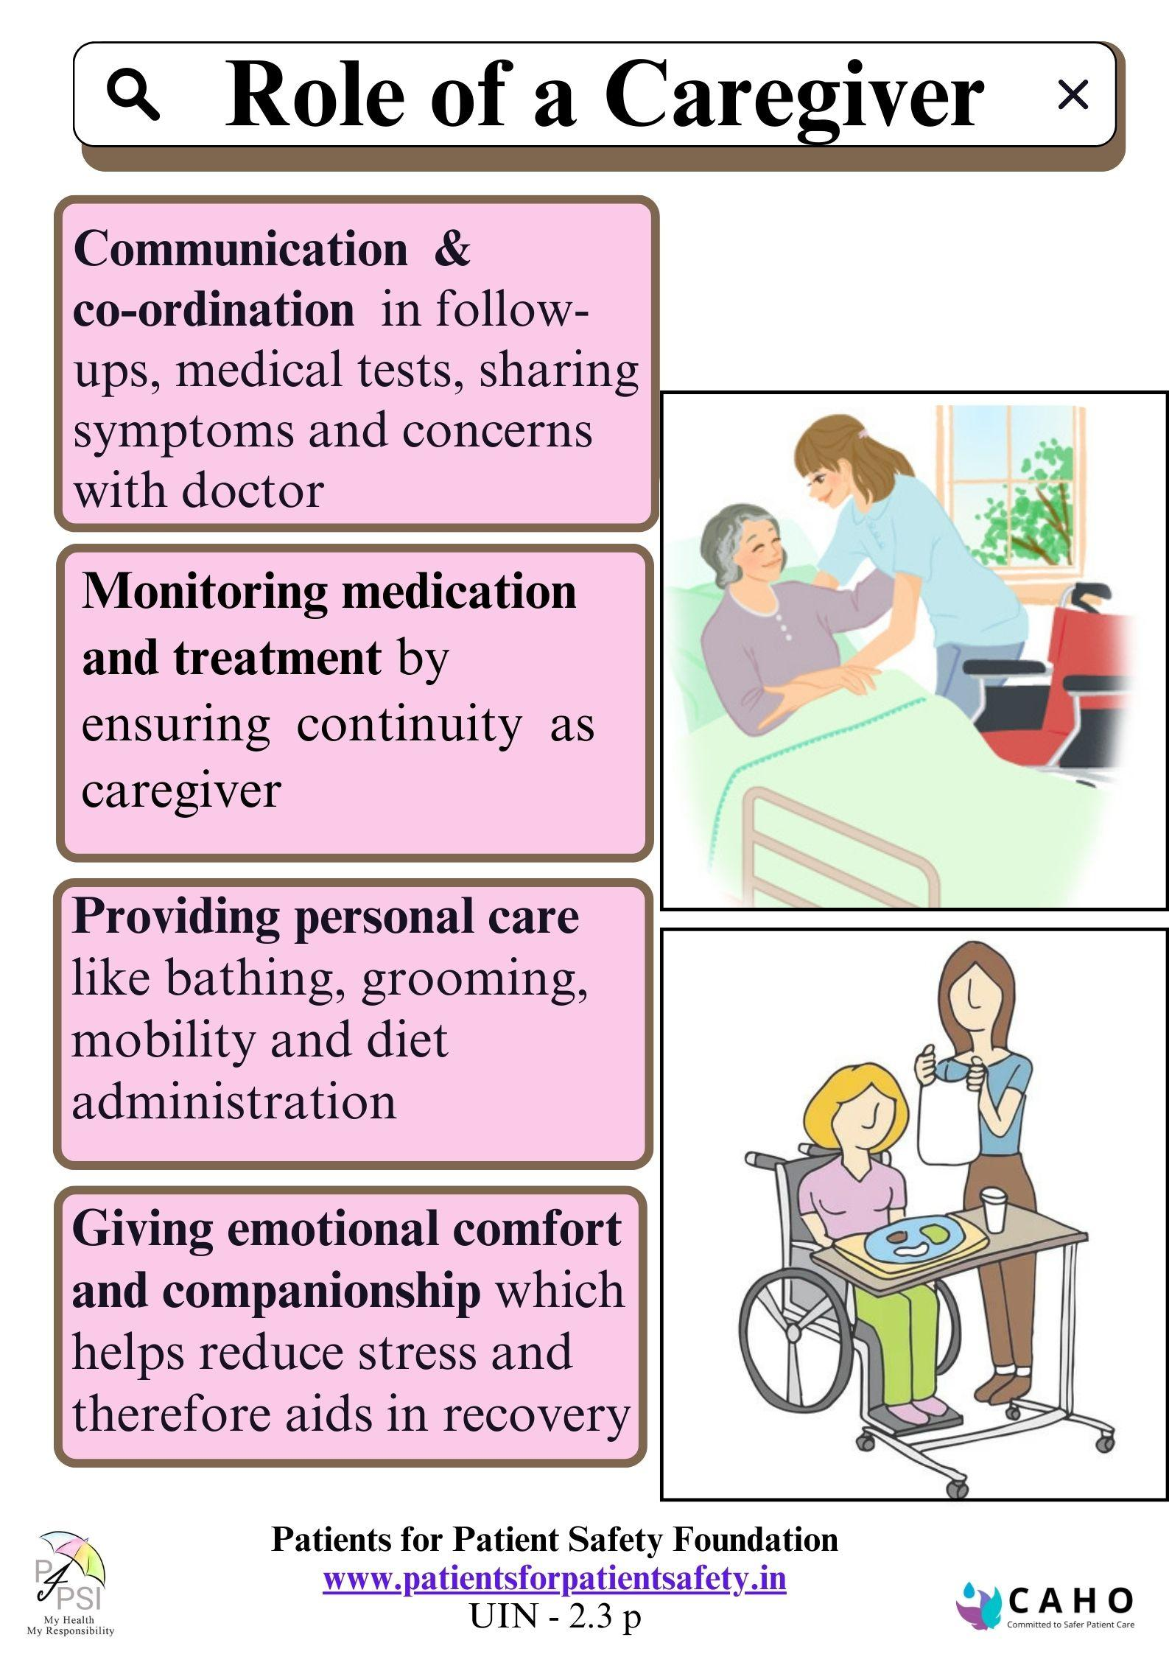

Slide 10
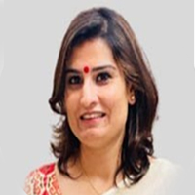
Dr Shweta Prabhakar
Role of Healthcare Providers – For or With patients
Importance of disseminating R and R to empower patients
Challenges and benefits,
Experience of successful communication in health care facilities

Slide 11


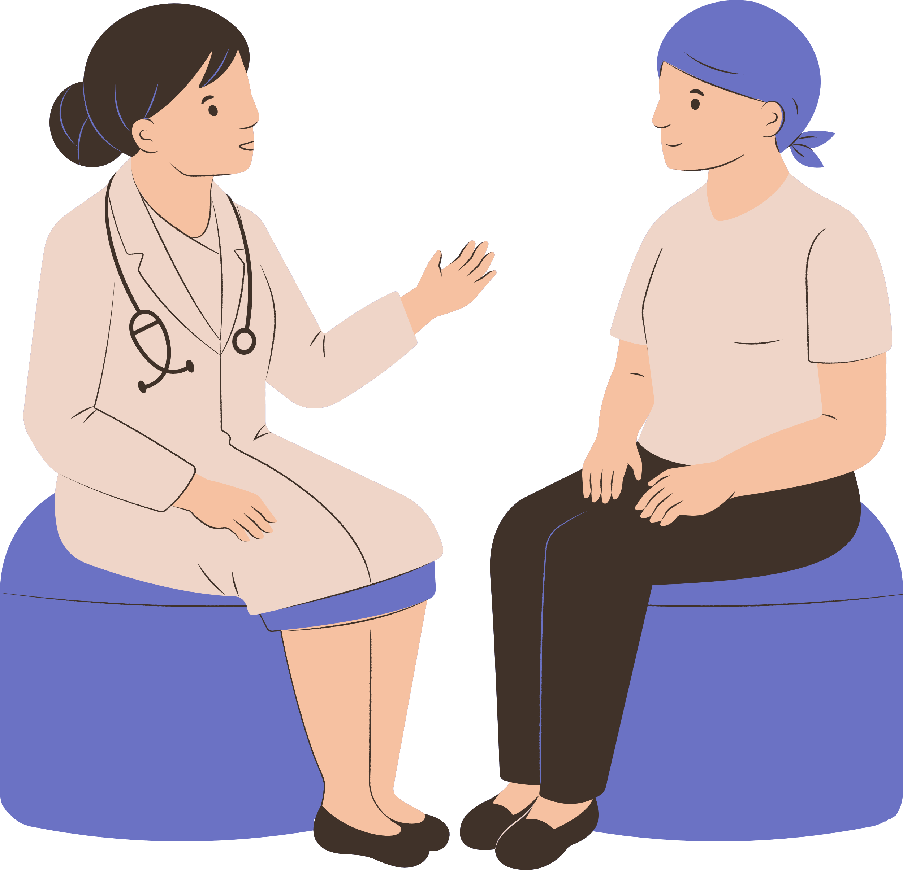
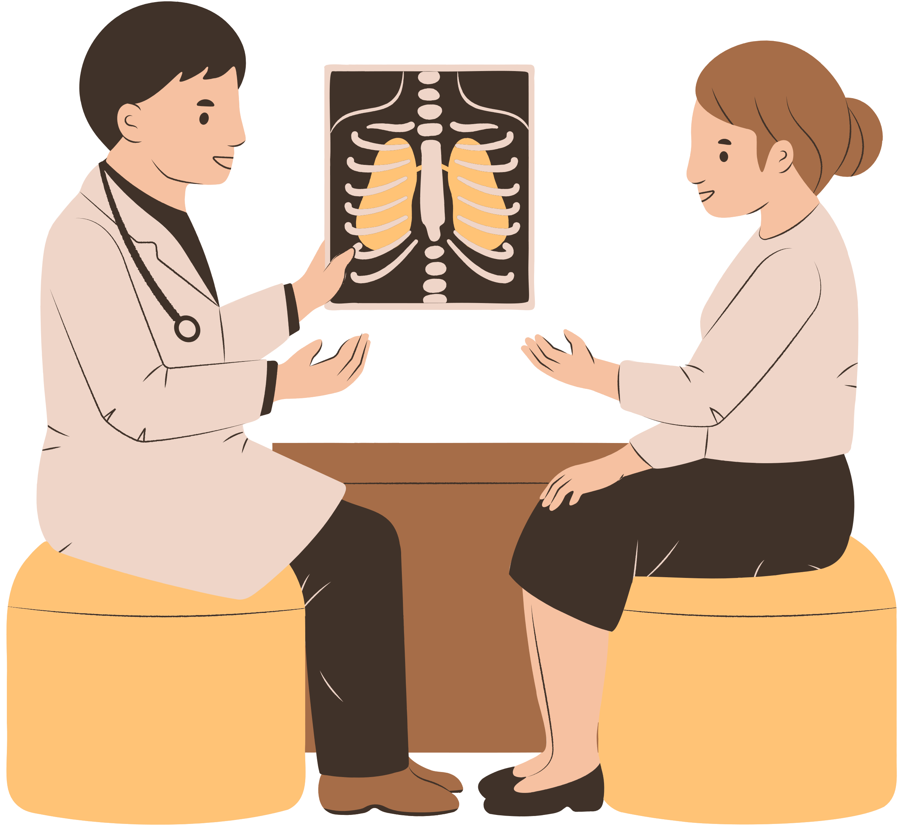
Patient has a Right to
Safe and Quick Recovery
Clear and Effective Two-way Communication
Receive Empathy, Respect, and Dignity
Access to Information , Records, to help decide
Response to Questions, proactive education
Coordination of care across specialties
Transparent & Consistent billing - faster discharge

Slide 12
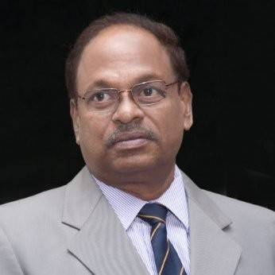
Dr Ashok Kunnapareddy
Tools for building trust – Partnerships in safe care
Information dissemination, role of PAC,
Contribution of Patient education, ( curriculum, audience)
Tools for dissemination- in hospital settings, on social media, print and digital mediums, regional language translations

Slide 13
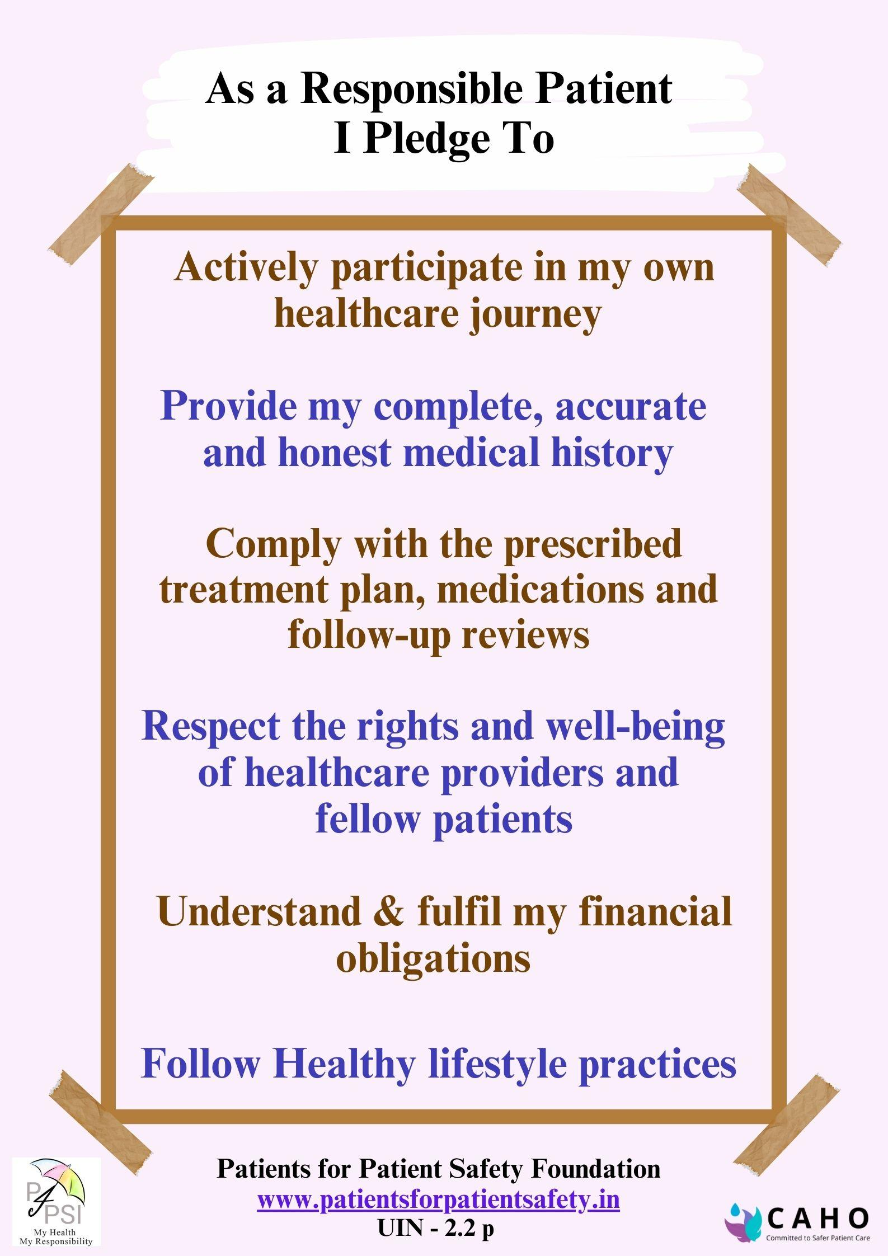
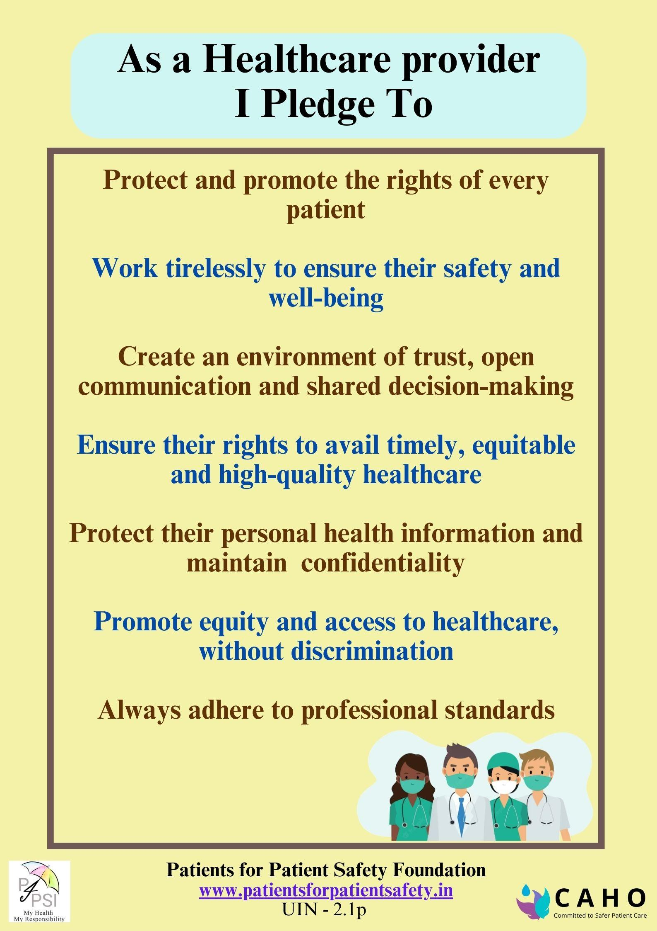

Slide 14
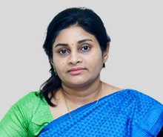
Dr Amitha Marla
Spreading R & R - Beyond Accredited Private Hospitals
Local –Regional - National levels- Global framework
Organizational role
Community role

Slide 15
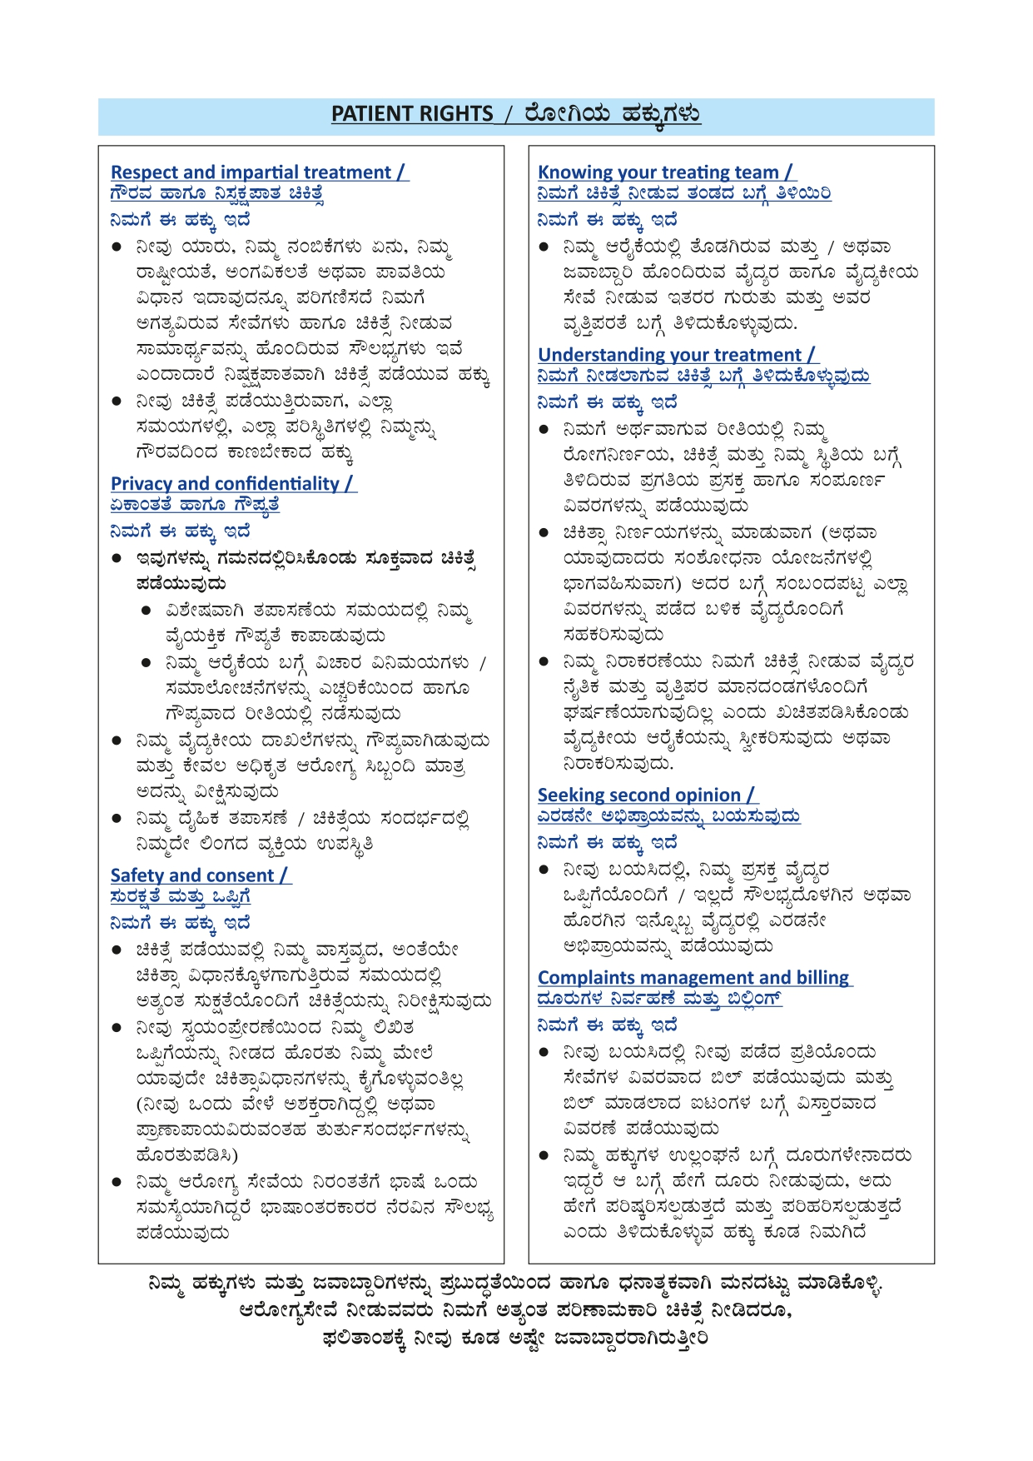
Patient Rights-Kannada

Slide 16
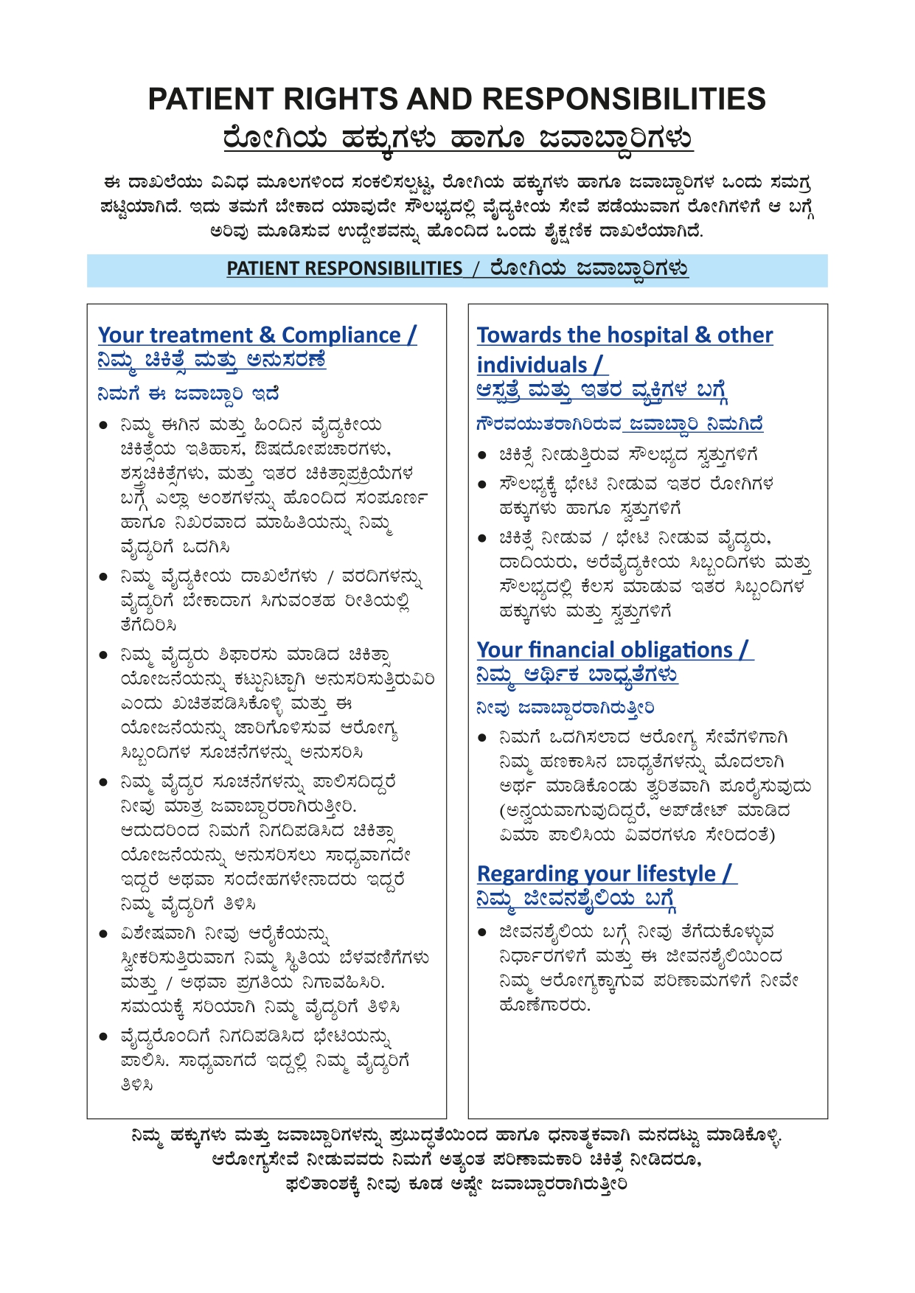
Patient Responsibilities-Kannada

Slide 17
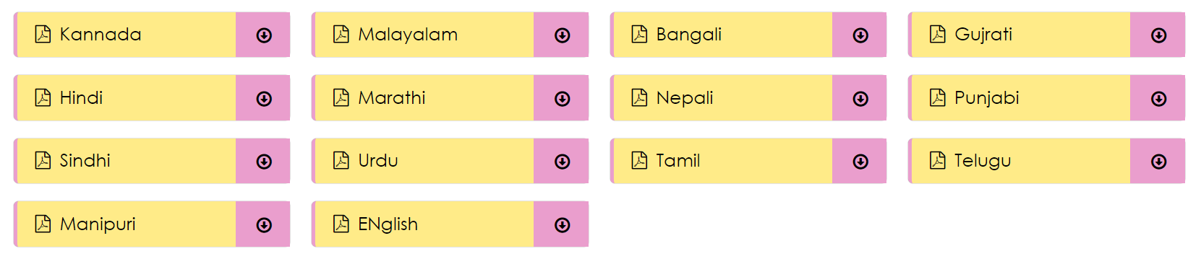
www.patientsforpatientsafety.in
Patients for Patient Safety Foundation
Regional Language Translations are available on our websites

