Slide 1




3rd ANEI Annual Patient Safety Conference
30th September, 2023
Patient Involvement & Centricity
Patients for Patient Safety Foundation

Slide 2

Patient is more than his Disease
Are my symptoms
serious?
What all do I tell the
doctor?
Shall I take a second opinion?
When & How?
Is my diagnosis
correct?
How expensive is the
treatment?
Are all the tests
required?
Where can I get answers to
these questions?
How should I keep my
records?

Slide 3

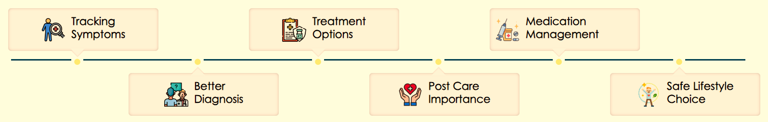
Patient Journey filled with doubts-possible harm?
Are both
Tablets same?
Are my symptoms serious?
Surgery vs Medicines
What should I
tell my doctor?
Shall I discontinue Medicines?
What's the harm in smoking ?
Delayed diagnosis
Non
compliance
Dispensing
errors
Incomplete information
Respiratory disease
Recurrence

Slide 4


Nurses Play a Critical Role
First & Critical Point of Patient Contact
Execution of Treatment Plan
Main communicator, and Educator
Patient assessment, and Vigilant Monitoring
Provide Comfort, Care, and Compassion
Overburdened but your smile/empathy makes the difference
Thanks for your Invaluable Contributions

Slide 5


How can Nurses help Patients
Encourage them to Ask Questions & have Open Communication
Educate them about Treatment Plan, Medications etc.
Explain all documentation and Reports to Patients and Caregivers including side-effects of medicines
Educate them about Home care issues, e.g. risks of falls, infections, diets etc.
Educate them about signs of deterioration & emergency protocols, What to do, What not to do & Why it is important
Teach Patients and Caregivers how to control infections at home

Slide 6
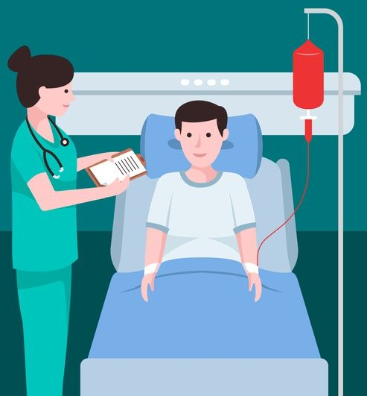





How Patients can assist Nurses perform
Share medical history, Express concerns or doubts
Inform about any allergy & adverse reactions
Be Polite and
Respectful
Verify your Identification band
Maintain health Records
Follow all instructions
By observing & learning from Nurses we can build own capability
My Health My Responsibility

Slide 7
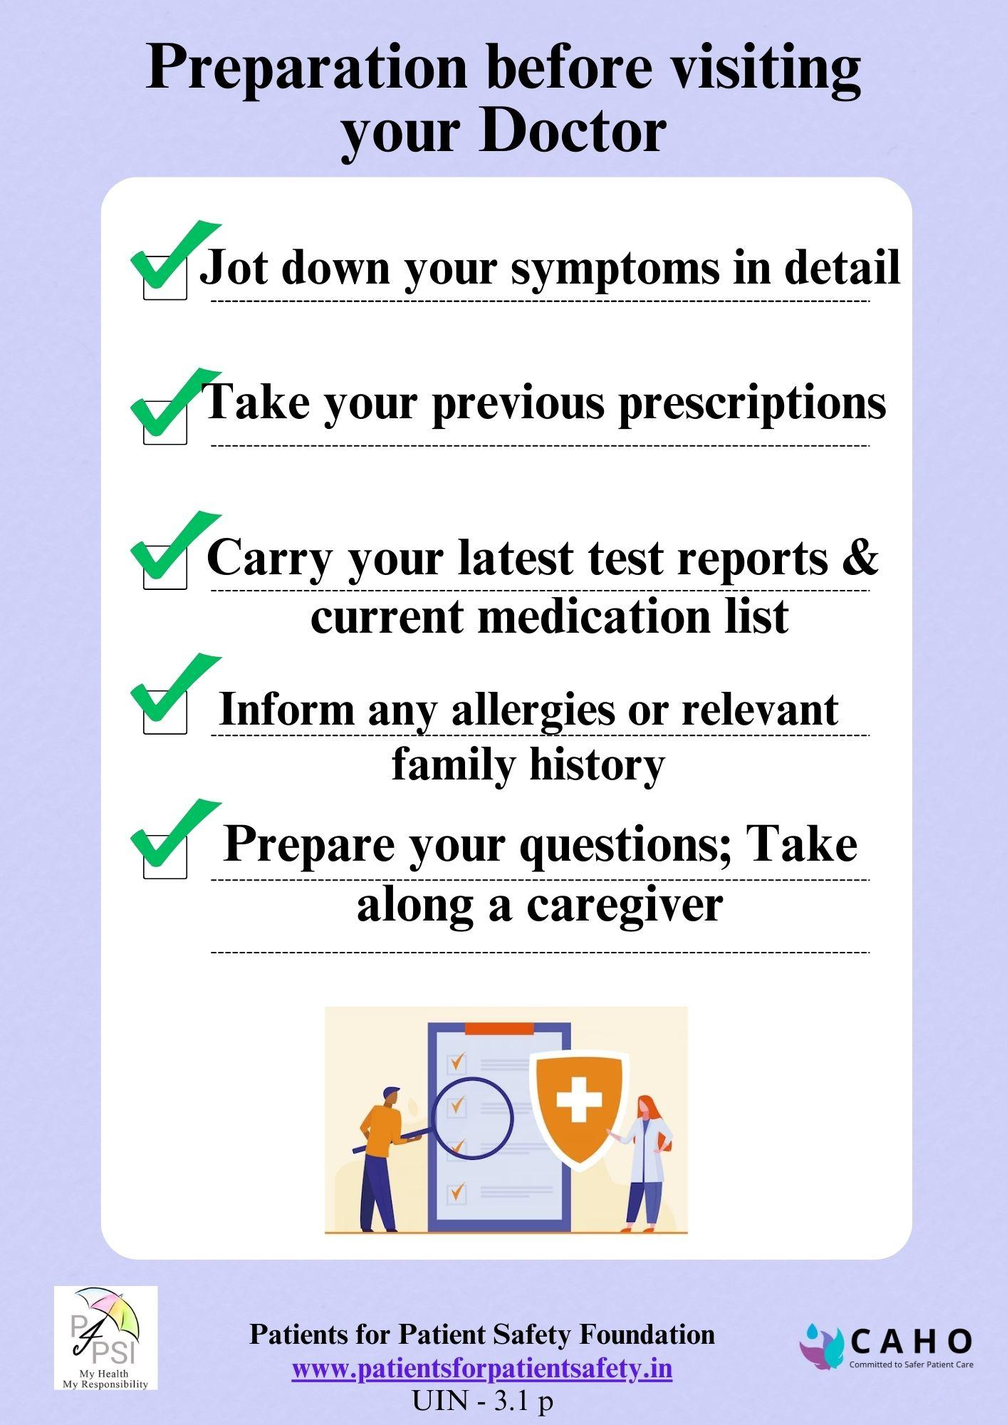
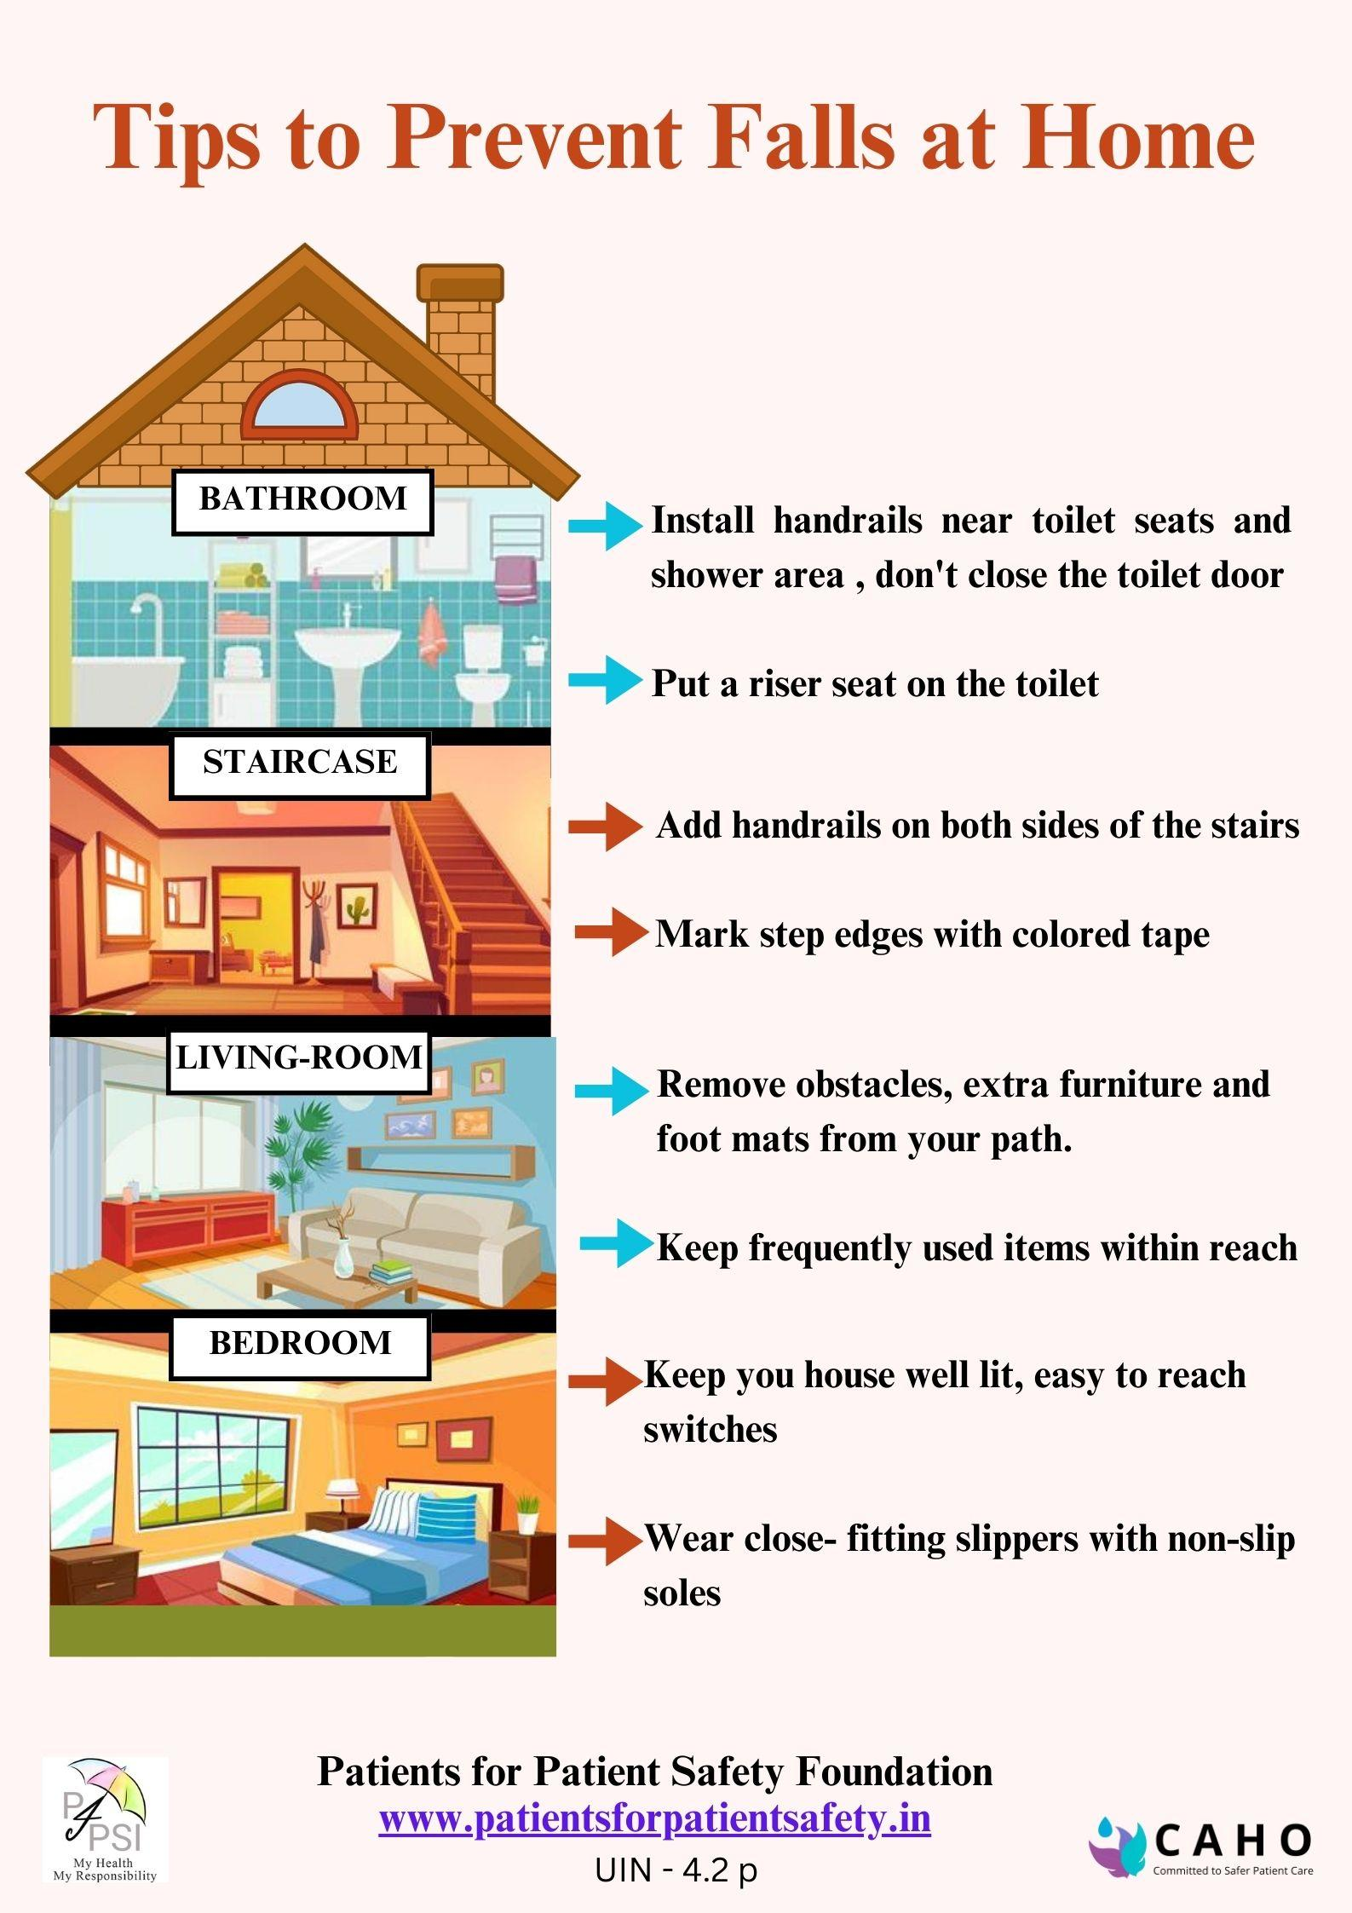
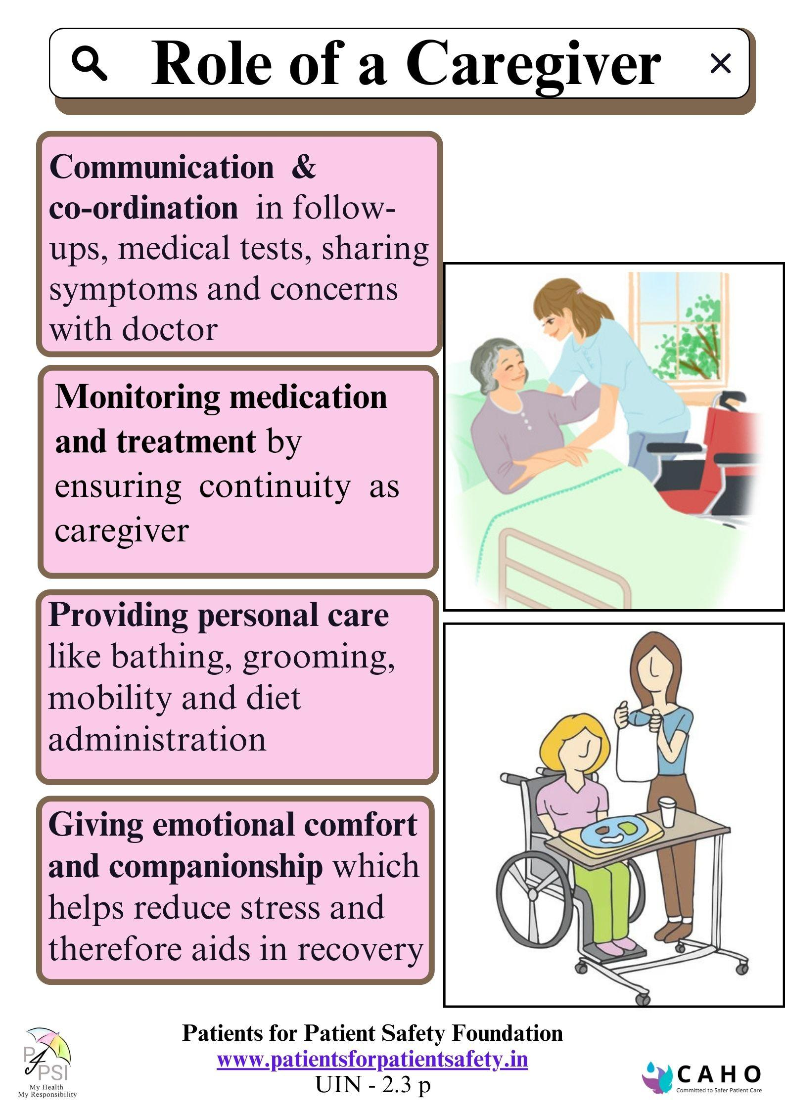
Patient engagement with patient education

Slide 8










Advantages of Patient Engagement to HCP
Early Detection & Prevention
Greater overall profitability
Better Outcomes & Reduced Medical errors
Increased Reputation
Improved Trust & Satisfaction
Improved Patient Loyalty & Referrals
Personal and Professional Fulfillment

Slide 9
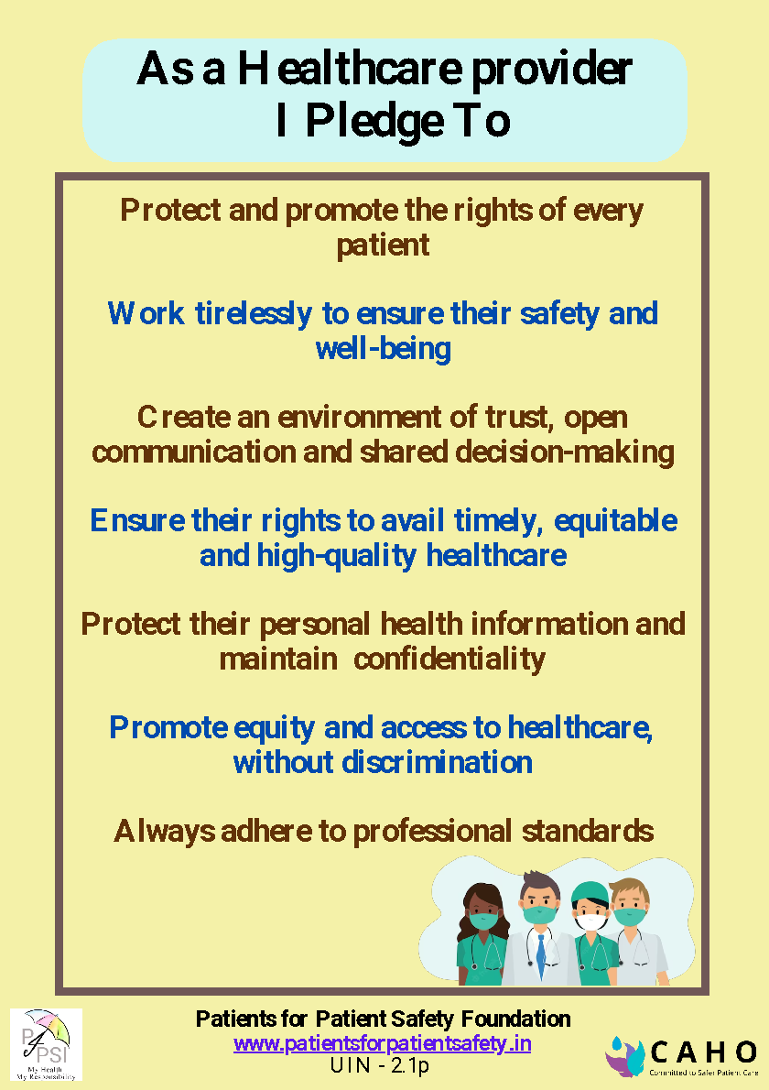
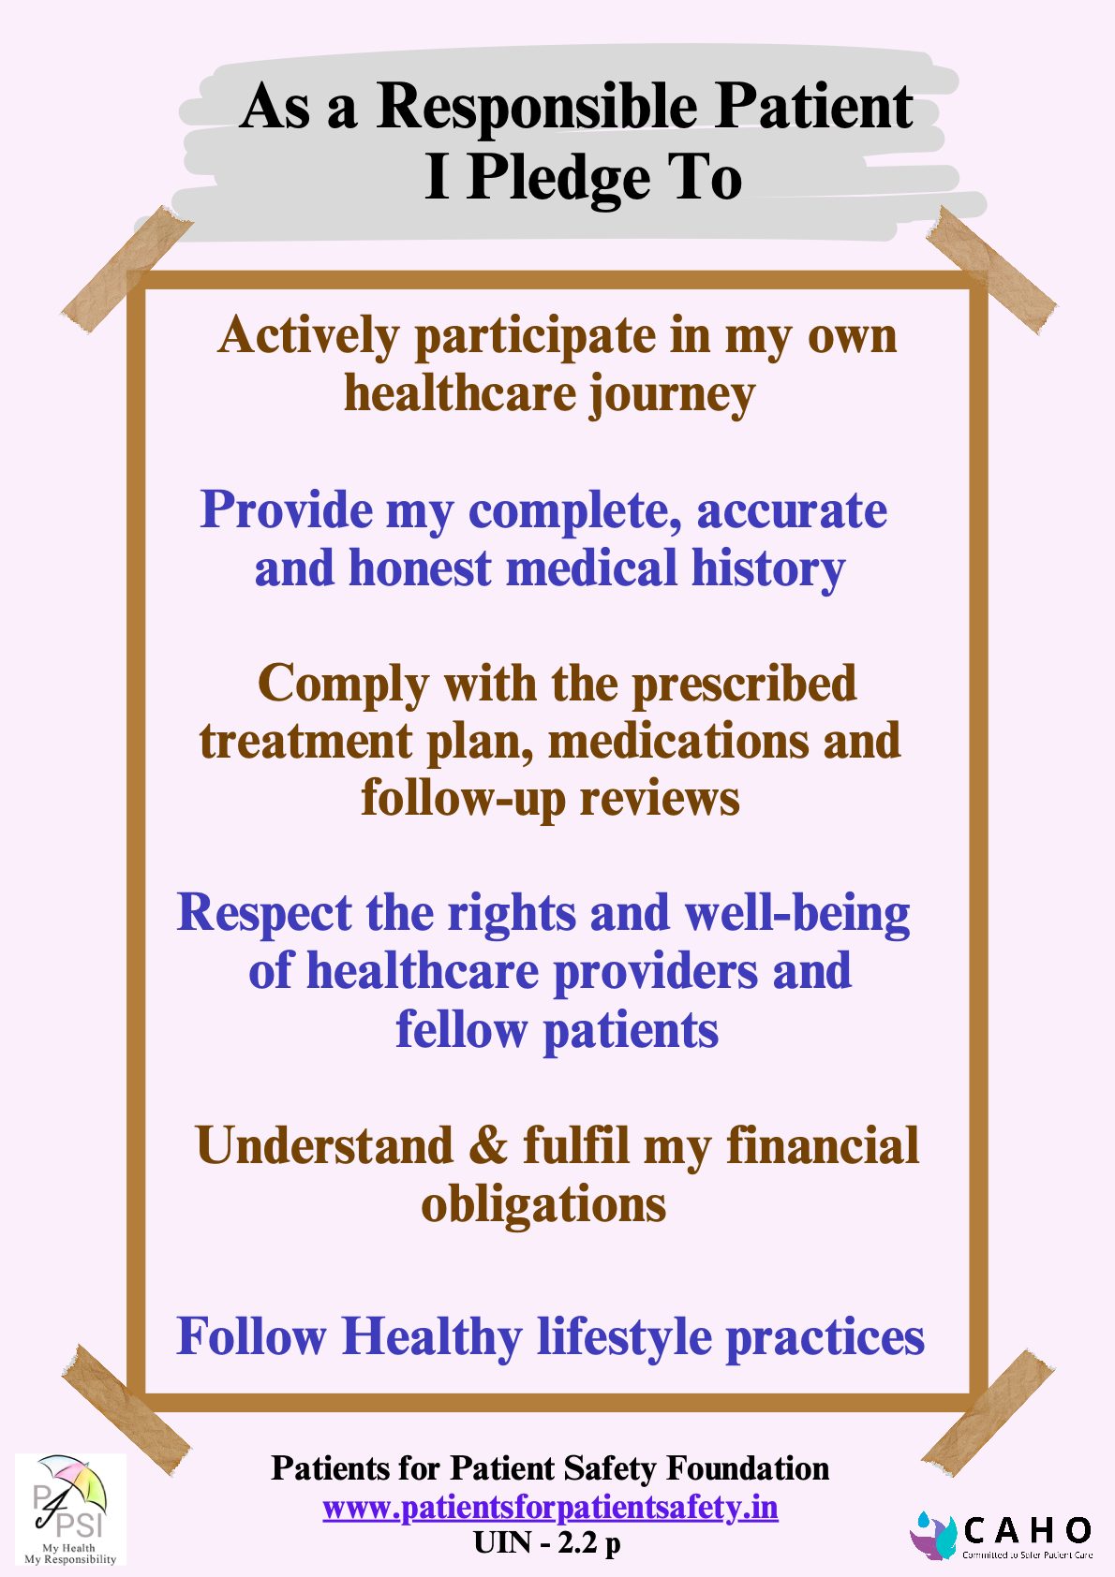
Patient Provider Partnership in safe care
www.patientsforpatientsafety.in

Slide 10


www.patientsforpatientsafety.in
In Conclusion
You play a vital role
Involve Patients
Patients are comfortable communicating with you
Encourage them to Ask
Patients understand your guidance
Please re-confirm
You know how to prevent harm
Share it
Patients are stressed
Your empathy is Magical
Patients for Patient Safety Foundation

