Slide 1






Aging Gracefully: Understanding the Challenges and Care for the Elderly
Patients for Patient Safety Foundation
Inner Wheel Club of Bangalore West (District 319) - 1st October 2024

Slide 2
Introduction - Embracing Aging: Understanding Changes and Risks
Aging is a natural part of life that brings about various physical changes and challenges. However, with awareness and proactive strategies, seniors can manage these changes effectively and enjoy their golden years.
Physical Changes (Bones, Joints, Muscle & Organs): Bones shrink, joints stiffen, and muscles weaken, raising the risk of fractures, arthritis, and falls. Vital organs like the heart and kidneys become less efficient.
Sensory Decline: Vision and hearing worsen, affecting daily activities and social interactions.
Cognitive and Mental Health: Memory loss and cognitive decline can lead to isolation and degenerative disorders. Depression and anxiety may develop due to health issues or loneliness.
Chronic Diseases and Weak Immunity: Higher risk of chronic conditions like heart disease, diabetes, and weakened immune function increases susceptibility to infections.

Slide 3

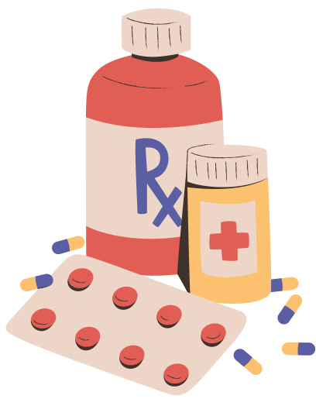

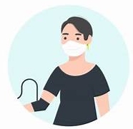
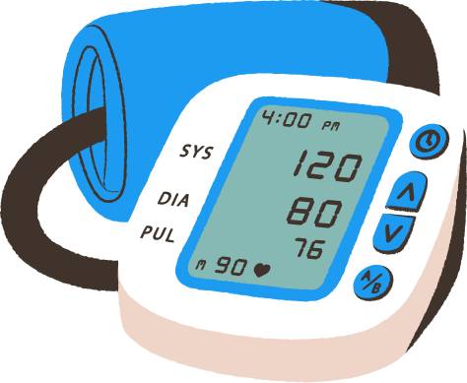
Medical Harm and its Consequences
1 in 10 patients* are harmed during hospitalization, while 4 in 10* face harm in OPD
Delayed Treatment
Prolonged Suffering
Increased Healthcare Costs
Loss of Trust in Healthcare and Psychological Impact on Patients
Wrong Treatment, Disability, Morbidity & mortality
Medication Errors* constitute 50% of avoidable harm
Unsafe Surgical Practices* cause
complications in 25% of patients
Patient Harm is also caused due to ignorance of patients and non-involvement
Unsafe Transfusion/ Injection practices
Up to 50% of this avoidable harm can be prevented by us
*Source: WHO

Slide 4
Who Causes Medical Harm
At Hospital
At Home
Errors/Misses by Providers
Omissions by Patients
Patient & Caregivers
Medications Errors
Wrong Diagnosis
Surgical Mistake
Infections
Communication Errors
Ignore Symptoms
Late Presentation
Incomplete Info
Not being alert
Not asking questions
Lack of awareness
Lack of preparedness
Not following prescriptions
Self treatment
Missing clinical signs
Aware Patients/Caregivers can help Prevent Medical Harm

Slide 5
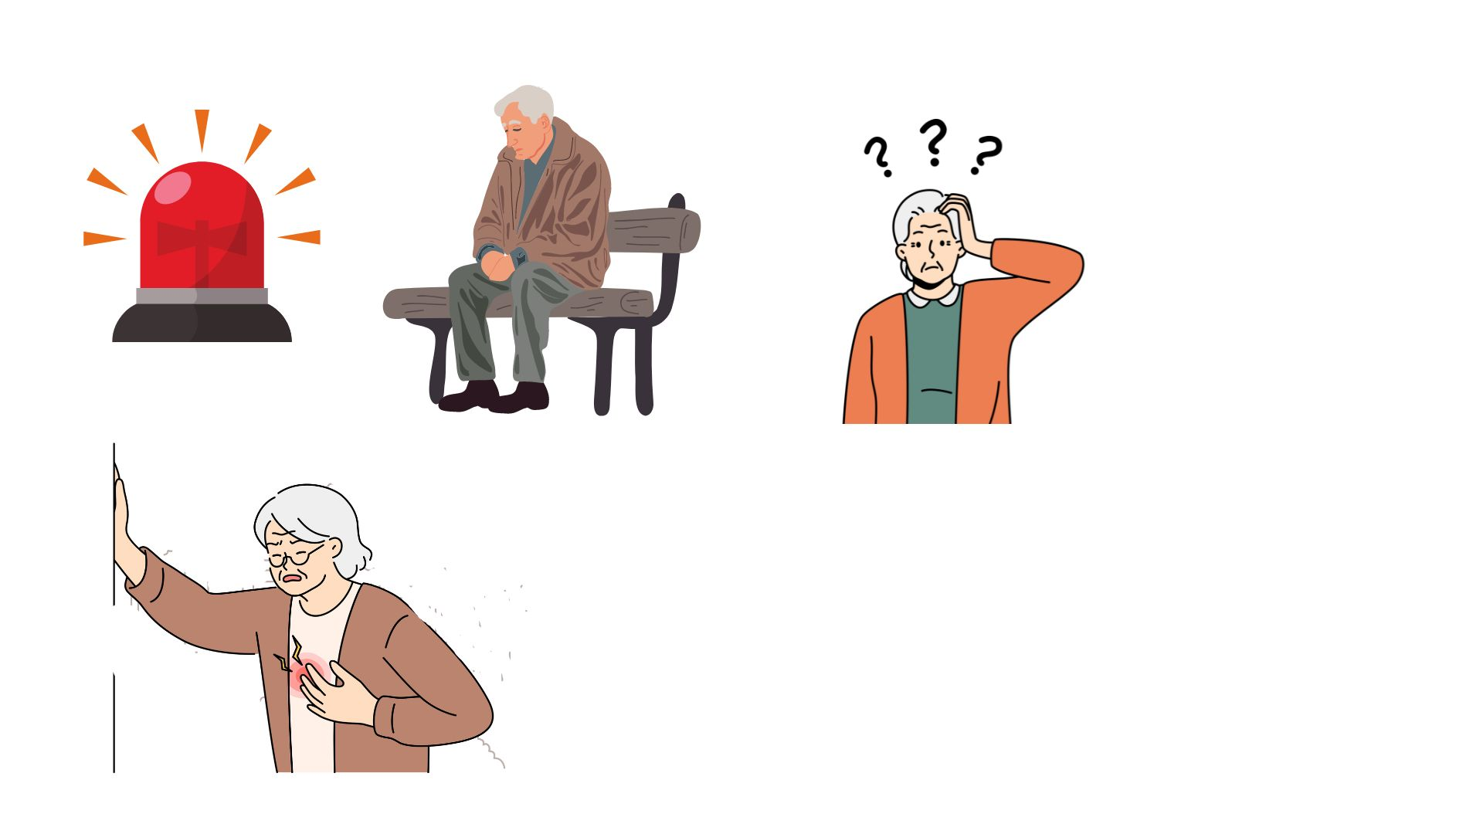
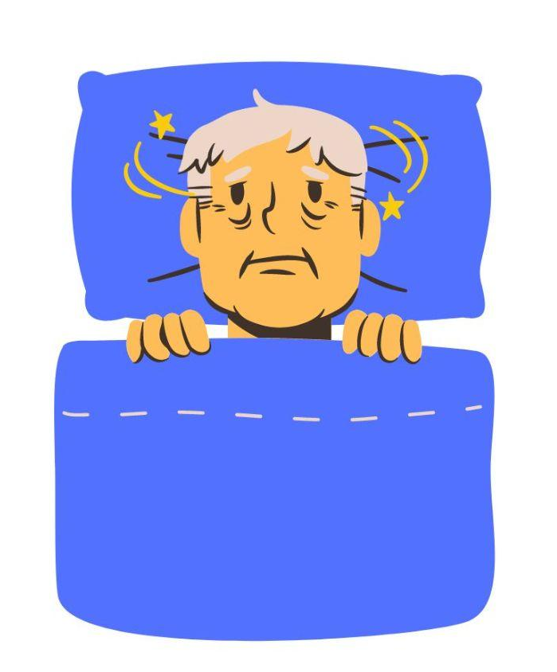
Special Challenges Faced by Elderly
Difficulty managing emergencies, unexpected falls, medications, chronic diseases (NCDs), cancers
Loss of purpose after retirement, leading to social isolation and loneliness
Challenges with traveling, attending doctor visits, daily activities, and poor sleep quality
Increased vulnerability to harm during medical treatments, worsening existing health conditions and UTIs

Slide 6
Why Falls Are More Common in Older Adults
Falls happen often among older adults over the age of 65. Every year, 3 million older adults are treated in emergency departments for injuries related to falling.
Physical changes: Aging naturally leads to decreased muscle strength, balance issues, and slower reaction times.
Vision and hearing impairment.
Environmental hazards: Poorly lit areas, cluttered spaces, slippery floors, and uneven surfaces in the home.
Outdoors: Wearing shoes with inadequate grip, walking in the dark, or on uneven roads.
Previous falls increase the likelihood of future falls.
Decrease in sensory ability due to medication.
Keep your bathroom and bedroom doors ajar to avoid accidents and improve accessibility.
Falls can lead to Loss of independence, Mobility & Social isolation

Slide 7
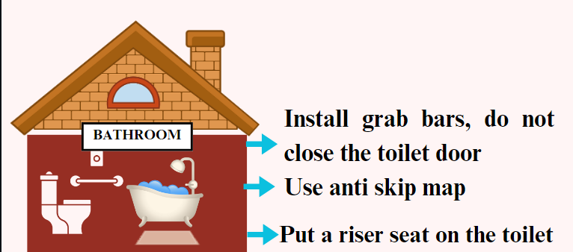
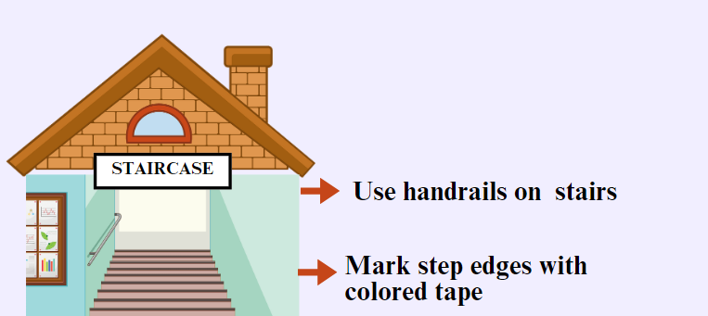
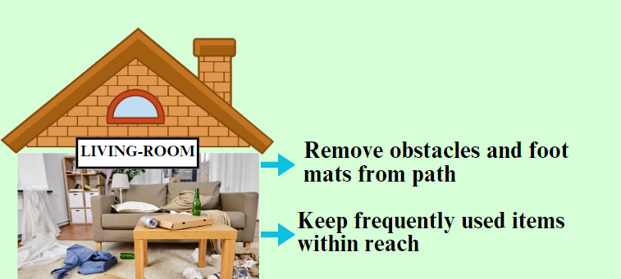
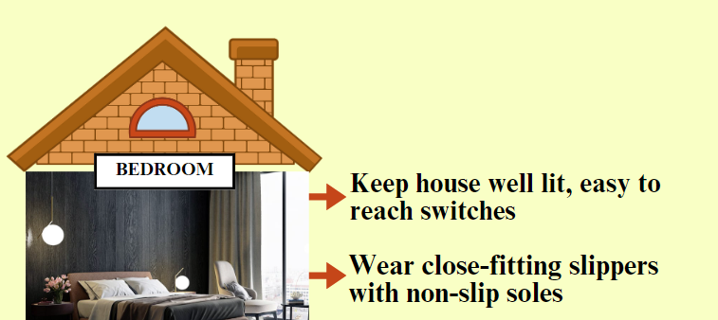
Tips to Prevent Falls at Home

Slide 8
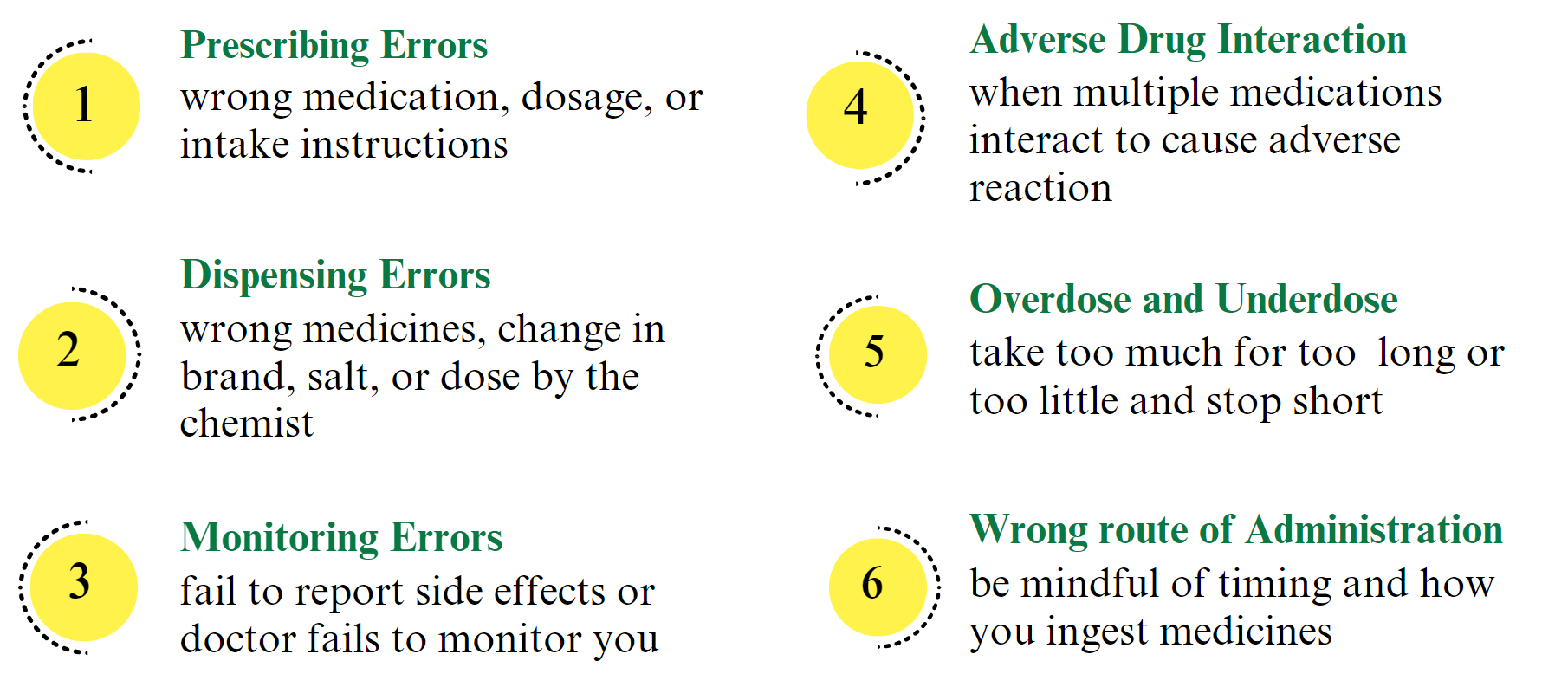
Common Medication Errors

Slide 9
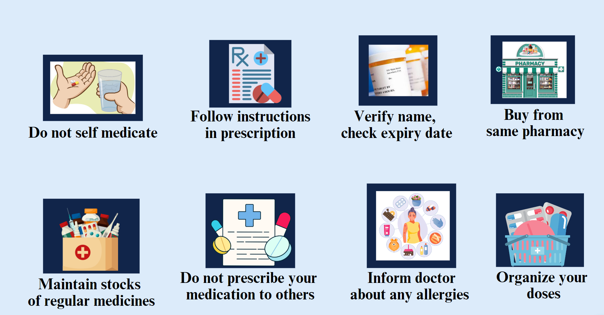
Tips for Medication Safety

Slide 10
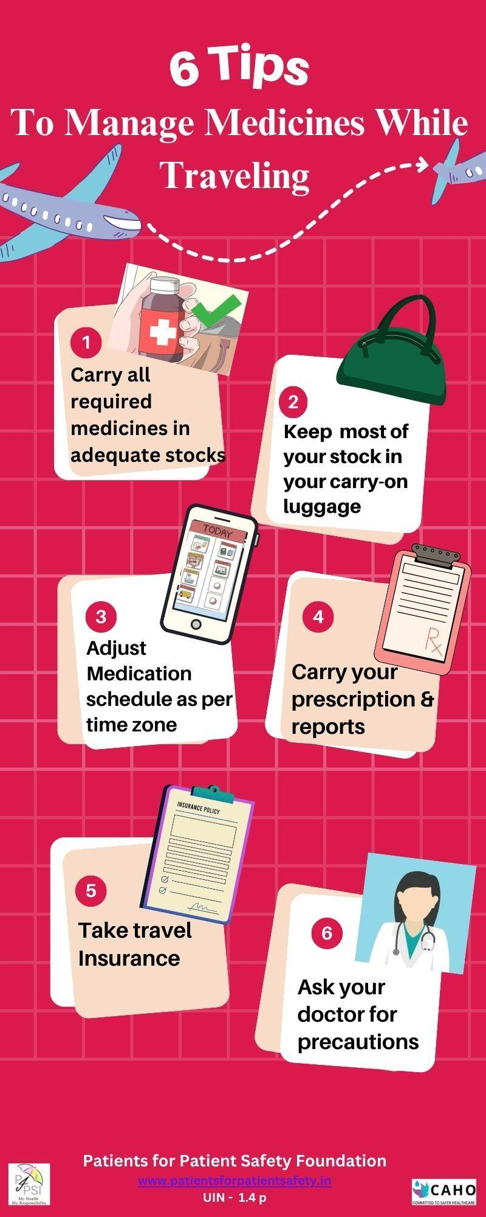
Common mistakes while Traveling
Forgetting to pack all medications/ monitoring aids
Putting in checked luggage chances of delay
Manage dosage in now time zone
Insufficient supply overstays
Not carrying prescriptions/ reports

Slide 11
Sleep related Problems
Changes in Sleep Patterns: Aging leads to lighter, shorter sleep with more awakenings. Circadian rhythm shifts result in early waking, trouble falling asleep, and poor sleep quality.
Health Issues: Conditions like arthritis, chronic pain, respiratory issues, and nocturia disrupt sleep.
Medications: Medications for high blood pressure, heart disease, or depression may cause insomnia or drowsiness.
Sleep Disorders: Sleep apnea, restless legs syndrome, and periodic limb movement disorder are common among older adults, significantly impacting sleep quality.
Mental Health Issues: Anxiety, stress, or depression can contribute to sleep problems.
Lack of Physical Activity: Reduced activity can disrupt the natural sleep-wake cycle, making it harder to fall asleep.

Slide 12
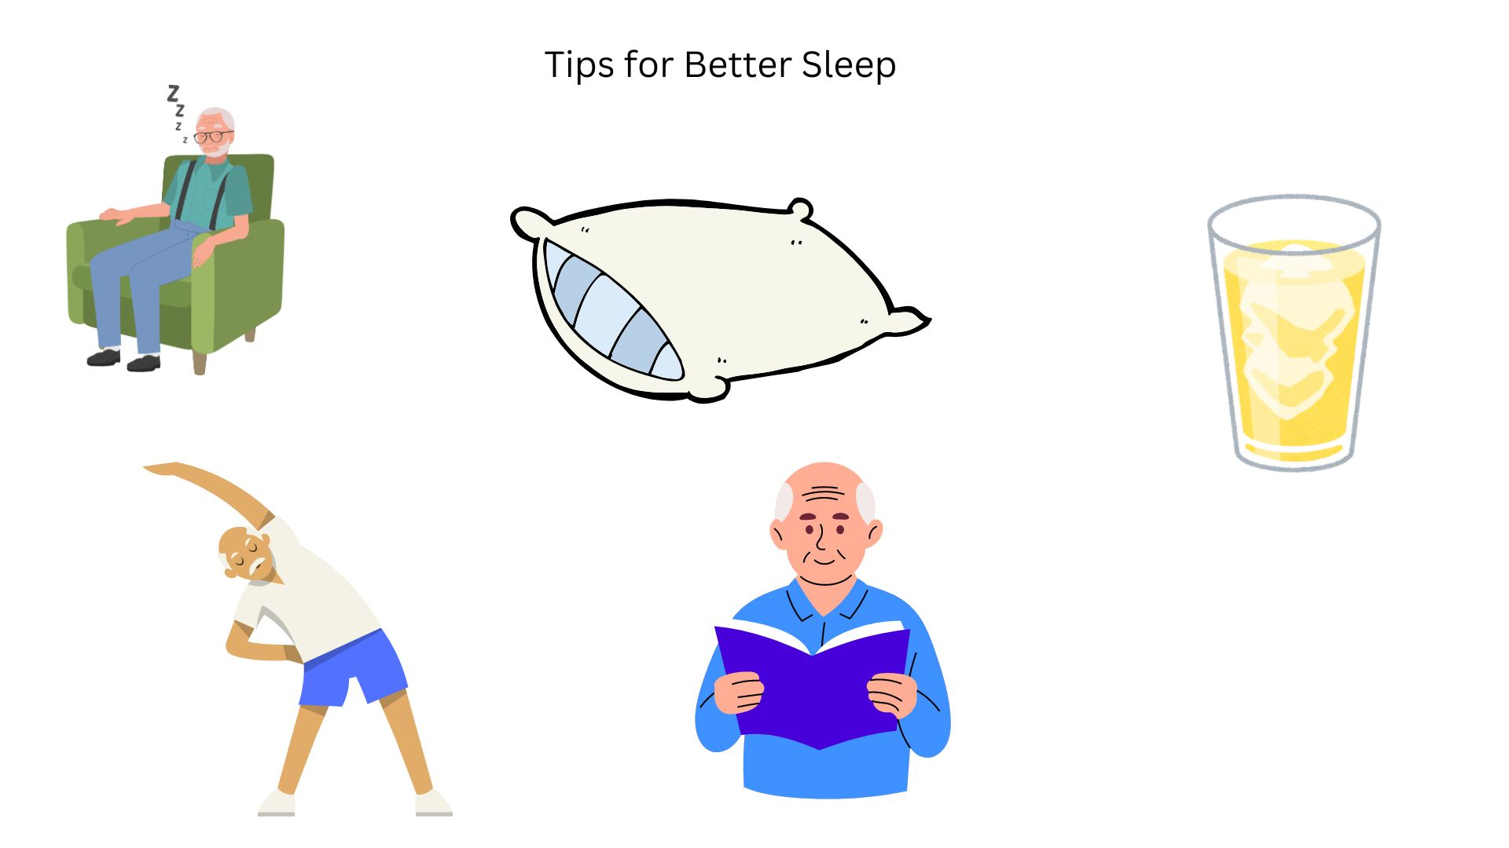
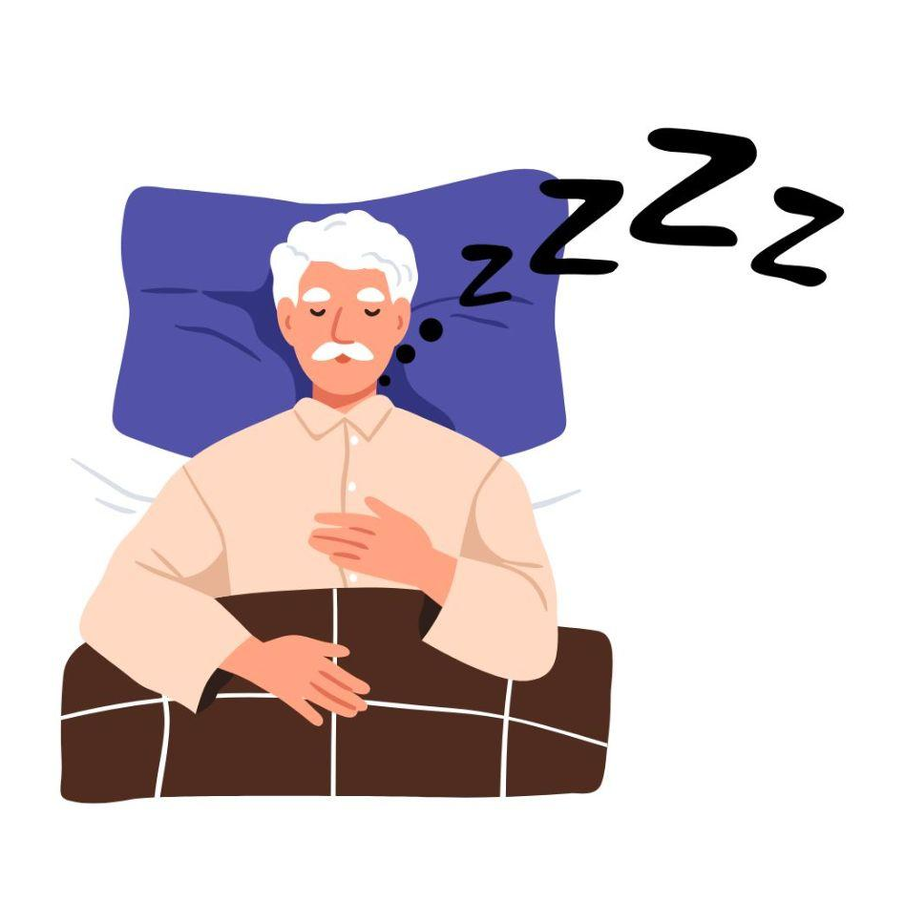
Tips for Better Sleep
Take a short 20-30 minute nap
Use pillows for comfort, chronic pain
Limit drinking fluids 2 hours before bed
Engage in light activities like walking or stretching
Do not ignore snoring, check for Sleep Apnea
Spend 30 minutes before bed relaxing with reading or music

Slide 13
Monitoring of Vitals for Chronic Problems
Chronic Condition Management: Ensures better control over conditions like diabetes, arthritis, Hypertentension, COPD, Cholesterol and heart disease.
Medication Adherence: Helps maintain proper medication schedules, reducing risks of missed doses or drug interactions.
Independence: Monitoring allows the elderly to live independently while managing their health proactively.
Reducing Hospital Visits: Proactive care lowers the chances of needing emergency or hospital care.
Mental and Emotional Well-being: Proper health management reduces stress and enhances emotional health by giving a sense of control.

Slide 14
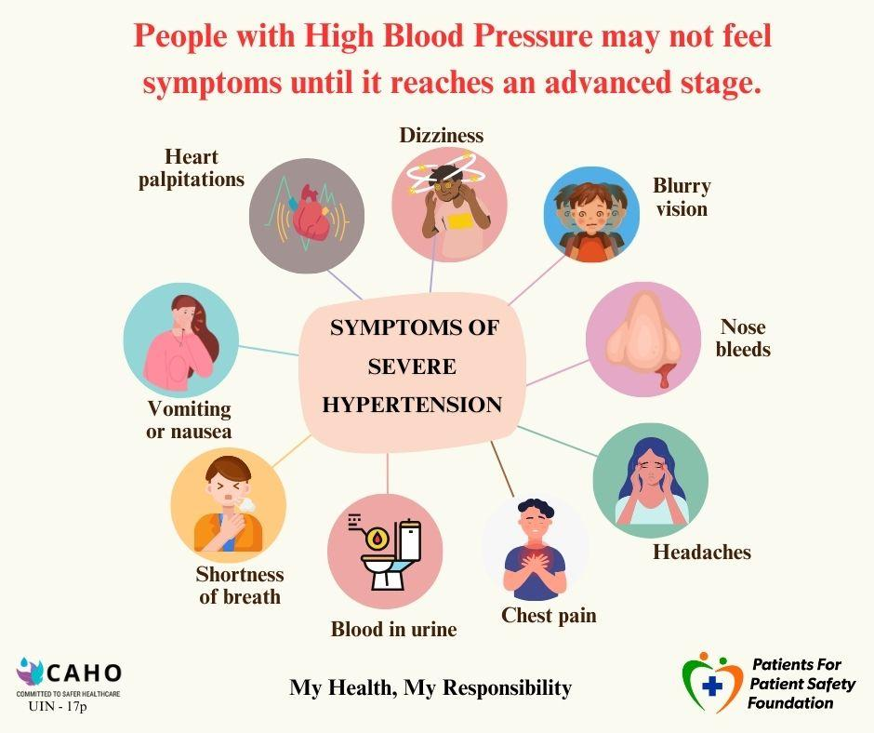
Hypertension
Symptoms
One in four adults
230 million people suffer
Only 12% of these have their blood pressure under control.
It can lead to severe complications, including heart attack, stroke, heart failure, and kidney disease.

Slide 15
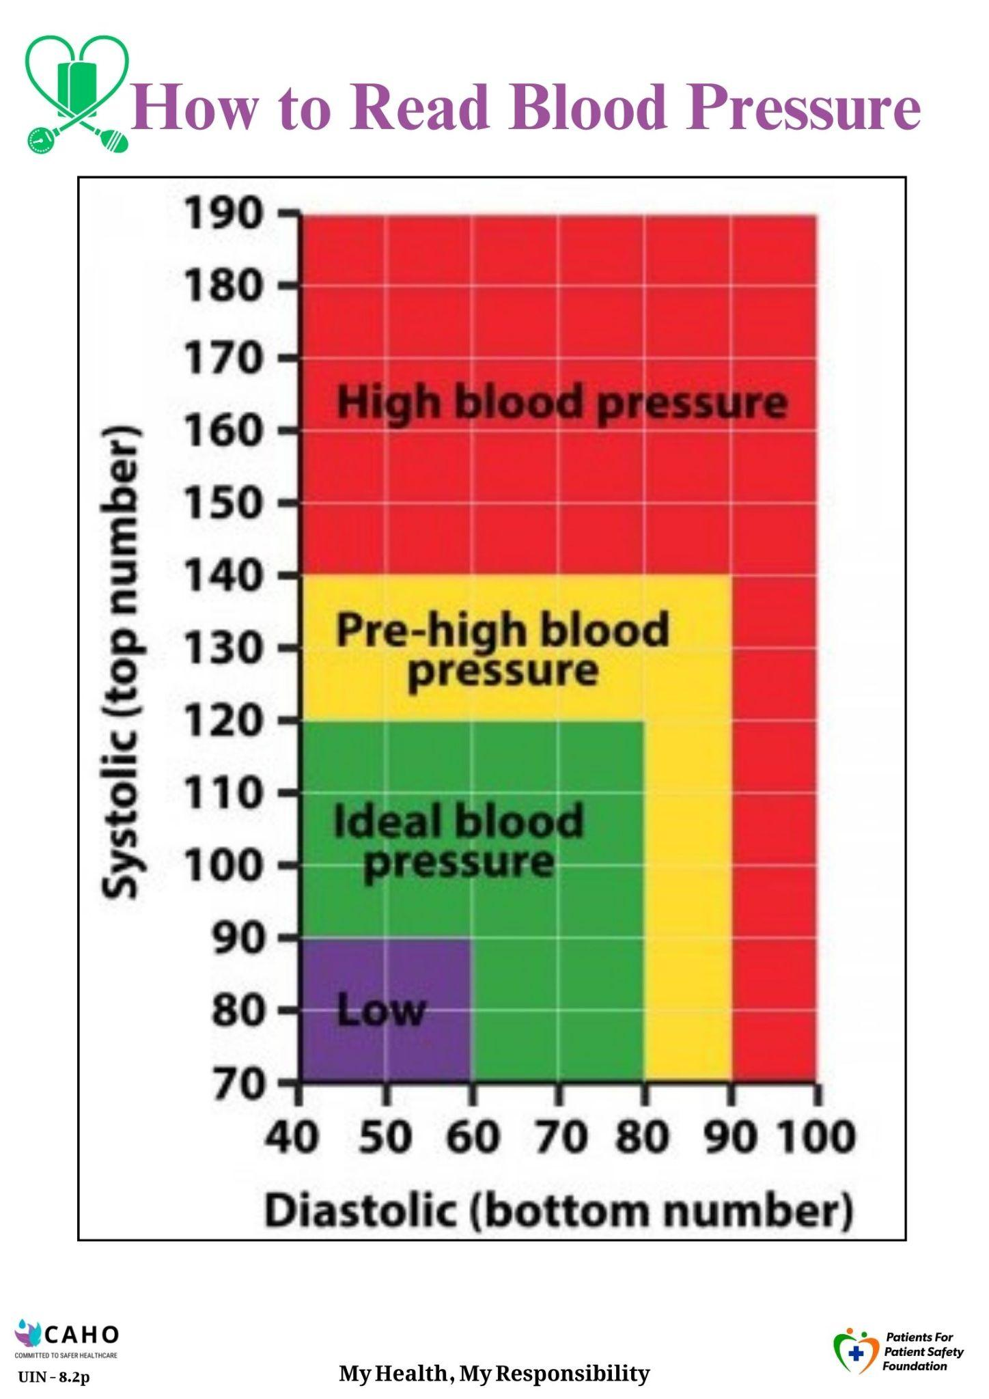
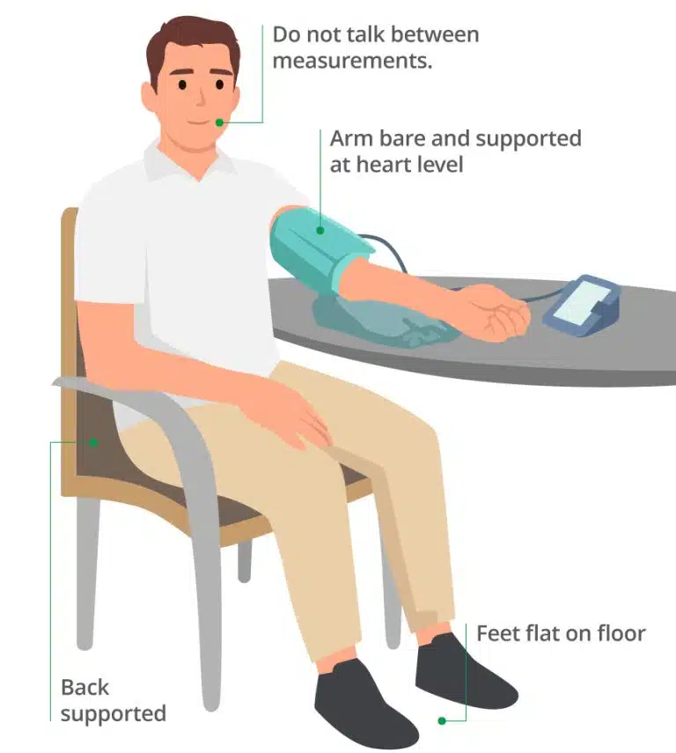
Measuring BP at home
Mistakes we make while measuring BP:
Incorrect Cuff Placement
Improper Body Position
Not Resting Before Measurement
Talking or Moving During Measurement
Errors in Instruments - calibration

Slide 16
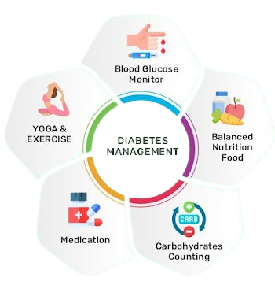
Managing Diabetes
1 in 4* have diabetes, 1 in 10* have uncontrolled diabetes.
Diabetes is silent, symptoms show later
Serious complications, controllable if detected early
*Source: Apollo Hospitals

Slide 17
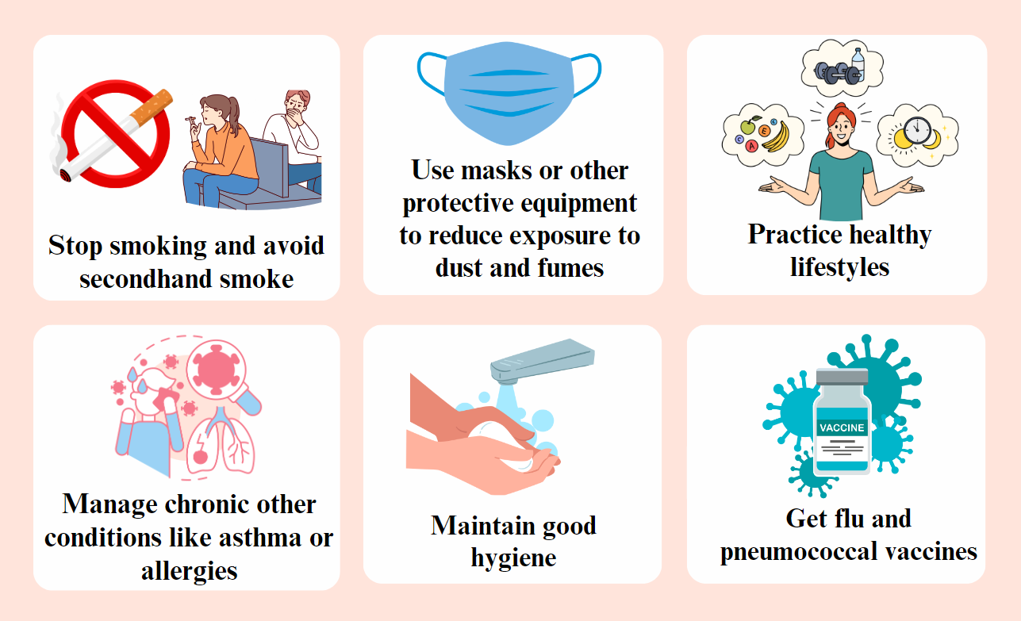
Managing COPD
Protection of COPD
Symptoms of COPD develop gradually and may not be noticeable until significant lung damage occurs, including:
shortness of breath during physical activity,
chronic cough with mucus production,
wheezing,
chest tightness, and
frequent respiratory infections

Slide 18
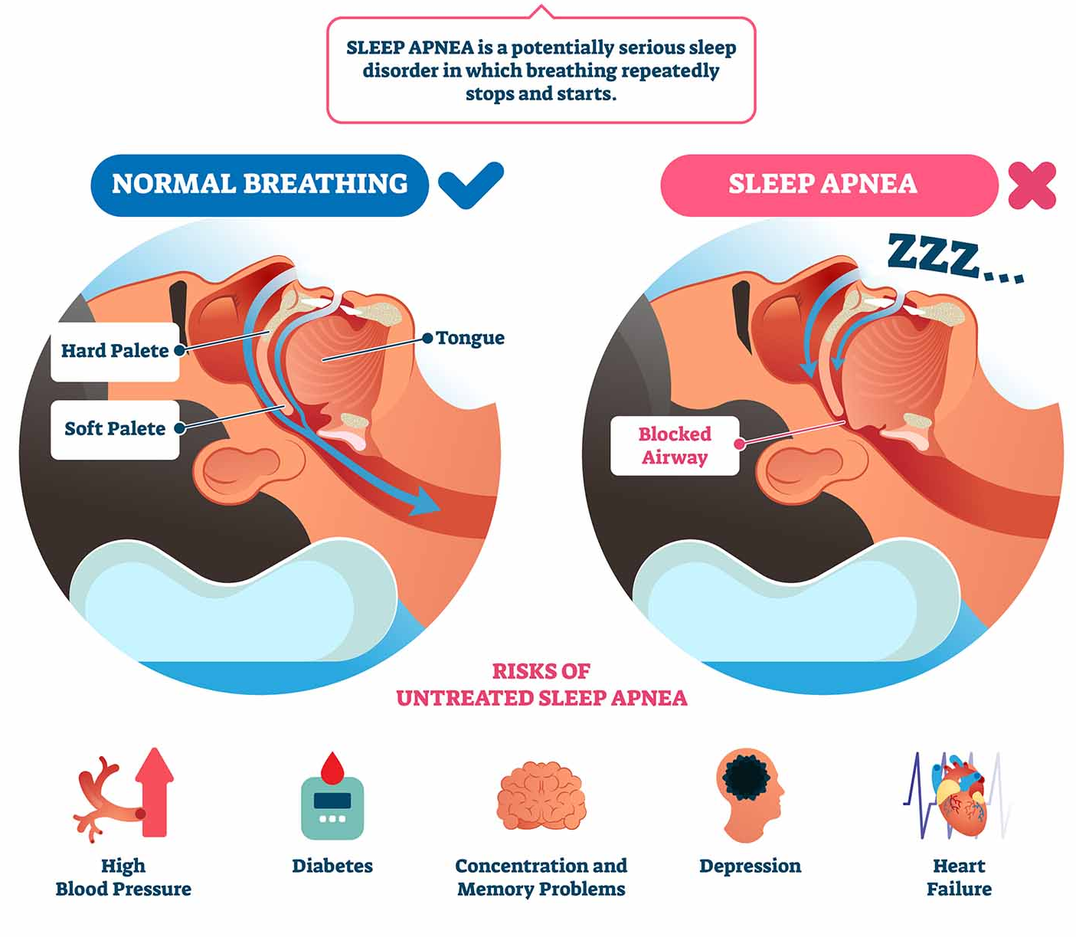
Managing Sleep Apnea
Lose weight to reduce symptoms.
Sleep on your side to keep airways open.
Avoid alcohol at least four hours before bedtime.
Eliminate tobacco use to reduce airway inflammation.
Exercise regularly to improve overall health
Use a CPAP machine to maintain open airways during sleep
Consult healthcare providers for ongoing management.
SOURCES: lighthousedentalcentre

Slide 19
What is a Medical Emergency
All of us will be unwell sometime; Our response depends on kind of illness
Builds gradually
Persistent
Long Treatment
Mostly Undiagnosed
Examples
Blood pressure
Diabetes
Joint pains
Asthma
Digestive issues
Chronic Illness
Sudden/ unannounced
First time; unprepared
Life threatening
Needs immediate response
Affects long term health
Examples
Heart attack
Stroke
Seizure/ unconsciousness
Head Injury
Choking
Common Illness
Medical Emergencies
Common & frequent
Rapid sudden onset
Normally short period
Recovery within weeks
Examples
Cold flu
Heartburn
Infections
Fracture
Medical Emergencies - Most Critical, Least Prepared, Least Aware

Slide 20
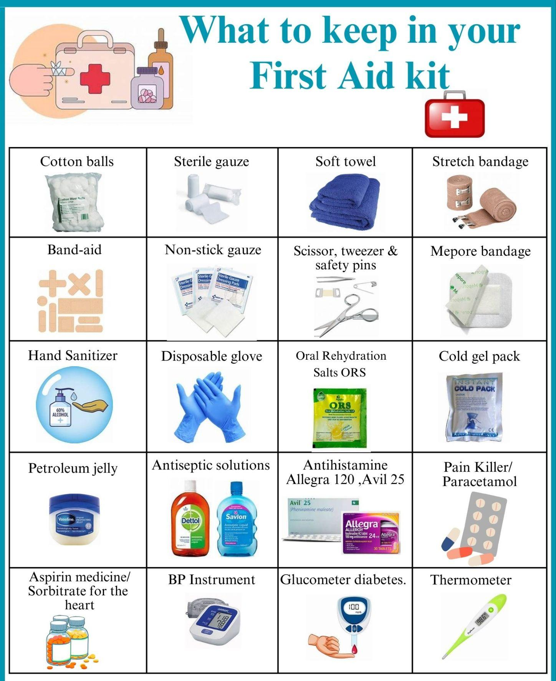
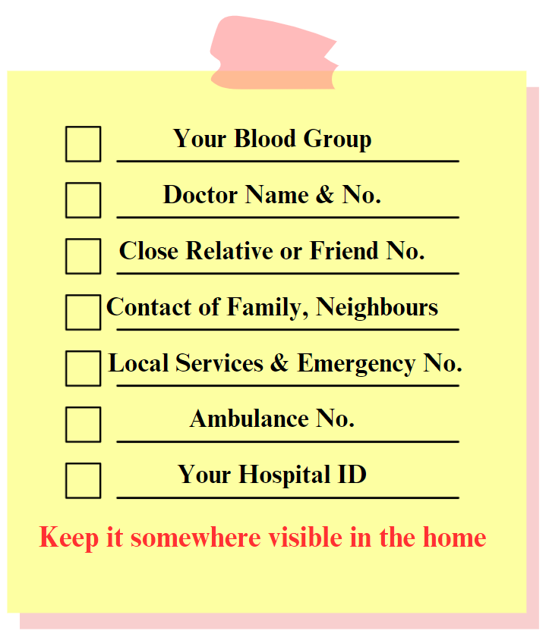
First Aid can saves live
ICE Chart (In Case of Emergency)

Slide 21
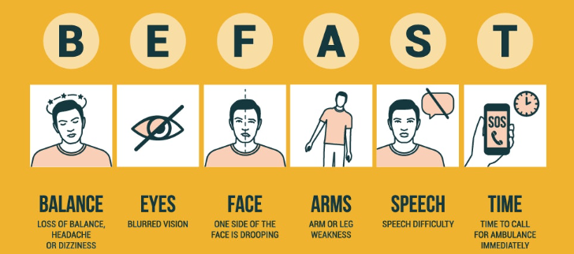
Stroke : Symptoms : Detection
Source: Semmes Murphy
Any One or Many - Condition Deteriorates Rapidly

Slide 22
Stroke : Response
Who is at Risk: People having blood pressure, cholesterol, sleep apnea, smoking, obesity & diabetes are at higher risk.
Act Fast:
If you are the one having symptoms; immediately share with someone family, neighbour, colleague, friend
Make person to lie down & stay calm
Talk to the patient, gather more info; will help in briefing doctor
Call Family physician (Video call); share symptoms, take advice.
Avoid giving them food, drink or medication unless advised
Drive the patient to recommended hospital. Inform the Emergency Deptt.
No home treatment for Strokes. Select a hospital having MRI & CT Scan

Slide 23
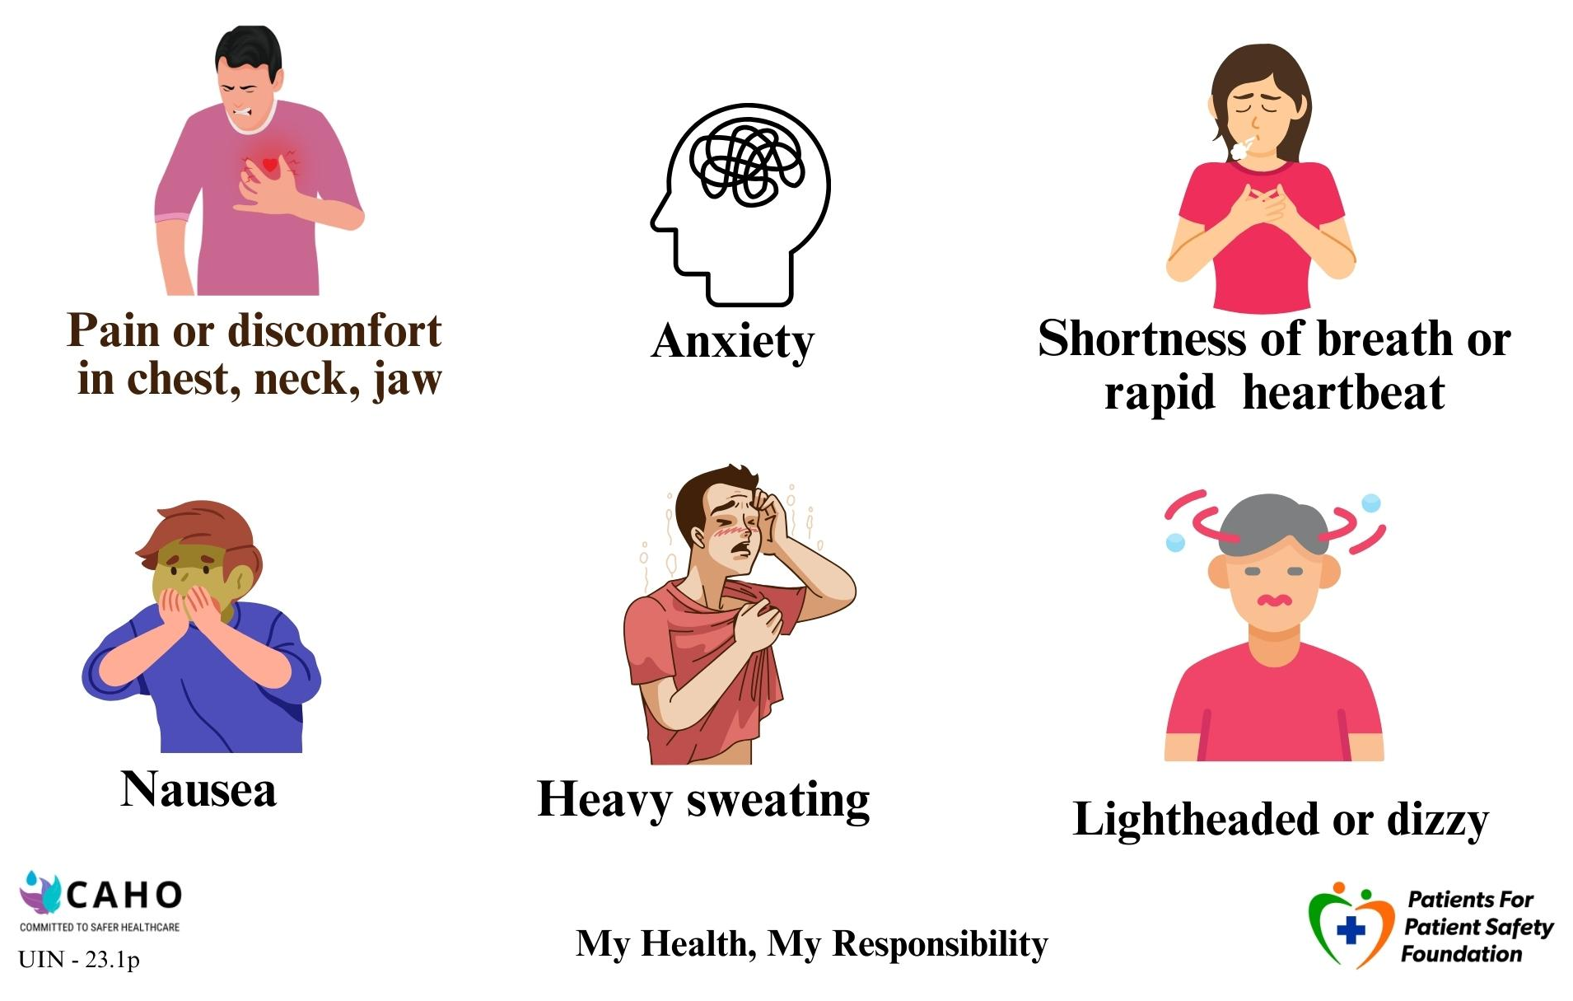
Heart Attack : Symptoms : Detection
You may have early symptoms like breathlessness and heartburn
You could confuse these with gastric discomfort

Slide 24
Heart Attack : Response
If I am having an a Heart Attack:
Inform someone nearby
Open front door if alone
Rest and stay calm
Chew Aspirin: If not allergic to Aspirin
Speak to your physician
Ask for Cardiac Ambulance; Dial 102
If delayed ask someone to drive you
If someone is having a heart attack:
Keep the person calm
Call a physician for advice
If the person is not allergic to aspirin, have them chew one regular strength.
Perform CPR. If unresponsive and stops breathing,
Call for Cardiac ambulance 102. If delayed drive patient to hospital

Slide 25
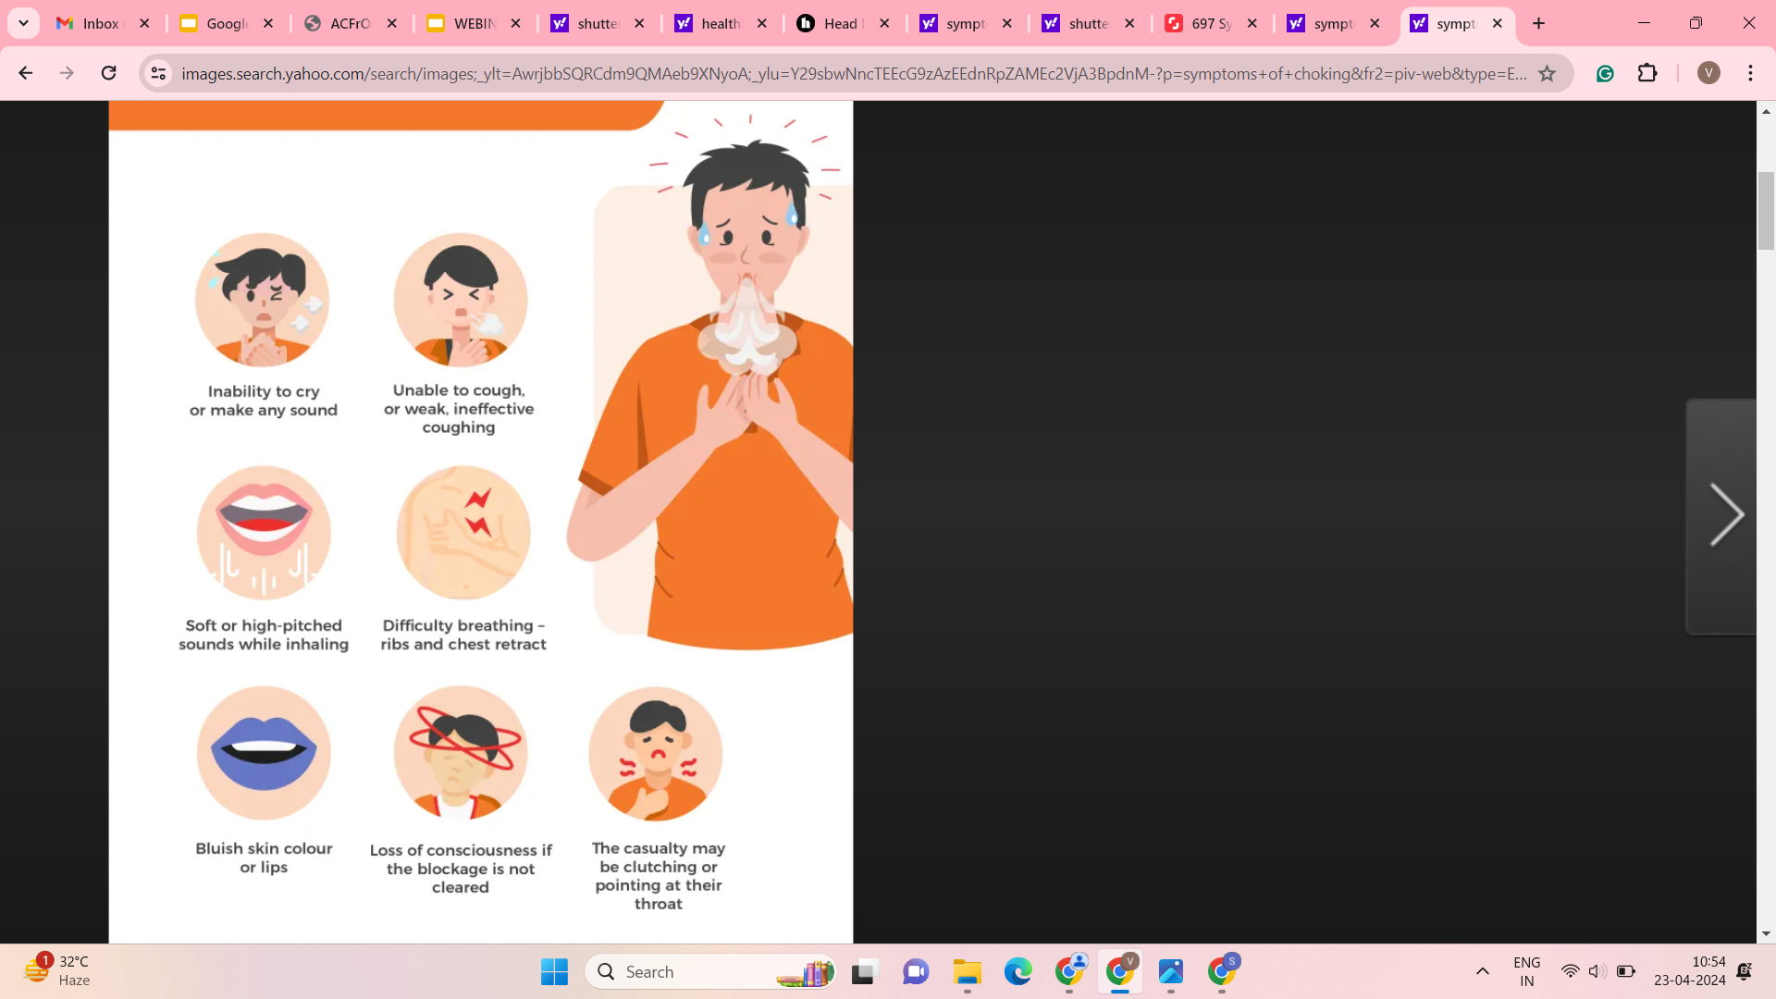
Choking : What is it : Detection : Response
Choking happens when an object lodges in the throat or windpipe, blocking the flow of air. In adults, it could be food or fluids. Young children often choke on small objects. Choking prevents normal breathing, supply of oxygen to the brain is interrupted leading to serious complications.
Symptoms of Choking

Slide 26
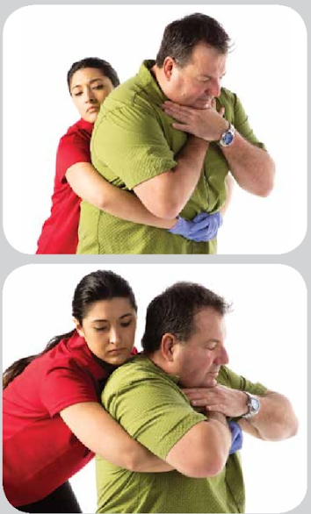
Choking : Response For Adult
Perform abdominal thrusts:
Stand behind the person: Place one foot slightly in front of the other for balance. Wrap your arms around their waist. Tip the person forward slightly.
Make a fist with one hand: Place it just above the person's navel.
Grasp your fist with the other hand: Press into the stomach with a quick, upward thrust as if trying to lift the person up.
After giving five abdominal thrusts check if the blockage has been removed. Repeat as needed to dislodge the blockage.

Slide 27
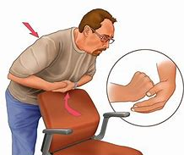
Choking : Response For Adults - Self
If you are alone and choking:
Place a fist slightly above your navel.
Grasp your fist with the other hand.
Bend over a hard surface. A countertop or chair will do.
Shove your fist inward and upward. Try to cough it out.

Slide 28
We Can All Prevent Errors and Save lives
In addition to hospitals and doctors, each of you can play a major role as a Patient, Caregiver, Family member, or as an Office Colleague, Friend, Neighbor, or Fellow traveler by:
Being Aware of diseases, symptoms, and hospital facilities around you.
Being Alert to potential harm and responding early.
Being Actively Involved in your care with prior preparation.
A well informed patient will be conscious about possible risks, watchful of symptoms, communicate clearly with health care provider and act/respond quickly

Slide 29
Common Preventive test for elderly
Complete Blood Count (CBC): Monitors health and diagnoses conditions.
Cholesterol Test: Checks levels to prevent heart disease.
Bone Density Test & Vitamins B12 & D: Detects osteoporosis, especially in post-menopausal women.
Vision, Hearing & Dental Tests: Evaluates sensory health and oral hygiene.
Blood Pressure & Blood Sugar Checks: Detects hypertension and diabetes risk.
Thyroid Function Tests (TSH, T3, T4): Assesses thyroid health.

Slide 30
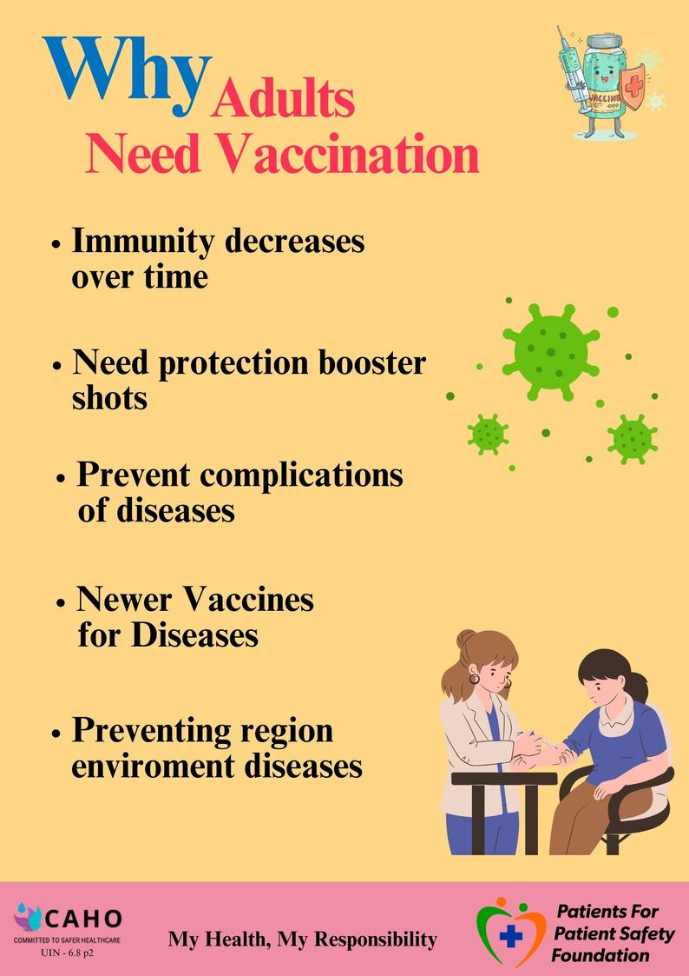
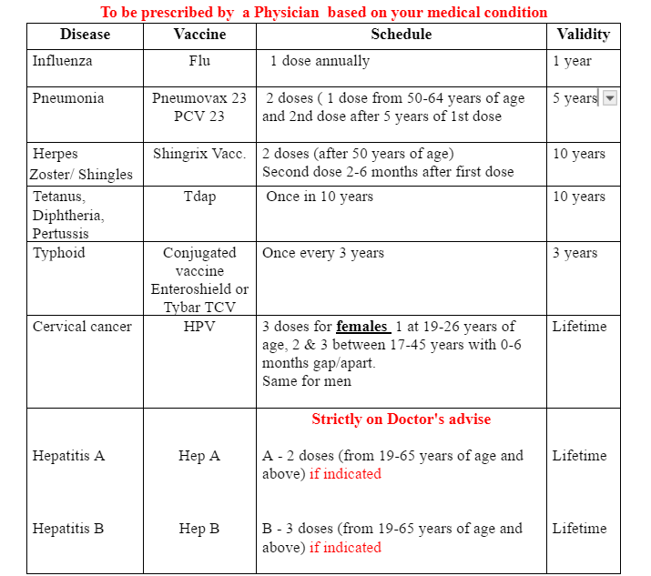
Why Do Adults need Vaccination
Illustrative Adult Vaccination Schedule
Please check for the latest vaccine available

Slide 31
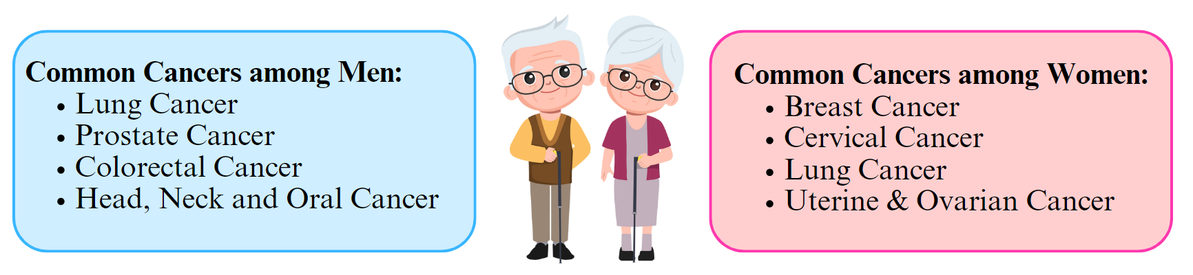
Catching Cancer Early
Cancer, significantly more prevalent among the elderly, is the second leading cause of death globally, responsible for approximately 9.6 million deaths, with one-third attributed to lifestyle factors, but many types are curable if detected early and treated effectively.
To prevent or for early detection:
Take preventive tests for cancer markers.
Do not ignore symptoms if you suspect something.
Remember, early detection means better chances of a cure.
*Source: WHO

Slide 32
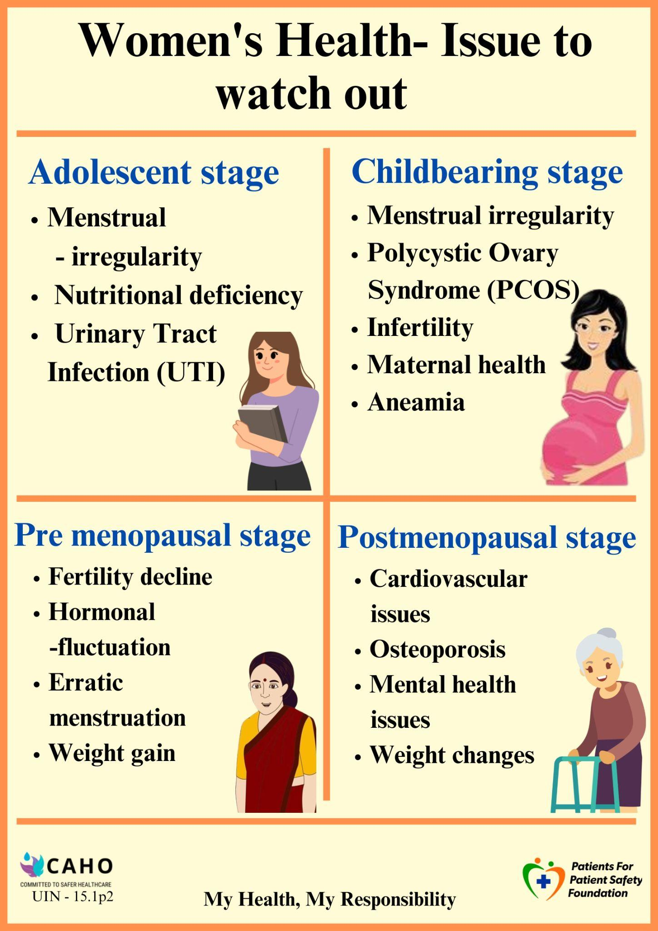
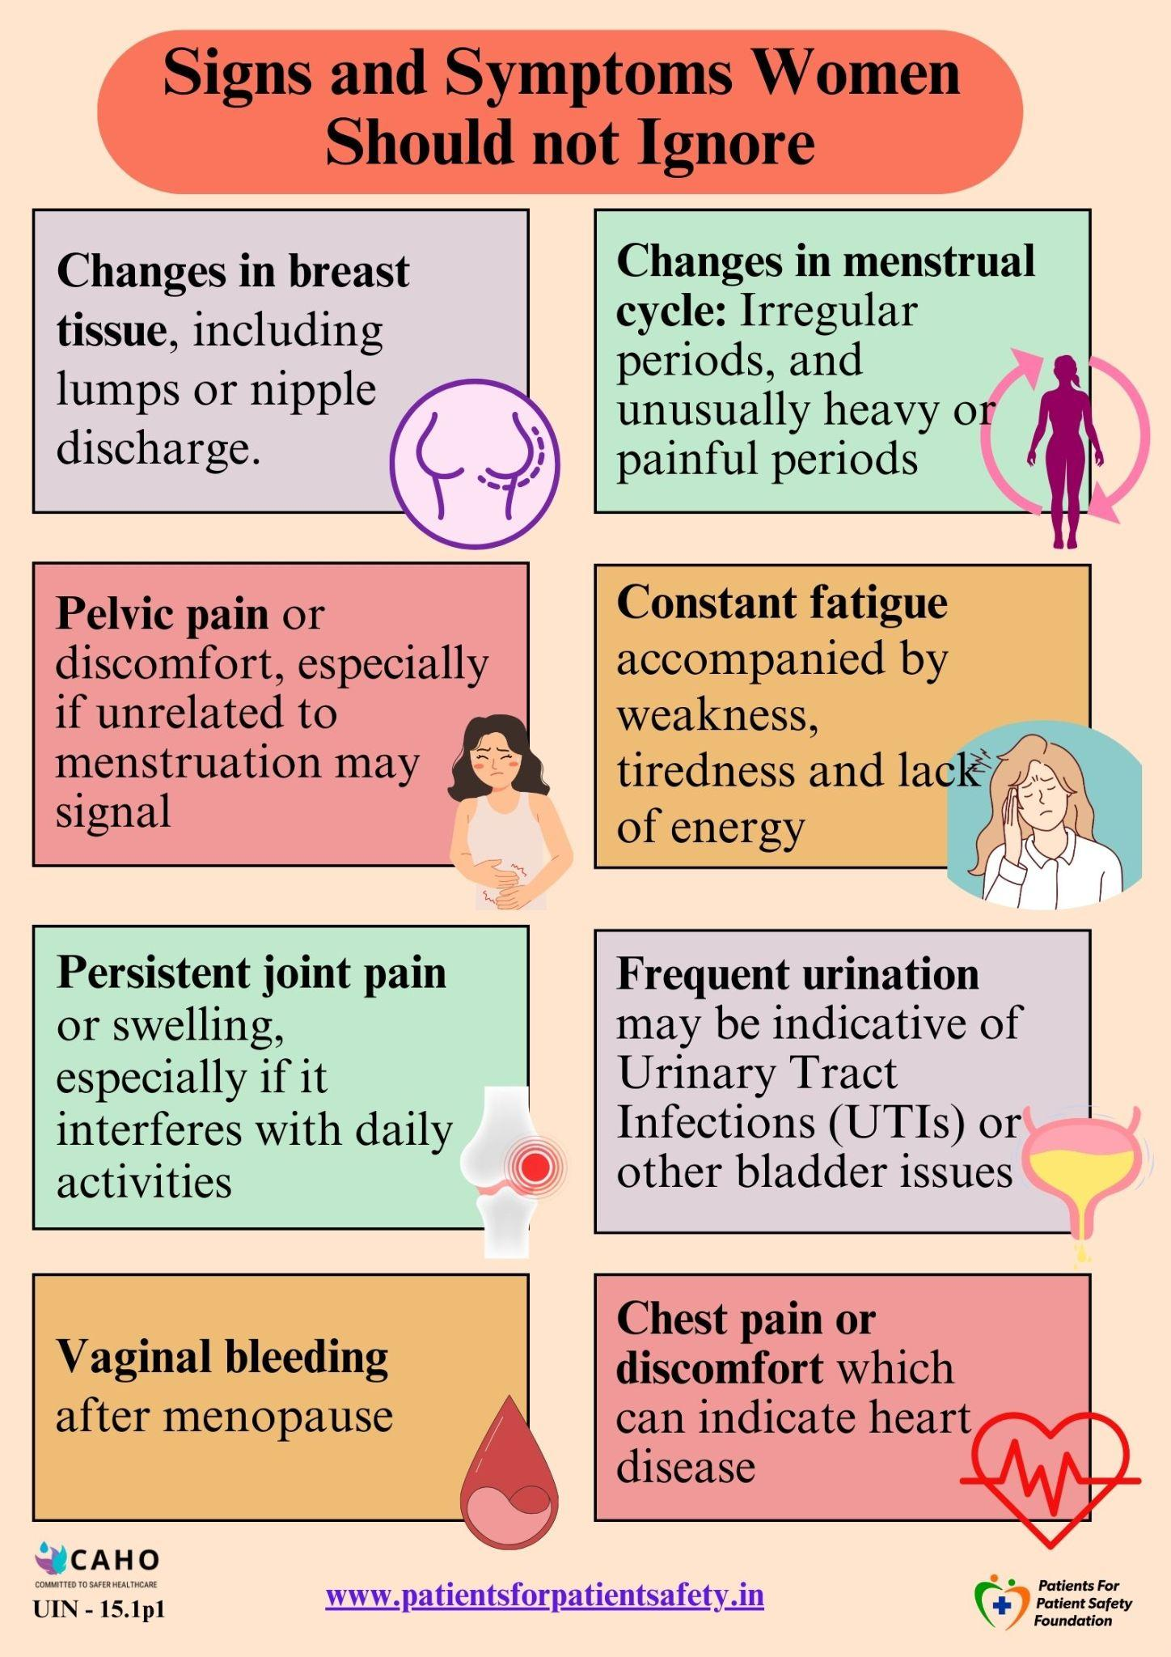
Prioritize Women’s Health

Slide 33

Stay Healthy with Personal Care
Eye Care
Use of proper eyewear and protection from UV rays
Oral Care
Brush teeth twice daily to prevent gum disease.
Skin Care
Daily moisturizing to prevent dryness.
Regular check-ups and personal hygiene practices are vital for maintaining health and well-being in the elderly.
Foot Care
Proper nail trimming to prevent ingrown nails.
Nail Care
Keep nails clean and trimmed to avoid bacteria buildup

Slide 34
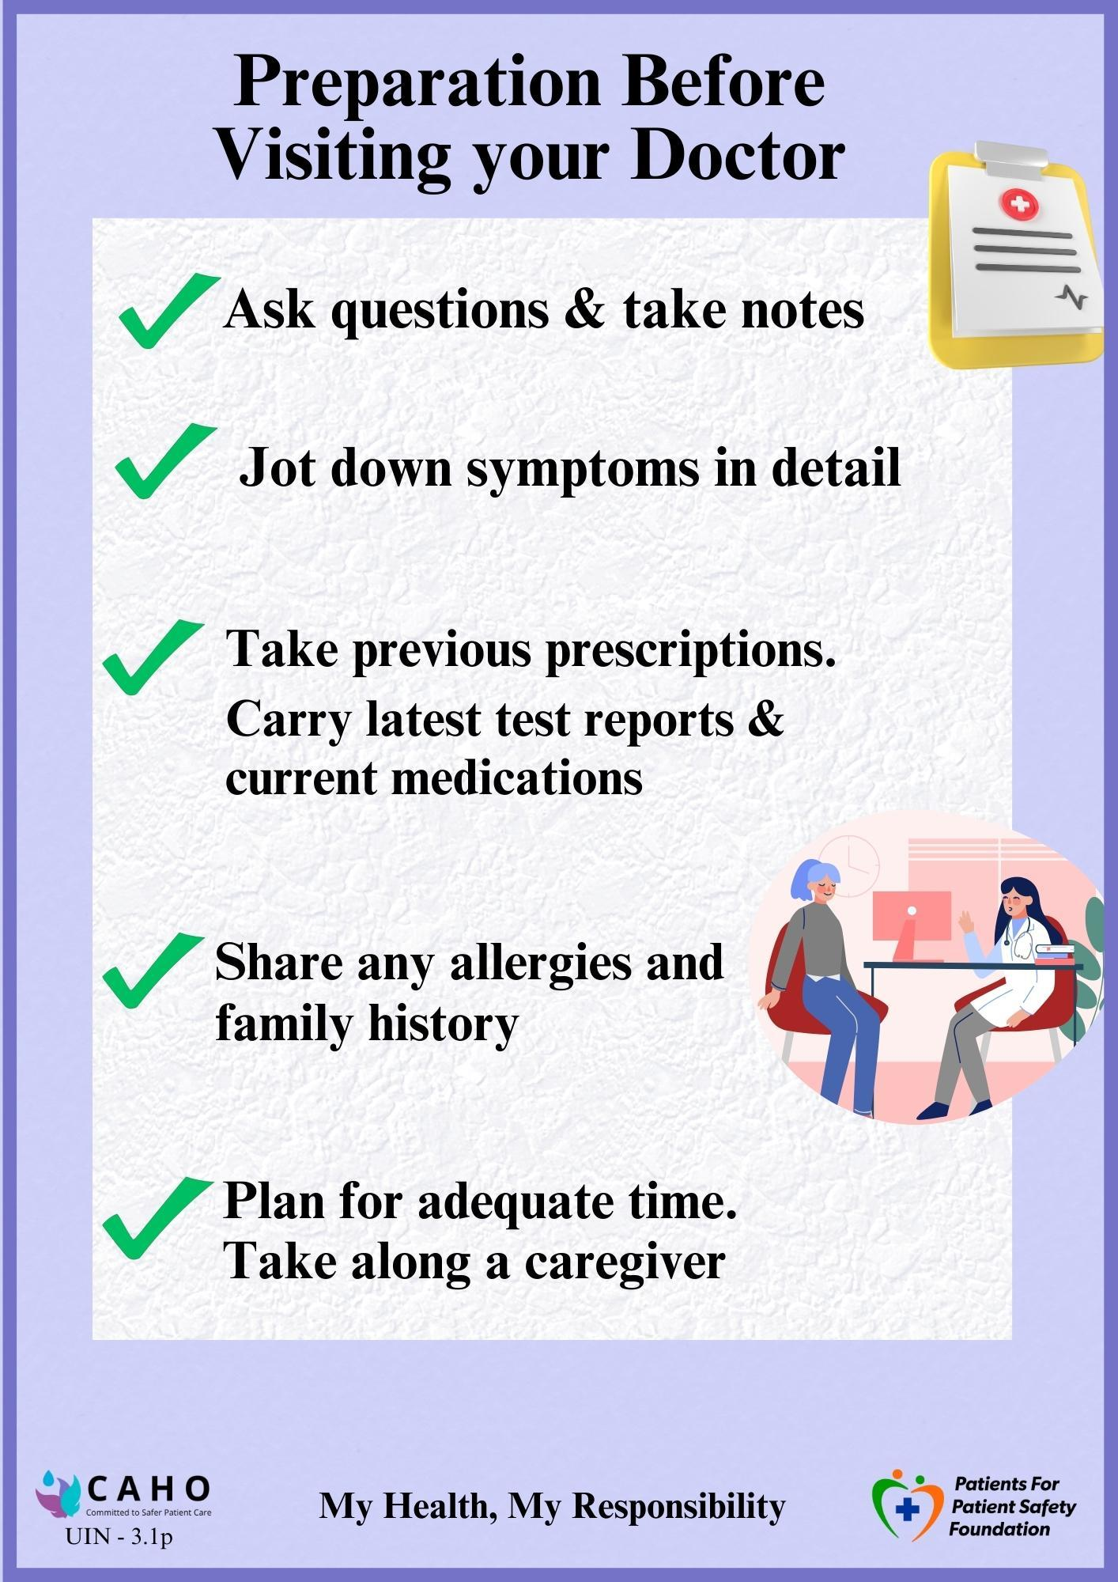
Prevent Errors during doctor’s visit
Doctors are busy and have limited time
Decisions based on the information you provide - symptoms, medical history/allergies, previous reports
You have limited time to provide info and clear your doubts
Inform if you are taking alternative medicines/ treatment like ayushman, yunani etc.
Keep medical records in one place
Prepare before - It will help in correct diagnosis
Patients can help doctors in correct diagnosis by providing accurate information, undergoing prescribed tests and maintaining clear communication.

Slide 35
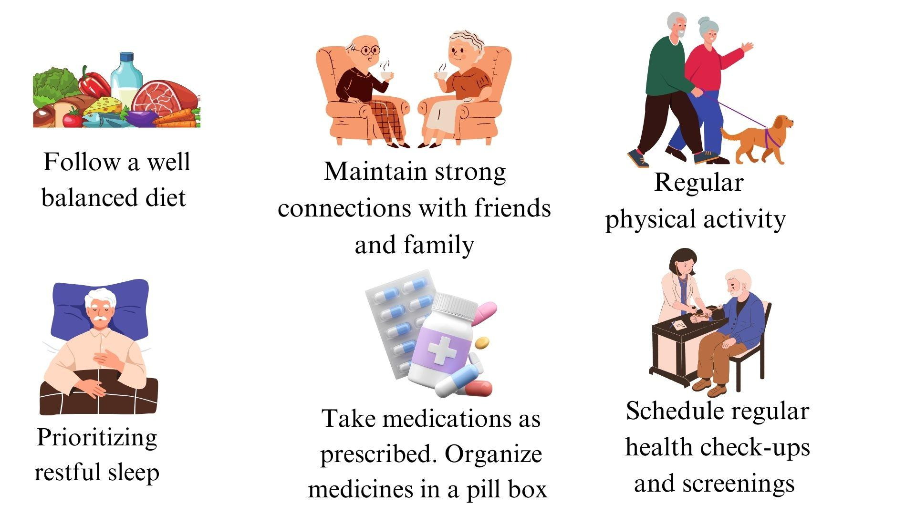
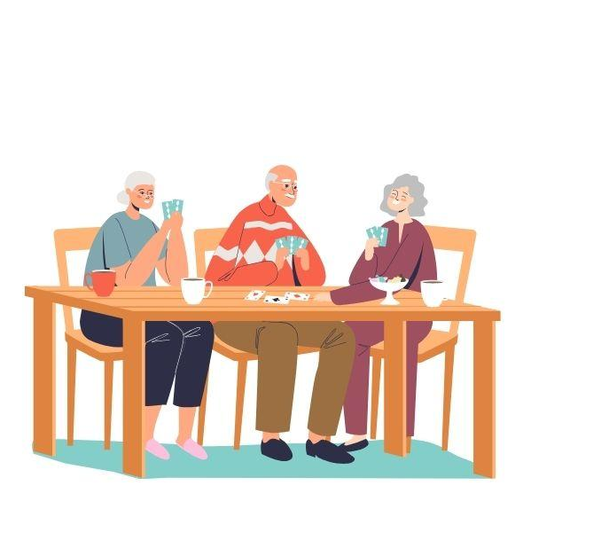
7 Pillars of Healthy Ageing
Engage in Mental and Intellectual activity
Find your IKIGAI

Slide 36
Building Support Network
Tips for establishing a support network for elderly couples living alone,
Have duplicate keys made and keep them with a neighbor, friend, or relative.
Set up regular phone or video calls with family and friends for emotional support and companionship.
Use smart devices like wearables or home monitors to track health metrics (e.g., vital signs, medication, and appointments) and alert family in emergencies.
Explore options for hiring caregivers to assist with daily tasks and provide companionship.
Join local or online support groups to connect with others facing similar challenges.
Start using telemedicine services for remote consultations with healthcare professionals to ensure timely medical advice without the need for physical visits.

Slide 37
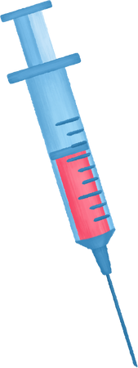
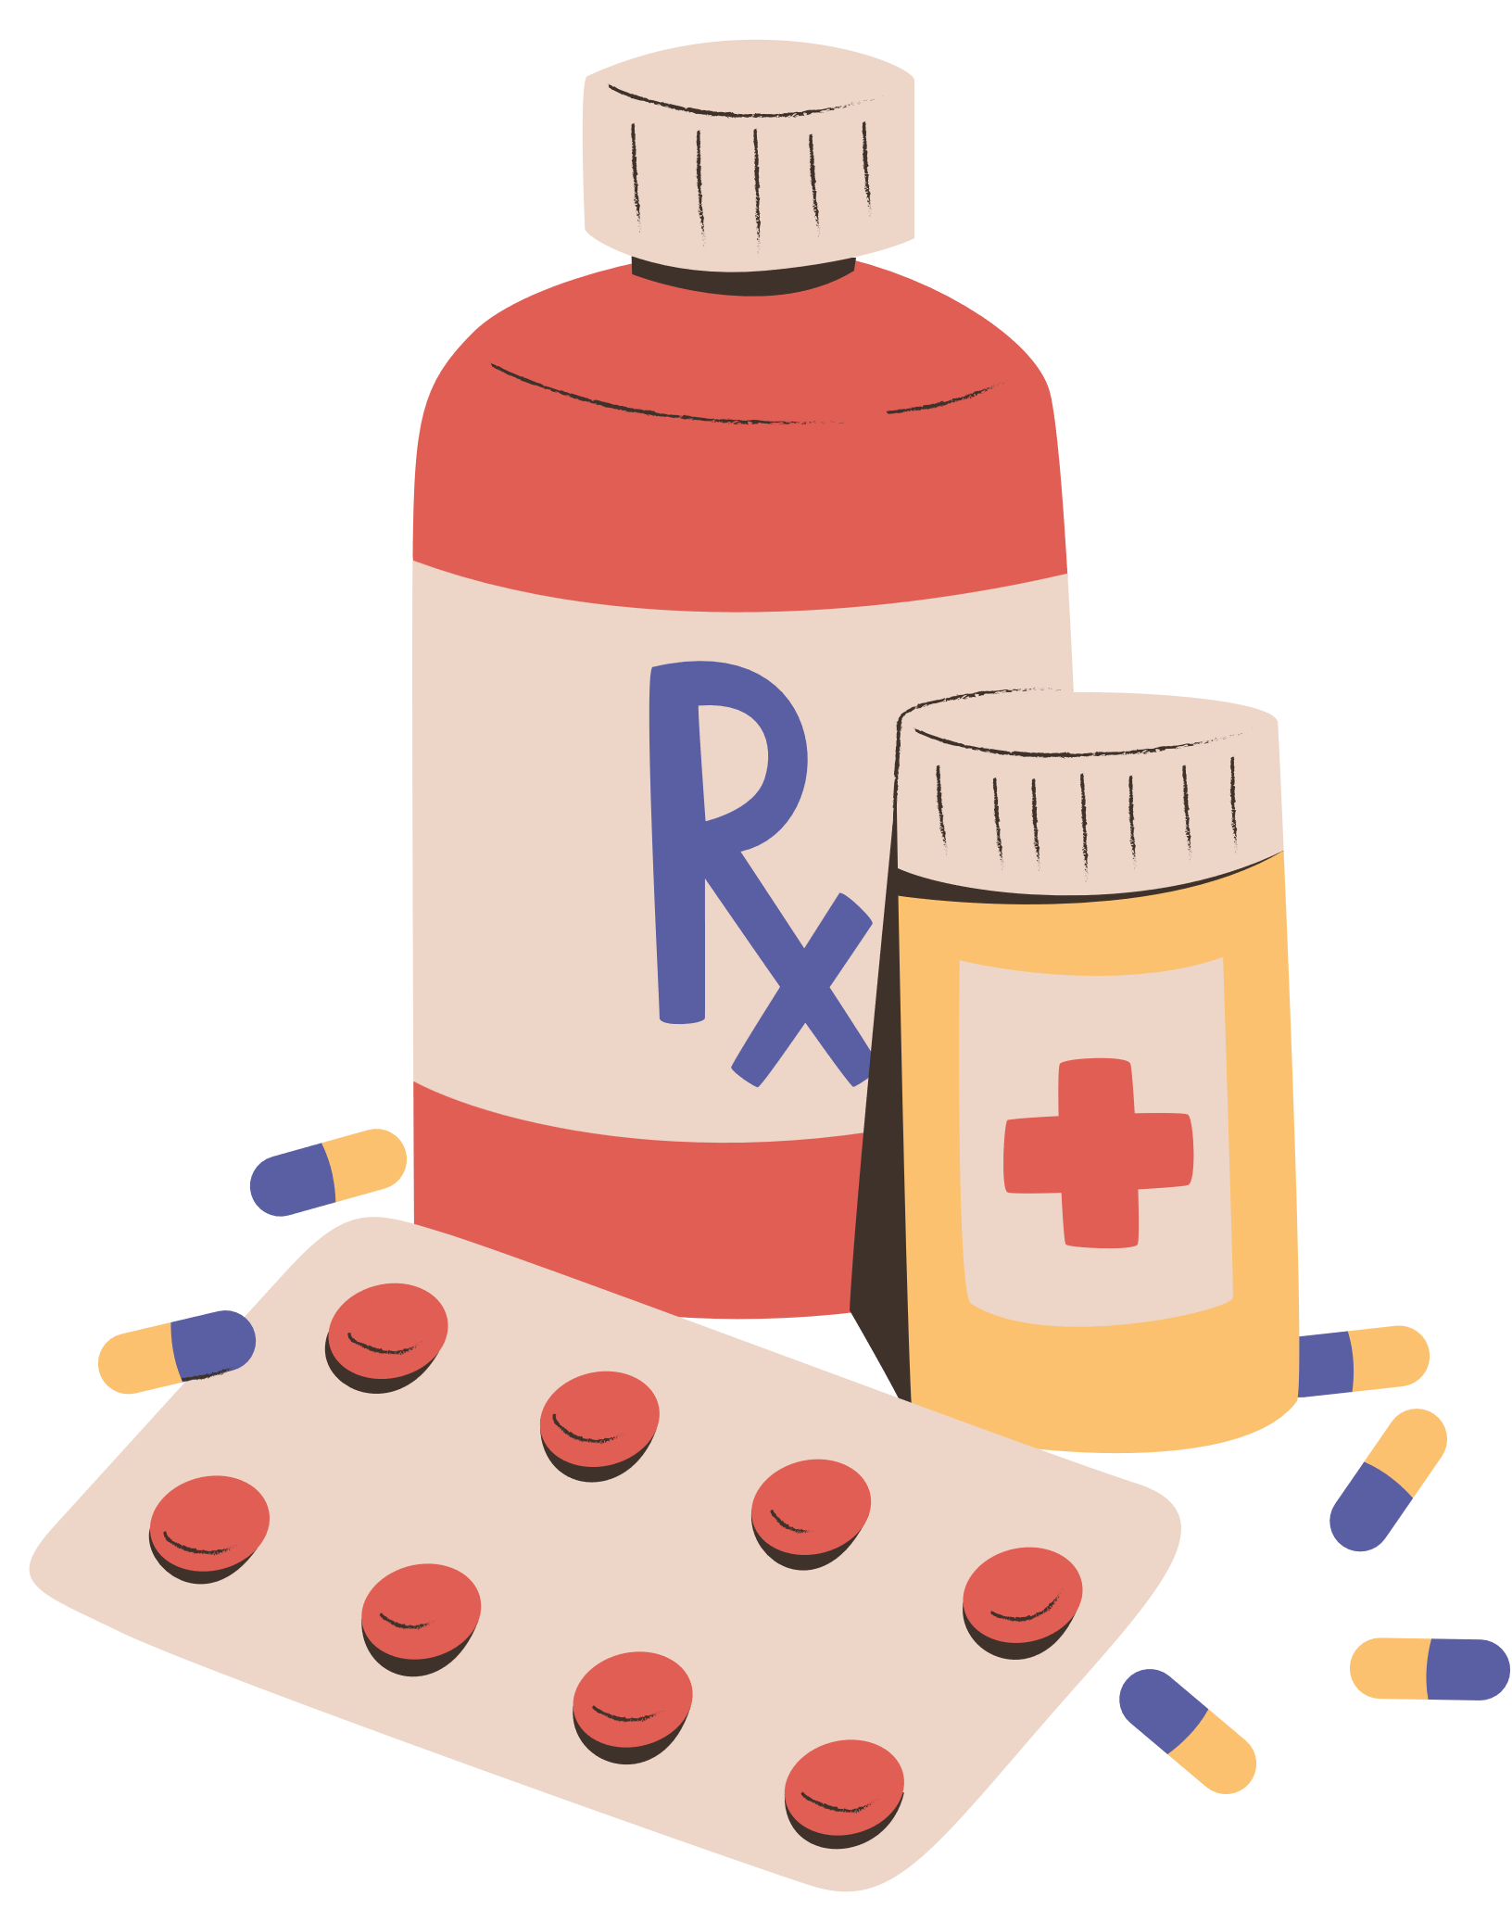

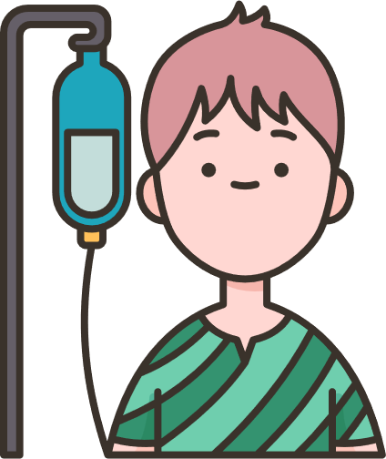
How PFPSF helps Elderly
Spreads awareness on Definition, Symptoms for Early Detection of possible Harm
Shares knowledge about Risks, Causes & Consequences of Medical harm
Provides Actionable tips for Self Protection,
and Prevention
Guides on the Role that Patients/Caregivers can play throughout their Patient Journey
PFPSF is a non- profit Trust, promoted by CAHO.
PFPSF content is aggregated from world renowned experts and vetted by domain specialists, makes us Trustworthy - no commercials associated

Slide 38
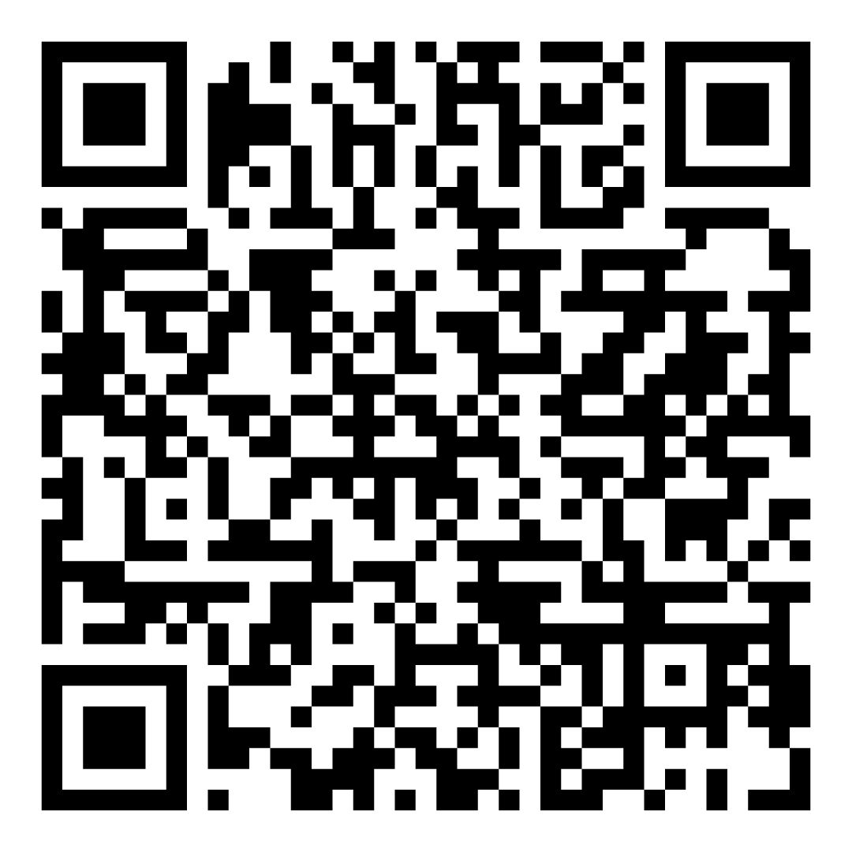
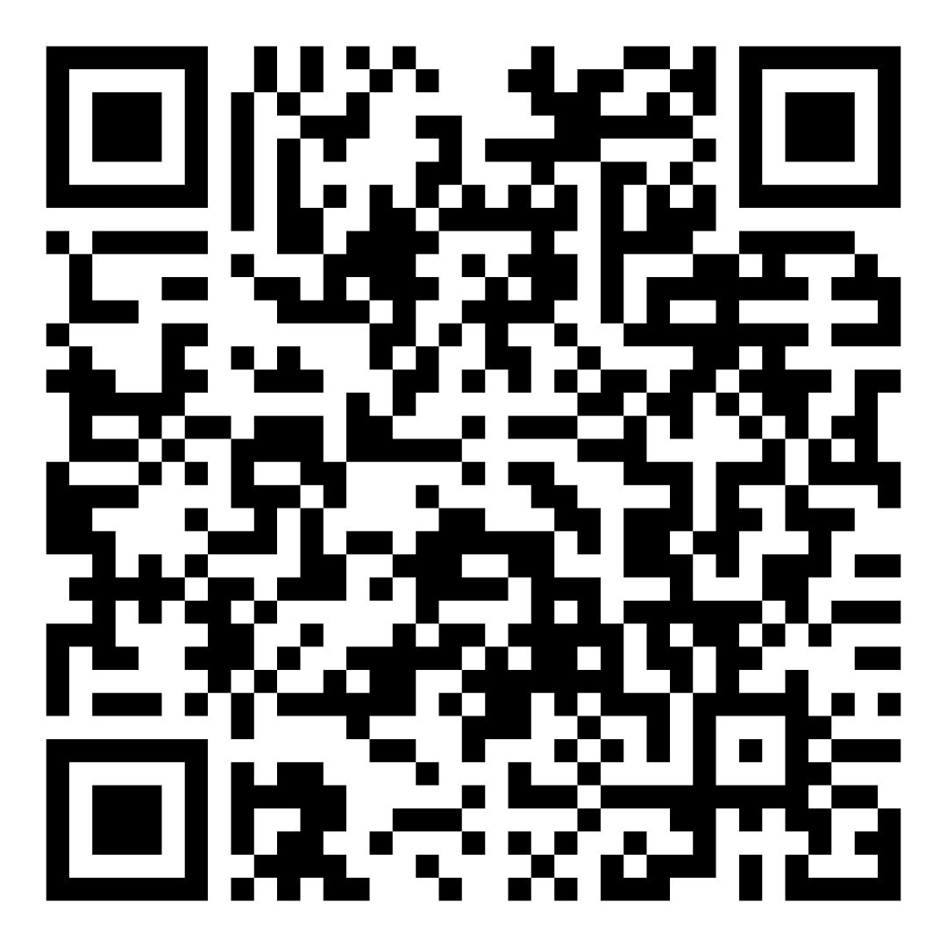
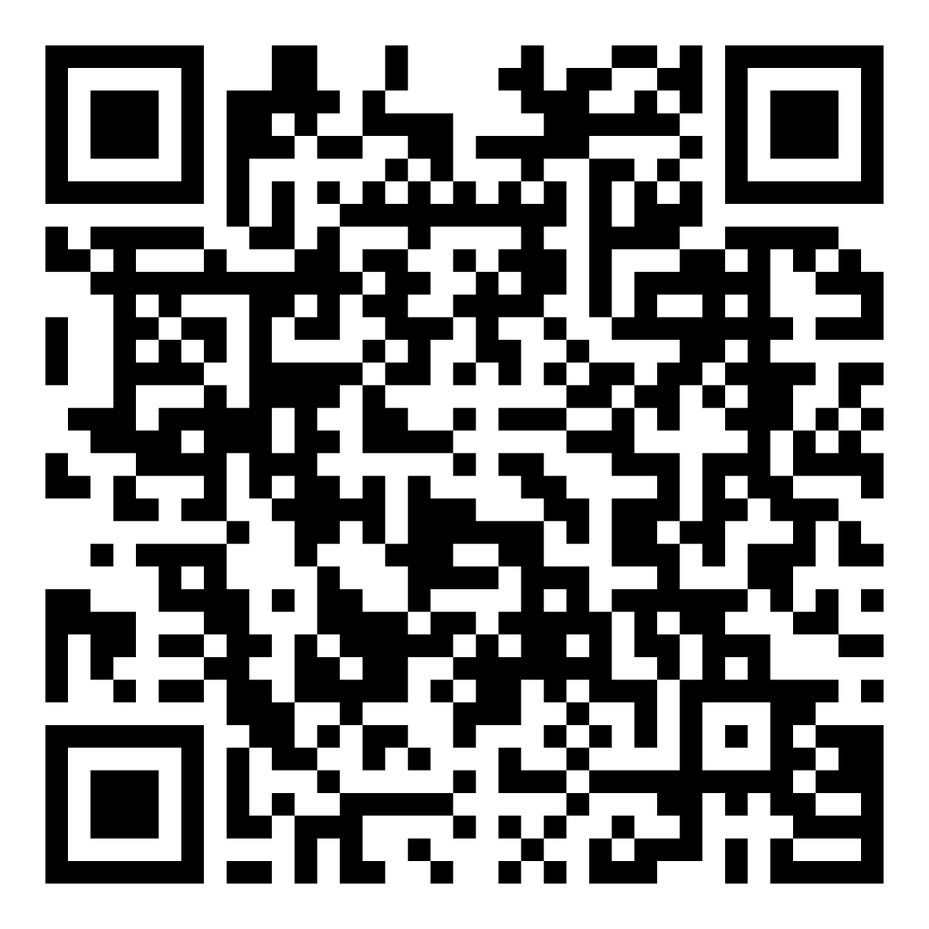
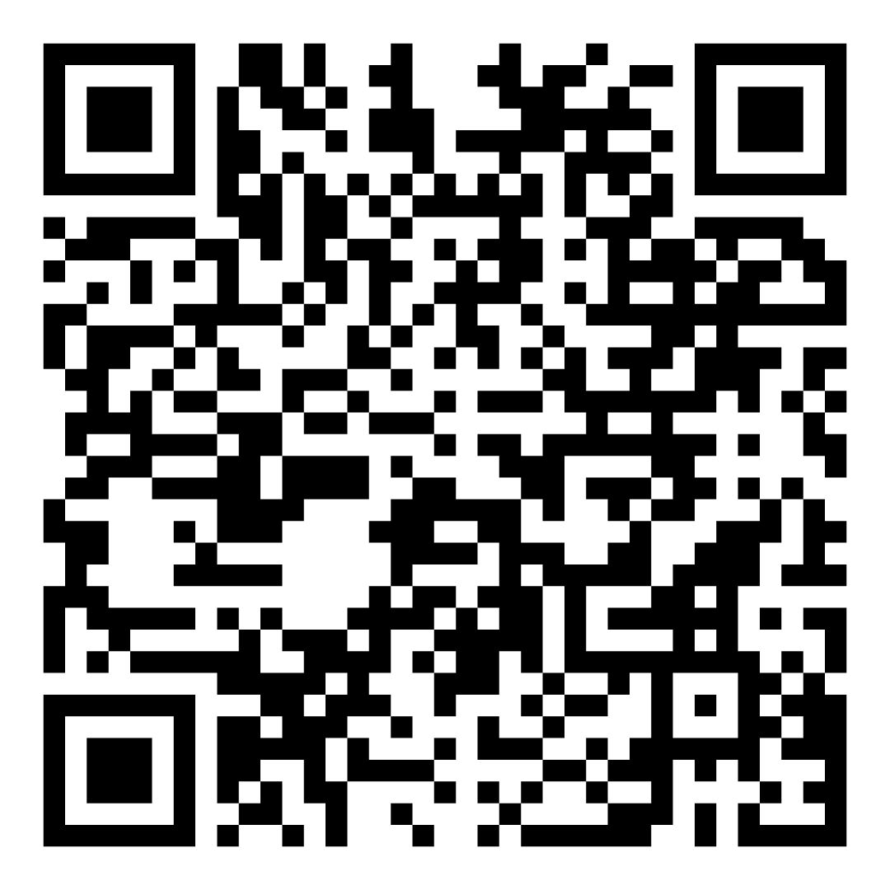
Scan to leverage Patient Education Material
Health Library
Infographics
Subscribe here
Newsletters

Slide 39





You can save yourself & your family from medical harm
Ask Questions, Send feedback@
info@patientsforpatientsafety.in
Share your story with us
https://www.patientsforpatientsafety.in/share-stories.php
Explore our website:
www.patientsforpatientsafety.in
Subscribe to our Newsletters: https://www.patientsforpatientsafety.in/subscribe-us.php
My Health, My Responsibility
PFPSF-india
patientsforpatientsafety
pfpsfindia
patientsafety22
+919289696709

