Slide 1

Sarvodaya Hospital Clinical Staff Workshop
Patients Engagement & Communication
Use Every Opportunity
Friday, Jan 10, 2025
Conducted by:

Slide 2


Objectives of Workshop
Interaction between Sarvodaya Clinical Teams with PFPSF Team for enhancing Patient Provider engagement
Leading To:
Better Clinical Outcomes
Reduced Medical Errors
Improved Patient Safety
Enriching Processes with Patient perspectives
Building loyal and healthy patient community

Slide 3


About PFPSF
Our Vision
To enhance Patient Safety and reduce Avoidable Harm with the active involvement of Patients and Community with support from Healthcare providers
Our Mission
Educate and spread awareness about Patient Safety and Best Practices among patients and the general public, empower them and their families to engage in their own care, and share their experiences to foster patient safety

Slide 4



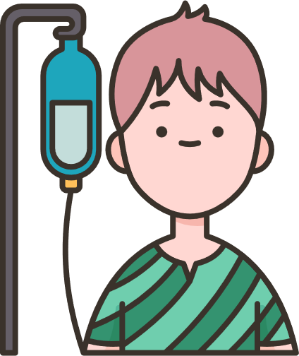
Role of PFPSF in Patient Safety
Spreads awareness on Diseases and Symptoms for Early Detection of possible Harm
Shares knowledge about potential Risks, Causes & Consequences of Medical harm
Provides Actionable tips for Self Protection,
and Prevention
Guides on the Role that Patients/Caregivers can play throughout their Patient Journey
PFPSF content is aggregated from world renowned experts and vetted by domain specialists, presented in patient friendly way

Slide 5
PART - 1 Enhancing Patient-Provider Engagement for Safer Outcomes
What is Patient Safety What is Medical Harm
About PFPSF and Role of PFPSF in Patient Safety
Benefits of Patient Engagement
Perceptions, and Expectations of Patients - Barriers to engage
Challenges faced by HCP - Barriers to Communication
Touch Points in Patient Journey - Possibility of Harm/ Errors
Opportunities of Engaging with Patients at each touch points:
Before seeking Appointment, OPD Consultations, Diagnostics, IPD, Pre and Post Surgery, Post Discharge and Transition to Home Care

Slide 6
PART 2 - Strategies for Sustainable Outcome of Patient Engagement
Patient and Caregiver Feedback and Experience Gathering Mechanisms
Patient and Community Education and Awareness of Disease protocols
Patient Support Groups
Patient and Family Advisory Councils (PACs)

Slide 7

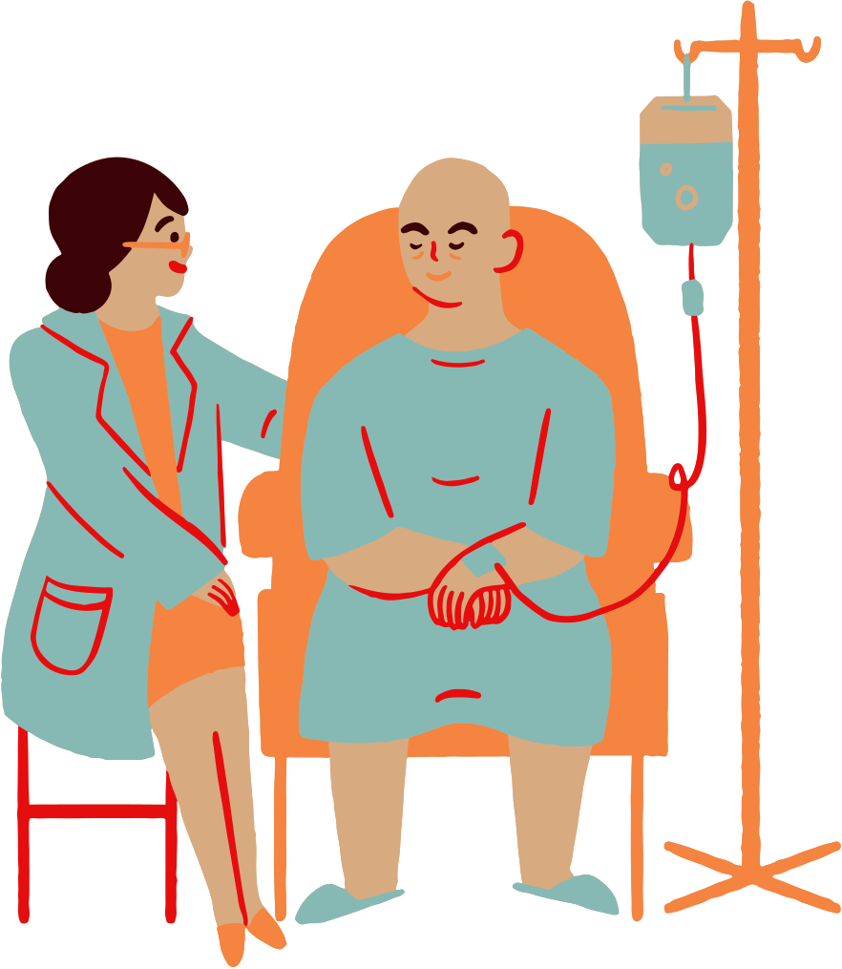



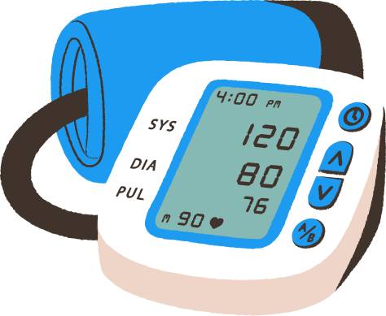
Why the work we do is Critical –Degree of Harm
1 in 10 patients suffer harm during hospitalization
In OPD 4 out of 10 patients are harmed due to missed/incorrect diagnoses, medication and prescriptions errors
Medication Errors constitute 50% of avoidable harm
Unsafe Transfusion/ Injection practices can transmit infections such as HIV and Hepatitis
Unsafe Surgical Practices cause
complications in 25% of patients
Other causes include Hospital Acquired Infections, Sepsis, Blood clots, Radiation errors, Fragmented care settings-change in doctors, hospitals, or transition to home care
Inadequate cleaning, sterilization/ calibration can lead to Medical Device errors
Patient Harm is caused due to ignorance of patients and non-involvement
*Source: WHO

Slide 8
Where Does Harm Happen
At Hospital
At Home
Errors/Misses by Providers
Omissions by Patients
Patient & Caregivers
Medications Errors
Wrong Diagnosis
Surgical Mistake
Infections
Communication Errors
Ignore Symptoms
Late Presentation
Incomplete Info
Not being alert
Not asking questions
Lack of awareness
Lack of preparedness
Not following prescriptions
Self treatment
Missing clinical signs
Aware Patients/Caregivers can help Prevent Medical Harm

Slide 9







Patients Can Play Vital Role to Improve Outcomes
Keeping Track
of Symptoms
Providing Complete Information
Keeping Updated Medical Records
Being Alert - Asking Questions
Following Prescriptions/ Advise
Building Trust and Confidence
Provide
Valuable Feedback

Slide 10









Benefits of Patient Engagement to HCP
Early Detection & Prevention
Greater overall profitability
Better Outcomes & Reduced Medical errors
Increased Reputation
Improved Trust & Satisfaction
Improved Patient Loyalty & Referrals
Personal and Professional Fulfillment

Slide 11
There are only two kind of people in a hospital:
One who is treating the patients and the other who is supporting someone who is treating the patients

Slide 12


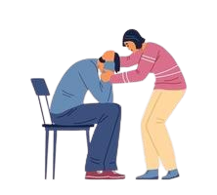
What Patients Feel When They Enter the Hospital
Do not come by choice; are compelled/ is an Emergency
Do not understand the complexity of either illness or treatment
They are Anxious; Concerned; Disturbed; Vulnerable
The Healthcare expenses are sudden, unknown & unplanned
All Family members affected and in distress
Depends on good faith and trust in the Healthcare provider.
OPPORTUNITY TO LISTEN AND ABSORB

Slide 13







Expectations of Patients
Safe and Quick Recovery
Clear and Effective Two-way Communication
Receive Empathy, Respect, and Dignity
Encourage Questions & Respond
Access to Information
to help decide
Coordination of care across specialties
Transparent & Consistent billing
- faster discharge

Slide 14
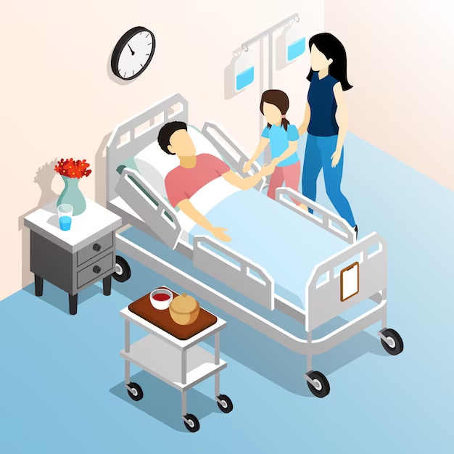
Why do Patients Not Engage
Lack of awareness
Don’t see their role - “Doctor is God”
Confused - Inability to absorb
Stressed and Anxious
Afraid to ask questions
Language/ Cultural barriers
Bridging the Trust Deficit

Slide 15

Barriers from HCP Side
Too many patients
Overworked clinical staff
Lack of patient centric content
May not appreciate the need
Communication barriers
Unclear on patient/ caregivers roles and capability
Bridging the Trust Deficit

Slide 16

Common Problems Faced by Patients During Conversations with Clinical Staff
Medical Terms: Using complex medical terms and abbreviations without proper explanation confuse patients, leading to poor adherence to treatment plans.
Assumptions about knowledge: Assuming patients understand medical terms or procedures result in incomplete follow-through.
Incomplete communication: Critical details about medication schedules, potential side effects or follow-up appointments might be missed.
Time Pressure: Rushed conversations miss important patient concerns or questions. Irritation when questions are asked.
Overloading information: Providing too much information at once (like at discharge) can overwhelm patients, causing them to miss critical details.

Slide 17
What can Clinical Staff do to Improve Conversations with Patients
Use simple language & Interactions: Use everyday terms to make explanations clear and relatable. Break down complex instructions into smaller, actionable steps. Use charts, diagrams or videos to help patients to understand.
Reconfirm for understanding: After explaining, ask patients to repeat the understanding in their own words to reconfirm comprehension.
Provide written materials: Offer take-home instructions or pamphlets that explain key points in detail and for later reference.
Team approach: Train all clinical staff to ensure uniformity in communication and avoid contradictory advice.
Encourage questions: Create an environment where patients feel comfortable asking questions about their care + second opinion + teach back
Cultural sensitivity training: Educate staff to handle cultural or language differences effectively. Providing interpreters for patients who speak a different language.

Slide 18
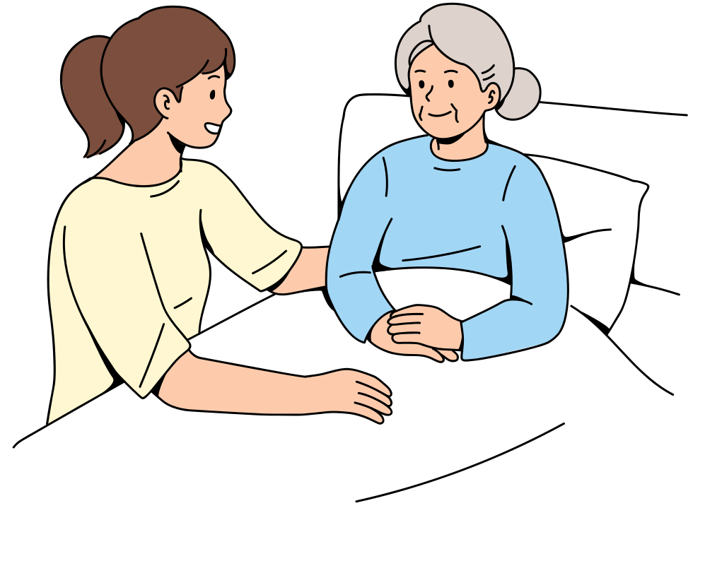




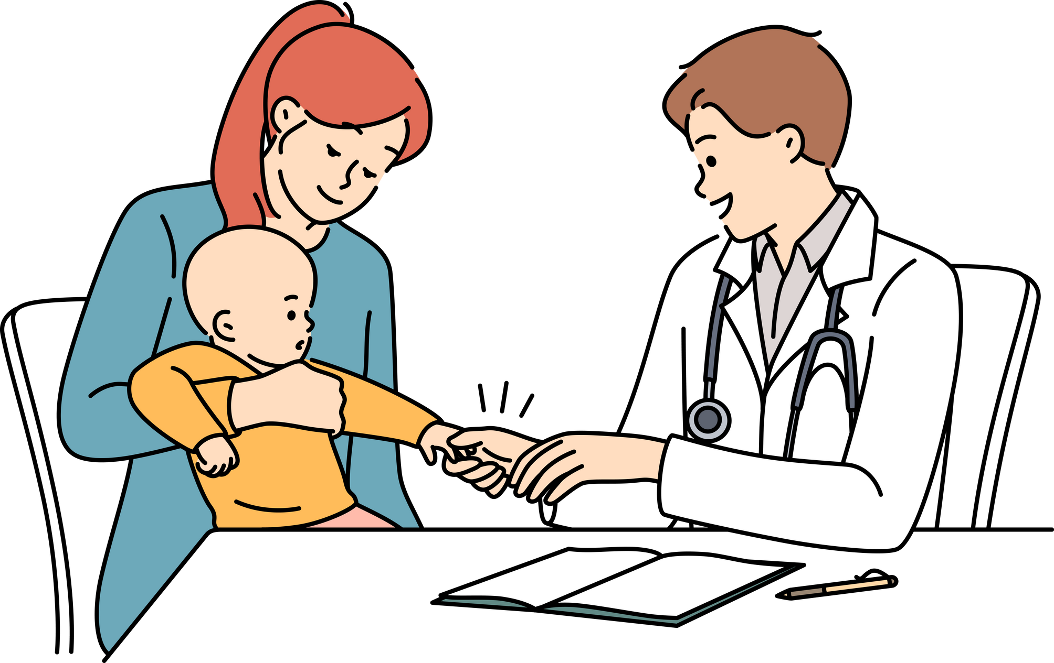

Entry of Patients in Hospital
Patients & Caregivers
Out Patients
In Patients
Walk - In
With Appointment
Emergency
Planned Admission
Common reasons: Seasonal problems, Chronic care, Acute care and Preventive Care

Slide 19
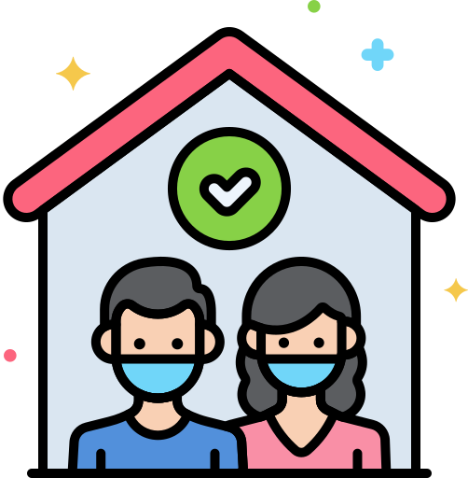

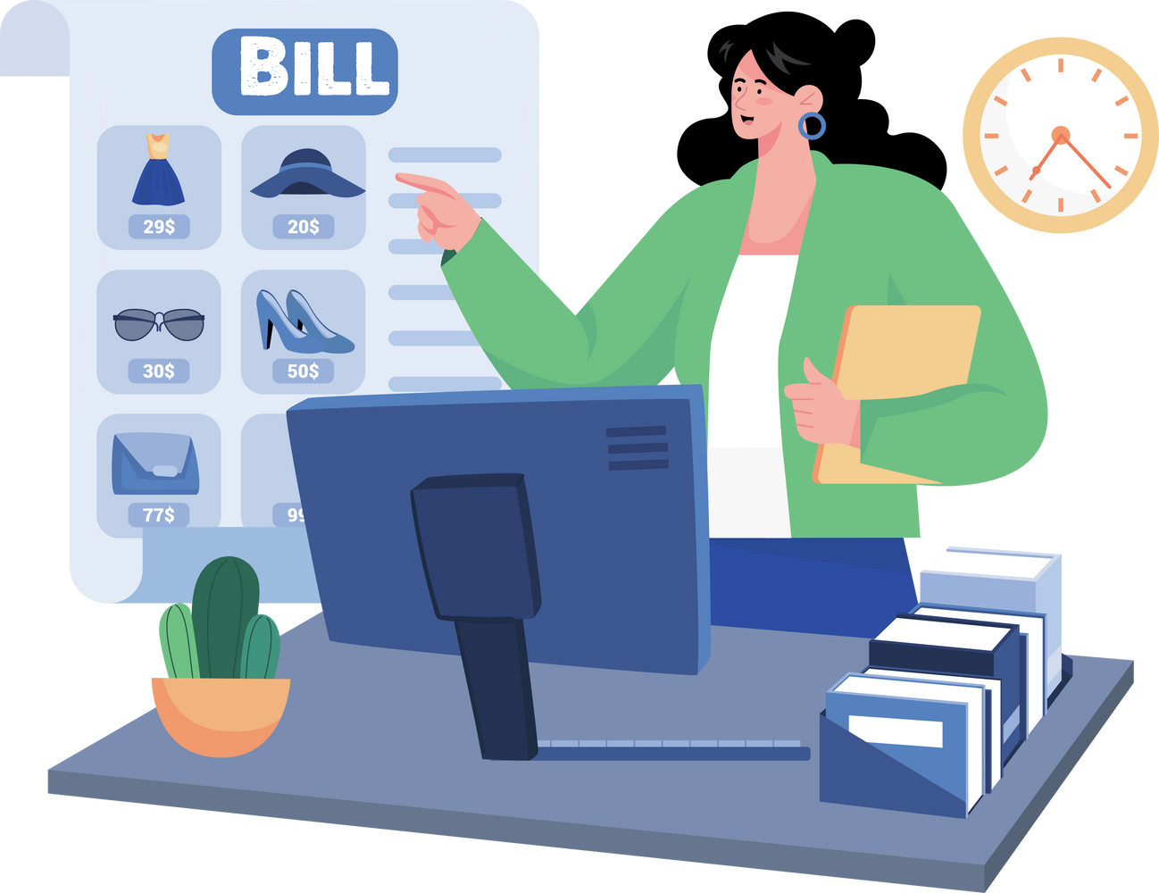





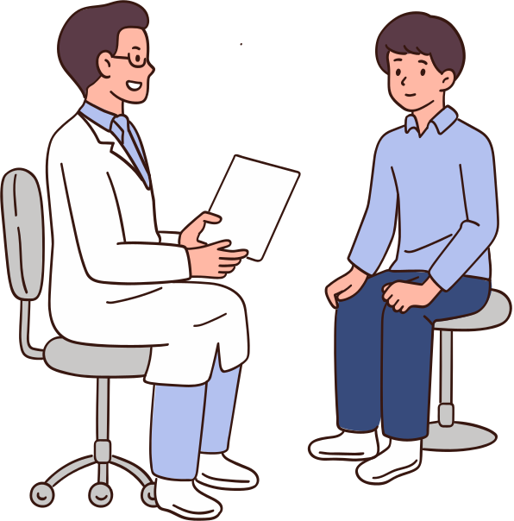
Multiple Points to Engage with Patients in OPD
8. Post-discharge
& Home Care
Appointment Booking
2. Registration and Billing
OPD
7. Review and Follow-up
3. Navigating within OPD
6. Diagnosis and Prescription
5. Diagnostic Tests
4. Doctor
Consultation

Slide 20
Potential Errors by Patient in OPD
Missing personal details (date of birth, contact details, ID, insurance etc.
Arriving late, waiting in the wrong area, missing facility signages and staff guidance.
Incomplete information about symptoms, medical history, or allergies, previous reports.
Insufficient time with doctor leading to Failing to clarify doubts about diagnoses, treatment plans, or test results
Skipping diagnostic tests, prescribed medications, or follow-up schedules
Switching doctors or facilities without sharing complete medical information, causing errors during transitions.
Self-medicating based on lab reports without consultation

Slide 21
Patient Engagement - Appointment Booking
Inform patients what to bring, such as Aadhar card, previous prescriptions, test reports, and insurance policies.
Recommend the consultant based on the patient’s condition.
Ensure patients bring an attendant if necessary.
Provide access to the hospital website for online appointments and other details.
Tell them where to report; pre-billing; pre payment if possible

Slide 22
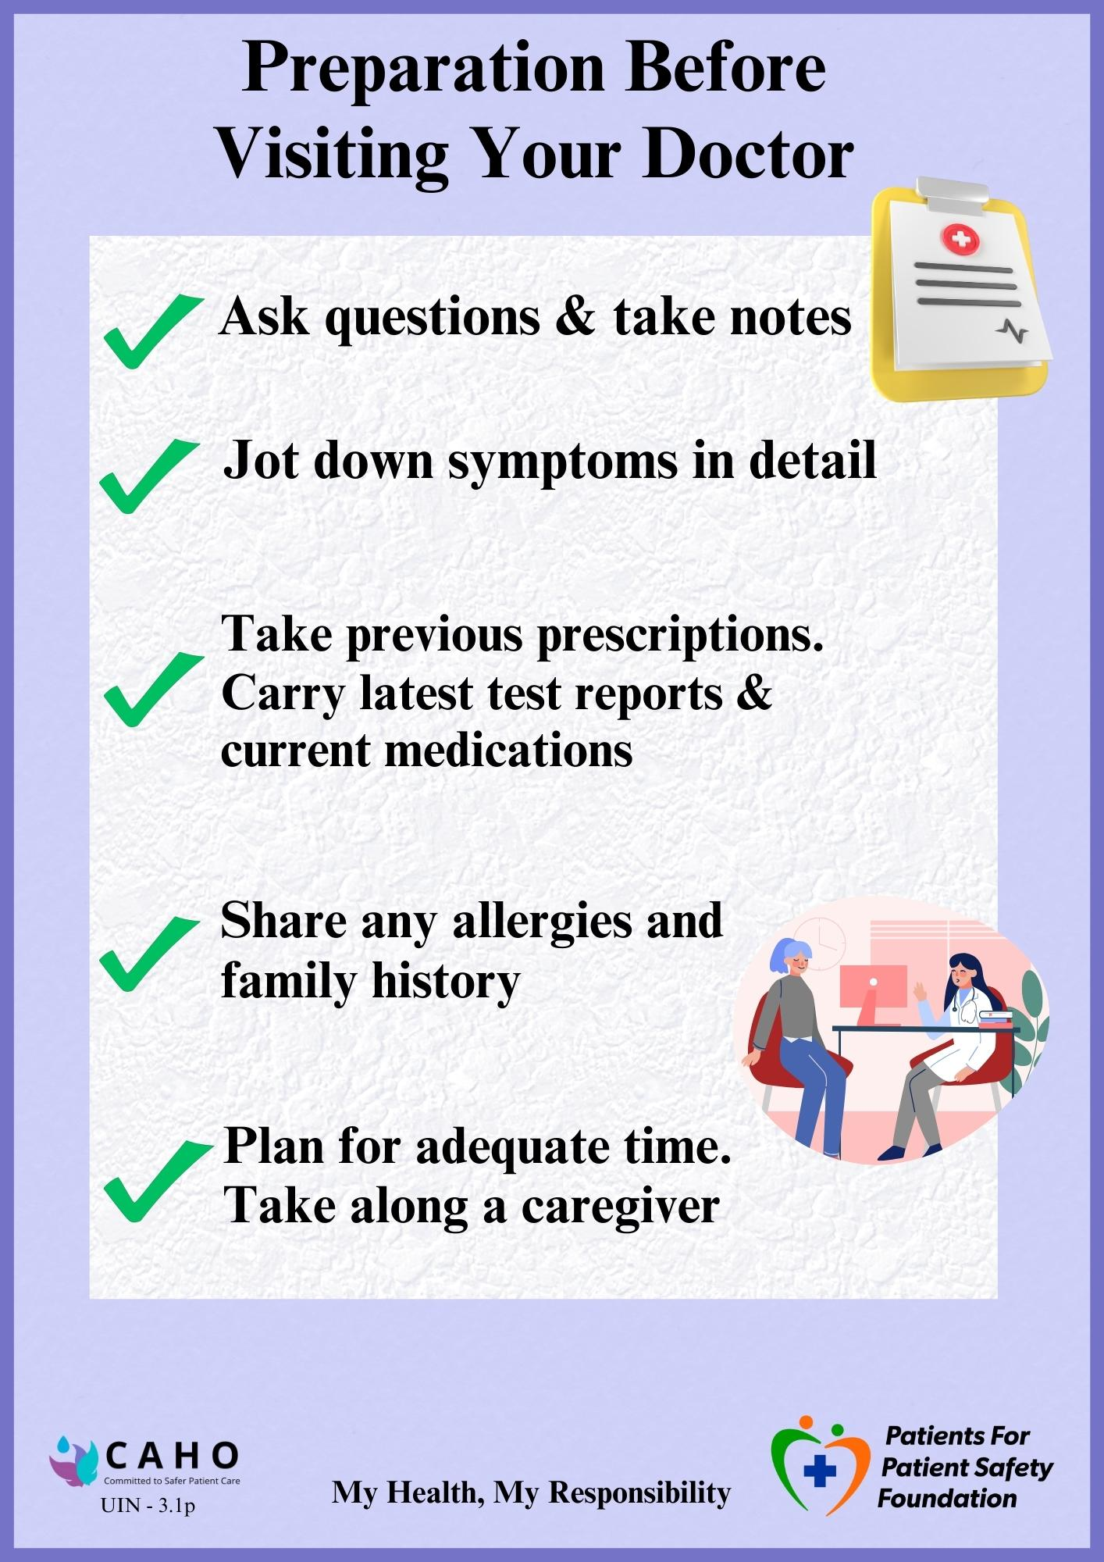

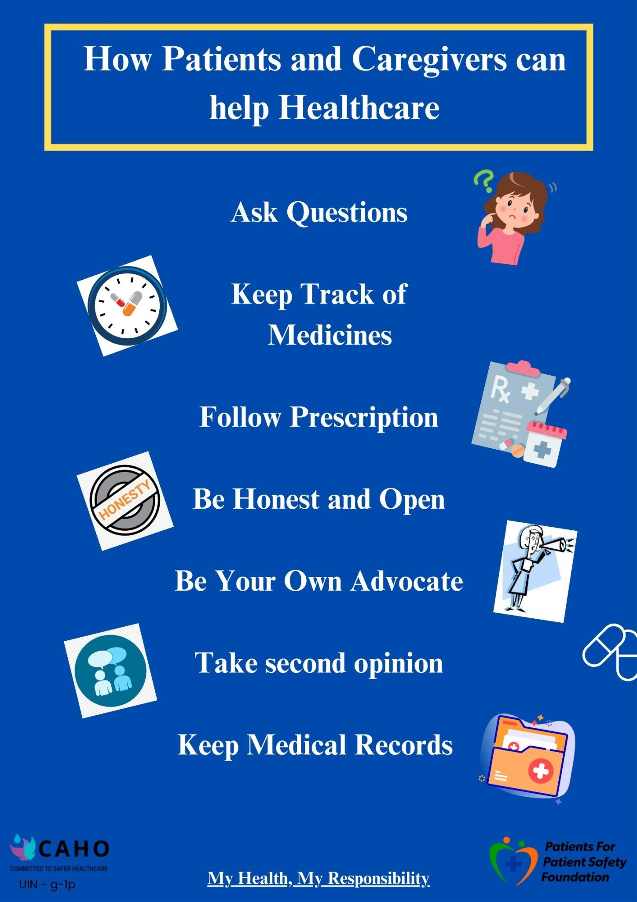

Slide 23
Patient Engagement - Registration and Billing
Collect accurate patient information, including demographics, contact details, and insurance coverage.
Explain costs, billing structure, and insurance coverage clearly to patients.
Issue a Unique Hospital Identification (UHID) for seamless records management.
Train staff to ask questions and summarize medical history to ensure accurate documentation.

Slide 24
Patient Engagement - Navigating within OPD
Install clear, multi-lingual signages and internal directions, emphasizing emergency and OPD locations.
Provide OPD tokens for queue management and guide patients on where to wait.
Implement a system to update patients on wait times and assist them in locating consulting rooms.

Slide 25
Patient Engagement - Doctor Consultation
Understand symptoms, medical history, current medications
Use patient-friendly language and visual aids to explain diagnosis, treatment plans, and precautions.
Provide written summaries of key points discussed during consultation.
Encourage questions and ensure time for patient comprehension.
Encourage second opinions for serious conditions or interventions when necessary.

Slide 26
Patient Engagement - Diagnostic Tests
Provide clear, written instructions for preparation, such as fasting or other precautions.
Explain test turnaround times, costs, and the significance of each test.
Obtain informed consent for invasive procedures, explaining risks, benefits, and alternatives.
Follow up on incomplete or missed tests to ensure continuity.
Ensure patients get a copy of test reports

Slide 27
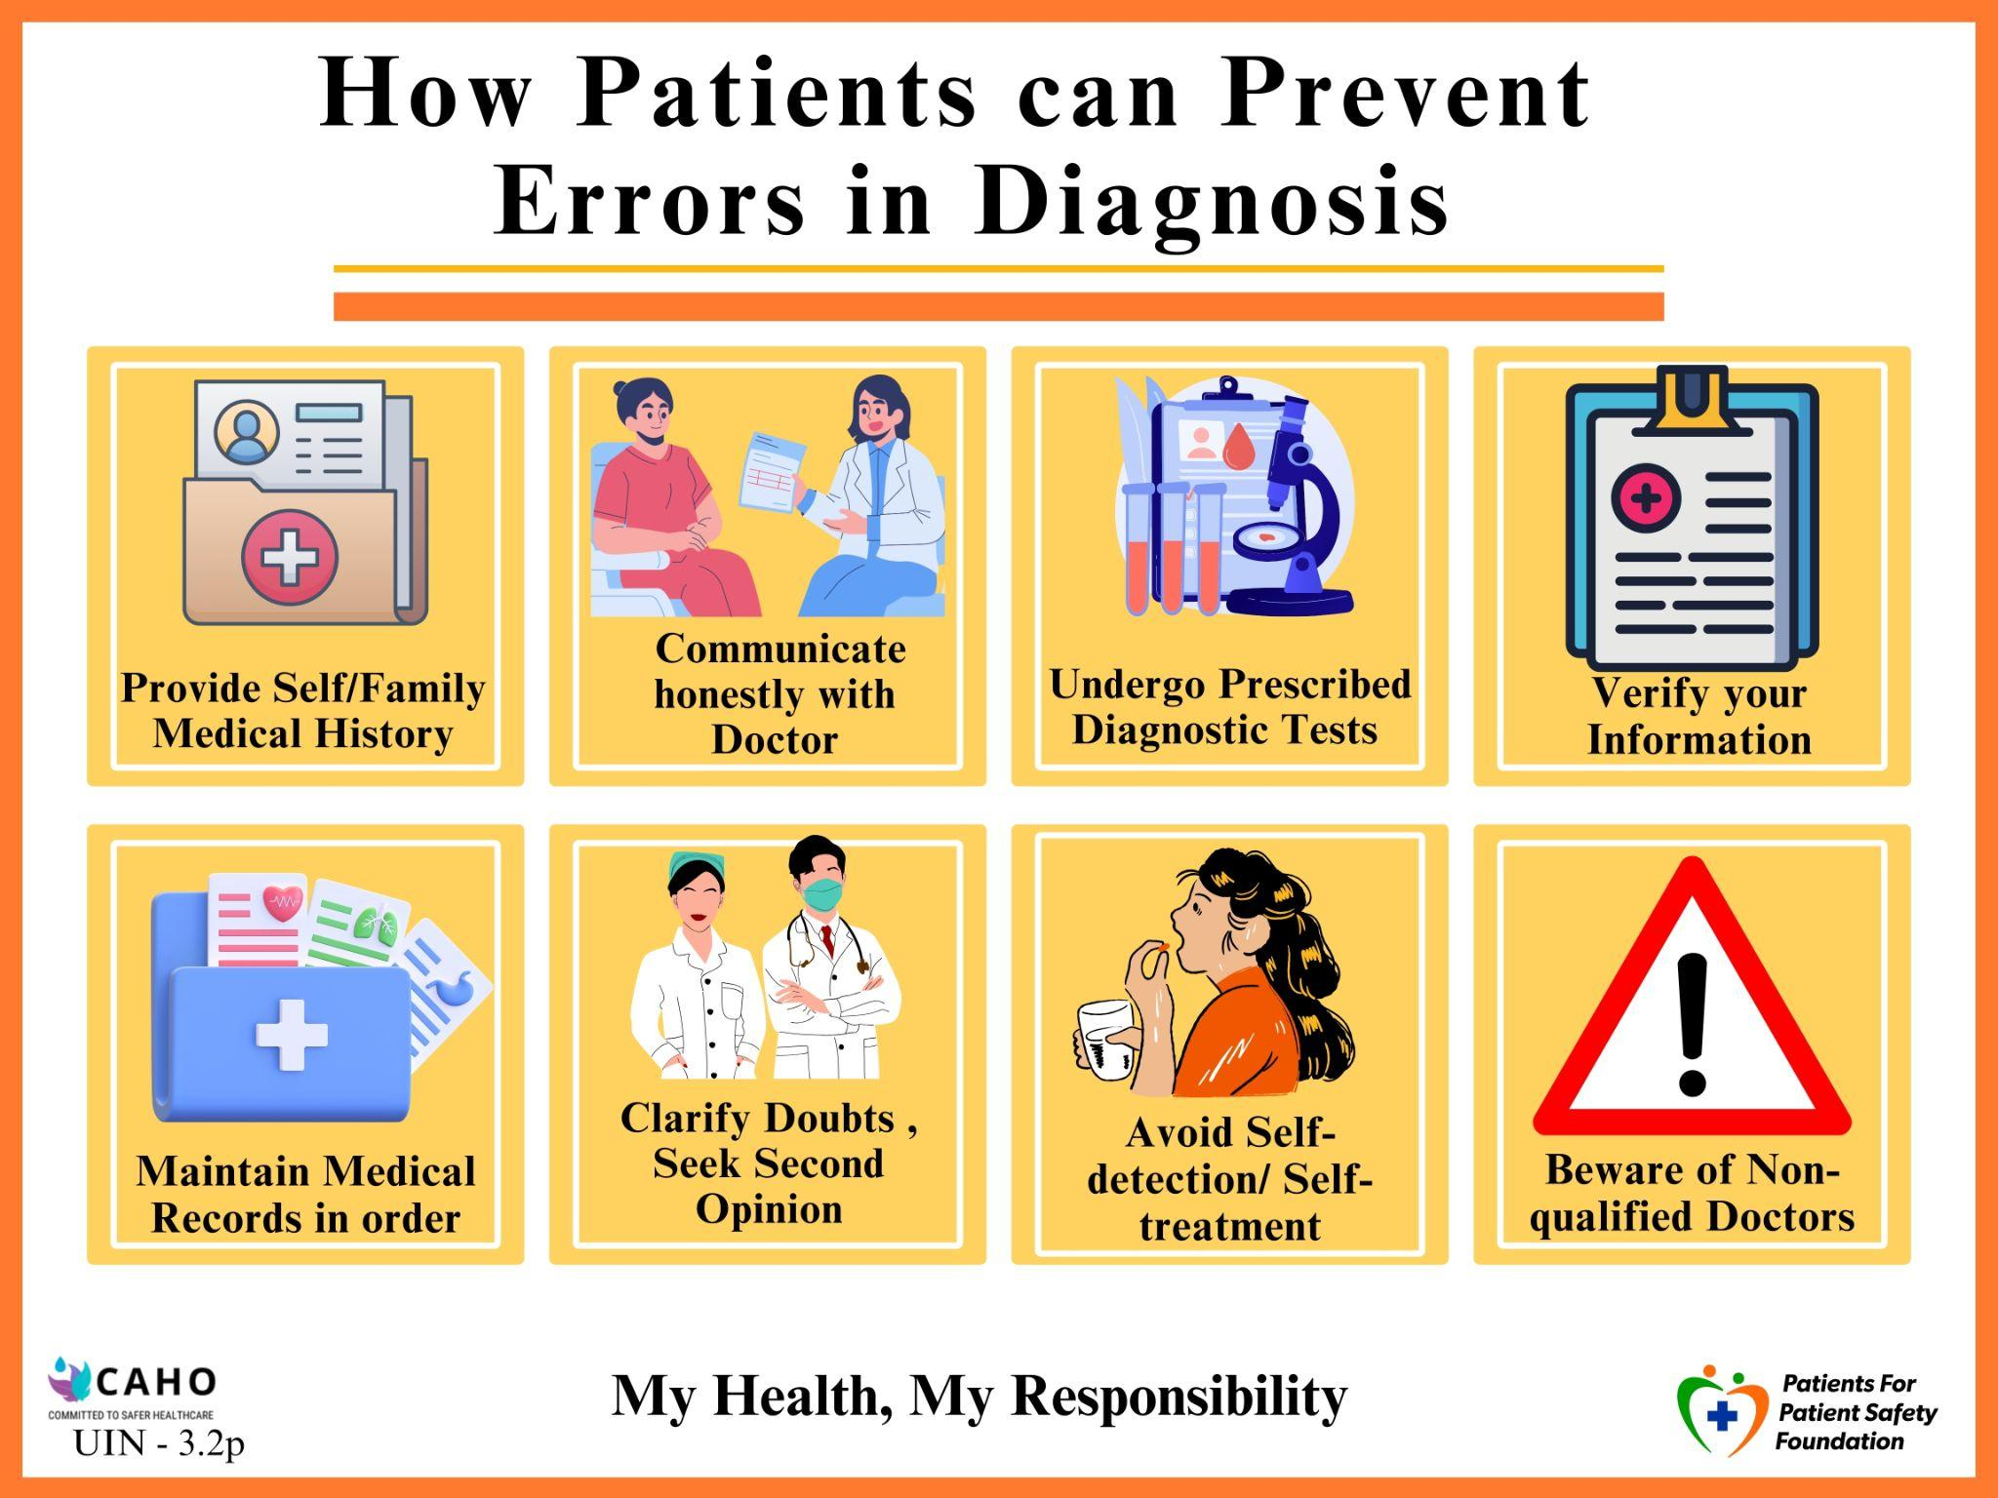

Slide 28
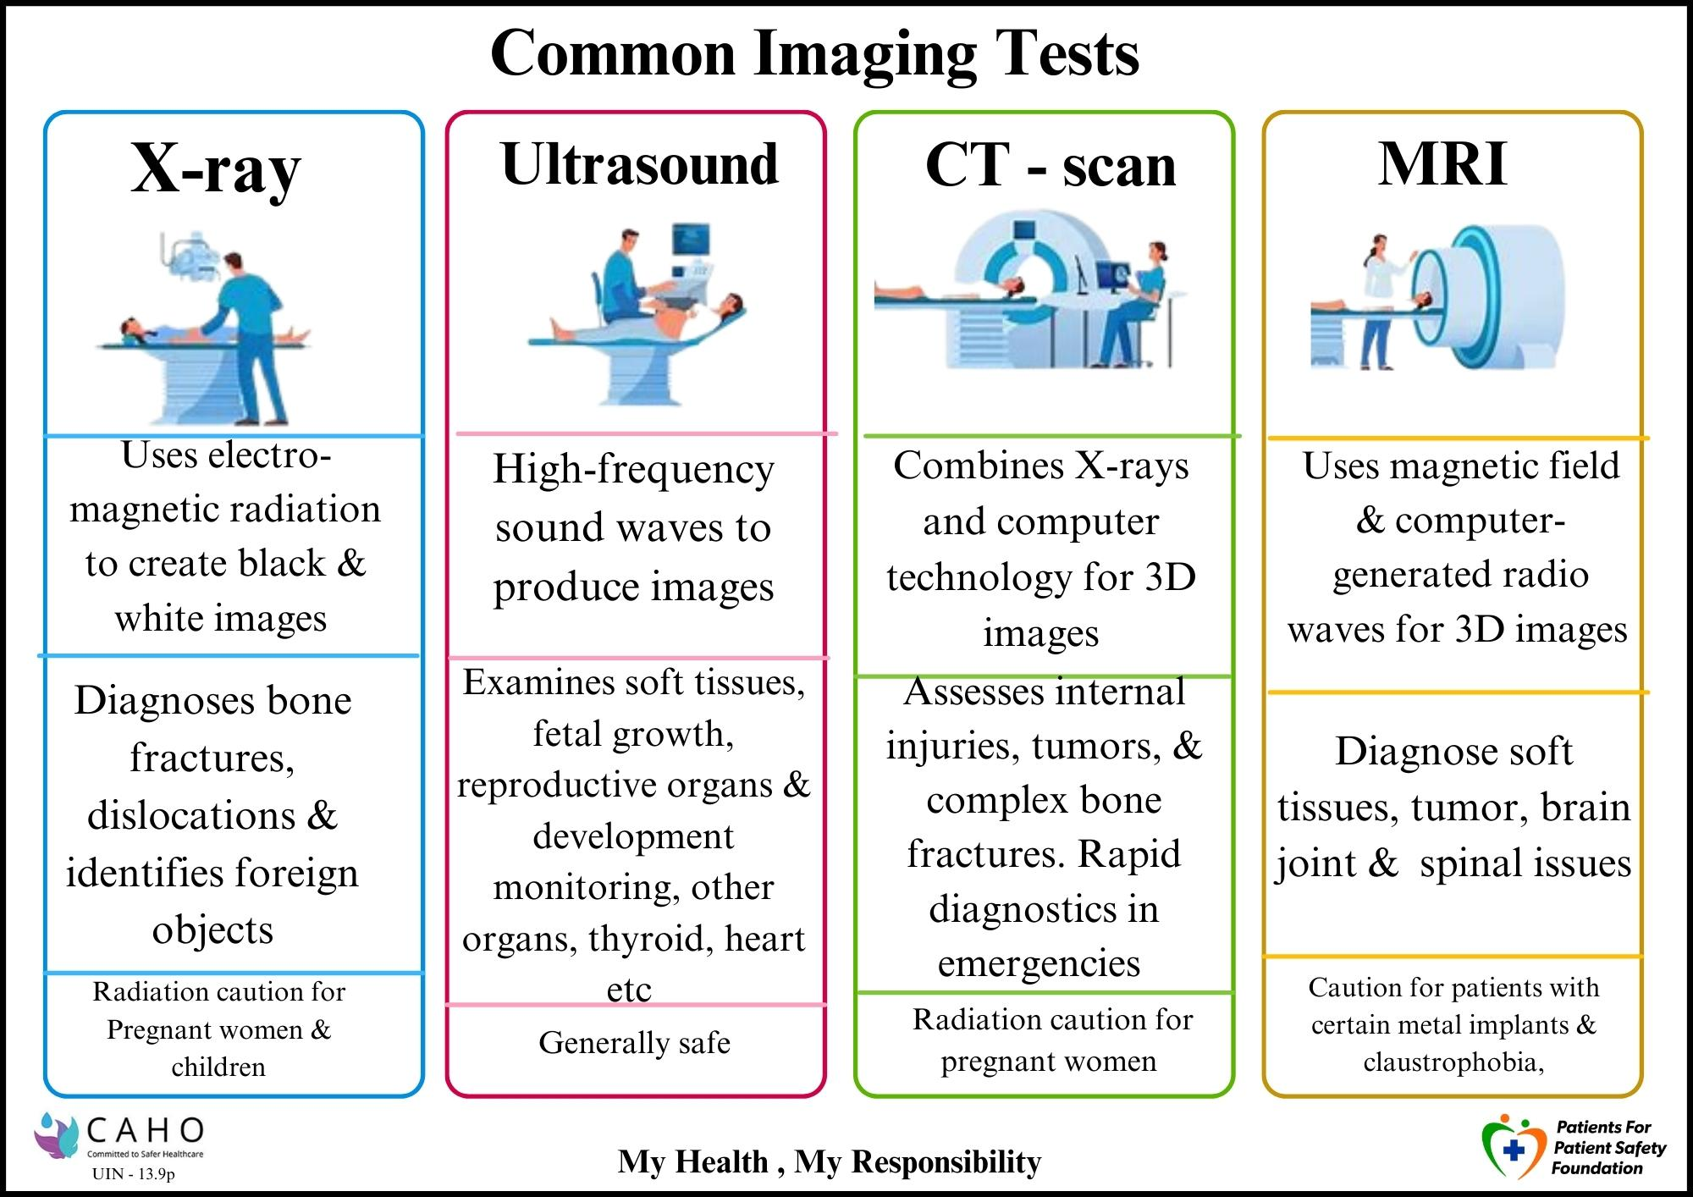

Slide 29
Patient Engagement - Post Diagnosis Consultation and Treatment
Provide a clear medicine prescription with dosage, timing, and route of ingestion.
Recommend additional diagnostic tests or specialist reviews if required.
Offer a written diagnosis summary and treatment options for clarity.
Ensure continuity of care by scheduling follow-ups with the same physician or an appropriate replacement.

Slide 30
Patient Engagement - Review and Follow-up post Treatment
Schedule follow-up appointments on the same day as the consultation.
Share patient-centric information for better preparation before reviews.
Clarify days/timings of visiting consultants to avoid confusion.

Slide 31
Patient Engagement - Discharge and Home Care
Provide physical or digital reports to patients promptly.
Advice on Do’s and Don’ts at home care, including treatment plans, precautions, and follow-up timelines.
Explain patients which negative signs to watch out for
Ensure patients understand how to reach out for further assistance or queries.

Slide 32
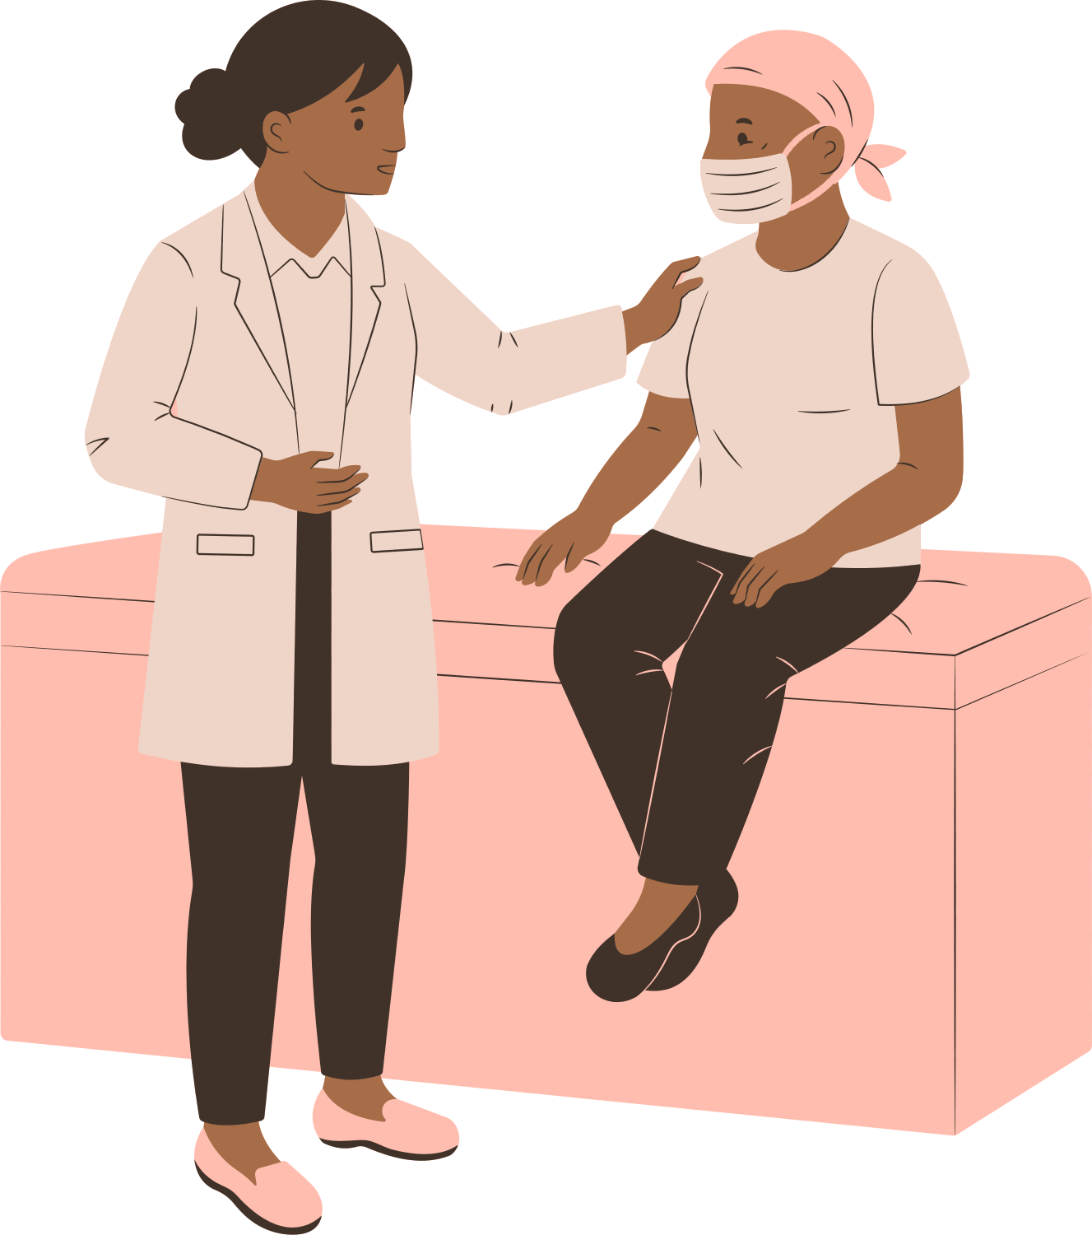



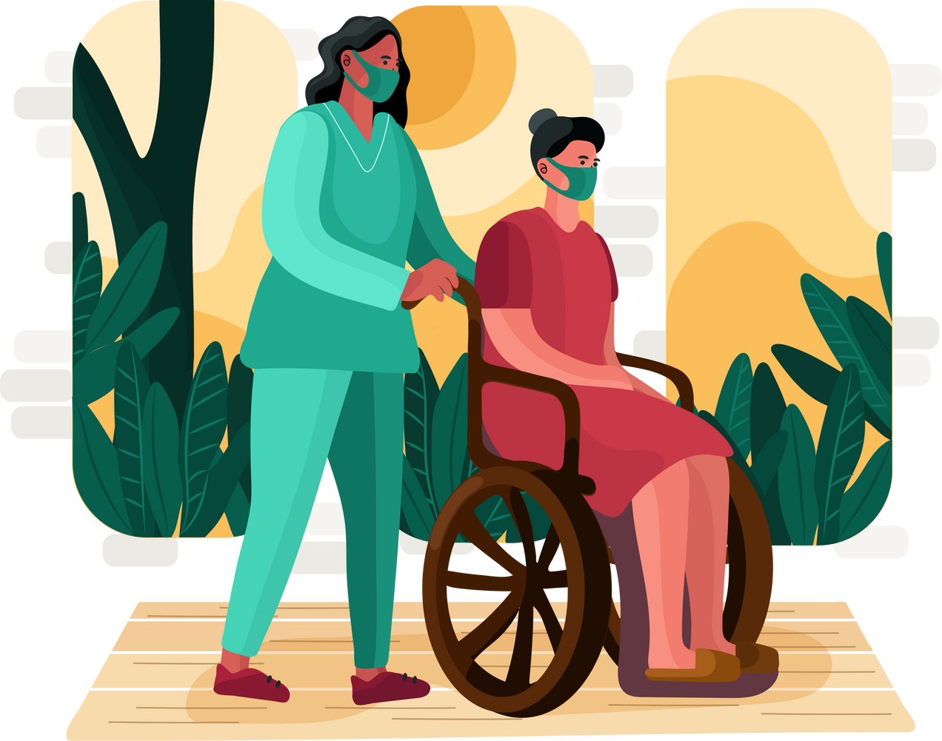
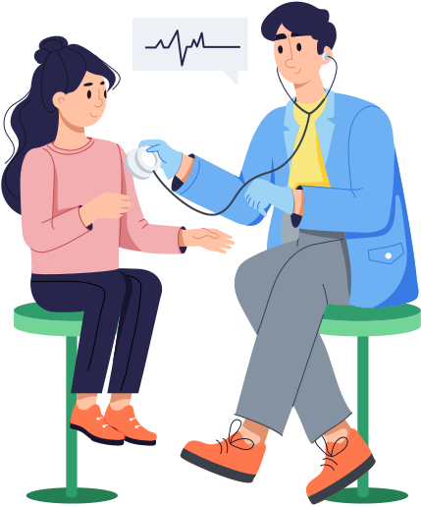


Opportunities to Engage with In Patients
Admission
8. Review and Follow-up
2. Insurance
IPD
3. Ward Instruction
7. Discharge
6. Recovery
5. Treatment / Surgery
4. Checkups

Slide 33
Potential Errors by Patient during IPD
Lack of vigilance regarding alarming symptoms and no timely presentation
Not having one designated family member, leading to missed information among multiple caregivers.
Over dependence on nurse, not taking ownership themselves of own health
Not adhering to treatment plan medicines, diet, exercise, or vital monitoring.
Not understanding discharge report and instructions
Missing follow-ups and reviews
Not understanding the financial implications, documentation for insurance claims

Slide 34
Patient Engagement - Admission
Assist in filling out admission forms with patient and attendant details.
Conduct thorough medication reconciliation upon admission.
Explain Consent Form details, including stay duration, payments, reuse of devices, risks, benefits, and alternatives.
Provide comprehensive room orientation to inpatient facilities, including call bell, nurse/doctor schedules, patient etiquettes, food and visitors policy.
Ensure Patient Rights and Responsibilities are verbally explained and a copy is provided.

Slide 35
Patient Engagement - Cost and Insurance
Explain cost estimation and payment schedule, offer financial counselling
Assist in filling forms for claims, pre-sanction, reimbursement, or cashless services.
Discuss estimated duration of stay and guide on full or advance payment if without insurance.

Slide 36
Patient Engagement - Ward Instruction
Inform about room orientation, bed, water, bathroom, fire, call bell, and cleaning schedules.
Explain patient and attendant provisions for food and stay, as well as visitor timings and restrictions (e.g., ICU policies).
Implement robust systems for tracking patient allergies and dietary needs.
Explain Waste disposal and Infection control

Slide 37
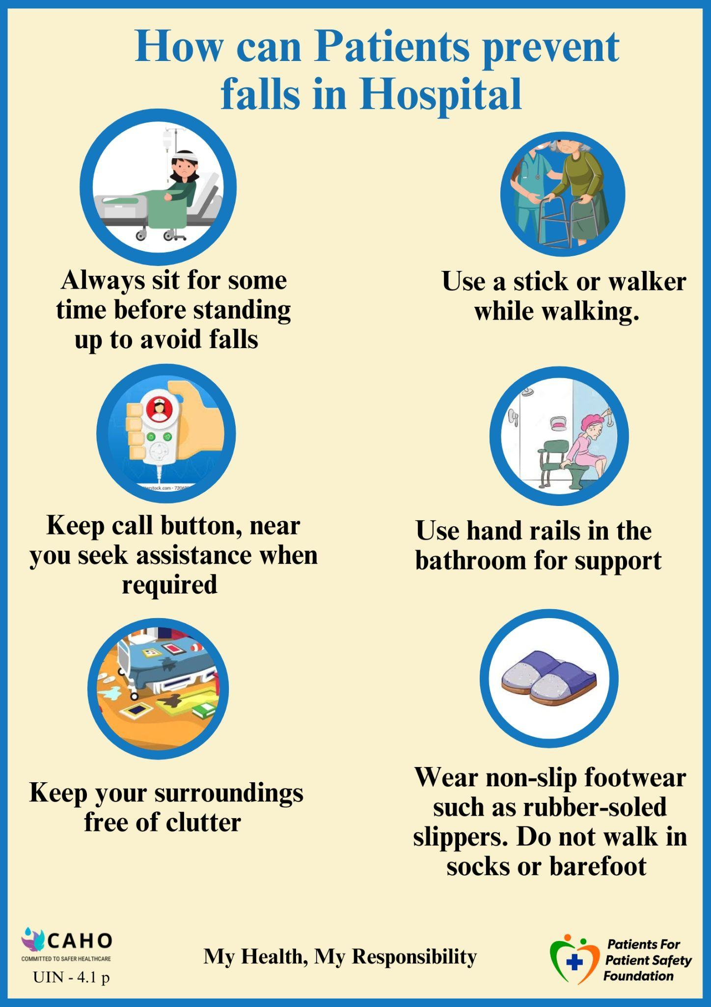
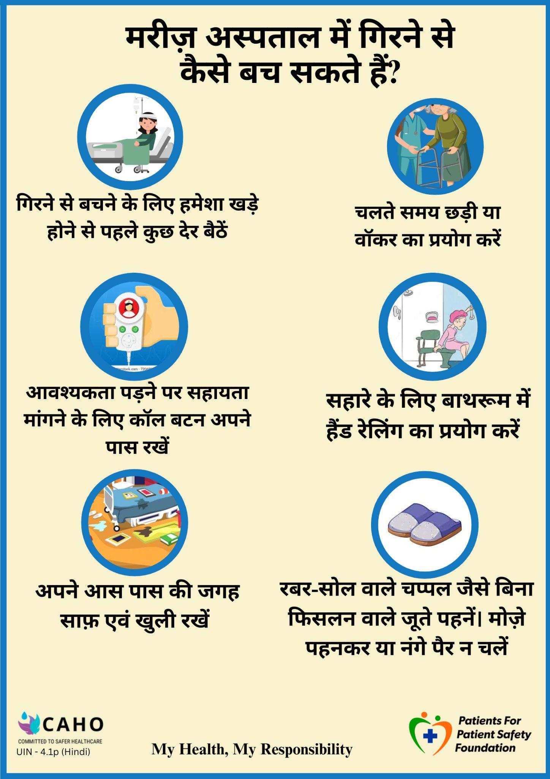
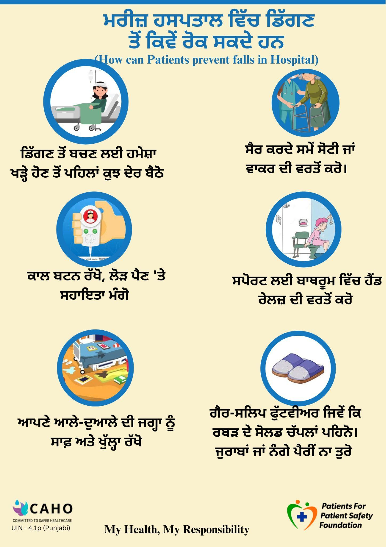

Slide 38
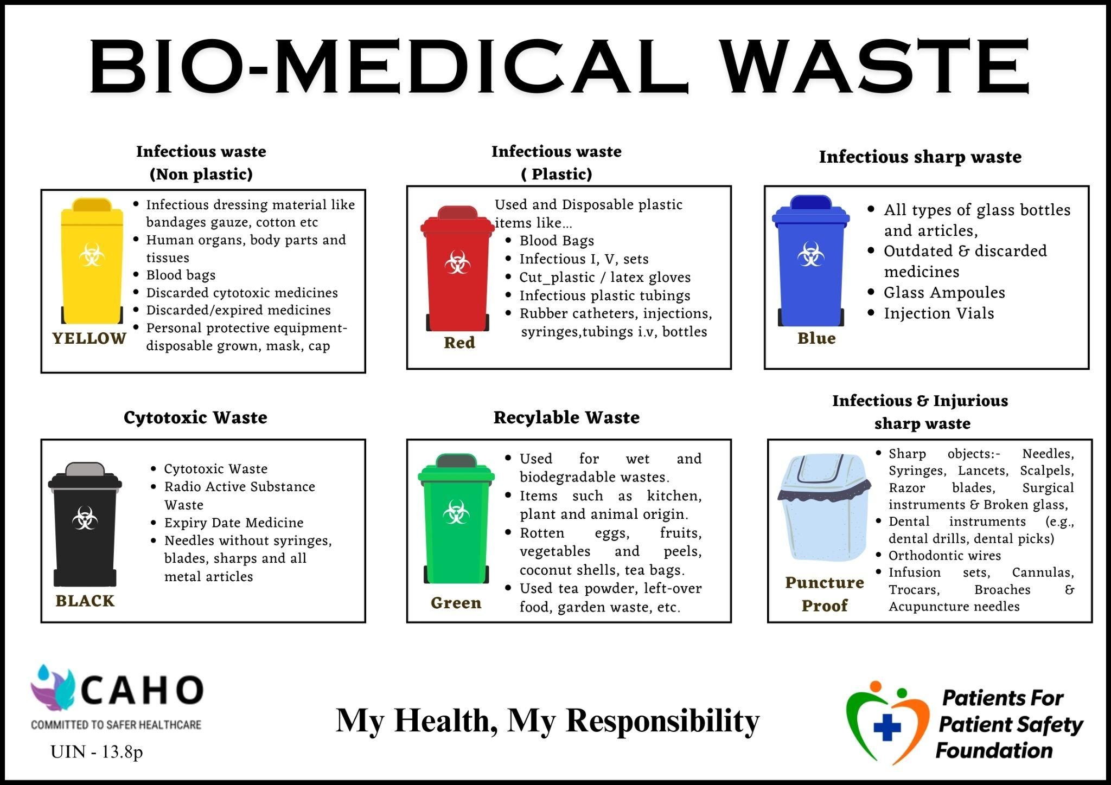

Slide 39
Patient Engagement - Treatment / Surgery
Provide a list of required tests and ensure consent for tests with risk profiles, both verbally and in writing. Explain possible risks, complications, and co-morbidity-linked risks using High-Risk Consent.
Conduct thorough pre-operative assessments (Pre Anaesthesia) , including allergies and anesthesia checkups.
Impart pre and post-surgery requirements and use teach-back methods for clarity.
Verify surgical site marking and patient ID.
Provide timely updates to family/caregivers during and after surgery.
Facilitate decision-making with family for transferring care settings or high-level care.

Slide 40
Patient Engagement - Recovery in Hospital and at Home
Explain medicines, diet, rehab therapies, exercise, and lifestyle changes.
Check e.g., risk of falls and provide a checklist of home precautions.

Slide 41
Patient Engagement - Discharge
Discharge process - Report. Medication, Diet and Rehab instructions, finalize Billing and Payments, medication reconciliation and return of extra medicines
Explain home medication management, wound care, and device management at least 2 days in advance.
Schedule follow-up appointments and provide a patient checklist before discharge.
Use teach-back methods to confirm understanding of home care instructions.
Explain negative signs to watchout for including Do’s and Don’t at home
Inform about emergency follow-up protocols and transportation from hospital to home.

Slide 42
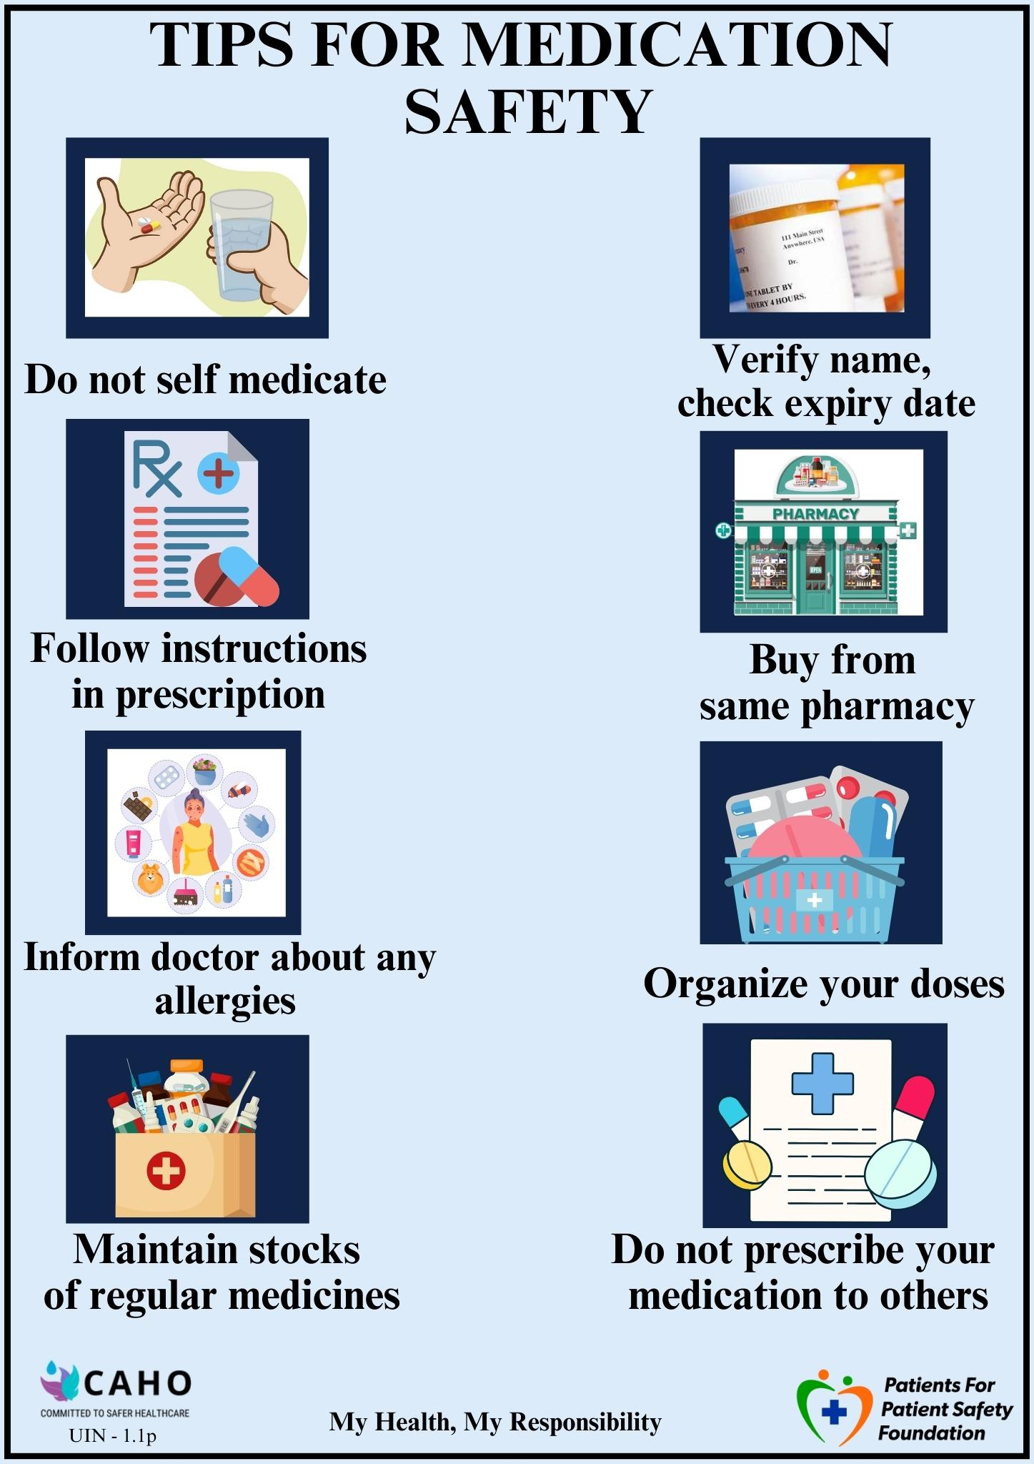
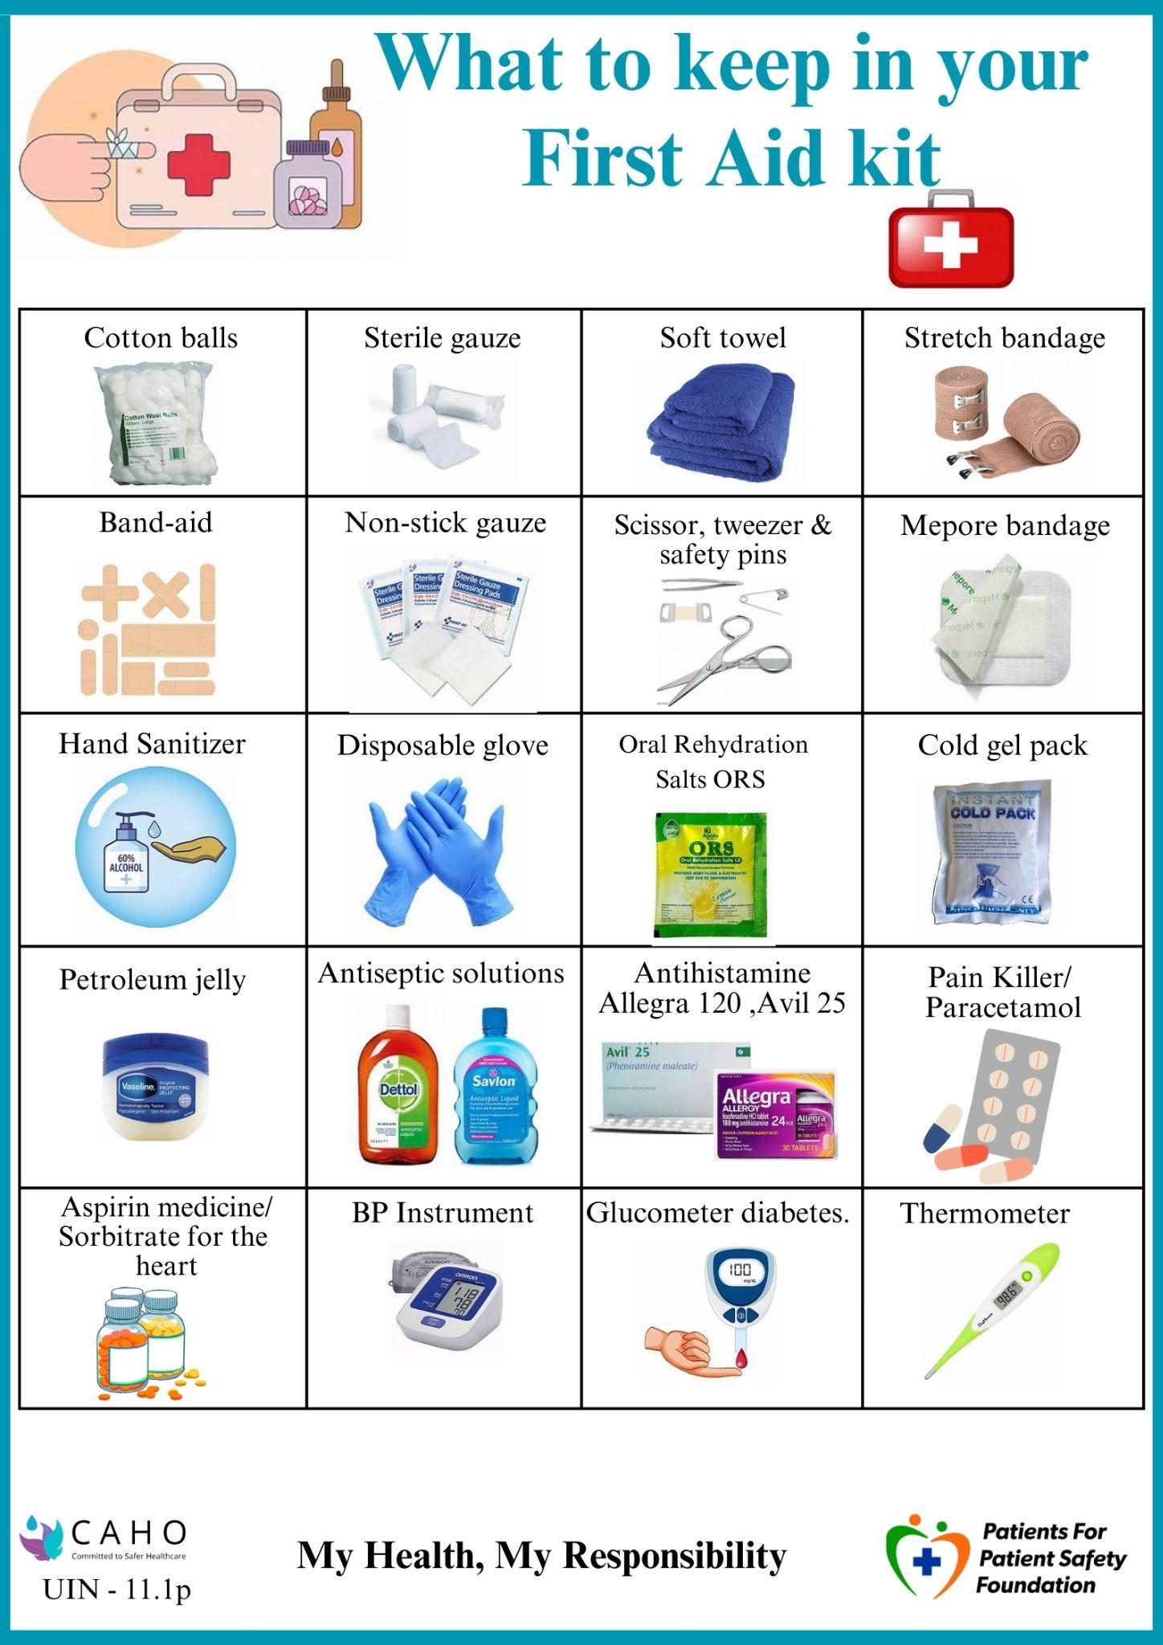
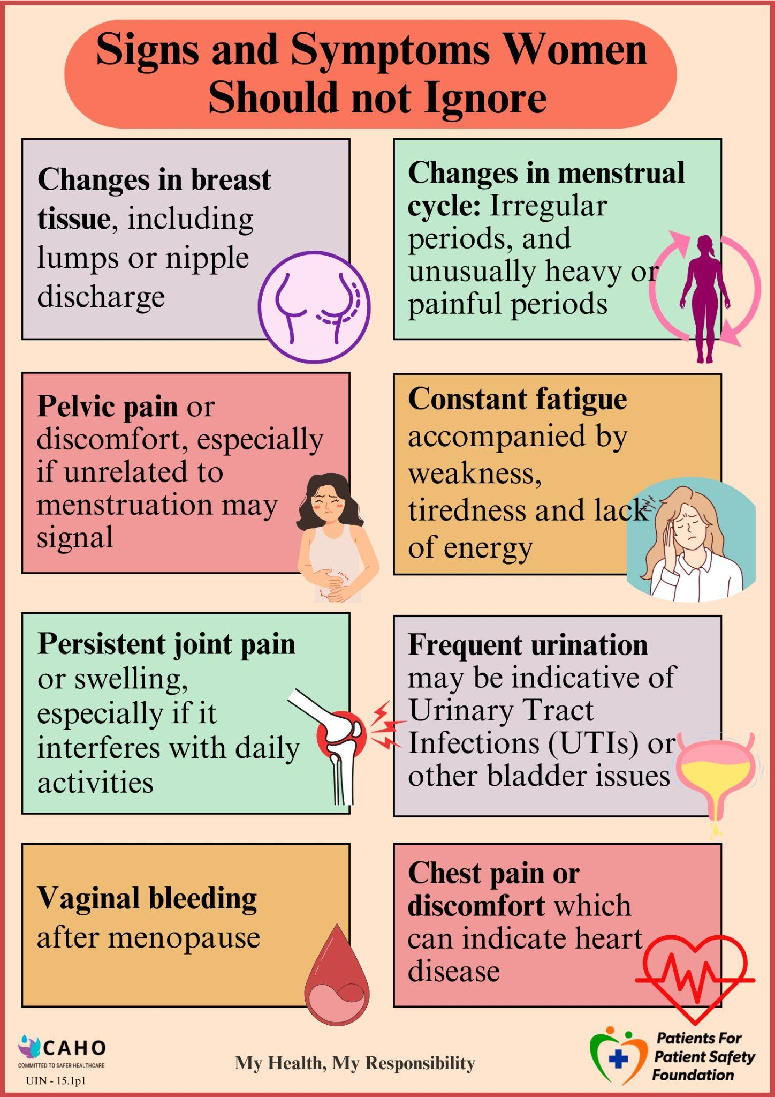

Slide 43
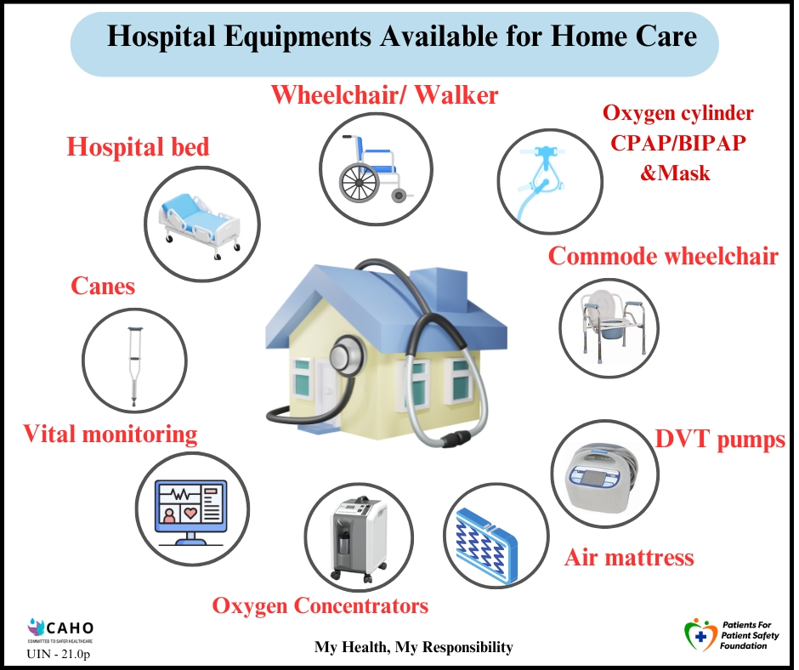
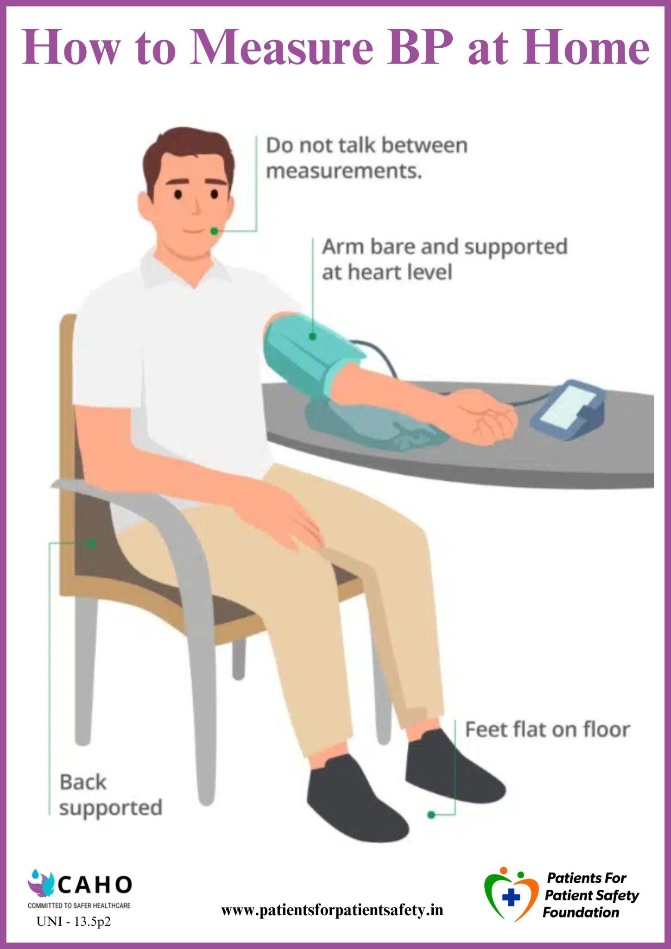
Patient Education Material

Slide 44
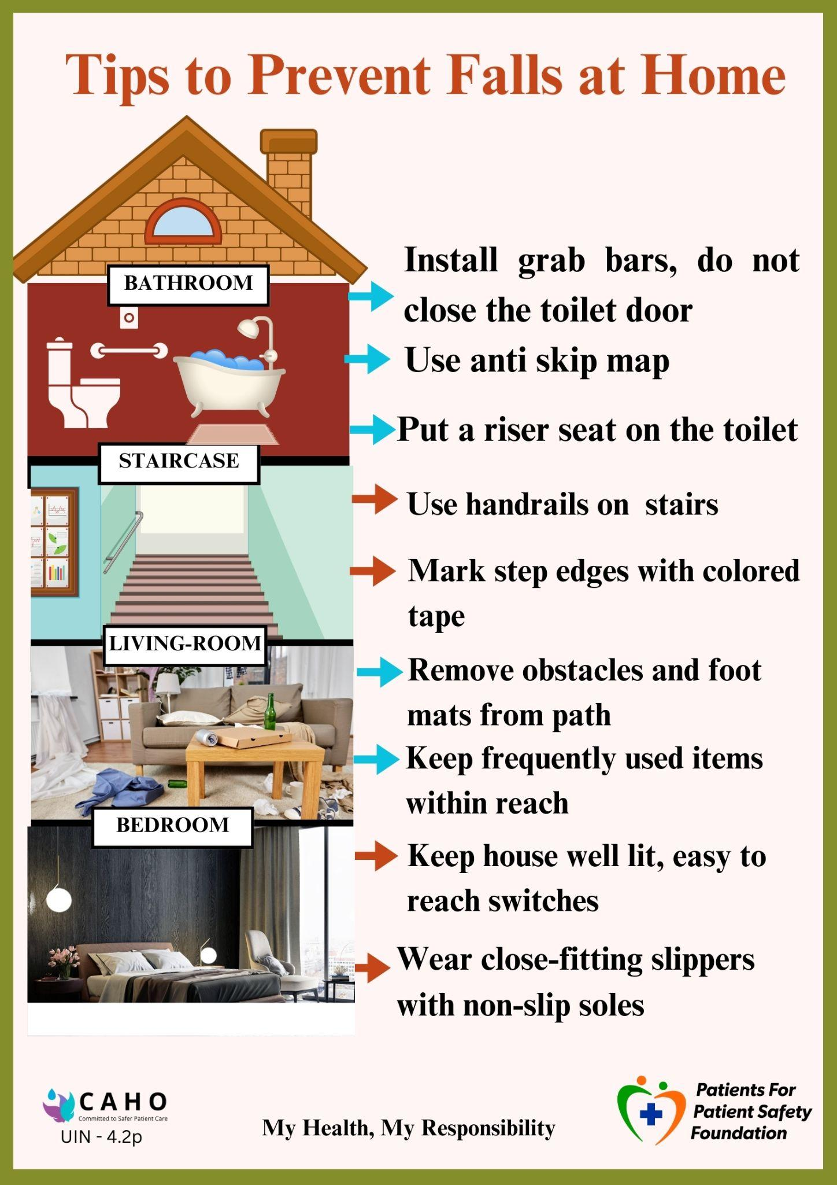
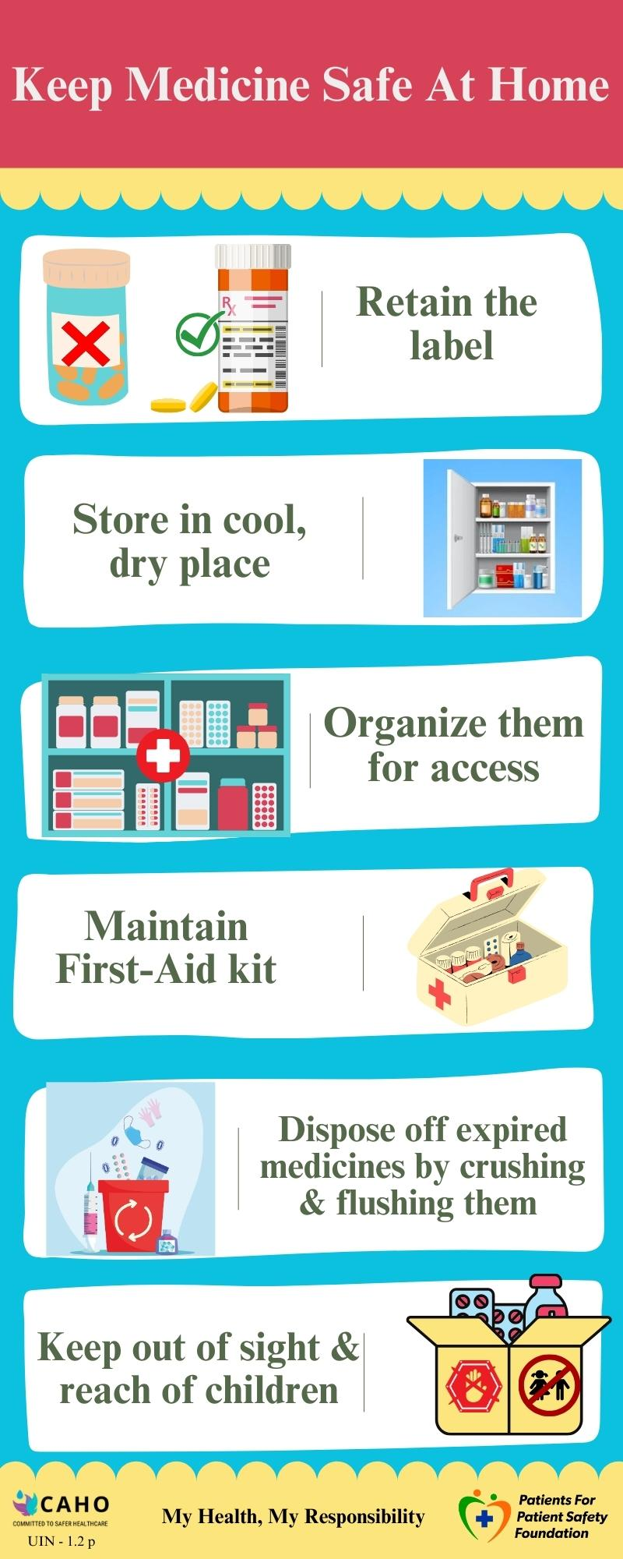
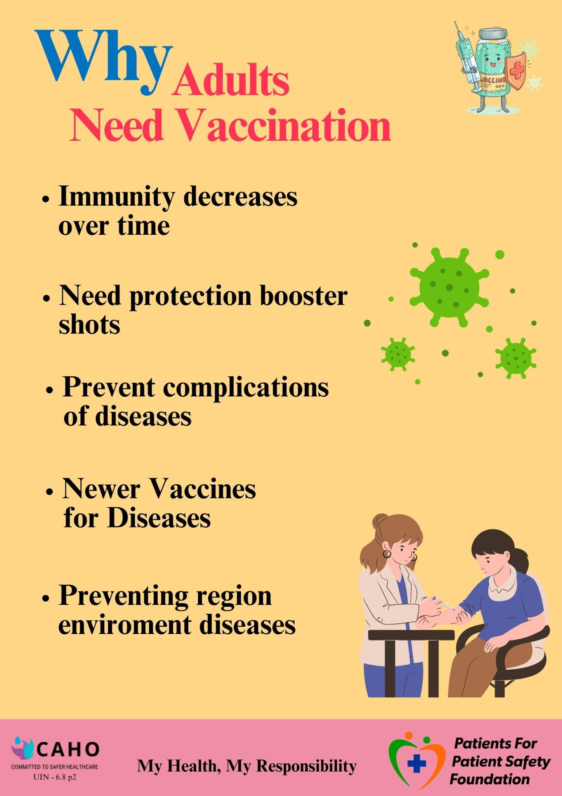

Slide 45
Patient Engagement - Review and Follow-up
Remind patients of follow-up appointments and revise treatment plans if necessary.
Take patient feedback and address issues through phone or in-person consultations.

Slide 46
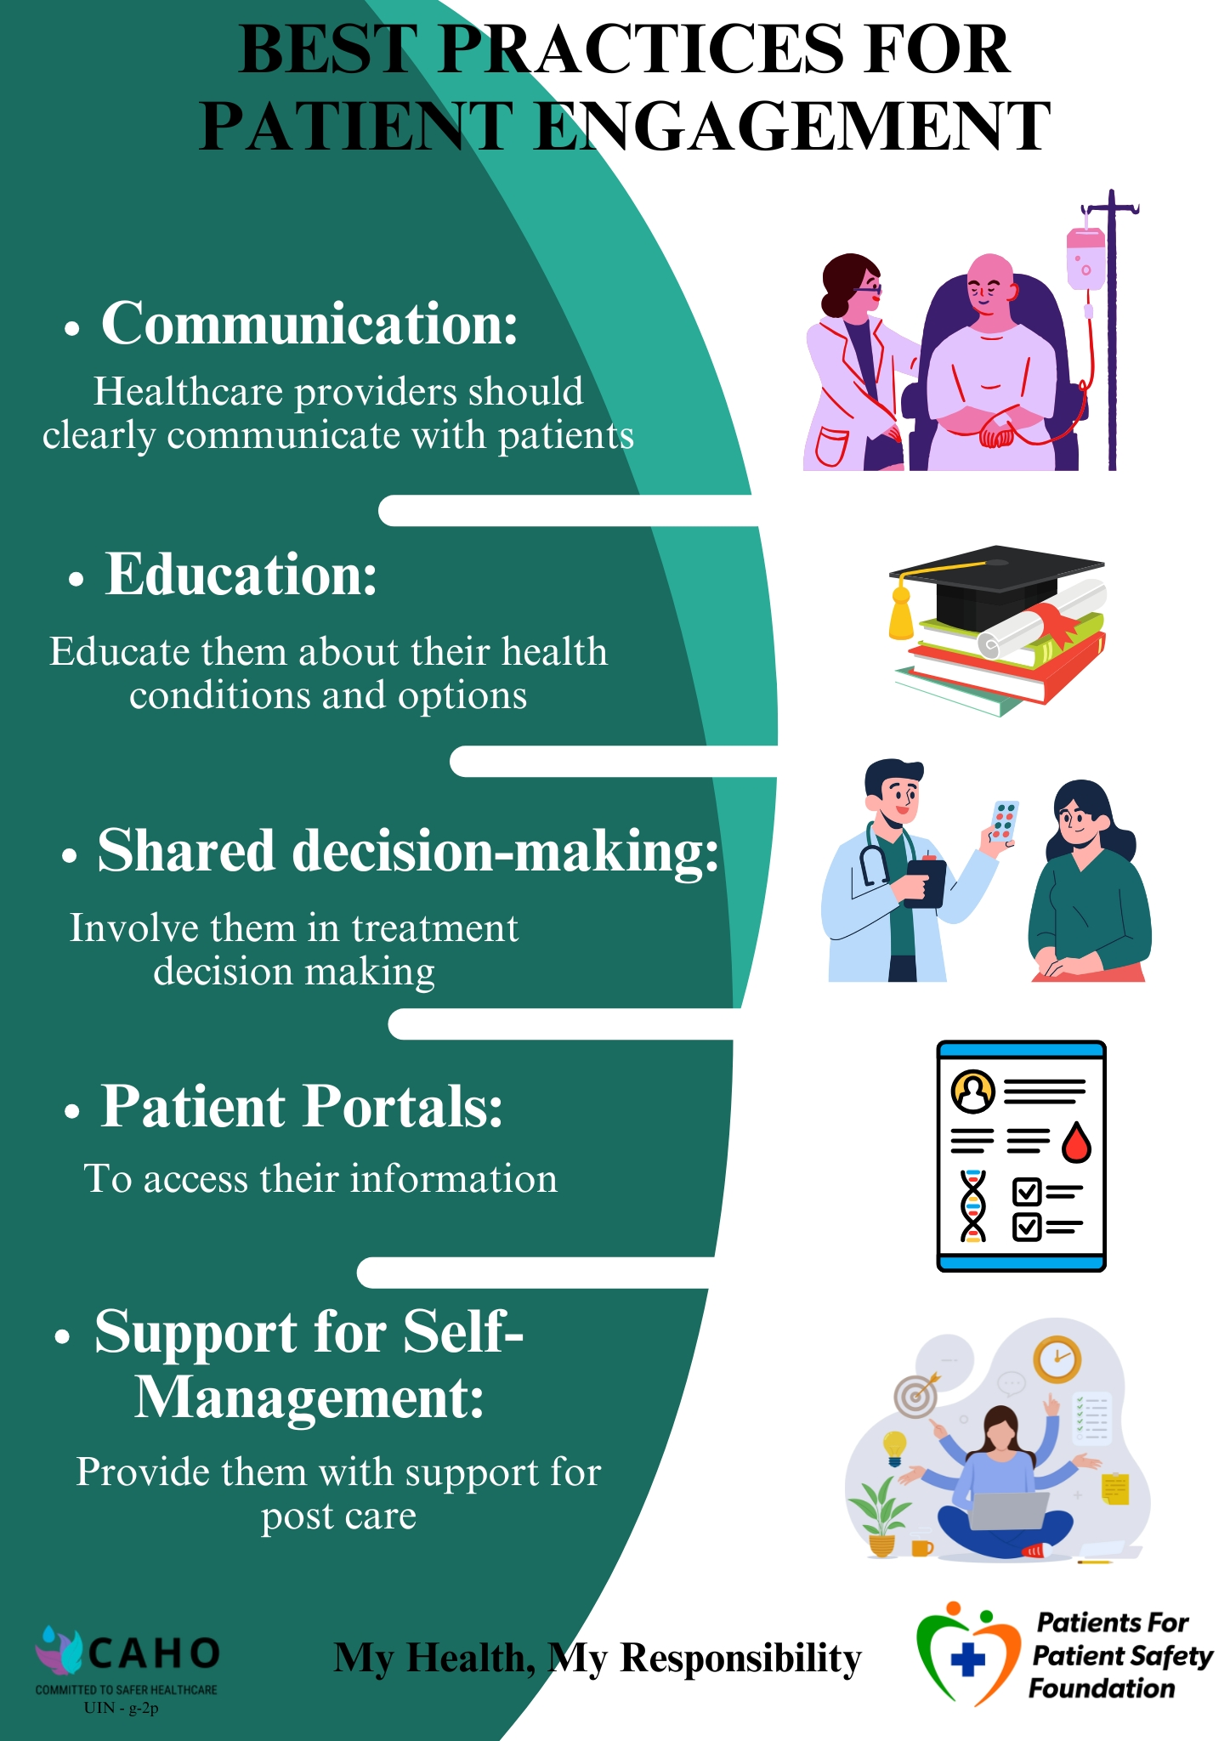
How to Save Doctor’s Time and Improve Patient Engagement
Have support staff - doctor or nurse, provide summary of patient condition with details
Use EHR or Apps to keep track of patient history.
Give sufficient time between appointments to address patients concerns
Inform in case of delayed waiting time, offer refreshments or something to do while waiting
Look at them as a person not just as a patient, address them by name
Give handouts of Patient Education Material for retention of advise

Slide 47
Sustainable Engagement
The engagement with patients and caregivers needs to be structured in a sustainable way.
Some suggested actions:
Develop Patient and Caregiver Feedback and Experience Gathering Mechanisms
Create Patient Communities for Health Education and Awareness
Establish Patient Support Groups
Formalize Patient and Family Advisory Councils

Slide 48
Patient Advisory Council - Bridging the Trust Deficit
What is it:
It is a voluntary board with combining patients and doctors from hospitals to work together tio:
Identifying chronic problems
Find solutions
Share the solutions with patients and healthcare workers
Repeat Cycle
Critical success factors:
Choice and orientation of of patient representative and healthcare representative is critical
Support of top management
Benefits:
A constructive way to add value to healthcare processes with patient feedback, patient insights and experiences
Provide a platform for improved two-way communication and generating awareness among patients about care practices
Increased loyalty & patients-satisfaction

Slide 49


Slide 50
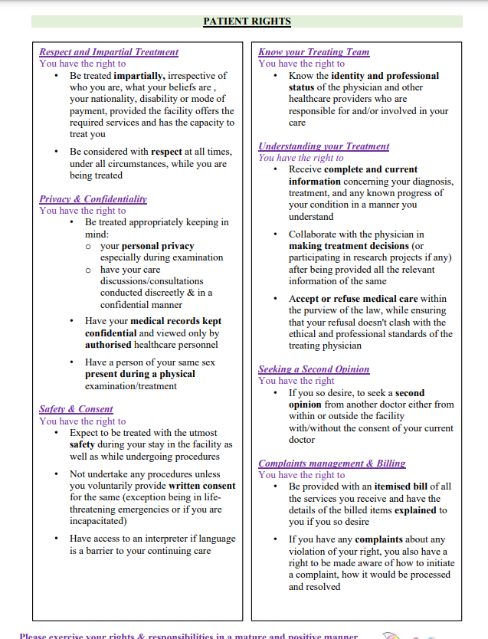

Slide 51
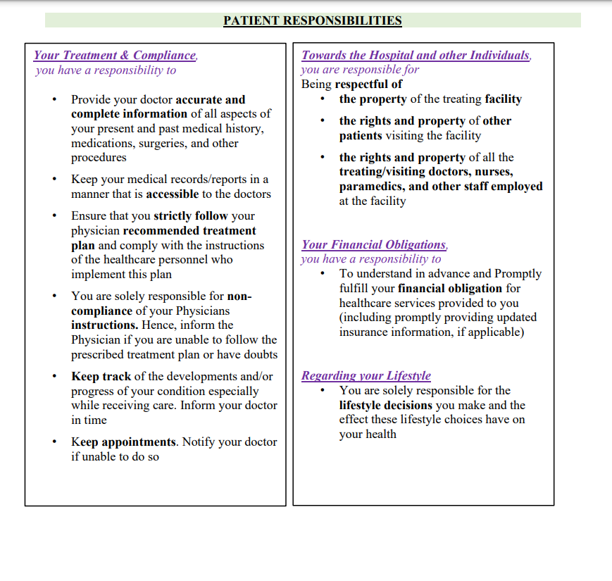
Patient Responsibilities - same comments as above

